Slide 1
SUCCOUR
TEAM CARPEDIEM

Slide 2
Purpose
To provide succour to the people who have been affected by such calamities and face economical, psychological and physical issues.
To provide a medium to help people from other parts connect with the victims.
To spread awareness on how to react and form a mindset when being in this situation.

Slide 3
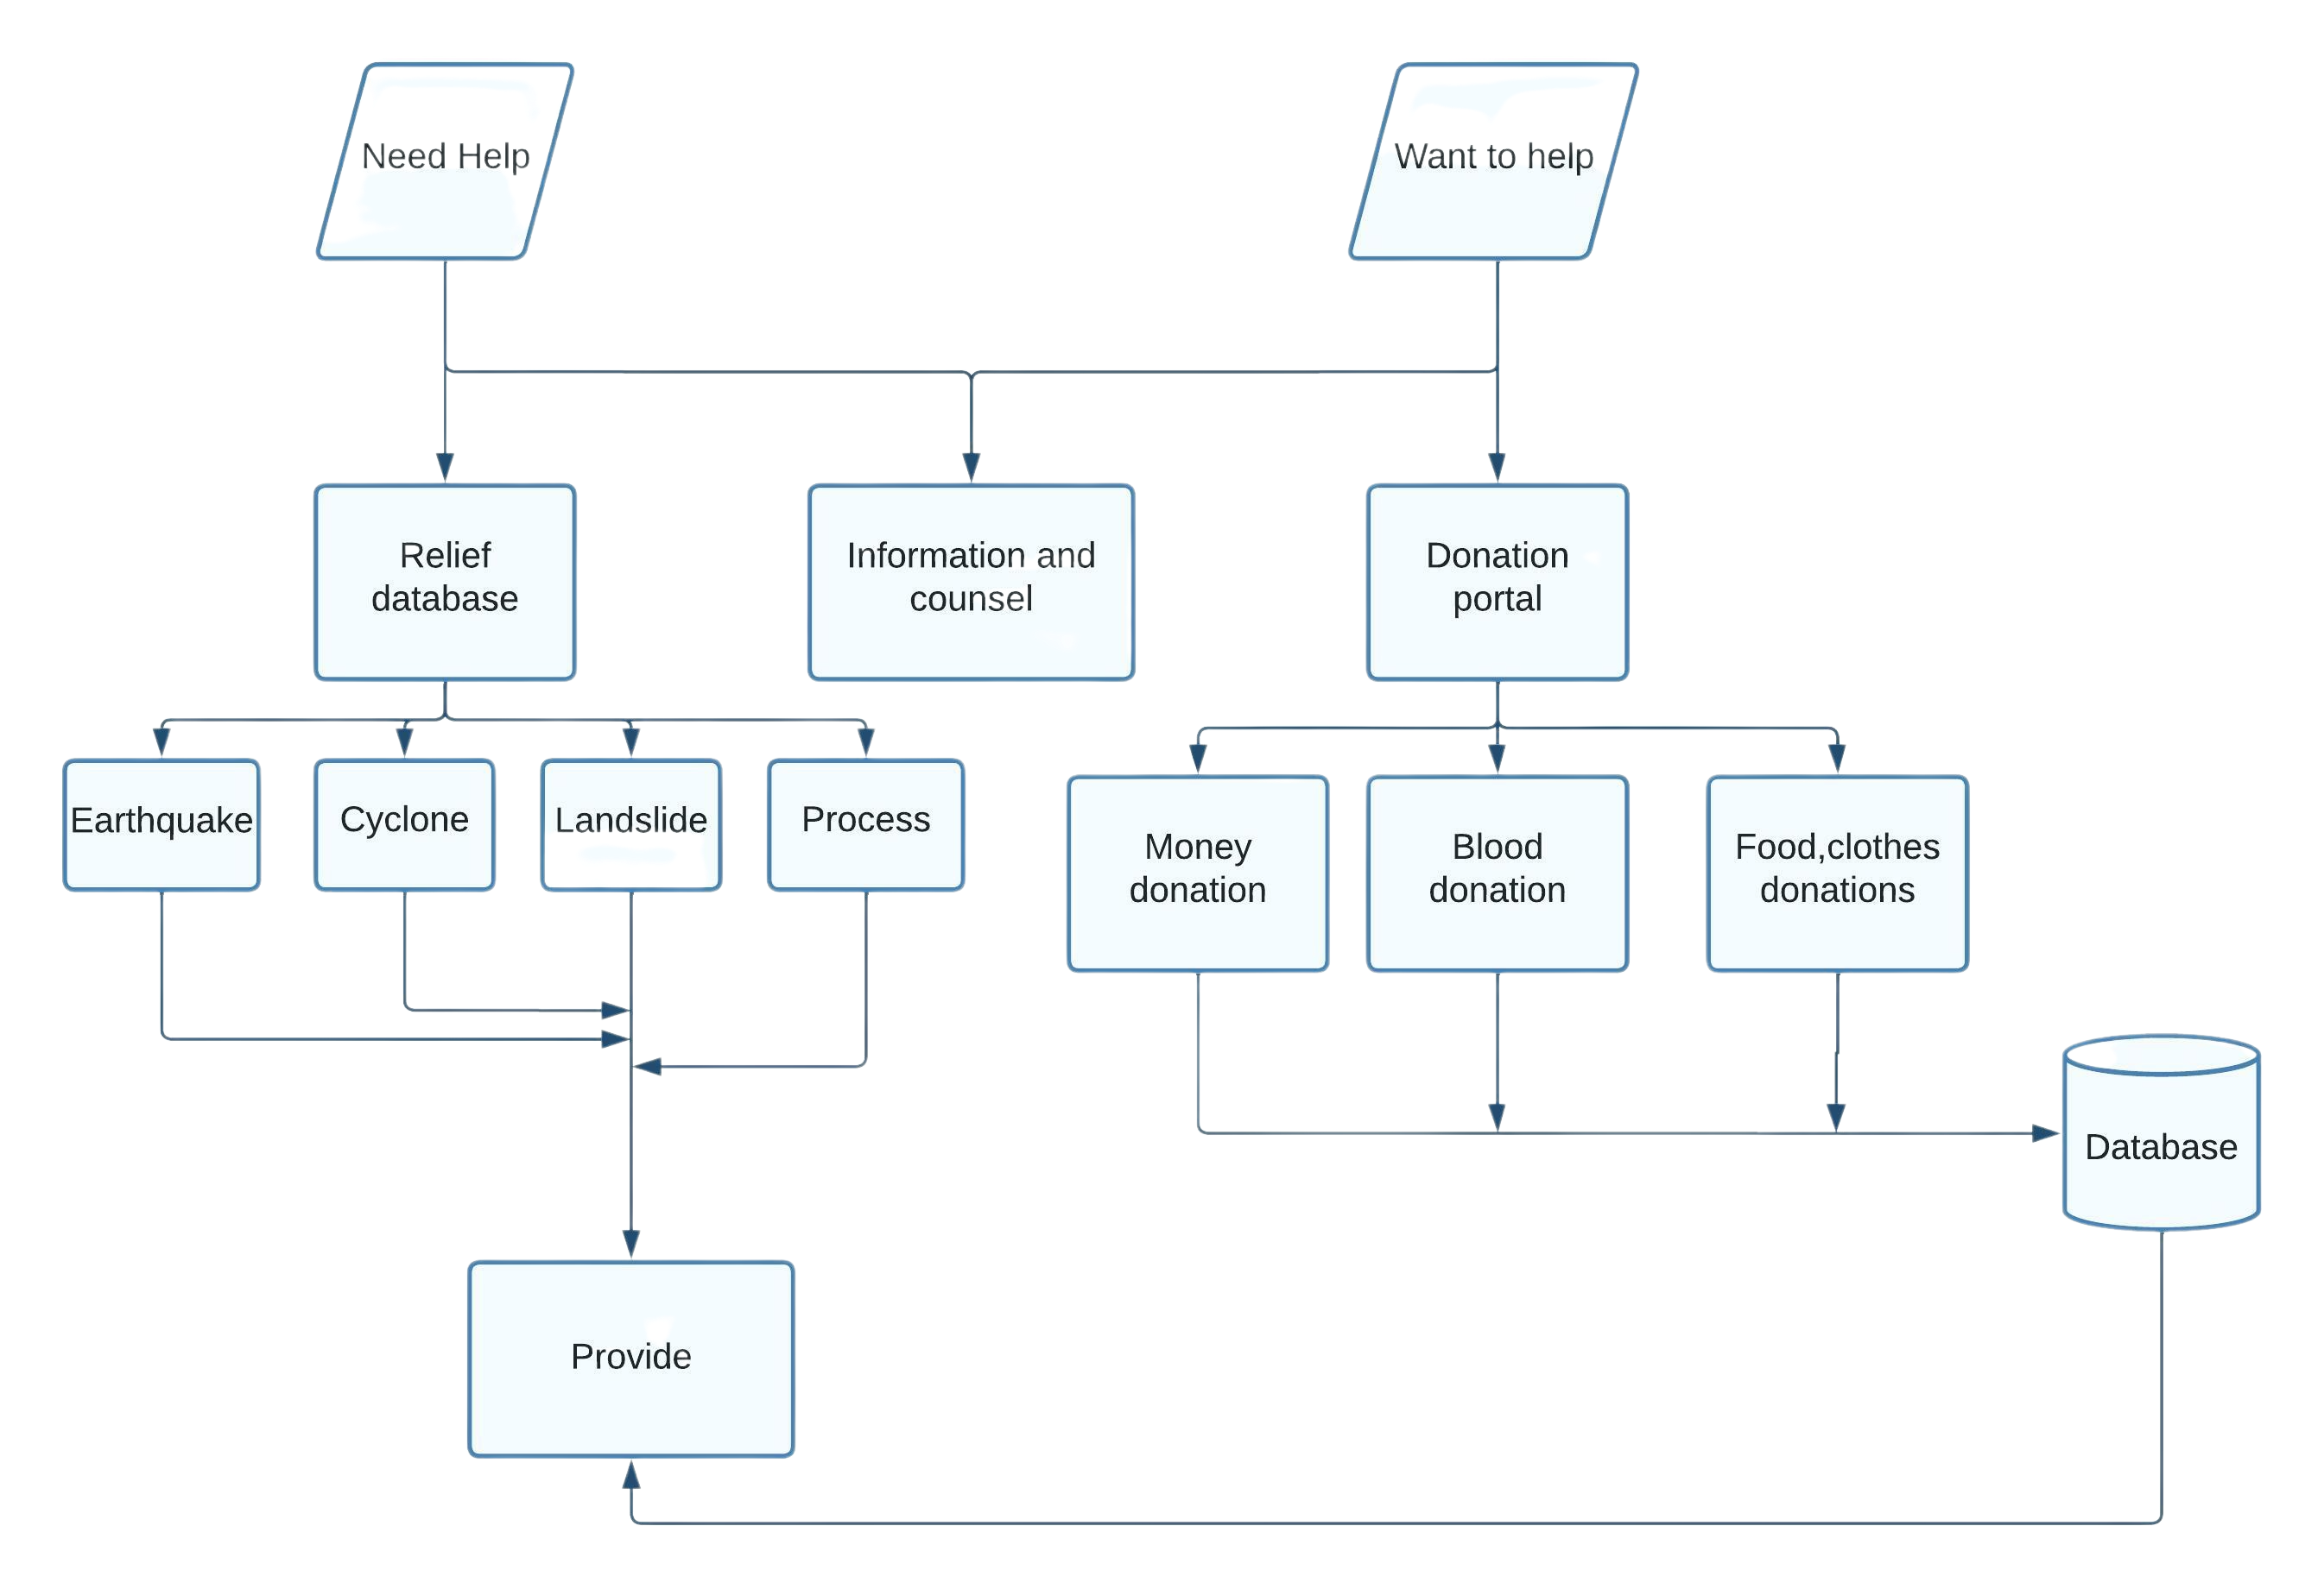
Flowchart

Slide 4
WEBSITE
succour.aws
succour.com

Slide 5
Future Aspects
Collaborating with NGO’s or higher government bodies to raise funds.
Consoling people who have been through such tragedy.
Preserving the environment and the natural resources.
Backup all the data safely into cloud.
Establishing co-ordination between different departments.

