Slide 1
Data Sights
IIM Kashipur
Team Name
Masterminds
Satyam Sharma
Mayank Gaur

Slide 2
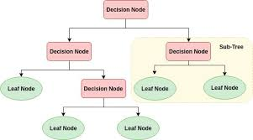

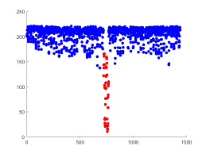

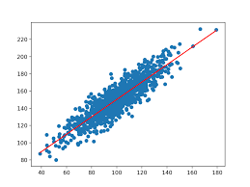
Model Development Process-flow
Using Decision Tree Classifier
Developing Classification Model
The Decision Tree is a powerful non-linear classifier. A Decision Tree makes use of a tree-like structure to generate relationship among the various features and potential outcomes. It makes use of branching decisions as its core structure
Data Analysis
Outlier Detection and Capping
Multicollinearity detection and correction
Implementing models and selecting the best results.

Slide 3
CONTINUOUS DATA
OBJECTIVE
Number of debit transactions
Total No. of Transaction
No. of Branch Cash Withdrawal Transactions
No. of ATM Debit Transactions
No. of Net Debit Transactions
No. of Mobile Banking Debit Transactions
No. of Cheque Debit Transactions
BALANCE
Amount Withdrawn from ATM
Amount cash withdrawn from Branch
Amount debited by Cheque Transactions
Amount debited by Net Transactions
Amount debited by Mobile Banking Transactions
Total Amount Debited
HOLDING PERIOD
Amount charged by way of the Other Bank ATM usage
Amount charged by way Minimum Balance not maintained
Amount charged by way Inward Cheque Bounce
Amount charged by way Outward Cheque Bounce
Avg. Amt withdrawn per ATM Transaction
Avg. Amt withdrawn per Cash Withdrawal Transaction
Avg. Amt debited per Cheque Transaction
Avg. Amt debited per Net Transaction
Avg. Amt debited per Mobile Banking Transaction
SCR-Generic Marketing Score
AGE
Business Objective:
To find prospective customers who can avail loan services from Rubicon bank.
Data analysis:
The data consists of 37 columns with target depicting whether the customer is a prospect for selling loan services or not. 5000 records are provided with this data and 15000 records are to be analyzed for future prospects.
CATERGORICAL DATA
TARGET
OCCUPATION
GENDER
Has Nominee - 1: Yes, 0: No
Has Credit Card - 1: Yes, 0: No
Has any earlier loan - 1: Yes, 0: No
Has any banking charges
ACCOUNT TYPE
LENGTH OF RELATIONSHIP IN MONTHS
Number of Credit Transactions

Slide 4
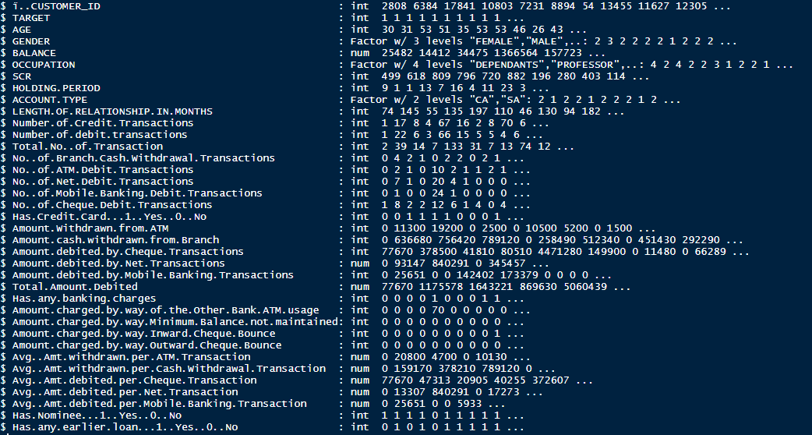
Data Characteristics
We have 5000 records with 37 variables out of which 1 is dependent and remaining 36 are independent variables
Among the independent variables, 8 are categorical and 28 are continuous variables.
Certain variables like Number of Credit transactions , Number of Debit transactions are linearly correlated with Total Number of transactions.
Customer ID column is redundant for developing a model so this has been dropped.
Balance variable exhibit huge difference between mean and median. Also, its 3rd quartile and maximum limit vary by a huge difference. This exhibits presence of outliers in this variable.

Slide 5
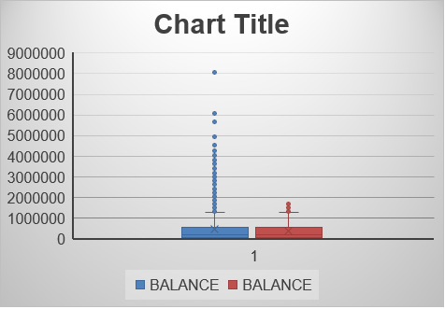
Outlier’s Detection and Capping
Preprocessing and outlier detection is an integral part of any data processing task.
Many continuous variables in the given dataset have outliers and we have followed CAPPING technique for outlier correction.
For Capping technique, we have considered those data points as outliers that lie outside the 3rd quartile + 1.5*IQR and 1st quartile – 1.5*IQR where IQR is the Inter Quartile Range.
Outliers are then capped with the 95 percentile in the upper bound and 5 percentile for the lower bound
This technique is implemented for various variables to overcome the problem of outliers in the dataset.

Slide 6
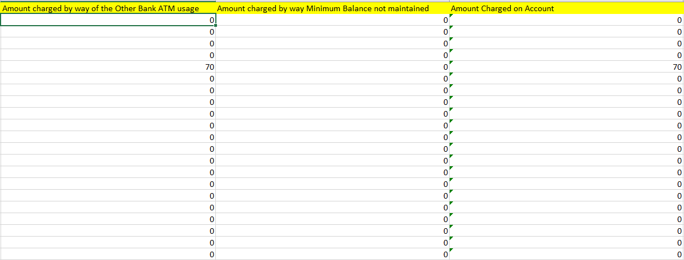
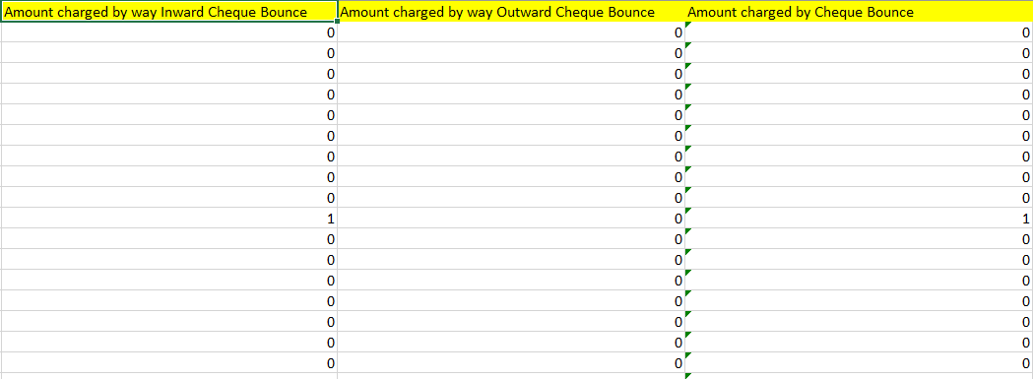
Feature Engineering
Variables Amount charged by way of the Other Bank ATM usage and Amount charged by way Minimum Balance not maintained can be combined to one single variable Amount Charged on Account as both variables are highlighting the same weakness of customer; not able to keep enough cash in his account
Variables Amount charged by way Inward Cheque Bounce and Amount charged by way Outward Cheque Bounce can be combined into a single variable Amount charged by Cheque Bounce as both variables highlight the customer’s inability to adhere to bank’s cheque transfer policy

Slide 7
Test of Multicollinearity
Multicollinearity is a phenomenon in which one predictor variable in a multiple regression model can be linearly predicted from the others with a substantial degree of accuracy.
We have used VIF(Variance Inflation Factors) method to identify Multicollinearity between different variables.
. There exists perfect collinearity between Amount Withdrawn from ATM, Amount cash withdrawn from Branch, Amount debited by Cheque Transactions, Amount debited by Net Transaction, Amount debited by Mobile Banking Transactions and Total Amount Debited. Hence only Total Amount Debited should be retained.
Similarly all Average amount debit transactions columns can be subsumed into Average Amount per Debit Transactions
Variables | Vif
LENGTH.OF.RELATIONSHIP.IN.MONTHS | 1.009105
Has.Nominee...1..Yes..0..No | 1.010051
Has.any.earlier.loan...1..Yes..0..No | 1.011385
Has.Credit.Card...1..Yes..0..No | 1.016872
SCR | 1.025005
AGE | 1.026327
BALANCE | 1.070309
OCCUPATION | 1.105716
GENDER | 1.140609
Amount.charged.on.Account | 1.201941
Amount.charged.by.Cheque.Bounce | 1.37284
HOLDING.PERIOD | 1.389827
Has.any.banking.charges | 1.568364
ACCOUNT.TYPE | 1.95198
Number.of.Credit.Transactions | 2.242165
Avg..Amount.per.Debit.Transaction | 2.279018
Total.Amount.Debited | 3.238069
No..of.Debit.Transactions | 4.108962

Slide 8
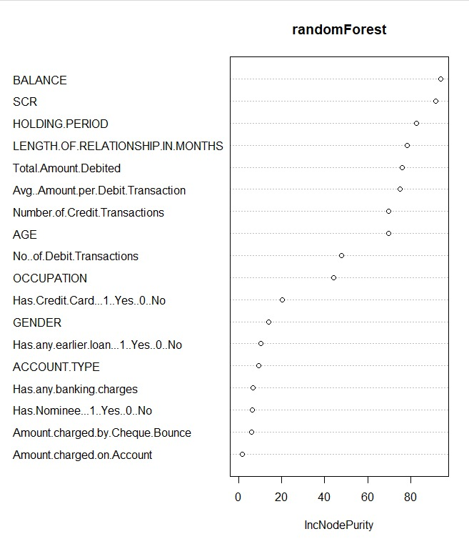
Variable Selection
From 36 independent variables we have consolidated the variable count to 19.
From these 19 variables to find out the variables that are deterministic in developing a model are identified using the VARIMP and IMPORTANCE method.
After applying both VARIMP and IMPORTANCE methods on the dataset we observed that following variables BALANCE, SCR, HOLDING PERIOD, Length of Relationship in months, etc. are common in both methods
From the graph alongside we can observe there are almost 12 major variables that are significant for developing a classification model for the given dataset. So we choose BALANCE, SCR ,…. Till GENDER from the table to create a classification model.

Slide 9
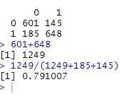
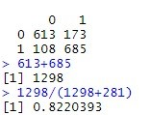
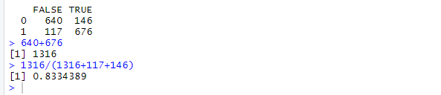
Results
Test results from different models
Logistic Model
AdaBoost
Accuracy of Test set = 66%
Accuracy of Test set = 79.10%
66%
79.10%
(518+524)/(518+524+268+270) [1] 0.6594937
Gradient Boosting
Bagging Technique
Accuracy of Test set = 82.20%
Accuracy of Test set = 83.34%
82.20%
83.34%

Slide 10
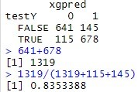
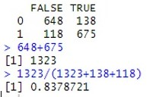
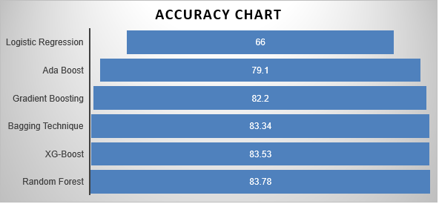
XG Boost
Random Forest
83.53%
Accuracy of Test set = 83.53%
83.78%
Accuracy of Test set = 83.78%
Selected Model
As Random Forest has the highest accuracy of prediction. We recommend Random Forest technique for predicting the potential loan availing customers

Slide 11




Business Insights
Demographic factors
Demographic factors like age, occupation and SCR score of a customer significantly impact the probability of a customer to buy a personal loan
Person holding credit card
Customers holding credit cards are generally more prone to heavy transactions and hence can be a profitable target for cross selling personal loans
Account balance
There exists a clear relationship between customer’s account balance and his conversion rate for personal loans. Customers having a low account balance on an average should be targeted.
Holding Period and Length of relationship
holding period of a customer and Length of Relationship with bank are also important factor to focus on.

Slide 12
Thank you

Slide 13
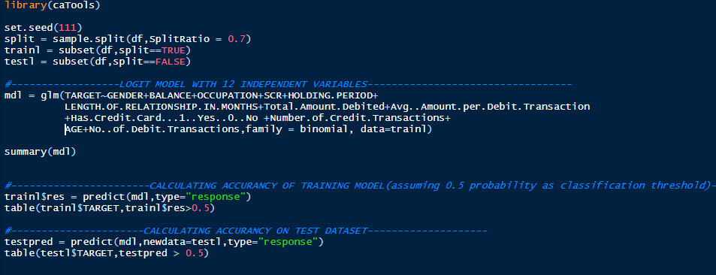
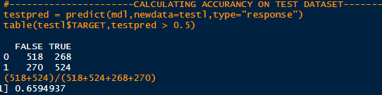
EXHIBIT-1
LOGISTIC REGRESSION

Slide 14
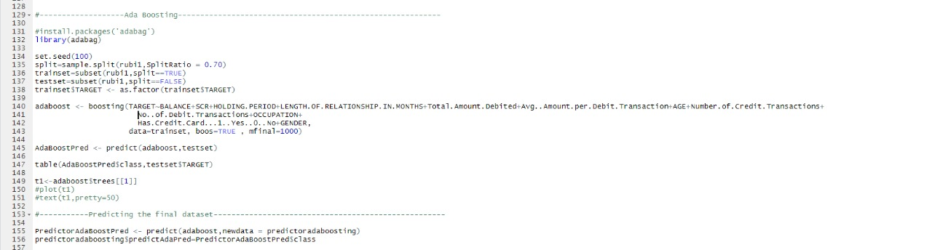
EXHIBIT-2
ADA BOOST

Slide 15
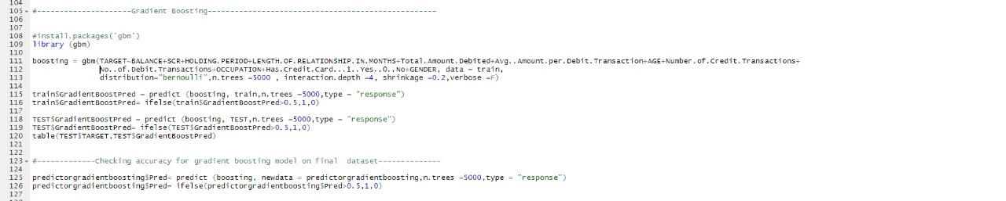
EXHIBIT-3
GRADIENT BOOSTING

Slide 16
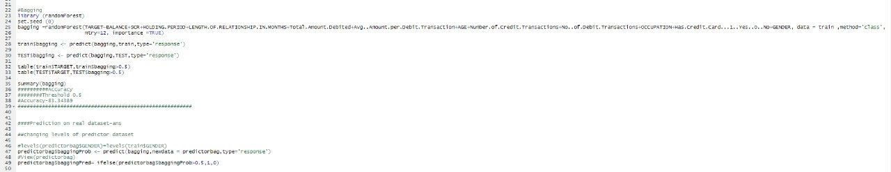
EXHIBIT-4
BAGGING

Slide 17
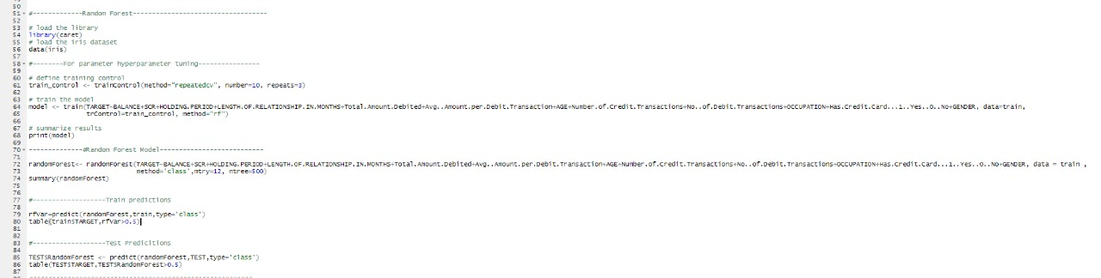
EXHIBIT-5
RANDOM FOREST

