Slide 1
+
Second Opinion AI
AI-Powered Medical Second Opinion Platform for India
Built with Claude AI | Supabase | Next.js | Sarvam Voice
1 / 12

Slide 2
The Problem: Healthcare in India
1:1,500
74%
2 min
Doctor-to-patient ratio
vs WHO recommended 1:1,000
Of doctors serve urban areas
where only 36% of the population lives
Average OPD consultation
time in government hospitals
Key Challenges
!
Patients in rural areas have limited access to specialist opinions
!
Doctors lack modern EHR tools; still use pen-and-paper in most clinics
!
No standardized clinical documentation (SOAP, EHR, referral letters)
!
Language barriers prevent effective history-taking in local languages
2 / 12

Slide 3
The Solution: Second Opinion AI
P
D
AI
For Patients
For Doctors
AI-Powered
AI-powered consultations
in text or voice, any language.
Upload documents, get
instant medical insights.
Auto-generated SOAP notes,
EHR entries, clinical letters.
Review AI-extracted findings
and finalize with one click.
Claude Opus for diagnostics,
Sarvam for voice ASR/TTS,
emergency detection, and
multi-model routing.
One platform connecting patients and doctors through AI-powered clinical intelligence
3 / 12

Slide 4
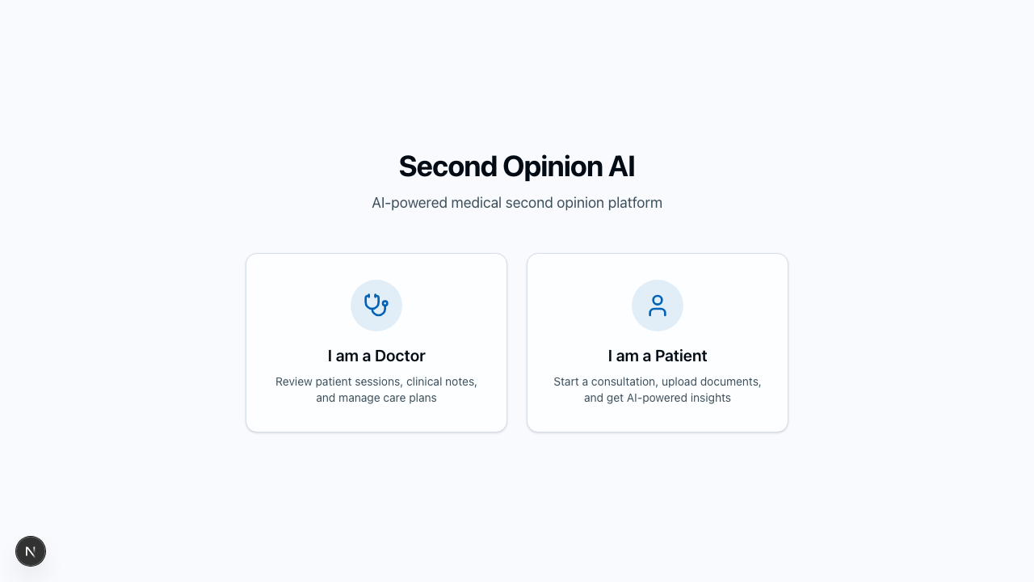
Portal: Unified Entry Point
How It Works
1
Users visit the portal and choose their role
2
Doctors access session reviews, SOAP notes, EHR entries
3
Patients start AI consultations in text or voice
4
Portal routes to the right app via Next.js rewrites
Next.js 16 | Tailwind CSS | Supabase Auth
4 / 12

Slide 5
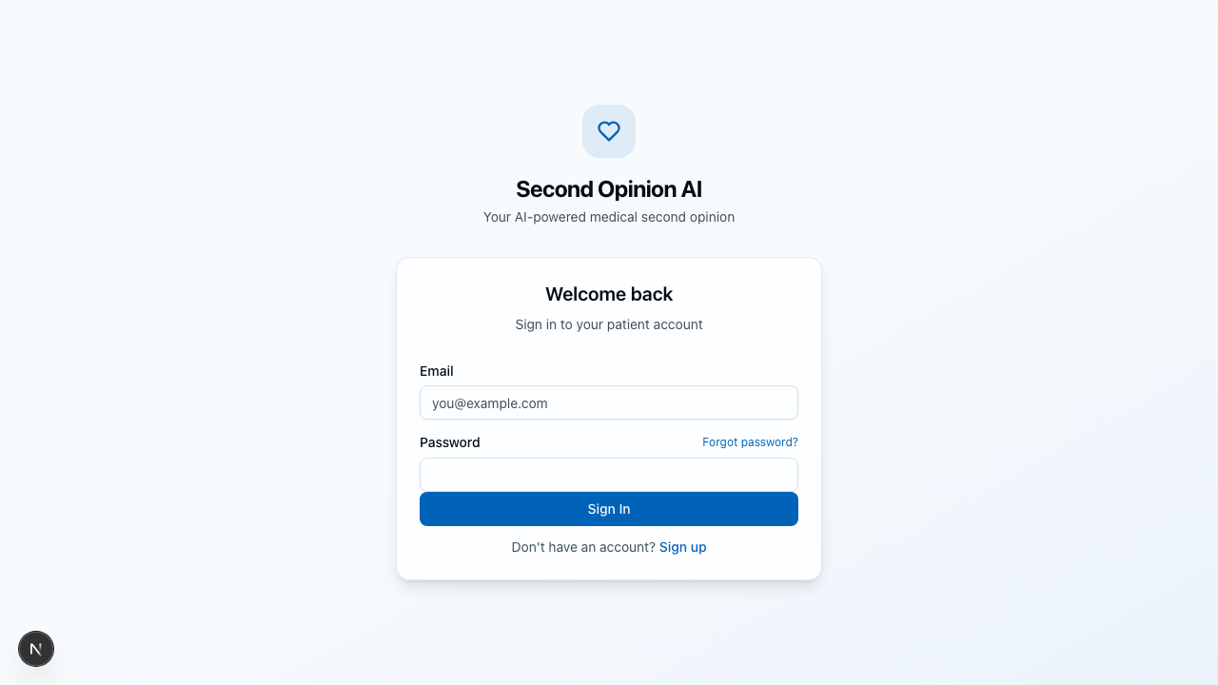
Patient App: AI Consultation Flow
Sign Up
& Login
Upload
Documents
Start
Consultation
AI
Diagnosis
Review
Results
→
→
→
→
Create account
or sign in
Medical records,
lab reports
Text or voice
in any language
Claude analyzes
symptoms + EHR
Visit record,
recommendations
Key Features
Voice consultation with Sarvam ASR/TTS (Hindi, Tamil, +10 languages)
Document upload with AI extraction (prescriptions, lab reports)
Real-time emergency detection via flag_emergency tool
Contextual follow-ups using temporal EHR hydration
Post-session: auto-generated visit record and summary
5 / 12

Slide 6
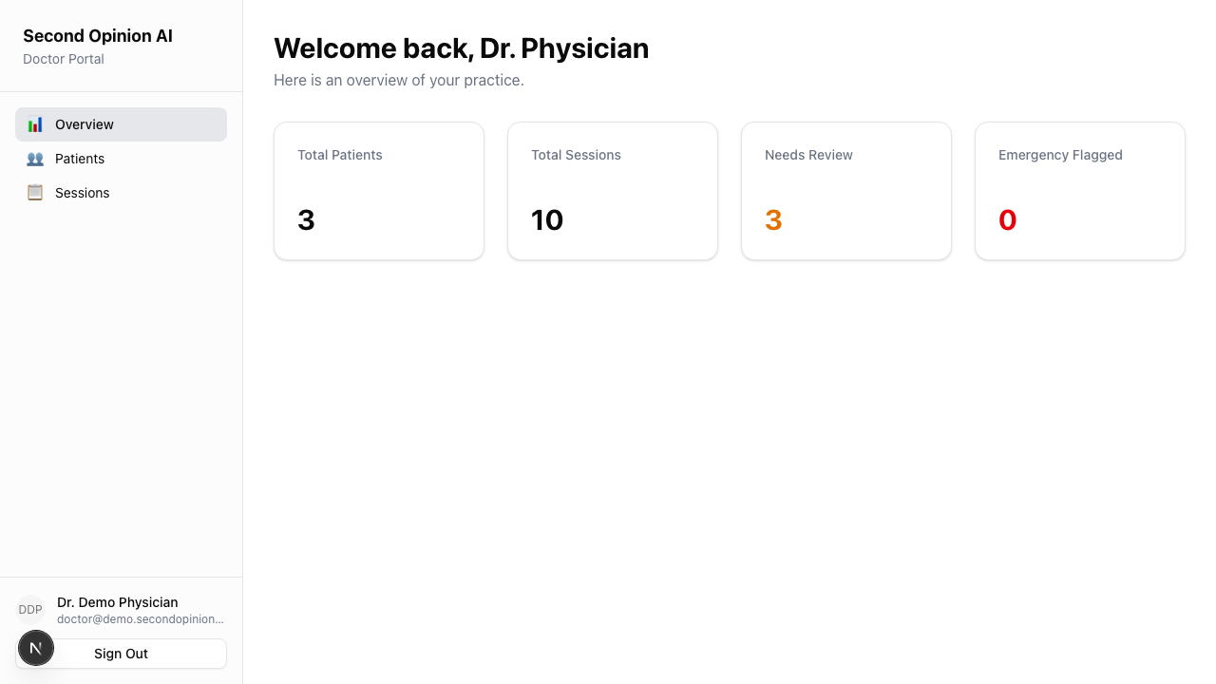
Doctor App: Clinical Review Dashboard
Doctor Workflow
Dashboard Overview - Patient count, sessions, review queue, emergencies
Session Review - Transcript + visit record side-by-side
SOAP Note Editor - AI-drafted S/O/A/P sections, edit and finalize
EHR Entry - ICD-10 codes, CPT, orders, prescriptions auto-filled
Clinical Letters - Generate referral, summary, and follow-up letters
Visit Record
Summary
SOAP Note
EHR Entry
Mark Reviewed - Approve AI outputs with confidence scoring
Letters
Five tabbed views per session — all AI-generated, all doctor-editable
6 / 12

Slide 7
System Architecture
Frontend Layer
Portal App (Next.js)
Patient App (Next.js)
Doctor App (Next.js)
↓
API & Auth Layer
Next.js API Routes
Supabase Auth (RLS)
WebSocket Server
↓
AI & Processing Layer
ConversationEngine
Post-Session Agent
MCP Tool Handlers (17)
↓
Data & External
Supabase PostgreSQL
Claude API (Opus/Sonnet)
Sarvam Voice (ASR/TTS)
7 / 12

Slide 8
ConversationEngine: AI Consultation Core
Intelligent Model Routing
Built-in Tools
Claude Haiku Emergency scanning
Every turn
get_patient_context
Fetch EHR, documents, past sessions
Claude Sonnet Initial history-taking
Turns 1-2
update_session_notes
Real-time clinical note updates
Claude Opus Diagnostic reasoning
Turn 3+
flag_emergency
Detect urgent conditions instantly
Context Window Management (200K tokens)
System Prompt (15%)
EHR Context (25%)
Conversation (45%)
Response (15%)
Temporal EHR serialization marks pre-existing history to prevent false extraction during consultations
8 / 12

Slide 9
Post-Session Agent: Automated Documentation
When a consultation ends, the Post-Session Agent automatically generates all clinical documents:
Visit Record
Chief complaint, symptoms, diagnoses, recommendations, follow-up
write_visit_record
1
Session Summary
Key findings, follow-up items, narrative summary
write_session_summary
2
SOAP Note
Subjective, Objective, Assessment, Plan — structured clinical format
write_soap_note
3
EHR Entry
ICD-10/CPT codes, orders, prescriptions, review of systems
write_ehr_entry
4
Clinical Letter
Referral or follow-up letter for specialist communication
write_clinical_letter
5
Patient Update
Merge new conditions and medications into the patient record
update_patient
6
Powered by Claude Opus 4.6 with an agentic loop — 17 MCP tool handlers for all database operations
9 / 12

Slide 10
MCP Tools: Database Operations Layer
Session Management
Patient Data
Clinical Records
create_session
get_patient
list_sessions
get_session
update_patient
write_visit_record
update_session
review_visit_record
delete_session
write_session_summary
SOAP & EHR
Clinical Letters
Documents
write_soap_note
write_clinical_letter
manage_document
update_soap_note
update_clinical_letter
write_ehr_entry
update_ehr_entry
All tools use Supabase service client with Row-Level Security (RLS) for data isolation between doctors
10 / 12

Slide 11
Benchmark Results
ACI-Bench (Clinical Note Generation)
MedXpertQA (Expert Medical QA)
Claude Sonnet 4.5 | ROUGE Score
Claude Opus 4.6 | Accuracy
Overall ROUGE
40.6%
53.3%
≥ 25%
Subjective
26.4%
≥ 20%
Overall Accuracy (8/15 correct)
Objective
45.1%
≥ 15%
Treatment
100%
Assessment
12.7%
Diagnosis
37.5%
≥ 8%
Plan
25.8%
Basic Science
33.3%
≥ 20%
All 5 sections passed their thresholds
Matches Claude 3.5 published baseline of 53.8%
11 / 12

Slide 12
Thank You
Second Opinion AI — Bridging India's Healthcare Gap with AI
3
17
3
10+
Apps
MCP Tools
AI Models
Languages
Built with: Claude Opus 4.6 | Next.js 16 | Supabase | Sarvam AI | TypeScript
12 / 12

