Slide 1
CONSUMER COMPLAINTS IN FINANCIAL SECTOR
Presented by:
Karan Kaura
Daniel Razmjou
Satyam Singh
Jobandeep Singh Mahal

Slide 2
INTRODUCTION
Financial companies are a big part of everyone’s daily life whether it is related to a checking account, a mortgage or many other services they provide. Like any line of work errors are made daily and disputes are filled to get a resolution, by submitting a complaint, consumers can be heard by financial companies, get help with their issues, and help others avoid similar ones. Every complaint provides insight into problems that people are experiencing, helping companies identify inappropriate practices and allowing them to stop them before they become major issues.

Slide 3
SPECIFICATION OF DATA SET
Data is collected from Data.gov published by Bureau of Consumer Financial Protection
File size: 260 MB
Number of files: 1
File format: CSV ( Comma separated value)
Total number of cases: 631,271

Slide 4
PROJECT FLOWCHART
Raw Data
Export results in MS Excel
Create Visuals using Tableau
Login to Hadoop Cluster
Query Data in Hive
Load Data in HDFS
Create Tables in Hive

Slide 5
IBM BLUEMIX BIG INSIGHT CLUSTER DETAILS
Number of data nodes: 1
CPU: 4 cores
Memory: 24 GB
Data Disk: 1 TB SATA
CPU Clock speed : 2.4 Ghz
Operating System: Windows 10

Slide 6
Hive Queries
CREATE TABLE
create table complaints
(
date_recieved string, product string, sub_product string, issue string, sub_issue string,complaint_narrative string, public_response string, company string, state string, zip int, tags string, consent_provided string, submitted_via string, date_sent string, response_to_consumer string, timely_response string, consumer_disputed string, complaint_id bigint
) row format delimited fields terminated by ',‘ ;

Slide 7
LOAD DATA INTO TABLE
LOAD DATA INPATH '/user/jmahal2/complaints.csv' INTO TABLE COMPLAINTS ;

Slide 8
Hive Query
select product, count(complaint_id) from complaints order by complaint_id;

Slide 9
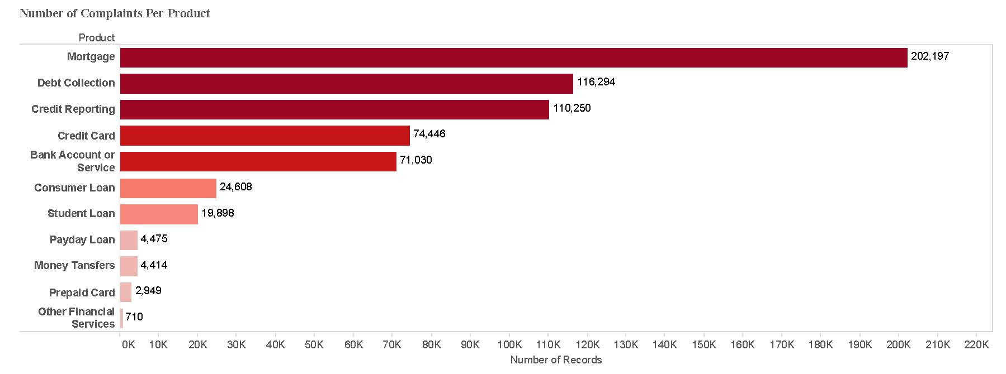
Number Of Complaints Per Product
Number of Complaints in Financial Industry from 2011 till date

Slide 10
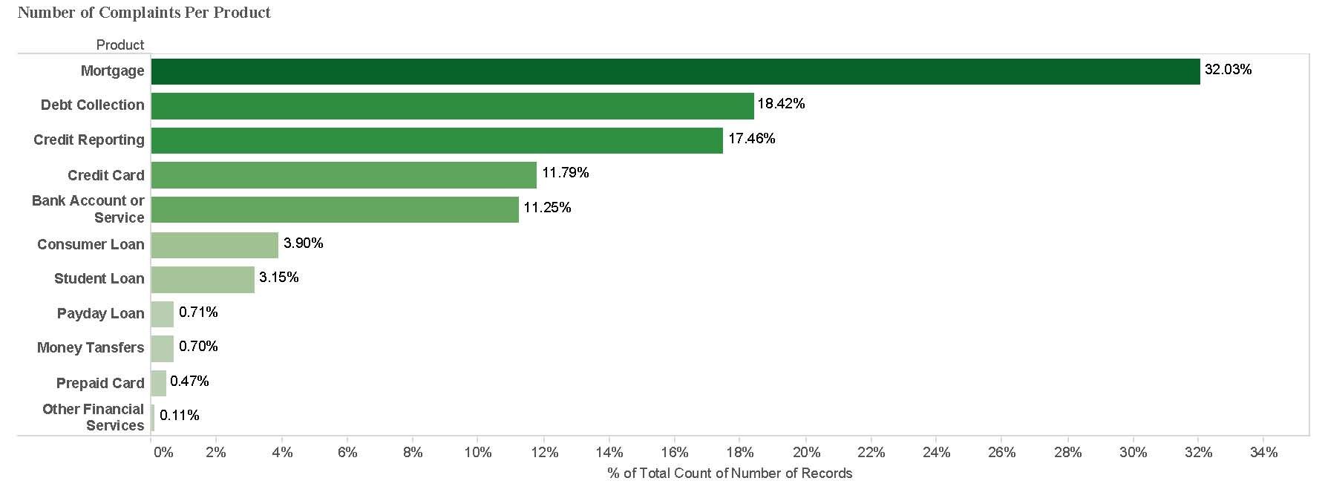
Percentage of Product wise Complaints in financial industries

Slide 11
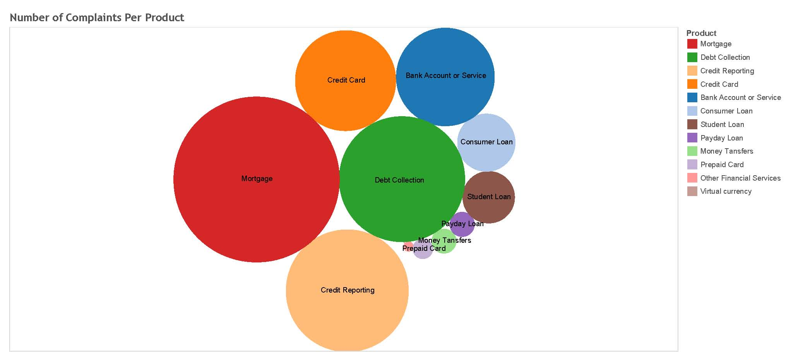
Packed Bubbles showing complaints for product

Slide 12
Hive Query
select state, sum(complaint_id) from complaints group by state order by state desc;

Slide 13
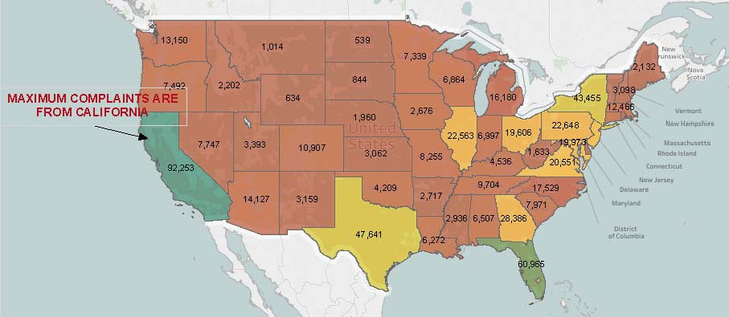
Filled map showing that California has maximum number of customer complaints

Slide 14
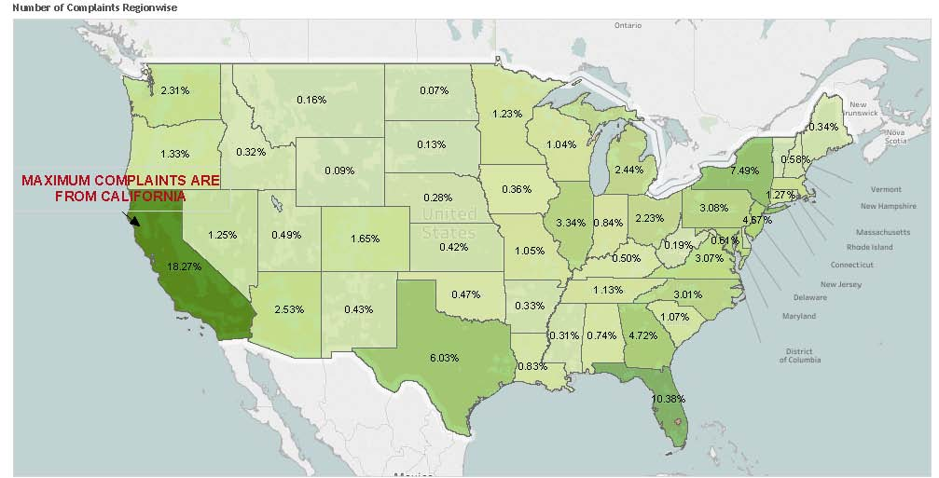
Percentage wise distribution of complaints in USA

Slide 15
Hive Query
select count(complaint_id), date_recieved from complaints;

Slide 16
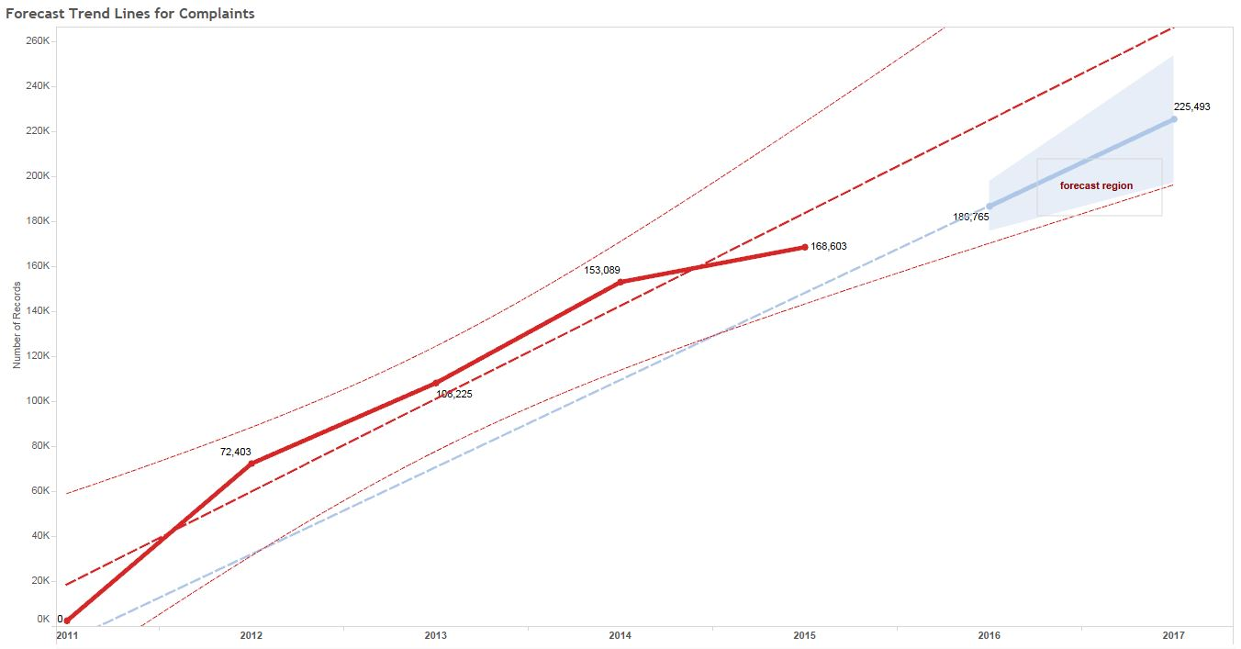
Trend line for complaints

Slide 17
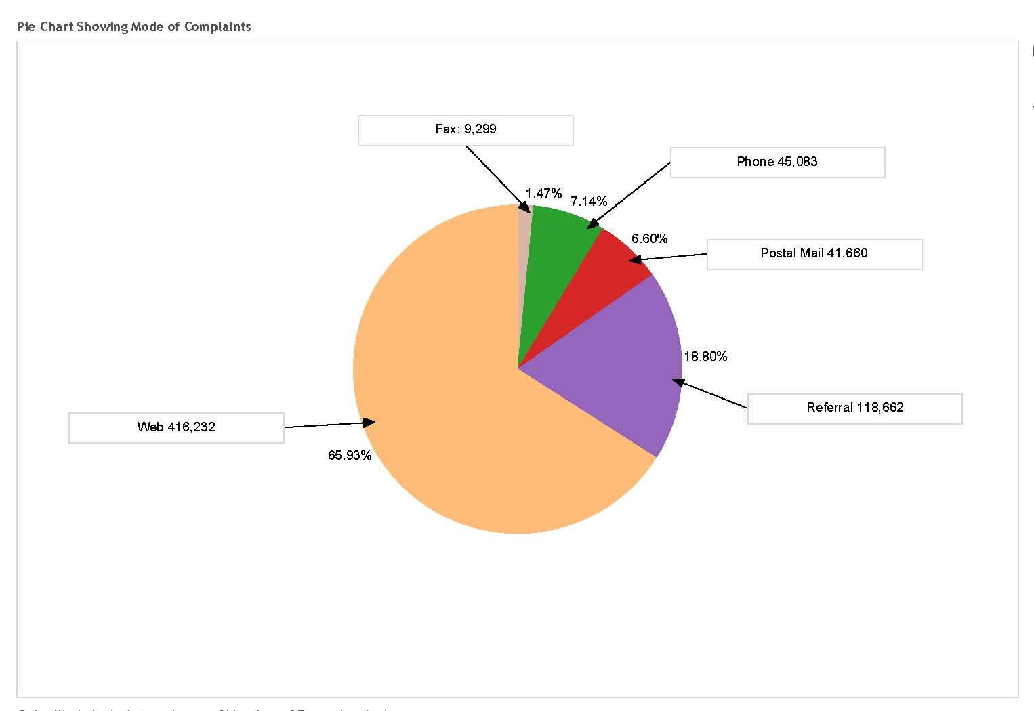
Pie Chart showing mode of complaints

Slide 18
Hive Query
select product,company,count(complaint_id) from complaints group by product;

Slide 19
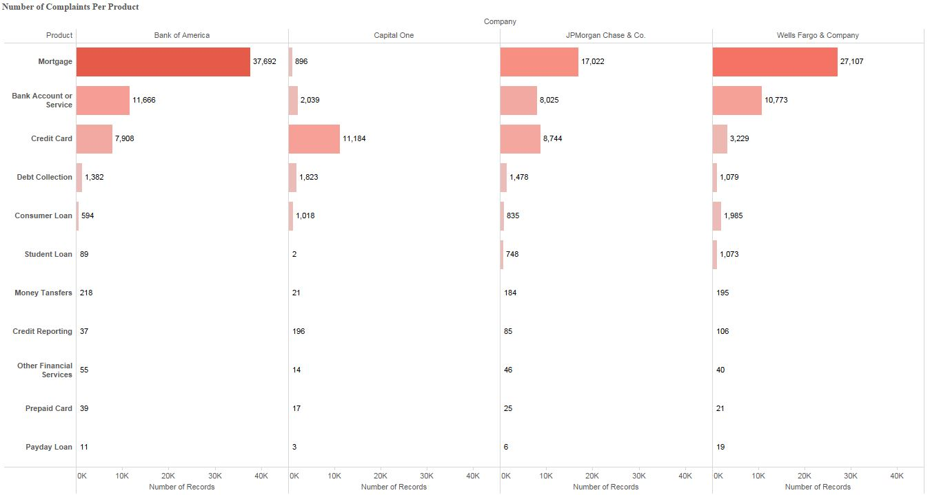
Product wise complaint of financial sector giants

Slide 20
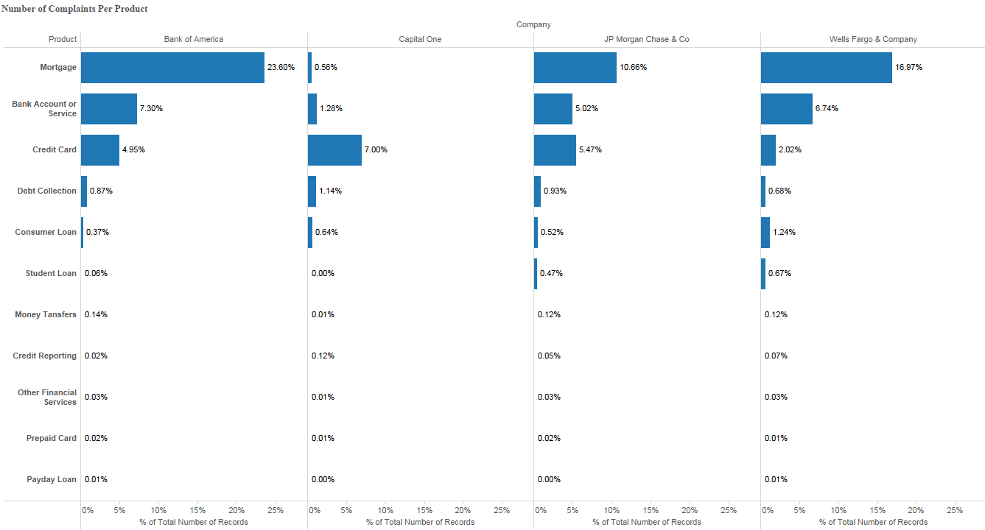

Slide 21
Hive Query
select product,company,count(complaint_id), timely_response from complaints group by product;

Slide 22
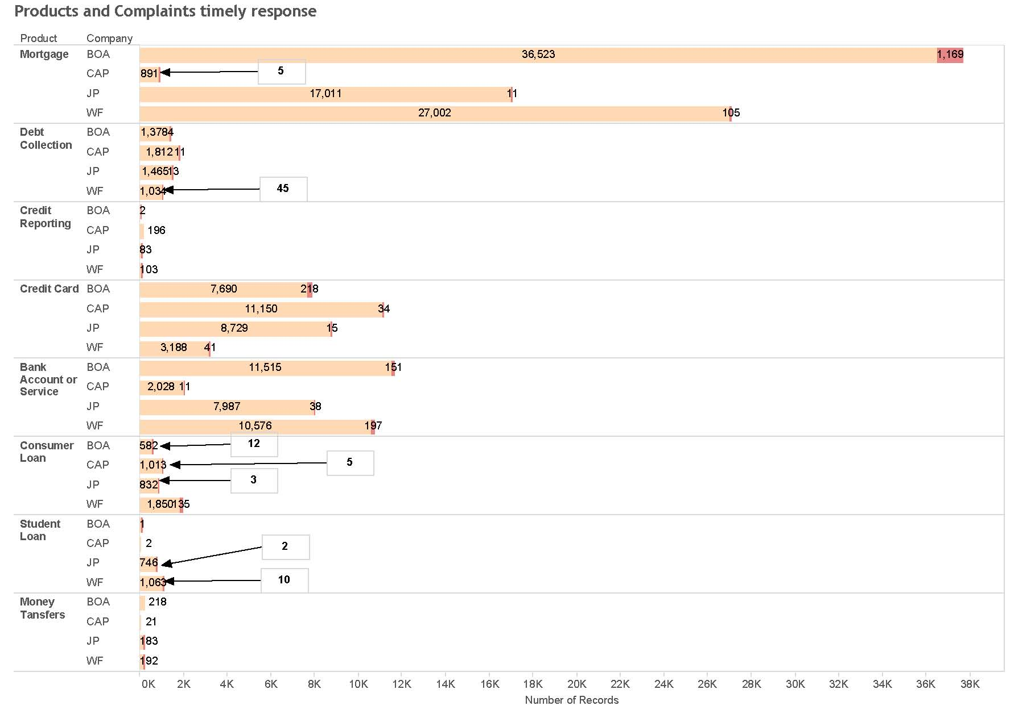
Timely Response of Complaints

Slide 23
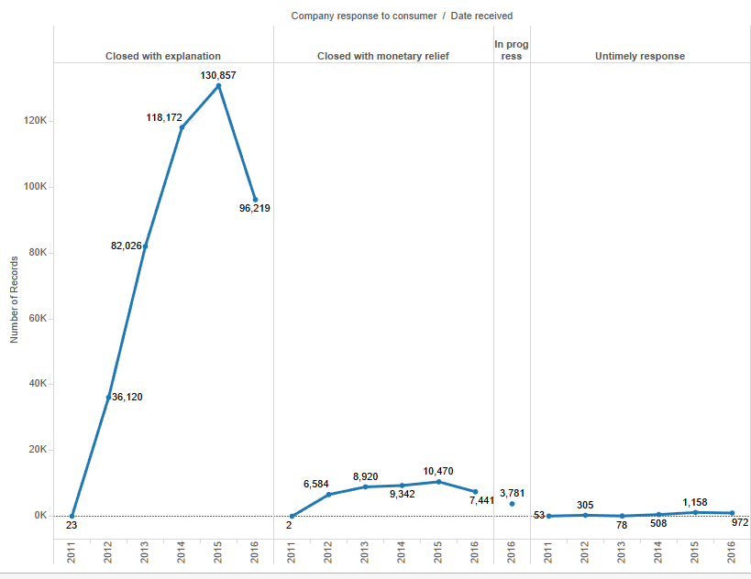
Company response to customers

Slide 24
Hive Query
Select count(complaint_id), issue, product, sub_category from complaints group by product;

Slide 25
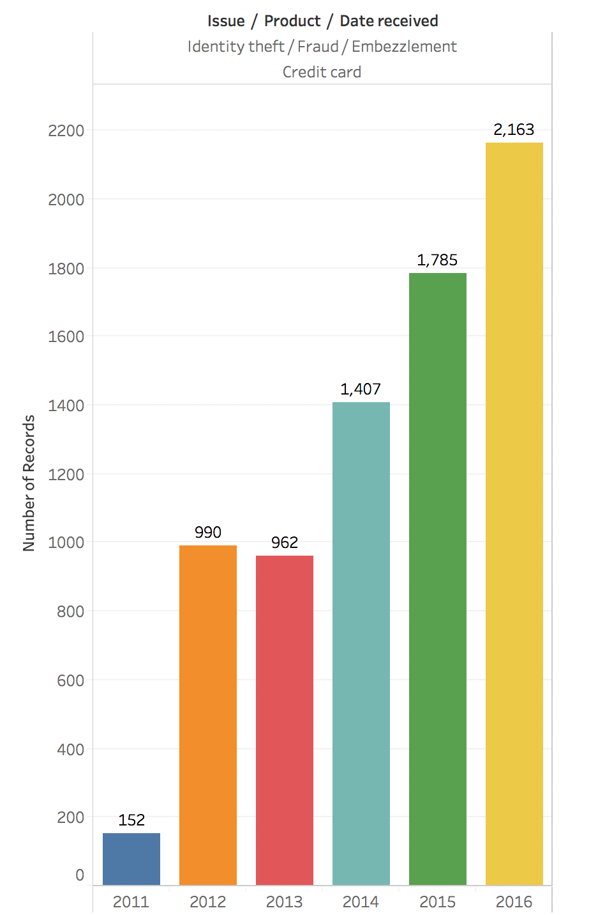
Cases of Identity theft via credit card

Slide 26
Github link & database link
Github : https://github.com/satyam241090/bigdata/projects/1
Database Link :
http://www.consumerfinance.gov/data- research/consumer-complaints/

