Slide 1

Team Name: Credible Sources
Team Member
Satyam Panda Satwik Kumar Sahoo Biswajit Sahoo

Slide 2
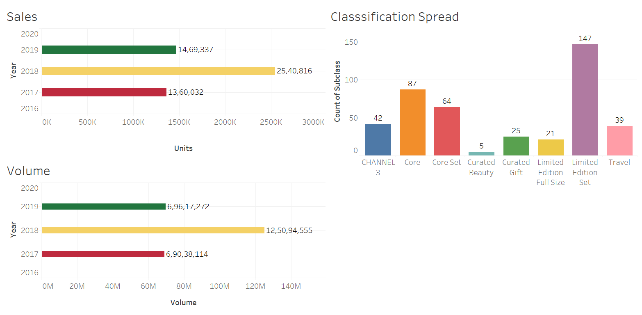
Dashboard
Link to access the supporting file/ calculations is provided at the end.

Slide 3
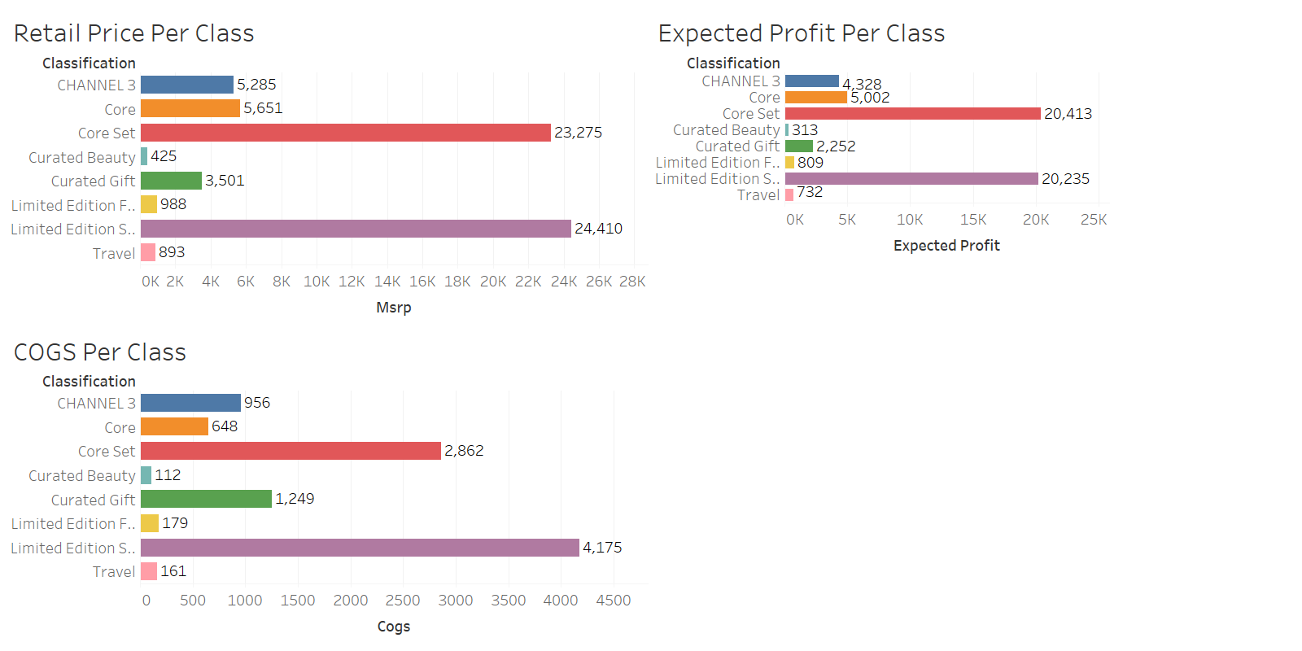
Dashboard

Slide 4
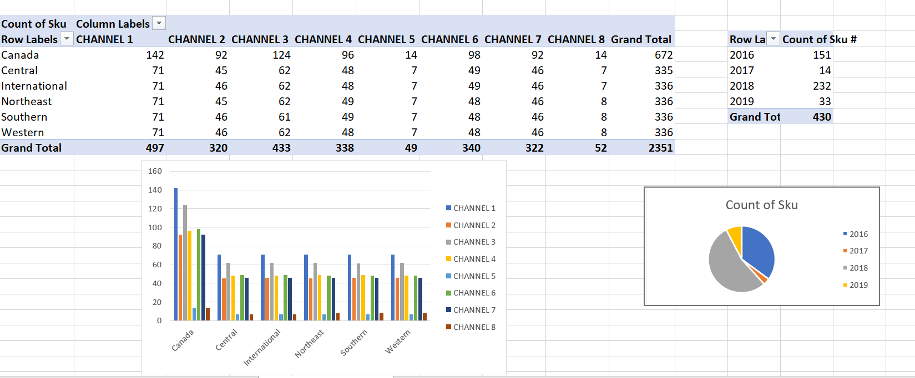
Dashboard

Slide 5
Summary: Top 10 Insights
After modeling the data carefully and doing all the necessary analysis we arrived at these noted insights:-
From the database, we observed an important insight that over the period of 2017-19, there has been a steady increase in net sales. Collectively there has been a total growth of 86.82% from 2017 to 2018, and in 2019 as there are 5 months of sales data available, so we compared the starting 5 months of 2018 to 2019 where we observed a 73.39% increase in net sales. Net Sales from 2017 - 2019 = 53,70,185 units
As a result of the increase in net sales, there also has been an increase in total revenue throughout the years. Evidently from ty/ly comparison, we found that there has been an increase of 81.20% in total revenue from 2017 to 2018. And there is a 72.07 % increase by comparing the first 5 months of 2018 and 2019. Total Revenue from 2017-19 = Rs26,37,49,941
Dividing the total revenue by net sales in the duration of data collection we find an average unit retail value of Rs 49.114.
Among all the channels, channel 6 has the highest net sales and revenue contributing 52.44% of the overall sales and 48.24% of total revenue, followed by channels 1 and 3, which shows an anomaly. Even though channel 1 and channel 3 contribute 22.13% and 13.26% of net sales respectively, channel 3 has higher total revenue at 23.45% compared to 15.74% of channel 1 in the same. This shows that the price per unit of sales is higher in channel 3 compared to channel 1.
In the classification table, each product has been classified into either of 8 classes, which further have subclass and collection information of each product. "Limited Edition Set" contains the most number of subclass with 147 of them which show that there is a availability of various products under the "Limited Edition Set".

Slide 6
Summary: Top 10 Insights
For the null MSRP value we predicted the value using COGS value which has a linear correlation of 81.11% and the predicted model was MSRP= 5.289*(COGS) +22.619. After calculating the total COGS which is Rs36657858, and total revenue from sales is Rs243399173.
Therefore COGS % =15.061, which is calculated from the above COGS and total revenue. This shows the Cost of Goods Sold value is sufficiently low to provide for a high profit margin.
Similarly, GM %=84.939. From this we inferred that Gross margin is sufficiently high resulting in growth of business, which directly impacted the increase in net sales and total revenue with time.
We observed a pattern in region name in the "Sku Region" table which follows a pattern of region code 0-5-0-1-2-3-4 throughout the entire table. From this we filled up the vacant region names column. This provided us the information regarding the availability of a product within a region in all the specific channel stores.
Out of the 430 products we have in our database 53.95% and 35.12% have been introduced in 2018 and 2016 respectively. This contributes for the majority of the products that the company sells, which in general provides a variety of option for products for the upcoming years resulting in increase of products sales year after year.

Slide 7
Link to access the supporting file / calculations:- https://drive.google.com/drive/folders/11haBa7FdXSSmfRvZYQm0E6fjjmwJ8PTx?usp=sharing

Slide 8
Thank You

