Slide 1

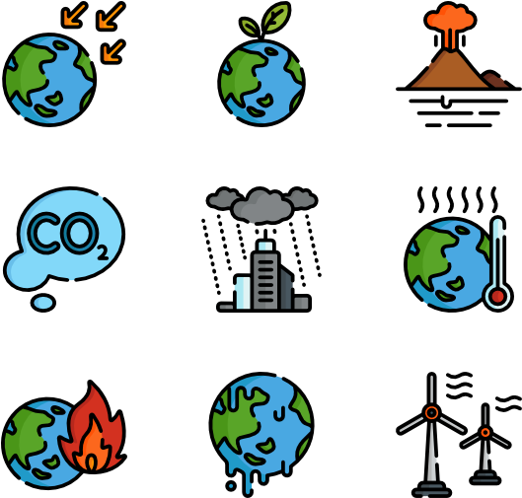
www.studymafia.org
Seminar
On
Climate Change
Submitted To: Submitted By:
www.studymafia.org www.studymafia.org
Notes:
1
1

Slide 2
CONTENT
Introduction
Definition of Climate Change
Causes of Climate Change- Natural Causes & Human Causes
Effects of Climate Change
Are humans responsible for climate change?
Conclusion
References

Slide 3
Introduction
Climate change is the change in our weather patterns that are occurring because of an increase in the earth's average temperature.
It is also known as global warming.
Climate change may result from both natural and human causes though the human causes appear to be increasingly responsible for climate change over the past few decades

Slide 4
Definition of Climate Change
“ It is a change which is attributed directly or indirectly to human activity that alters the composition of the global atmosphere and which is in addition to natural climate variability observed over comparative time periods”

Slide 5
Causes of Climate Change
Human causes of climate change
Greenhouse gases
Deforestation
Coal mining
Industrial processes
Agriculture
Natural changes to the climate
Volcanic eruptions
Solar irradiance
El Niño Southern Oscillation (ENSO)
Milankovitch cycles

Slide 6
Natural changes to the climate
Volcanic eruptions
Solar irradiance
El Niño Southern Oscillation (ENSO)
Milankovitch cycles

Slide 7
Volcanic eruptions
Volcanoes have a mixed effect on our climate. Eruptions produce aerosol particles that cool Earth, but they also release carbon dioxide, which warms it. Volcanoes produce 50 times less carbon dioxide than humans do, so we know they are not the leading cause of global warming.
On top of this, cooling is the dominant effect of volcanic eruptions, not warming.

Slide 8
Solar irradiance
Changing energy from the sun has affected the temperature of Earth in the past. However, we have not seen anything strong enough to change our climate.
Any increase in solar energy would make the entire atmosphere of Earth warm, but we can only see warming in the bottom layer.

Slide 9
El Niño Southern Oscillation (ENSO)
ENSO is a pattern of changing water temperatures in the Pacific Ocean. In an 'El Niño' year, the global temperature warms up, and in a 'La Niña' year, it cools down.
These patterns can affect the global temperature for a short amount of time (months or years) but cannot explain the persistent warming that we see today.

Slide 10
Milankovitch cycles
–As Earth travels around the sun, its path and the tilt of its axis can change slightly. These changes, called Milankovitch cycles, affect the amount of sunlight that falls on Earth.
This can cause the temperature of Earth to change. However, these cycles take place over tens or hundreds of thousands of years and are unlikely to be causing the changes to the climate that we are seeing today.

Slide 11
HUMAN CAUSES (Anthropogenic or Man-made causes)
Greenhouse gases
Deforestation
Coal mining
Industrial processes
Agriculture

Slide 12

Greenhouse Effect
The greenhouse effect is a natural process that warms the Earth’s surface. When the Sun’s energy reaches the Earth’s atmosphere, some of it is reflected back to space and the rest is absorbed and re-radiated by greenhouse gases.

Slide 13

Deforestation
Forests remove and store carbon dioxide from the atmosphere. Cutting them down means that carbon dioxide builds up quicker since there are no trees to absorb it. Not only that, trees release the carbon they stored when we burn them.

Slide 14
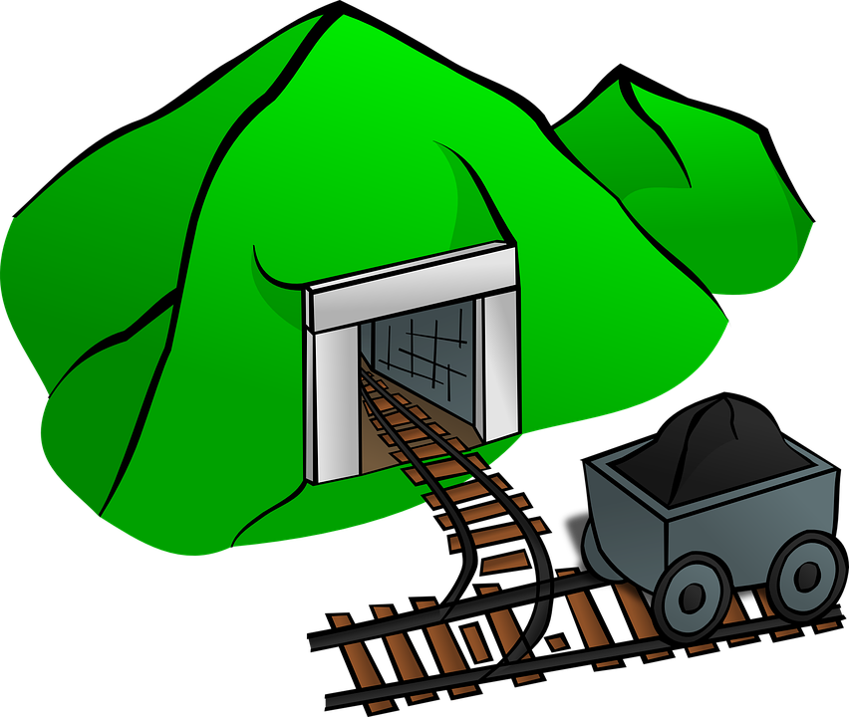
Coal Mining
Coal mining, extraction of coal deposits from the surface of Earth and from underground.
Coal is the most abundant fossil fuel on Earth. Its predominant use has always been for producing heat energy.

Slide 15
Industrial processes
Industrial processes are procedures involving chemical, physical, electrical or mechanical steps to aid in the manufacturing of an item or items, usually carried out on a very large scale. Industrial processes are the key components of heavy industry

Slide 16
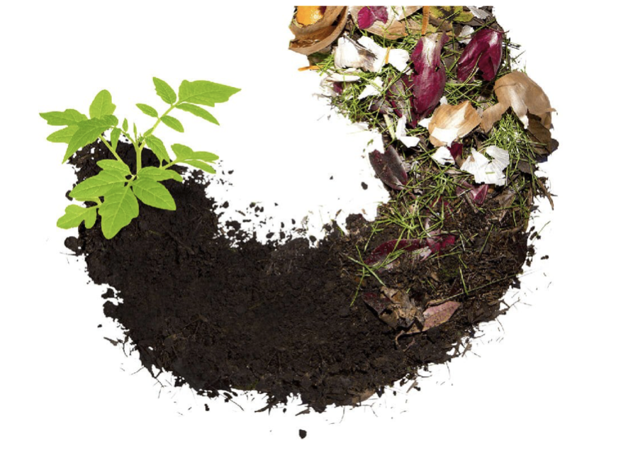
Agriculture
Agricultural waste is waste produced as a result of various agricultural operations. It includes manure and other wastes from farms, poultry houses and slaughterhouses; harvest waste; fertilizer run- off from fields; pesticides that enter into water, air or soils; and salt and silt drained from fields.

Slide 17
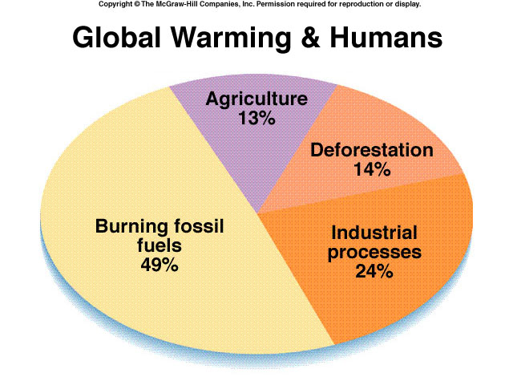

Slide 18
Effects of Climate Change
According to the World Economic Forum’s Global Risks Report 2021, the failure to mitigate and adapt to climate change is “the most impactful” risk facing communities worldwide—ahead of even weapons of mass destruction and water crises.
Blame its cascading effects: As climate change transforms global ecosystems, it affects everything from the places we live to the water we drink to the air we breathe.

Slide 19
Extreme weather
As the earth’s atmosphere heats up, it collects, retains, and drops more water, changing weather patterns and making wet areas wetter and dry areas drier.
Higher temperatures worsen and increase the frequency of many types of disasters, including storms, floods, heat waves, and droughts.

Slide 20
Dirty air
Air pollution and climate change are inextricably linked, with one exacerbating the other. When the earth’s temperatures rise, not only does our air get dirtier—with smog and soot levels rising accordingly—but it also becomes filled with more allergenic pollutants, such as circulating mold (thanks to damp conditions from extreme weather and more floods) and pollen (due to longer, stronger pollen seasons).

Slide 21
Health risks
According to the World Health Organization, “climate change is expected to cause approximately 250,000 additional deaths per year” between 2030 and 2050. As global temperatures rise, so do the number of fatalities and illnesses from heat stress, heatstroke, and cardiovascular and kidney disease.
And as air pollution worsens, so does respiratory health—particularly for the 300 million people living with asthma worldwide; there’s more airborne pollen and mold to torment hay fever and allergy sufferers too.

Slide 22
Rising seas
The Arctic is heating up twice as fast as any other place on the planet. As its ice sheets melt into the seas, our oceans are on track to rise by anywhere from 0.95 to 3.61 feet by the end of this century, threatening coastal ecosystems and low-lying areas.
Island nations face particular risk, as do some of the world’s largest cities, including New York City, Miami, Mumbai in India, and Sydney in Australia.

Slide 23
Imperiled ecosystems
Climate change is increasing pressure on wildlife to adapt to changing habitats—and fast. Many species are seeking out cooler climates and higher altitudes, altering seasonal behaviors, and adjusting traditional migration patterns. These shifts can fundamentally transform entire ecosystems and the intricate webs of life that depend on them. As a result, according to a 2020 study, one-third of all animal and plant species could face extinction by 2070.

Slide 24
Are humans responsible for climate change?
When looking at all the evidence, there is a large scientific consensus that humans are the leading cause of climate change. In their latest report, the Intergovernmental Panel on Climate Change stated unequivocally that human activity is the cause of global warming.
Natural climate cycles can change the temperature of Earth, but the changes we are seeing are happening at a scale and speed that natural cycles cannot explain. These cycles affect the global temperature for years, or sometimes just months, not the 100 years that we have observed. Meanwhile, longer-term changes like Milankovitch cycles and solar irradiance take thousands and thousands of years.

Slide 25
Conclusions
Based on the results we got about our carbon footprints, we discussed different ways to reduce it without losing quality of life.
We found out it’s quite hard, as new technologies aren’t always available in the market and are usually really expensive.
In our country we can see many direct consequences of climate change: we’ve recently suffered from floods, droughts, we have hotter summers and colder winters (we even had snowfall in our city, which is really unusual!).

Slide 26
References
www.google.com
www.wikipedia.com
www.studymafia.org

Slide 27
Thank You

