Slide 1

Project
Book Management System

Slide 2
Table of Contents
1. Introduction
1.1. Purpose of the Document
1.2. Project Overview
1.3. Scope
2. System Requirements
2.1. Functional Requirements
3. User Interface
4. Technologies Used

Slide 3
1.Introduction
1.1 Purpose of the Document : - The purpose of this document is to provide an overview of the Online Book Management System project developed using C. It outlines the system's requirements, architecture, features, user interface.
1.2 Project Overview : - The Book Management System is a Console application that allows users to perform various activities such as book management, Add a book, and more. The system aims to provide a user-friendly interface for customer to access their books.
1.3 Scope : - The scope of the Book Management System project includes the following functionalities:
- Add a Book with BookID,BookName,ISBN NO.
- Delete a Book
- List all Books.
- Update a Book Details

Slide 4
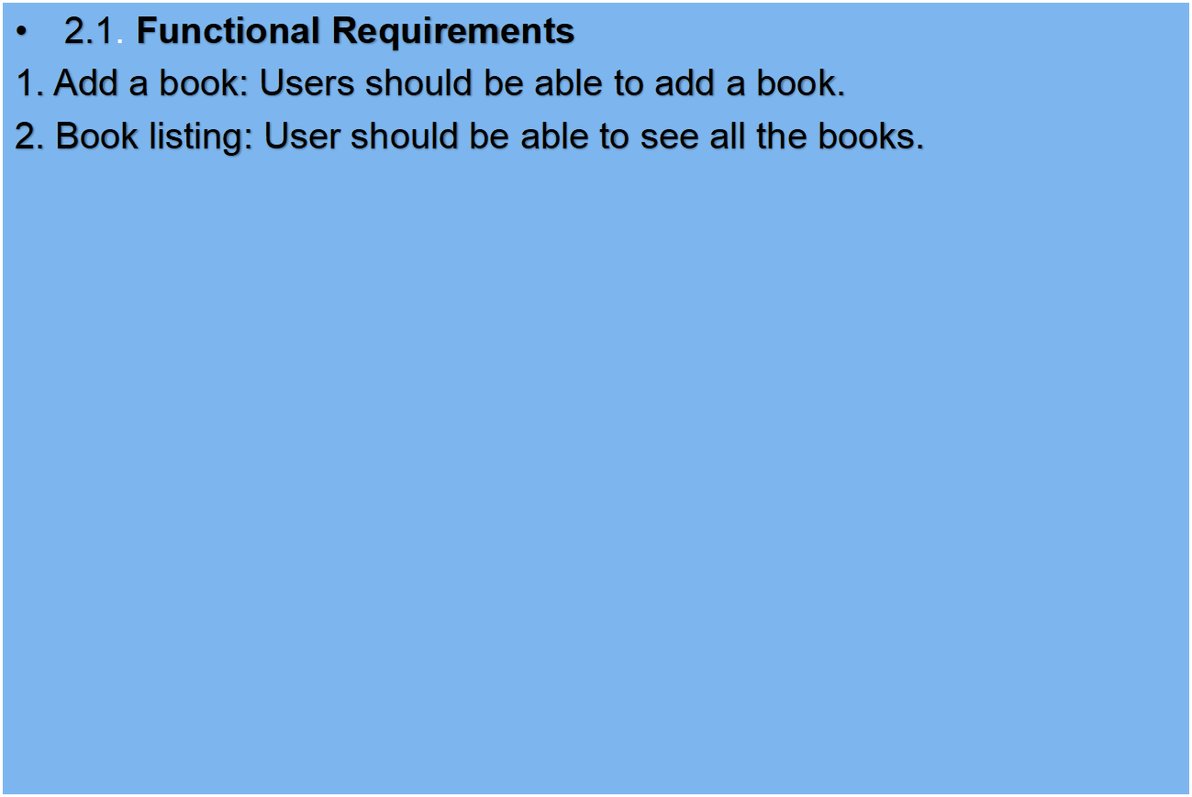
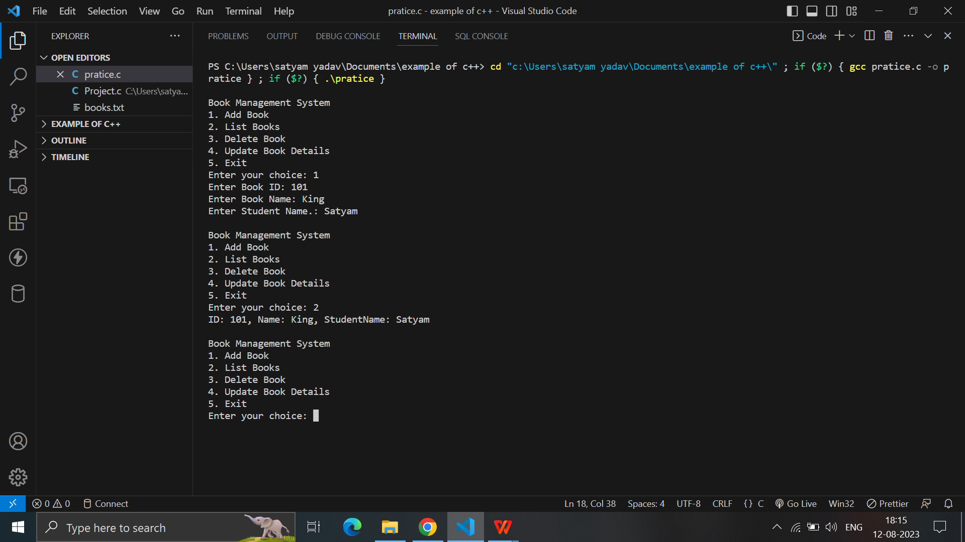
2. System Requirements

Slide 5
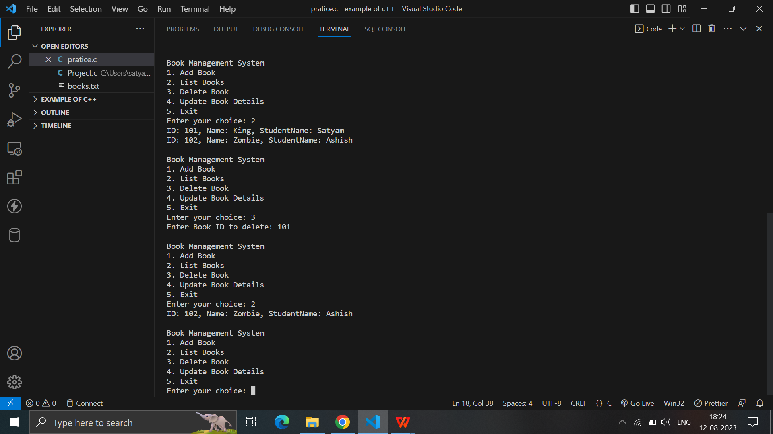
3. Delete Book: User should be able to delete the book.

Slide 6
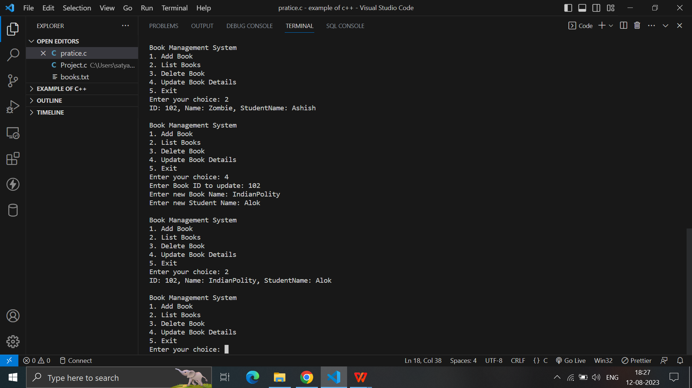
4. Update Book: User should be able to update a book.

Slide 7
User Interface & Technologies Used
User Interface
1. User interface is menu based.
2. Below will be the menu item that is there in this System.
- List
- Add a Book
- Delete a Book
- Update a Book
Technologies
- Mainly C language is used in this Project.

