Slide 1
Face Detection and Recognition using OpenCV

Slide 2
Chapter 1 : Introduction
Face detection and recognition is technology which is used to identify a person from a image or video.
It was first introduced in 1960s by Woody Bledsoe and his team. Since then it is being improved and optimized constantly.
Everyday action performed by human are increasingly being handled electronically. For that reason there is great demand for fast and accurate identification method. Face recognition technology can be used to solve these problems.

Slide 3
Chapter 2 : Applications
ID Verification : This technology has been leveraged as a form of biometric authentication for various computing platforms and devices.
E.g. Face ID used in iPhoneX smartphone is a facial recognition system.
Social Media : Social media platforms use this technology to identify age, gender etc. of people present in photos or videos uploaded on their platform.
E.g. DeepFace which is Facebook’s deep learning facial recognition system

Slide 4
Security Services : Today security is main concern at airports. Face recognition technology is used in airport protection system as it can identify suspicious individuals in less time and cost-effective manner.
E.g. All Canadian international airport use facial recognition as a part of primary …..inspection program that compare traveler face to their photo stored in ePassport.
Additional Uses : In August 2020, amid the COVID-19 pandemic in U.S, American football stadiums of New York and Los Angeles announced the installation of facial recognition for upcoming matches. The purpose was to make the entry process as touchless as possible.

Slide 5
Chapter 3 : OpenCV
OpenCV is an open source computer vision and machine learning software library.
It was started by Intel in 1999. It contains more than 2500 optimized algorithms of computer vision and machine learning.
It has Python, C++, Java and MATLAB programming interfaces and supports Windows, Linux, Android and Mac OS.
This library comes with FaceRecognizer class which can be used for face recognition.

Slide 6
Chapter 4 : Face Recognition System
A general statement of the face recognition problem is often formulated as follows: “given still or video images of a scene, identify or verify one or more persons within the background using a stored database of faces.”
It involves two processes : Face Detection and Face Recognition
Detects human faces in an image
Identifies faces present in an image

Slide 7
Chapter 4.1 : Haar Cascade Classifier
For Face Detection, Haar cascade classifier is used.
A classifier is an algorithm that decides whether a given image is positive (face) or negative (not a face).
Haar cascade classifier provided by OpenCV is pre-trained classifier, trained on thousands of images with or without faces.
This classifier has high detection accuracy and features used by detector are computer very quickly.

Slide 8

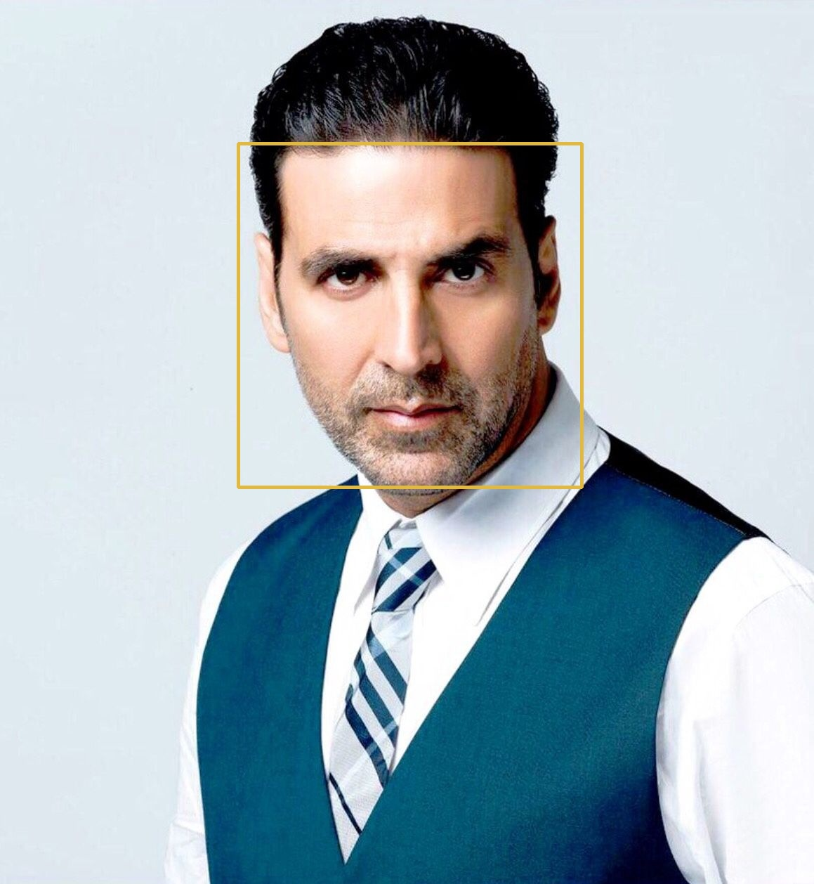
Haar cascade’s detectMultiscale() function returns coordinate (x,y,w,h) of detected face.
Using these coordinate, rectangle is drawn with the help of cv.rectangle() function of OpenCV.
Face Detection
Input Image
Output Image

Slide 9
Chapter 4.2 : LBPH Recognizer
LBPH(Local Binary Pattern Histogram) is one of the popular face recognition algorithms.
It is a feature based approach meaning it processes input image to identify and extract distinctive features.
It is possible to get good results with this recognizer but in a controlled environment.
This algorithm take use of LBP(Local Binary Pattern) and HOG(Histograms of Oriented Gradients) for improving the detection performance on some datasets.

Slide 10
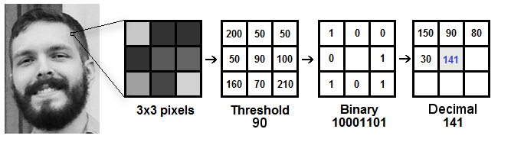
LBP Operation
The first computational step of LBPH is to create an intermediate image that describes the original image in a better way, by highlighting the facial characteristics.
Image Credit - https://towardsdatascience.com/face-recognition-how-lbph-works-90ec258c3d6b

Slide 11
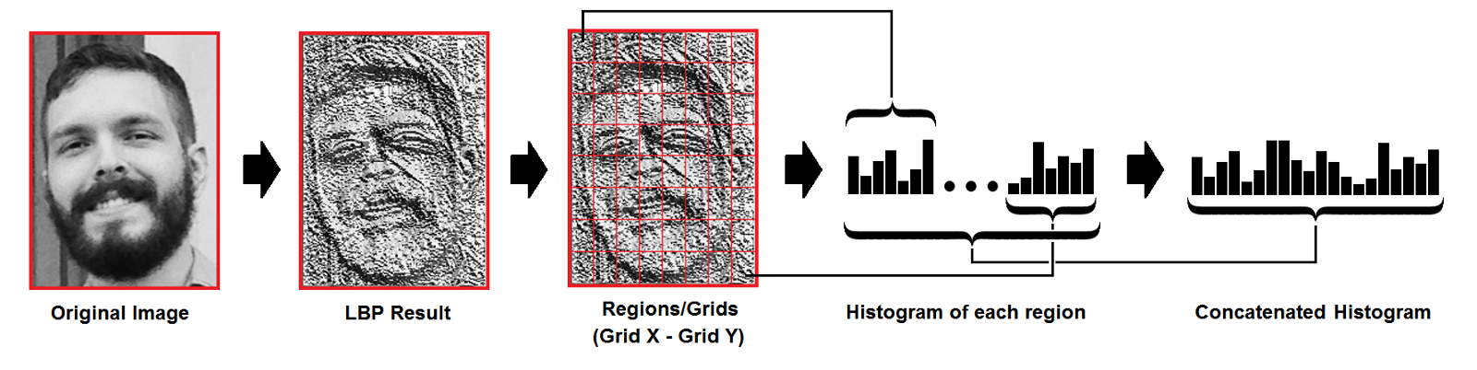
2) Extract the Histograms
Using image generated in the last step, it is divided into multiple regions, then histogram for each region is created and all histograms are concatenated to form new and bigger histogram.
Image Credit - https://towardsdatascience.com/face-recognition-how-lbph-works-90ec258c3d6b

Slide 12

3) Performing Face Recognition
Now model is already trained after performing 2nd step on training dataset.
Now new input image is given and again above two steps are performed on it, and histogram is created.
So to find the image that matches the input image it is just needed to compare two histograms and return the image with the closest histogram.
To do above operation Euclidian distance formula is used :
$$D= \sqrt{\sum_{i}^{n}{{({hist1}_{i}−{hist2}_{i})}^{2}}}$$

Slide 13
Chapter 5 : Conclusion
Implemented a face recognition system which uses Haar cascade classifier for face detection and LBPH algorithm for face recognition in Python.
It detects and identifies faces in an image with good accuracy.
Further accuracy can be improved by checking for different values of parameters or by improving quality of training dataset.

