Slide 1
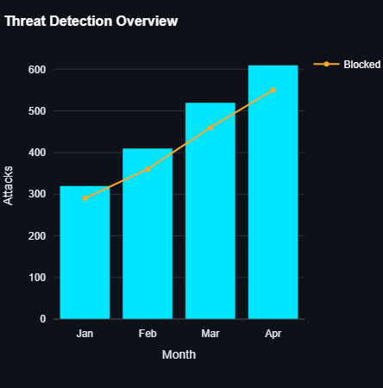
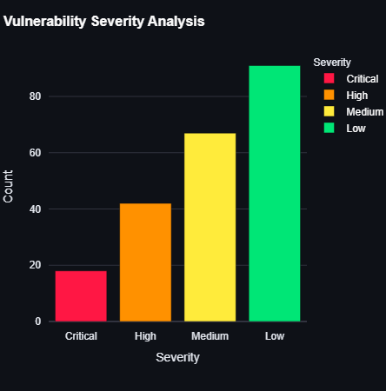
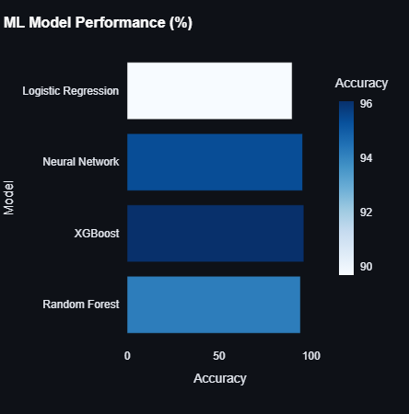
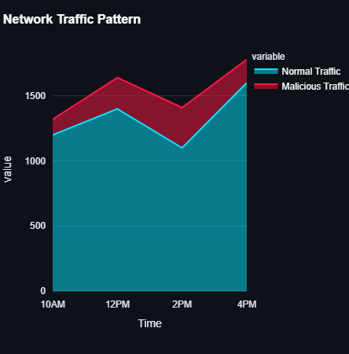
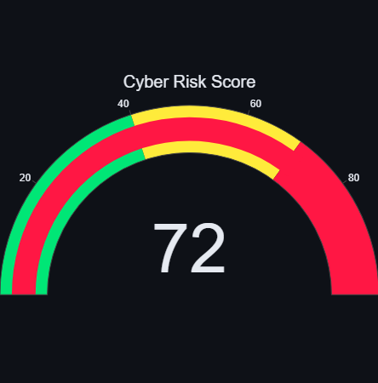
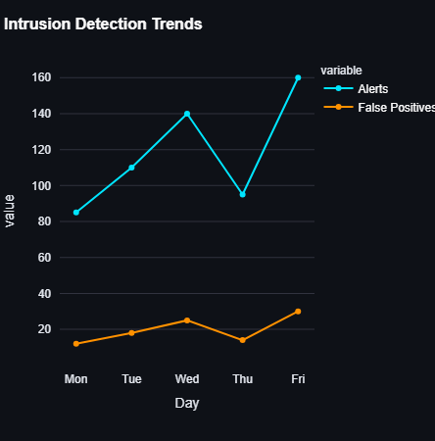
🛡️Cyber Analytics & Ethical Hacking Intelligence Dashboard
Presented by- Satyam Saha

Slide 2
1️⃣ Threat Detection Overview
(Cyber Attack Monitoring)
Work Done:
Analyzed monthly cyber attack data.
Compared total attacks with successfully blocked attacks.
Identified attack growth trends over time.
Purpose / Importance:
Helps security teams understand attack frequency.
Identifies high-risk periods or months.
Supports proactive security planning and defense strategies.
Satyam Saha

Slide 3
2️⃣ Vulnerability Severity Analysis
(Ethical Hacking Findings)
Work Done:
Classified vulnerabilities discovered during ethical hacking.
Grouped vulnerabilities by severity:
  Critical
  High
  Medium
  Low
Purpose / Importance:
Helps prioritize vulnerability remediation.
Ensures critical risks are fixed first.
Useful for security audits and compliance reporting.
Satyam Saha

Slide 4
3️⃣ ML Model Performance (%)
(Data Science & Machine Learning Integration)
Work Done:
Evaluated multiple machine learning models.
Compared models based on accuracy:
  Random Forest
  XGBoost
  Neural Network
  Logistic Regression
Purpose / Importance:
Identifies the most accurate model for cyber threat detection.
Supports predictive security analytics.
Enables data-driven decision making.
Satyam Saha

Slide 5
4️⃣ Network Traffic Pattern
(Normal vs Malicious Traffic Analysis)
Work Done:
Analyzed network traffic at different time intervals.
Compared normal traffic with malicious traffic.
Identified peak attack time windows.
Purpose / Importance:
Detects abnormal network behavior.
Supports firewall and network security tuning.
Helps in real-time threat response.
Satyam Saha

Slide 6
5️⃣ Cyber Risk Score
(Overall Security Health Indicator)
Work Done:
Combined multiple security metrics into a single risk score.
Visualized risk levels using a gauge:
  Low (Green)
  Medium (Yellow)
  High (Red)
Current Risk Score: 72 / 100 (High Risk)
Purpose / Importance:
Provides a quick snapshot of overall cyber security health.
Helps management make fast, informed decisions.
Simplifies risk communication.
Satyam Saha

Slide 7
6️⃣ Intrusion Detection Trends
(IDS – Intrusion Detection System)
Work Done:
Analyzed daily intrusion alerts.
Compared real alerts with false positives.
Studied alert patterns across weekdays.
Purpose / Importance:
Measures IDS effectiveness.
Helps reduce false alarms.
Critical for Security Operations Center (SOC) monitoring.
Satyam Saha

