Slide 1

Recursive PCA for Adaptive Process Monitoring
Course Project CHE-765
Satyam Agnihotri

Slide 2
Introduction
Fixed Model
Adaptive Model
PCA model
training set
SPE, T²
Monitoring set
PCA
model 1
PCA
model 2
Monitoring
set
SPE, T²
SPE, T²

Slide 3
Data Set
Urban municipal wastewater treatment plant, 527 days, one observation per day
Primary Settler
Secondary Settler
Volume
Zinc
pH
BOD
COD
SS
VSS
Sediments
Conductivity
pH
BOD
COD
SS
VSS
Sediments
Conductivity

Slide 4
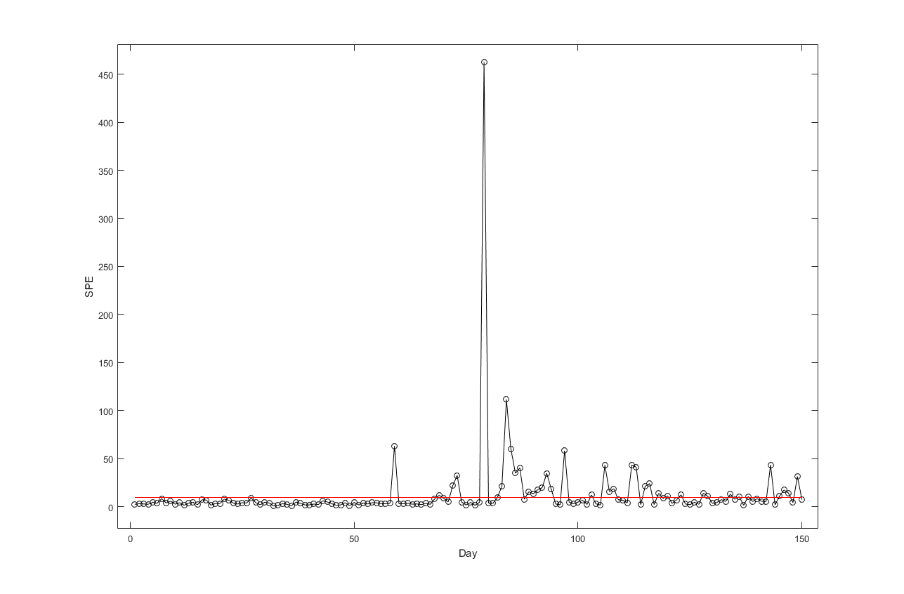
Results
Fixed PCA model (50 days)
Model training
Monitoring
Fixed PCA model
Abnormal Operation

Slide 5
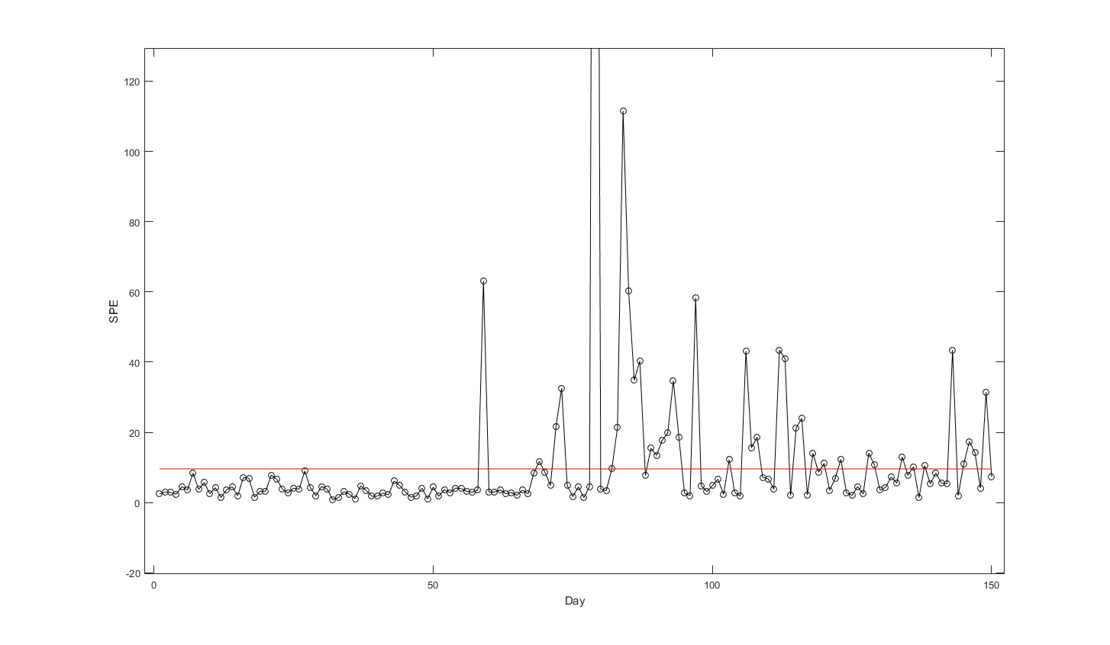
Fixed PCA model (50 days)
Model training
Monitoring
Points above limit: 38

Slide 6
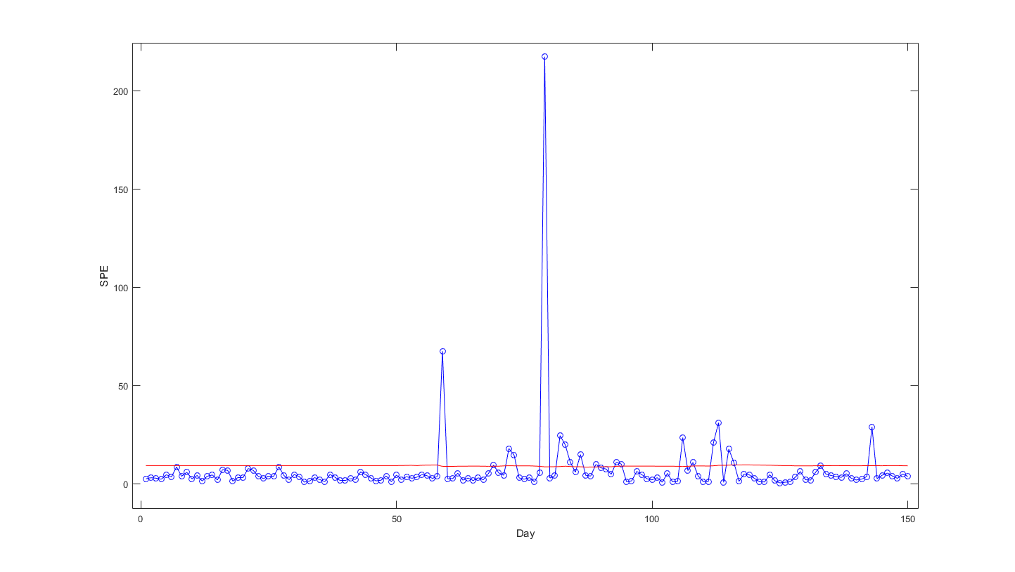
Continued…
Adaptive PCA model (starting at 50 days)
Initial Model training
Adaptive modeling and monitoring

Slide 7
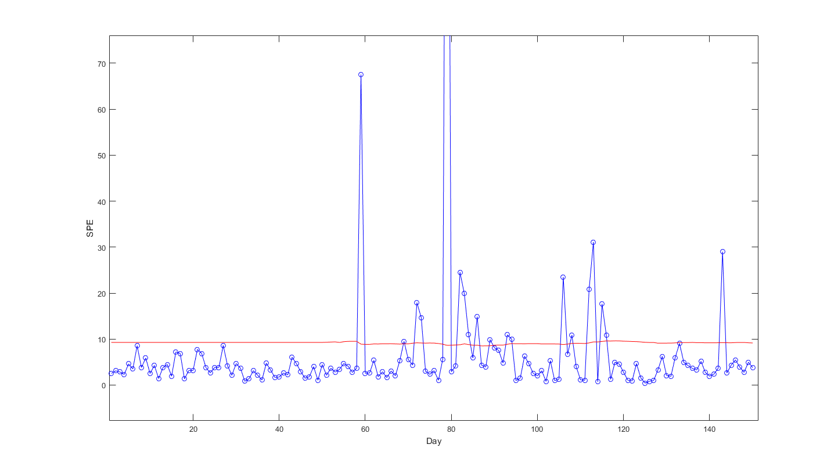
Adaptive PCA model (starting at 50 days)
Initial Model training
Adaptive modeling and monitoring
Points above limit: 19

Slide 8
Advantages
Model | Alarms raised | False alarms (product quality was normal)
Fixed PCA | 38 | 36
Adaptive PCA | 19 | 17
Reduced false alarms
Model is coping up with the seasonal changes
Beneficial for processes with slow drifting

Slide 9
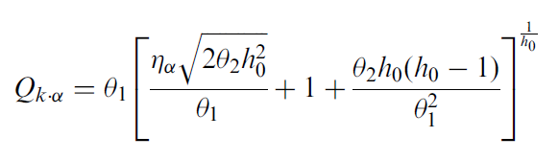




Methods
Recursive PCA
Recursive relations to update mean, standard deviation and correlation matrix were derived and used. [Ref. Weihua Li, Recursive PCA for adaptive process monitoring 2000]
Confidence limit for SPE
The upper limit of SPE was calculated with every iteration using
[Ref. J.E. Jackson, G. Mudholkar, Control procedures for residuals associated with principal component analysis 1979]

Slide 10
Continued…
All calculations were done in matlab
Confidence intervals for T² can also be updated but not covered in this work
All the models were built with 5 principle components only. Online updation of number of principle components in the model can be helpful where correlation between variables change significantly with time. This was not considered in this work

Slide 11
Thank You

