Slide 1
GRIDRESOLVE AI
Evidence-first utility billing resolution
A multi-agent system built and verified on Microsoft Foundry
THE SOLUTION
Nine specialist agents investigate a high-bill dispute, check the evidence and policy, and control what can be released to the customer.
9
14 / 14
1,174
Specialist agents
Hosted acceptance criteria
Local checks passed
105 additional Power Fx cases passed on Microsoft's engine
Three genuine hosted runs. Workflow v10 passed its pre-registered case acceptance. All customer and utility records used in testing are synthetic.
Satyam Pandey | Microsoft Agent-a-thon, Level 3 Architect
Microsoft Agent-a-thon, Level 3 Architect | Synthetic data only | Verified on hosted Foundry. Production path built and tested locally, not yet connected

Slide 2
GRIDRESOLVE AI
A high bill is not one question. It is five.
Evidence-first multi-agent utility billing resolution on Microsoft Foundry
THE PROBLEM
A customer's bill jumps from $152.80 to $203.40. They are certain the meter is broken, and want it confirmed and the charge reversed.
Answering needs billing records, consumption, policy, customer wording and approval authority, reconciled at once.
A single assistant answers all five, then approves its own answer. Under pressure from a confident customer, agreement is the easiest output.
PURPOSE AND AUDIENCE
Who it is for
Utility billing operations: the agents who answer high-bill disputes, and the supervisors who must approve any money.
What it does
Investigates the dispute from the records, explains only what the evidence supports, and hands open questions to a person with a decision card.
What it will not do
Confirm a meter fault without evidence, promise a credit, or let the agent that wrote an answer approve it.
BUSINESS VALUE
Avoided wrong adjustments
An unsupported meter-fault conclusion is money out plus a technician sent for nothing.
Regulatory defensibility
Every released statement traces to evidence and policy IDs. Every path ends in an audit record.
Human attention where it counts
Open cases arrive triaged, with the missing evidence named.
WHERE IT STANDS
I ran it for real on Microsoft Foundry three times. The final run, on workflow v10, passed 14 of 14 acceptance criteria that I wrote down before it ran. The first two runs exposed real defects, and they are in the repository too. Since then I have built the production path around it: typed integration ports, a migration proof on Microsoft Agent Framework, and 1,174 local checks.
Microsoft Agent-a-thon, Level 3 Architect | Synthetic data only | Verified on hosted Foundry. Production path built and tested locally, not yet connected

Slide 3
ARCHITECTURE
Nine specialists, one governed workflow
The agent that writes the answer is never the agent that clears it for release
FOUR INVESTIGATE
CaseTriageAgent
classifies the complaint and the allegations
AccountEvidenceAgent
builds the evidence ledger from the records
UsageAnomalyAgent
separates supported from unsupported explanations
PolicyKnowledgeAgent
maps the governed policies that apply
TWO PRODUCE
ResolutionPlannerAgent
plans against a claim ledger, and says whether a person is still needed
CustomerCommunicationAgent
drafts the six-part plain-language message
THREE CONTROL
EvidenceComplianceAgent
independently approves or refuses the message, with reasons
EscalationCoordinatorAgent
prepares the human review package
CaseAuditAgent
writes the terminal record on every path
HOW THEY COLLABORATE
Sequential, on one shared conversation. Each agent receives an explicit task naming its step. Seven agents run with output withheld, so nothing they write can reach the customer. Every material claim carries the evidence IDs and policy IDs that support it. All nine run gpt-5-mini with no external tools.
Microsoft Agent-a-thon, Level 3 Architect | Synthetic data only | Verified on hosted Foundry. Production path built and tested locally, not yet connected

Slide 4
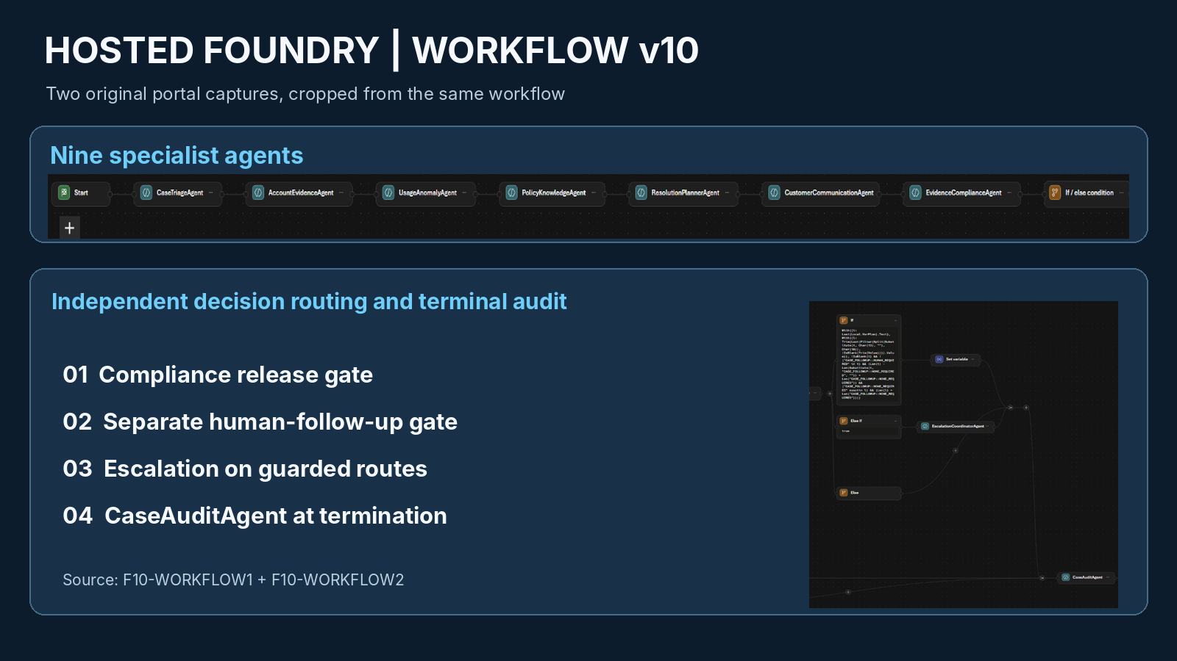
MICROSOFT FOUNDRY
Built as Foundry agents and one Foundry workflow, version 10
Declarative workflow YAML, Power Fx conditions, strict JSON output schemas
HOW IT IS BUILT
Release gate, three terms
An exact approval token on the final line, six readable customer fields, and a complete investigation. Anything else withholds the message and goes to a human.
Strict output schemas
Evidence, policy, communication and audit agents must return a JSON object that matches a schema. Invalid outputs cannot satisfy the downstream release requirements.
Explicit invocation
Every agent node passes a literal task message. This is the fix for the stalls seen in the first two real runs.
Separate follow-up decision
Message approval and the need for a person are two gates, so a safe message never erases an open case.
Verified before it ran
105 cases on Microsoft's real Power Fx engine, the v10 YAML on Microsoft's open-source workflow engine, 94 read-only checks of the live configuration.
Original Foundry portal screenshots, cropped with annotations.
Microsoft Agent-a-thon, Level 3 Architect | Synthetic data only | Verified on hosted Foundry. Production path built and tested locally, not yet connected

Slide 5
GENUINE RUNTIME DEMONSTRATION
Final run on workflow v10: 14 of 14 criteria passed
Criteria were written down before the run. Every figure below is read from the run's evidence folder
Checked
Platform record
SYNTHETIC CUSTOMER-FACING OUTPUT, EXCERPT
The meter register increased from 41,820 kWh on 2026-06-30 to 42,690 kWh on 2026-07-31, a change of 870 kWh. That register change matches the 870 kWh billed for July 2026.
We did not find evidence in the supplied diagnostics or event logs that the meter over-recorded usage.
However, remote diagnostics have limits and do not absolutely rule out intermittent or installation issues.
Three sentences of a 2592 character, six-part message. It promises no credit and offers a human-reviewed inspection.
Agents that did their work
9 of 9
Evidence ledger
22 entries, all matched to the case
Policies mapped
9, none invented
Register vs billed
870 kWh vs 870 kWh
Meter failure asserted
no
Credit promised
no
Compliance
APPROVE, with recorded reasons
Route
message released; review package ready
HUMAN-REVIEW PACKAGE PREPARED SEPARATELY
For Billing Supervisor role, status PENDING_HUMAN_REVIEW. Proposed decision: whether to perform an on-site inspection and/or authorize a financial adjustment. No actual employee was notified.
Audit vs platform
0 findings
Tokens, cost
94,352 in, 22,433 out, about $0.07
Compliance approved this message. It did not reject it, and the final run did not take the fail-closed route. That route was demonstrated in run 2.
Source: evidence/runtime/20260921T000142Z_SYN-CASE-4003_c2be2b51 | docs/FINAL_RUN_RESULT_2026-09-20.md

Slide 6
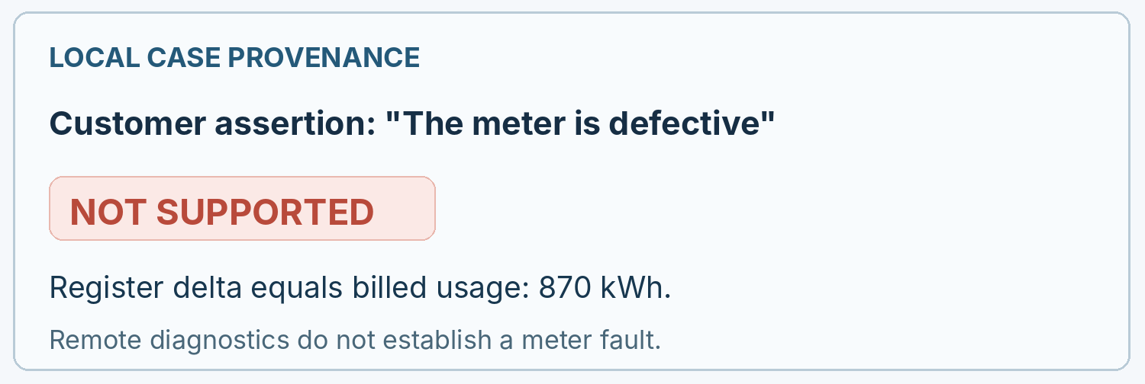
GOVERNANCE AND COMPLIANCE
Release is the exception, and it has to be earned
Independent review, human authority over money, and an audit that is checked against the platform
CONTROLS
Independent compliance
A different agent, twenty checks, four decisions, no tools. It must give reasons. A bare verdict now withholds the message.
Two separate questions
Is this message safe to send, and does this case still need a person. In the final run the answers were yes and yes.
Human authority
No agent can authorize a credit or adjustment. The final run prepared a Billing Supervisor review package with a decision card: 4 known facts, 4 unknowns, policies, risk, next step.
The audit is not trusted
The runner compares the audit record with the platform's own record of who ran, which branch was taken and what was delivered.
COMPLIANCE REASONS, FINAL RUN, VERBATIM EXCERPT
All required checks passed: the customer message correctly cites evidence IDs showing meter register delta (EVID-READ-0003-A-REG, EVID-READ-0003-B-REG) equals billed kWh (EVID-BILL-0003-07-KWH) and references remote diagnostics (EVID-DIAG-0003-01-RESULT, EVID-DIAG-0003-01-TAMPER, EVID-DIAG-0003-01-FAULT) showing PASS/no tamper/ no register fault.
Decision APPROVE, failed checks 0, token on the final line.
Readable summary of local case provenance. Not a Foundry capture.
Microsoft Agent-a-thon, Level 3 Architect | Synthetic data only | Verified on hosted Foundry. Production path built and tested locally, not yet connected

Slide 7
RESULTS AND LESSONS
Three real runs, and what each one taught
All three evidence folders are in the repository, unedited
Run 1, workflow v6
Run 2, workflow v9
Final run, workflow v10
Agents that did their work
7 of 8
6 of 9
9 of 9
Evidence ledger
none
none
22 entries
Compliance
approved
escalated, gave no reasons
approved, with reasons
Synthetic message output
an unevaluated expression
nothing, failed safe
a readable message
Human follow-up
not built
escalation package
handoff after the release
Audit findings
7
6
0
Cost, provisional
$0.0334
$0.0292
$0.0685
KEY LESSONS LEARNED
1. Local tests did not catch what one real run caught. Run the real thing early, once, with evidence capture. 2. When a fix changes the wording of a failure but not the failure, the cause is elsewhere. The platform's record of what each agent received showed it: no new request on a shared conversation. 3. Fix acceptance criteria before the run, and report a branch not taken as not observable, never as a pass. 4. A model's own audit of a run is a claim, not a record. Check it against the platform.
Why run 2 escalated is not established, and this project does not claim to know. | docs/CURRENT_STATUS.md

Slide 8
THE PATH TO PRODUCTION
What is built and tested, and what still needs a real utility
The hosted workflow is verified. The production path around it is built and tested locally
BUILT AND TESTED LOCALLY
Eight typed integration ports
Account, billing, meter and diagnostic evidence are read only and scoped to one case. CRM, review assignment, adjustment authorization and an append-only audit store. Synthetic adapters, 138 checks.
Money stays with a person
Only a human billing supervisor can authorize an adjustment. An agent principal is refused, a forged role is refused, and a supervisor cannot approve their own request. Tested.
Migration proof, 11 of 11
Foundry workflows retire on 2026-12-01. I replayed the final run's nine real agent outputs through Microsoft Agent Framework on the same YAML. Same agents, same branch, the same 2,592 characters released.
Policy catalog with provenance
Ten governed policies as versioned records. In the final run all 8 provenance links resolve, from the customer's words to the audit record.
OPERATIONS, AND WHAT REMAINS
Foundry tracing, read back
61 platform spans across the three runs, none failed, no content filter block. Azure Monitor agrees with my token counts to the token.
What the traces taught me
Foundry marked every span successful, including the runs where agents stalled. Production alerts have to watch what an agent returned, not the status code.
Guardrails as configured
Microsoft.DefaultV2 is on the deployment and evaluated all 26 model calls. No custom policy exists, and I do not claim one.
Still to do with a utility
Connect the ports to real systems, close public network access and key authentication, pin the model version, decide content recording, add alerts and a budget, then pilot with billing supervisors.
NOT YET SHOWN: repeatability, a second case, the fail-closed route on v10, the 30 evaluation cases and 16 adversarial scenarios, a correction loop, a real person being notified.
Microsoft Agent-a-thon, Level 3 Architect | Synthetic data only | Verified on hosted Foundry. Production path built and tested locally, not yet connected

Slide 9
CHECK IT YOURSELF
Every number here has a file behind it
Runtime numbers come from evidence files. Local numbers come from one command each
WHAT WAS VERIFIED
Three real Foundry runs
evidence/runtime/, three folders, unmodified. Re-read any of them offline: python -m runner analyze --run-dir <folder>
1,174 local checks, no model call
83 routing, 151 synthetic, 156 application, 357 runner, 91 engine, 198 evaluation, 138 integration
105 cases on the real Power Fx engine
dotnet run --project tests/powerfx_gate
94 read-only live configuration checks
python tests/verify_live_config.py, with your own Foundry resource
12 of 13 deterministic checks on the final run
python -m evaluation.run_checks. The one it fails is a root cause label that differs from the one I prepared in advance. I have left it as a failure.
Agent Framework parity, 11 of 11
python migration/agent_framework/parity_check.py
COST, STATED CAREFULLY
About $0.13 provisional, three runs
186,614 tokens in and 42,155 out, at list price, from the usage Foundry returned.
Billed amount: not yet visible
Azure Cost Management returned no rows when queried. That is not a confirmed $0.00 and not a confirmed $0.13.
Microsoft's own meter agrees
Azure Monitor metrics and the platform's 61 trace spans report the same token counts, to the token, and 26 model requests. Read back, read only: evidence/platform_telemetry/
Nothing else was created
No embeddings, no evaluation runs, no new resources.
Read first
submission/final/JUDGE_NARRATIVE.md and docs/CURRENT_STATUS.md
Repository https://github.com/satyamamarpandey/GridResolve-AI-MS-Agentathon
Microsoft Agent-a-thon, Level 3 Architect | Synthetic data only | Verified on hosted Foundry. Production path built and tested locally, not yet connected

Slide 10
GRIDRESOLVE AI | FINAL RESULTS
Evidence before explanation.
Independent review before release. Human authority over consequential decisions.
WHAT I VERIFIED
14 / 14
1,174
105
11 / 11
Hosted acceptance
Local checks
Power Fx cases
Migration parity
Built for verifiable decisions, not automated agreement.
Nine hosted agents, an independently enforced release gate, and a separate Billing Supervisor review package.
Thank you.
github.com/satyamamarpandey/GridResolve-AI-MS-Agentathon
Microsoft Agent-a-thon, Level 3 Architect | Synthetic data only | Verified on hosted Foundry. Production path built and tested locally, not yet connected

