Slide 1
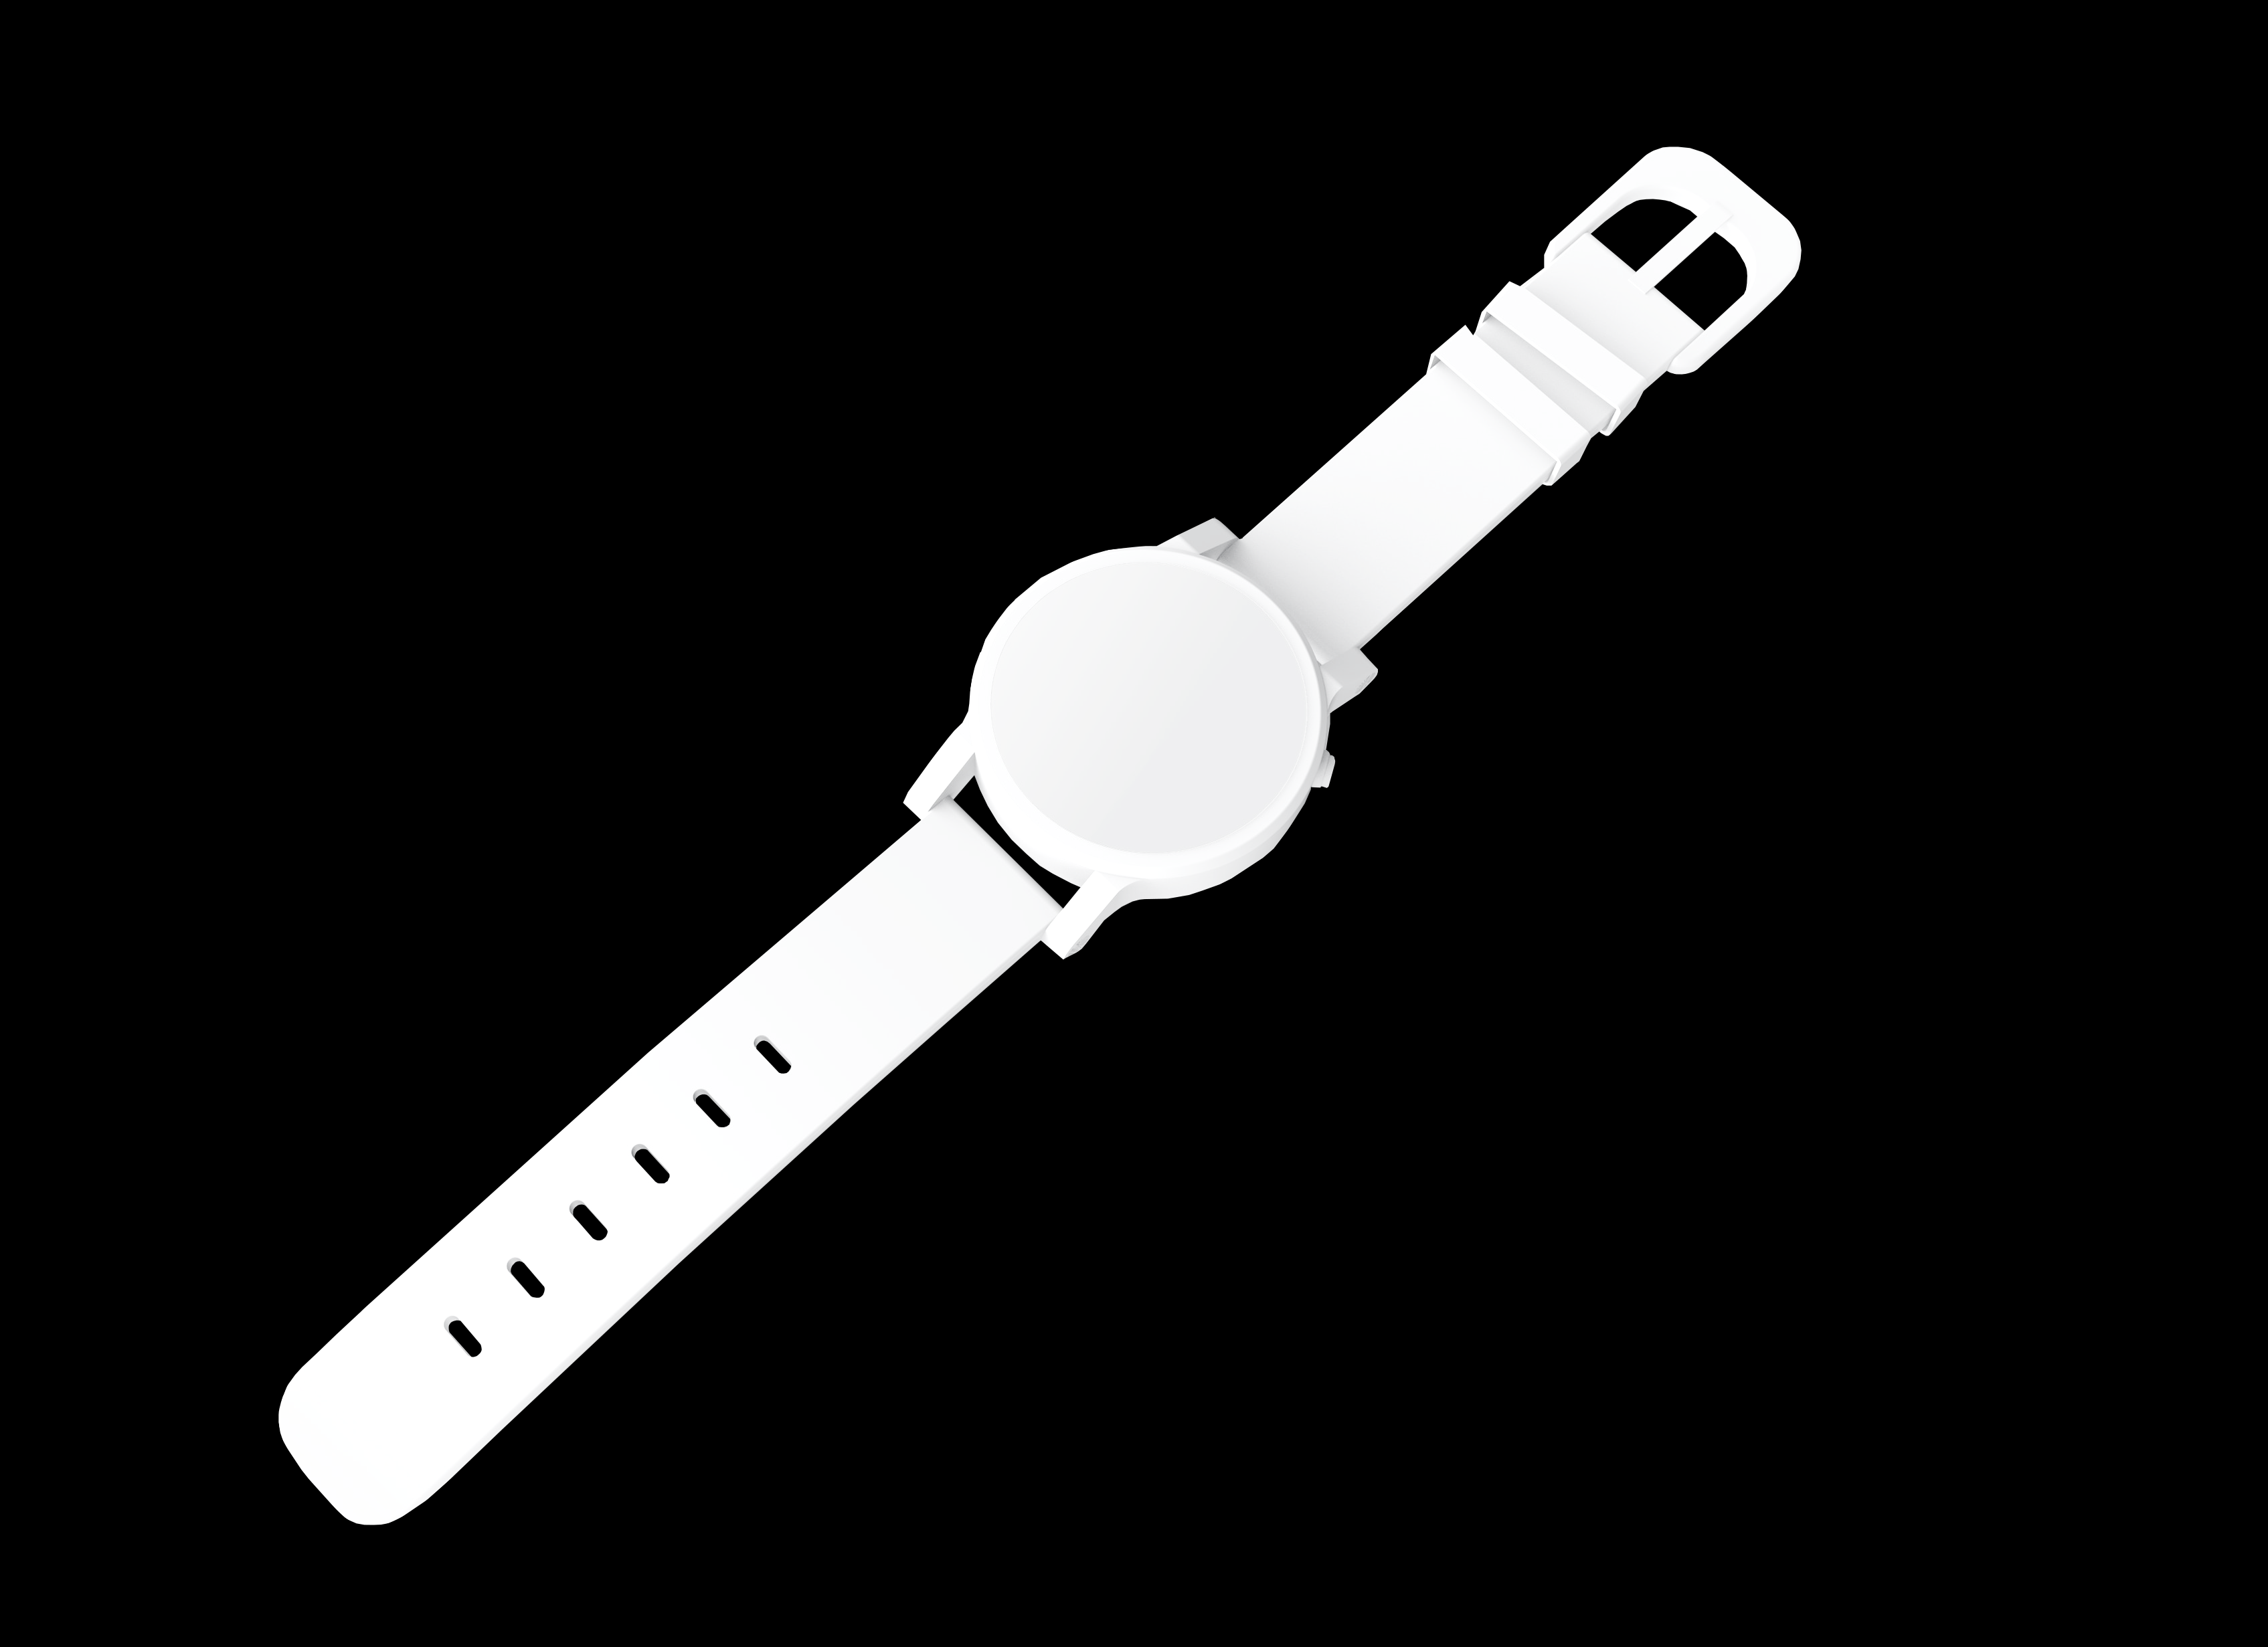
MINAPOLIS
On-Chain City Development Arcade game built on MINA blockchain
SATYAM BANASL • MAY 01, 2024

Slide 2
WHAT IS MINAPOLIS ?
MINAPOLIS is a city development game where arcade game where player builds city from Road, Windmill, and Tree hexagonal tiles.

Slide 3


Slide 4
PROBLEM
WHY MINAPOLIS ?
With O1JS, its possible to generate zk proofs in users device and this opens-up whole lot of possibilities for on-chain games where player play the games in their device without worrying about transaction cost.

Slide 5

Thank you
SATYAMBNSAL@GMAIL.COM

Slide 6



