Slide 1
DBT Development
using
Cortex Code

Slide 2
Agenda
Overview
Cortex Code Features
Cortex Code Workflow
Cortex Code Templates
Demo

Slide 3
Cortex Code Overview
Snowflake Cortex Code (often called CoCo) , a built in AI-powered development assistant that turns natural language into production-ready SQL and data pipelines instantly
Wide Range of LLM Support - Cortex Code gives teams access to leading frontier models from Anthropic (Claude), OpenAI (GPT), Meta (Llama), Mistral, and Snowflake Arctic — all running within the Snowflake perimeter, allowing flexibility and cost optimization
Model-Level RBAC - Administrators can grant or revoke access to specific LLMs via role-based controls, ensuring compliance with governance policies

Slide 4
Cortex Code Features
Snowflake Cortex Code can helps us
Generate SQL queries from natural language descriptions
Explain, refactor, and modernize legacy stored procedures
Auto-generate full dbt project including SQL models, configurations, tests, and documentation
Build and deploy Snowflake Cortex agents using natural language commands
Write Python scripts and Snowpark code for data transformations
Generate Apache Airflow DAG definitions for pipeline orchestration

Slide 5
Cortex Code Features - DBT
Auto-generates full dbt project structure including SQL models, schema YML files, configurations, tests, and documentation
Builds all transformation layers like staging, intermediate, and mart and publish models following dbt and Snowflake best practices
Creates built-in dbt tests for not null, unique, accepted values, and relationships out of the box
Reads your actual Snowflake environment including table structures, data types, and foreign key relationships before generating models
Handles full dbt workflow including model dependencies, ref() references, sources configuration, and documentation strings

Slide 6
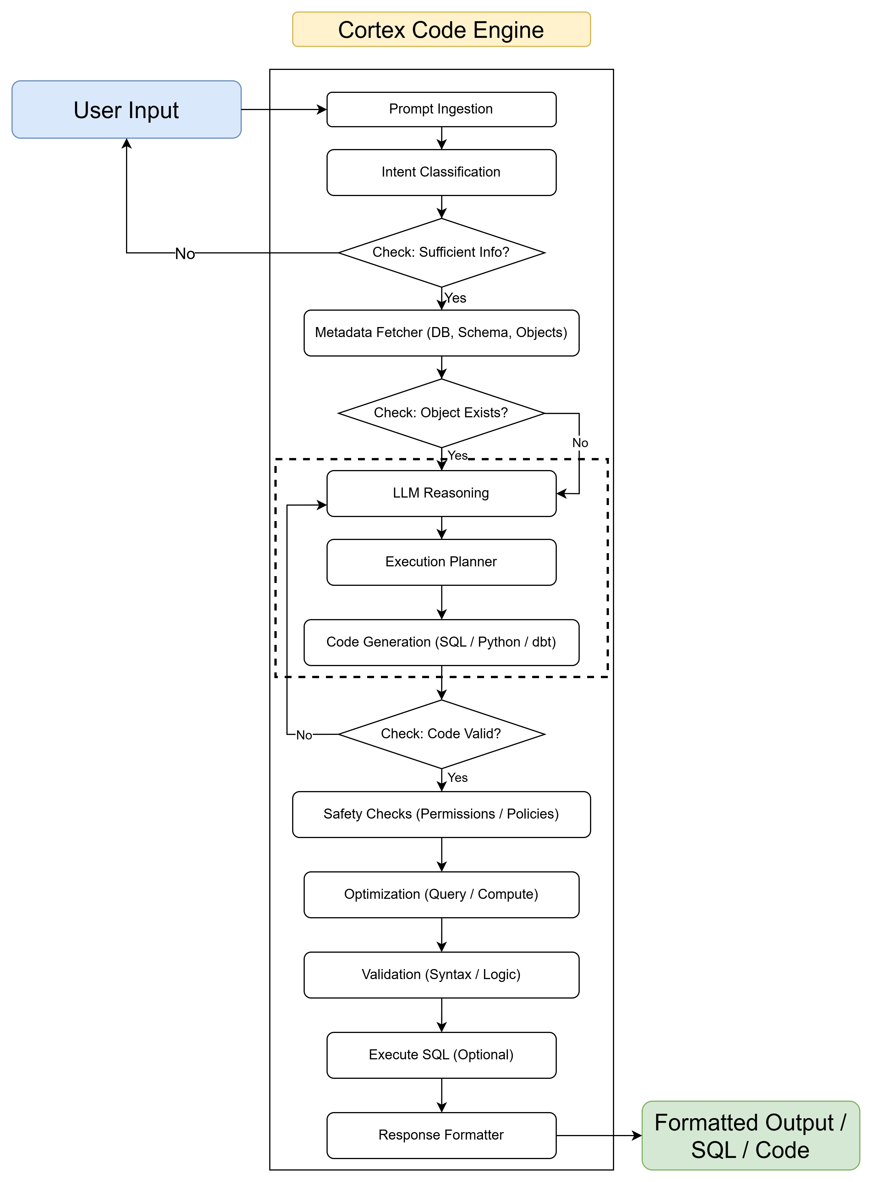
Cortex Code Workflow
“Create a staging model for customer table”
“The system receives and reads the user's request”
“The AI identifies that the user wants to create a dbt staging model.”
“The system checks if required details like database, schema, and table name are provided.”
Ask the user: “Which database and schema contain the customer table?”
“The system retrieves metadata such as columns and data types of the customer table from Snowflake.”
“The system verifies whether the customer table exists in the specified schema.”
Inform user: “Customer table not found. Please verify the table name or schema.”
“The AI decides how the staging model should be created following dbt project standards”
AI-Powered Code Generation Layer
“The system plans steps like creating source YAML, staging SQL, and model documentation”
“The AI generates the dbt staging SQL model and YAML definition files”
“AI fixes the code and regenerates it”
“The system checks whether the generated code follows dbt syntax and project rules”
“The system ensures the generated code does not violate security or access policies”
“The query is optimized for better performance and efficient warehouse usage”
“Final validation ensures the SQL is correct and logically consistent”
“The system can optionally run the query to test if it works successfully”
“The system formats the output and presents the ready-to-use dbt model code”
“The user receives dbt SQL model + YAML definition files ready to commit to the repository”

Slide 7
Cortex Code Templates
Source Model :
@(skill:dbt-router)
Create dbt source model:
Database: CORTEX_ANALYST_DEMO
Schema: INSURANCE_RAW
Table Name: CLAIMS

Slide 8
Cortex Code Templates
Stage Model :
@(skill:dbt-router)
Create staging model:
Database: CORTEX_ANALYST_DEMO
Schema: INSURANCE_RAW
Table Name: CLAIMS
Primary Key: Check the contraints

Slide 9
Cortex Code Templates
Intermediate Model:
@(skill:dbt-router)
Create intermediate model.
Pipeline Sub folder: insurance_pipeline
Input tables:
stg__insurance_raw__claims
stg__insurance_raw__policies
Transformations:
Joins: Join claims to policies on policy_id
filters: Only include claims with claim_status IN ('APPROVED', 'SETTLED’)
Aggregations: None
computed columns: net_payout_amount = approved_amount - deductible_applied, days_to_settle = datediff(day, report_date, settlement_date)

Slide 10
Cortex Code Templates
Dimensional Model:
@(skill:dbt-router)
Create marts.
Pipeline Sub folder: policy
Input tables:
stg__genius__policy
Grain: policy_id
Columns:
policy_id
policy_number
policy_type
policy_status
effective_date
expiration_date
premium_amount
customer_id
Materialization: table

Slide 11
Cortex Code Templates
Fact Model:
@(skill:dbt-router)
Create marts.
Pipeline Sub folder: policy
Input tables:
stg__genius__policy_transactions
Grain: policy_id
Measures:
billing_amount_usd
gl_amount_usd
payment_amount_usd
total_discrepancy_usd
Dimensions:
product_line
region
reconciliation_status
Materialization: incremental

Slide 12
Cortex Code Templates
Publish Model:
@(skill:dbt-router)
Create a publish model.
Pipeline Folder: insurance_pipeline
Publish Folder Name: reporting
Model Name: policy__claims
Input Mart Models:
fct__claims_summary
dim__customer
dim__policy
Columns Required:
claim_id
customer_name
policy_number
claim_status
claim_amount
net_payout_amount
days_to_settle
region
Filters: claim_status IN ('APPROVED', 'SETTLED')
Business Description: Dataset used by BI dashboards to track approved and settled insurance claims with customer and policy context.
Materialization: view

Slide 13
Appendix

Slide 14
Templates Checklist
Consideration | Source | Staging | Intermediate | Mart | Publish
Naming conventions | ✔ | ✔ | ✔ | ✔ | ✔
Source objects definition | ✔ | ✔ | ✖ | ✖ | ✖
Target model definition | ✖ | ✔ | ✔ | ✔ | ✔
Src/tgt schema awareness | ✔ | ✔ | ✔ | ✔ | ✔
dbt project structure | ✔ | ✔ | ✔ | ✔ | ✔
Model layer selection | ✖ | ✔ | ✔ | ✔ | ✔
Transformation logic | ✖ | ✔ | ✔ | ✔ | ✖
Join logic | ✖ | ✖ | ✔ | ✔ | ✖
Aggregations | ✖ | ✖ | ✔ | ✔ | ✖
Incremental loading logic | ✖ | ✖ | ✖ | ✔ | ✖
Surrogate key generation | ✖ | ✖ | ✖ | ✔ | ✖
Audit columns | ✖ | ✖ | ✖ | ✔ | ✖
Testing rules integration | ✔ | ✔ | ✔ | ✔ | ✔
YAML doc generation | ✔ | ✔ | ✔ | ✔ | ✔
SQL pattern usage | ✖ | ✔ | ✔ | ✔ | ✔
CTE modeling pattern | ✖ | ✔ | ✔ | ✔ | ✔
Modular model generation | ✖ | ✖ | ✔ | ✔ | ✖
dbt ref() relationships | ✖ | ✔ | ✔ | ✔ | ✔
Source() usage | ✔ | ✔ | ✖ | ✖ | ✖
Data test generation | ✔ | ✔ | ✔ | ✔ | ✔
Pipeline dependency | ✖ | ✖ | ✔ | ✔ | ✔
E2E pipeline generation | ✖ | ✖ | ✖ | ✖ | ✖
Synthetic data creation | ✖ | ✖ | ✖ | ✖ | ✖

Slide 15
Performance Stats
 |  | Development |  | Validation
Model Type | Complexity | Manual Time (min) | CoCo Time (min) | Manual Time (min) | CoCo Time (min)
Source | Simple | 5 | 1 | 5 | 1
Staging | Simple | 15 | 2 | 10 | 2
Intermediate | Simple | 30 | 5 | 15 | 3
Intermediate | Moderate | 60 | 10 | 20 | 5
Intermediate | Complex | 180 | 30 | 45 | 10
Mart (Dimension) | Moderate | 90 | 15 | 30 | 8
Mart (Fact) | Complex | 180 | 30 | 45 | 10
Publish | Simple | 20 | 3 | 10 | 3
Full Pipeline (5–6 models) | Complex | 360 | 45 | 90 | 20
Test & YAML Docs | Moderate | 40 | 5 | 15 | 3

Slide 16
How can this help AA team in development?
Faster Development of models
Standardized Data Models for Analytics
Faster Turnaround for Dashboard Data Requests
Applying DRY(Do not repeat yourself) principle is easier
Natural Language Data Discovery
End-to-End DBT pipeline automation

