Slide 1

Marathwada Mitra Mandal's College of Engineering, Pune
Automatic Irrigation System Using Arduino
Name of Student
Dalal Satyam Suhas
Under the guidance of
Ms. S. N. Shekapure
Roll No: TE259
Date: 22/04/2020

Slide 2
Index
Introduction
Objective
Related Works
Proposed System(System Architecture)
Proposed System(Implementation/Working Principle)
Design with UML Diagram(Deployment Diagram)
Demo(Circuit Diagram/Schematic Diagram)
Results(Feasibility)
Applications(usability)
Conclusion
Future work
References

Slide 3
Introduction
Irrigation of plants is usually a very time consuming activity to be done in a reasonable amount of time, it requires a large amount of human resources. Traditionally, all the steps were executed by humans. Nowadays, some systems use technology to reduce the number of workers or the time required to water the plants. With such systems the control is very limited, and many resources are still wasted. Water is one of those resources that are used excessively. Technology is probably a solution to reduce costs and prevent loss of resources.
1. To develop an Auto Irrigation system to water the plants according to the nature of soil like dry or wet.
2. If the value of Sensor( DOUT)= 0,then nature of soil will be dry.

Slide 4
Objective
In today’s world due to irrigation there might be some possible wastages.It may be water wastages, wastages of crops and so on…
In order to solve this issue we introduce an automatic irrigation system.
By using this system it will possibly reduce such wastages. So that better utilization of resources can be made possible.
It shows the basic switching mechanism of motor using sensors by sensing moisture present in the soil.

Slide 5
Related works
Report: https://drive.google.com/drive/folders/1QnlHxIIWUCbkrsETzSszdWMaJZnkWieF
Source Code: https://drive.google.com/drive/folders/1xWcB1Wlumhr3qjx62d1OnE8PzJ6crVrc
PPT:https://drive.google.com/drive/folders/1QnlHxIIWUCbkrsETzSszdWMaJZnkWieF
IEEE Papers: https://drive.google.com/drive/folders/1QnlHxIIWUCbkrsETzSszdWMaJZnkWieF

Slide 6
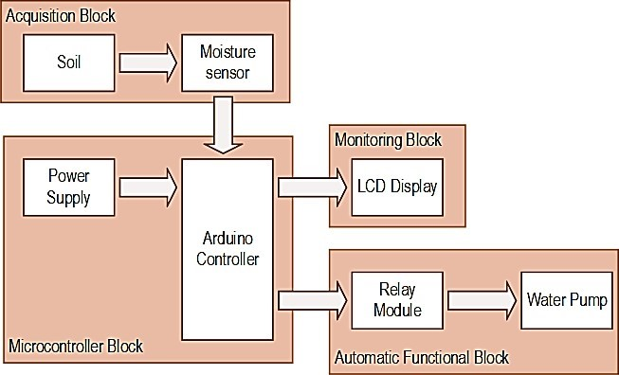
Proposed System(System Architecture)
The given block diagram shows that how an Automatic Irrigation System works. The moisture of the soil detect by moisture sensor is controlled by Arduino Controller and according to that it will pump the motor on and oﬀ.

Slide 7


Soil Moisture Sensors Equation
A soil moisture sensor is a device that measures the volumetric water content (VWC) of soil. Mathematically VWC, is given as follows:
Where:
Vw is the water volume and VT is the total volume (soil volume + water volume).
Soil moisture sensors are classiﬁed according to how they measure the soil moisture content. Two methods are used in determining the volumetric water content (VWC); direct and indirect. The direct method entails drying a known volume of soil in an oven and weighing it. The direct method of measuring VWC is done using the following mathematical notation:
Where:
a. Mwet is soil sample before drying in the oven
b. Mdry is soil sample after drying in the oven
c. w is water density
d. Vb is the volume of soil sample before

Slide 8
Proposed System(Implementation/Working Principle)
An automatic plant watering system using Arduino microcontroller ATmega328P is programmed such that gives the switching signal on/oﬀ to the motor via relay. Soil sensor is connected to the Arduino board which senses the moisture content present in the soil. Whenever there is change in the moisture content of the soil, the sensor senses the change, giving signal to the microcontroller so that the pump/motor can be used for automatic irrigation system. First we give supply to Arduino than from Arduino board (no.8) digital pin to soil moisture sensor and for relay (no.13) pin and both terminal of pump will be connected to relay for switching purpose. for pump we put 12v battery when there is 0 at that time soil will not have moisture than relay will switch on and pump will start and when set limit of the temperature comes automatically pump will stop and when there is 1 at that time soil will have moisture than relay will not switch on the pump when moisture will low than dc motor pump will suction water from the bucket and give too plants

Slide 9
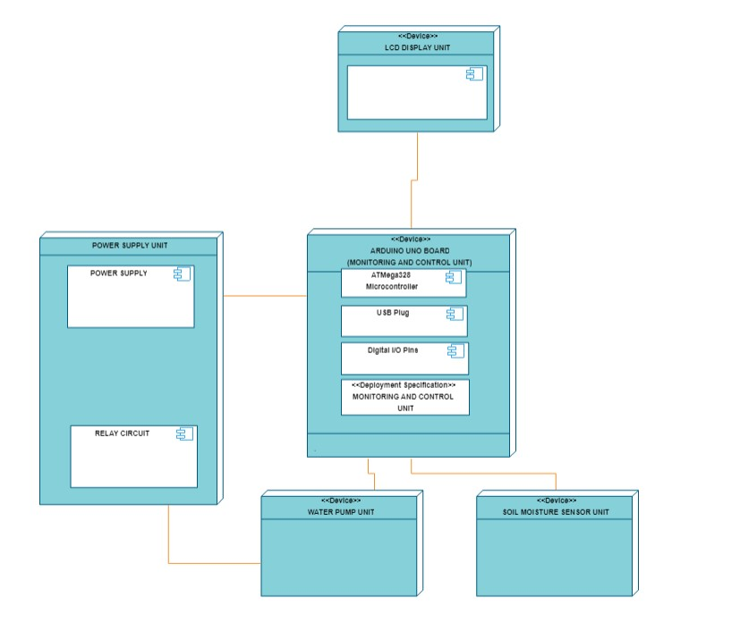
Design with UML Diagram
(Deployment Diagram)

Slide 10
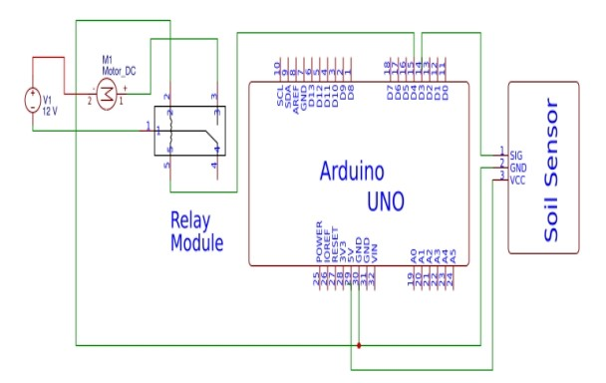
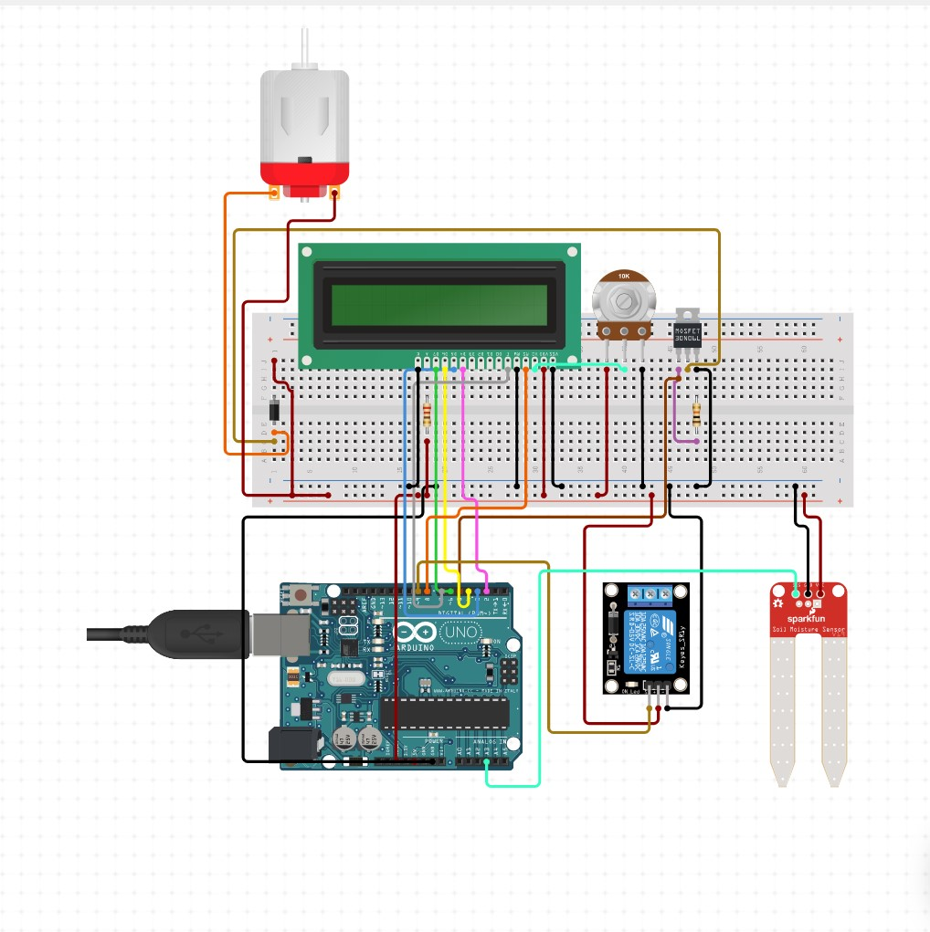
Demo
(Circuit Diagram/Schematic Diagram)
Circuit Diagram
Schematic Diagram
Notes:
Circuit Diagram

Slide 11
Results(Feasibility)
This miniature model of automatic plant irrigation is to be tested in two different soils. One soil is wet and the other is dry. Only in the dry condition the pump will start working, since the requirement of water is more for that soil for the proper growth of the crops and in wet soil the pump won’t work since the soil does not need any water due to the presence of water in it hence this project will conserve water during irrigation.
From this project, we can control the moisture content of the soil of cultivated land. According to soil moisture, water pumping motor turned on or off via the relay automatically. This saves water, while the water level can be obtained in a preferred aspect of the plant, thereby increasing productivity of crops.

Slide 12
Applications(usability)
• It can be used in agricultural ﬁelds, lawns and as drip irrigation system.
• It can be used to provide water in nursery planting arena.
• It can be used for wide range of crops as one can customize reference required for diﬀerent kind of crops.
• Pond water management and water transfer.

Slide 13
Conclusion
• This project has a high social impact. As it is already dealt, the system is non existing, and still majority of the farmers use the traditional human intervention based irrigation, due to which there is huge loss in cultivation
• Hence, this project serves as a motivation for farmers who are declining in number day by day due to lack of technology and sophistication.
• This system provides several beneﬁts and can be operated with less manpower.
• Over-watering and under-watering aﬀects the crop so proper amount of water should be supplied. By analyzing the soil parameters system waters the farm. So by this wastage of water reduced.
• It reduces the human resources. This irrigation system was found to be feasible and cost eﬀective for optimizing water resources for agricultural production.
• The irrigation system can be adjusted to a variety of speciﬁc crop needs and requires minimum maintenance

Slide 14
Future work
  The micro irrigation system implemented was found to be feasible and cost effective for optimizing water resource for agricultural production. This irrigation system allows cultivation in places with water scarcity thereby improving sustainability. The micro irrigation system developed proves that the use of water can be diminished for a given amount of fresh biomass production. The use of solar power in this irrigation system is pertinent and significantly important for organic crops and other agricultural products that are geographically isolated, where the investment in electric power supply would be expensive. The irrigation system can be adjusted to a variety of specific crop needs and requires minimum maintenance.

Slide 15
The modular configuration of the micro irrigation system allows it to be scaled up for larger greenhouses or open fields. In addition, other applications such as temperature monitoring in compost production can be easily implemented. The Internet controlled duplex communication system provides a powerful decision making device concept for adaptation to several cultivation scenarios. Furthermore, the Internet link allows the supervision through mobile telecommunication devices, such as a smart phone. Besides the monetary savings in water use, the importance of the preservation of this natural resource justify the use of this kind of irrigation systems. Due to the soil’s natural variability, location and number of soil water sensors may be crucial and future work should include specific calibration. Power supply can be replaced with the solar panels. We can add extra sensors like gas sensor, voltage sensor.

Slide 16
References
[1] C. M. Devika, K. Bose, and S. Vijayalekshmy. Automatic plant irrigation system using arduino. In 2017 IEEE International Conference on Circuits and Systems (ICCS), pages 384–387, Dec 2017.
[2] D. Divani, P. Patil, and S. K. Punjabi. Automated plant watering system. In 2016 International Conference on Computation of Power, Energy Information and Commuincation (ICCPEIC), pages 180–182, April 2016.
[3] Birasalapati Doraswamy. Automatic irrigation system using arduino controller. Int. J. Adv. Technol. Innovative Res, 8(4):635–642, 2016.
[4] K. Taneja and S. Bhatia. Automatic irrigation system using arduino uno. In 2017 International Conference on Intelligent Computing and Control Systems (ICICCS), pages 132–135, June 2017.

