Slide 1
Retail Insights Assistant
GenAI-Powered Multi-Agent System for Large-Scale Retail Analytics
Architecture & Implementation Overview

Slide 2
Problem Statement & Overview
Problem
Our Solution
Large retail organizations struggle with:
• Analyzing massive datasets across multiple tables
• Complex SQL query generation from natural language
• Ensuring query accuracy and data validation
• Providing contextual insights from unstructured data
Multi-agent AI system that:
• Orchestrates specialized agents via LangGraph
• Uses vector search for intelligent table selection
• Self-corrects queries through validation loops
• Generates accurate SQL with natural language interface
• Provides contextual summaries of complex queries

Slide 3
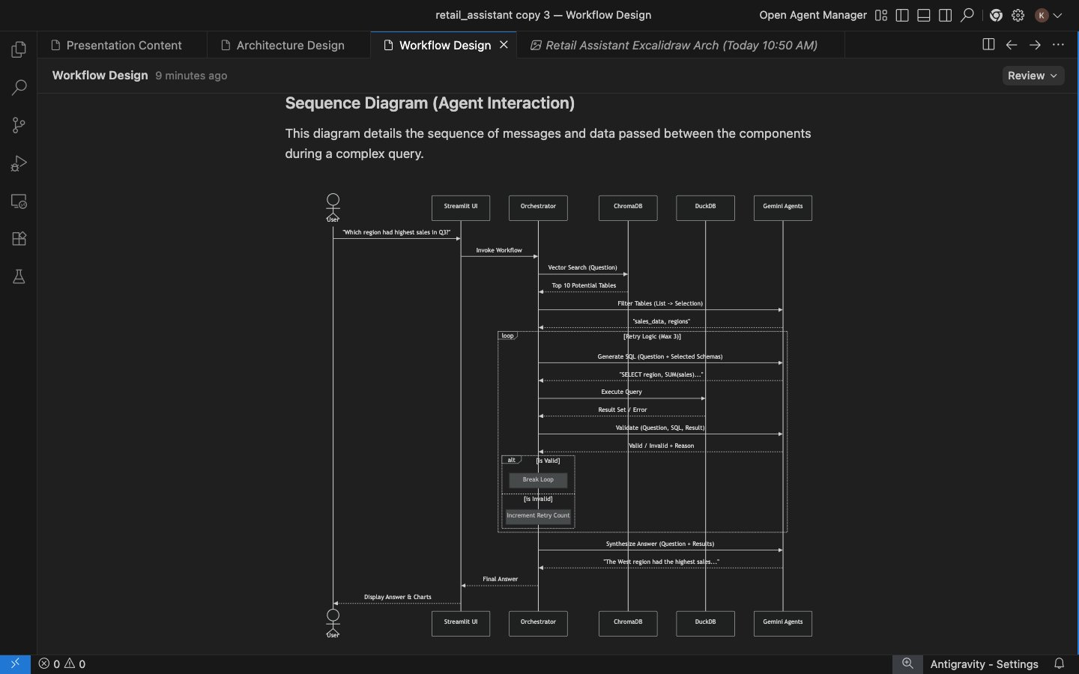
Agentic Workflow Design

Slide 4
Technical Architecture
AI Environment
Data Sources
Ingestion Layer
Data Storage
🔄
Interfaces
Validation Agent
🖥️
⚙️
🦆
LangGraph Orchestrator
Ingestion
Streamlit
DuckDB
📊
💬
👤
📄
🔍
Summarizer
Response
🔮
Query Agent
User
CSV
Profiling
📝
ChromaDB
🤖
📱
Metadata
API
Google Gemini
Supporting Services
🔐
⚡
📚
📝
🛡️
Session
SQL Service
Catalog
Logging
Security
Data Flow
Primary
Response

Slide 5
Implementation Stack
Core Technologies
Service Layer
• LLM: Google Gemini (gemini-3-flash)
• Agentic Framework: LangGraph
• Vector DB: ChromaDB
• SQL Engine: DuckDB
• UI Framework: Streamlit
• Session Management: In-memory
• Self-correcting Query Agent
• CatalogService: Vector search
• SQLService: Query execution
• IngestionService: CSV processing
• SessionService: Temp data cleanup
• Workflow Nodes:
- Summarization
- Table Retrieval
- Query Processing
Key Features: ✓ State-based workflow ✓ Vector similarity search ✓ SQL self-correction (3 retries) ✓ Metadata extraction & indexing

Slide 6
LangGraph Workflow & Query Pipeline
Path 1: Summarization
Path 2: Query Processing
1. User uploads CSV
1. User asks question
2. Clicks 'Summarize'
2. Workflow routes to retrieve_tables_node
3. Workflow routes to summarize_node
3. ChromaDB semantic search (Top-K=3)
4. Query_node: Gemini generates SQL
4. Gemini generates insights
5. DuckDB executes query
5. Return summary to user
6. Validation & self-correction (3x)
7. Gemini synthesizes NL answer

Slide 7
Scalability Strategy for 100GB+ Data
Data Engineering
Storage & Indexing
• PySpark/Dask for preprocessing
• Batch & streaming ingestion
• Automated data quality checks
• Partitioning: date/region/product
• Data Lake: S3/GCS (Parquet)
• Warehouse: BigQuery/Snowflake
• Analytics: Delta Lake/DuckDB
• Vector: Managed ChromaDB/Pinecone
Retrieval Efficiency
Model Orchestration
• Semantic vector search (Top-K)
• Metadata-based filtering
• Embedding model: text-embedding-001
• RAG pattern implementation
• LangGraph state management
• Prompt templates (T=0.1)
• Self-correction loop (3 retries)
• Cost optimization via caching

Slide 8
Monitoring & Performance Optimization
Accuracy
Latency
Cost
• Query understanding
• SQL correctness
• Result relevance
• Self-correction rate
• LLM response time
• Vector search (<100ms)
• SQL execution
• End-to-end <3s
• Gemini API calls
• Token consumption
• Storage (DuckDB/Chroma)
• Session cleanup
Error Handling & Validation
✓ SQL self-correction with error context feedback (up to 3 retries)
✓ Graceful degradation when no relevant tables found
✓ Automatic temp table cleanup per session
✓ Query logging and exception handling throughout workflow

