Slide 1

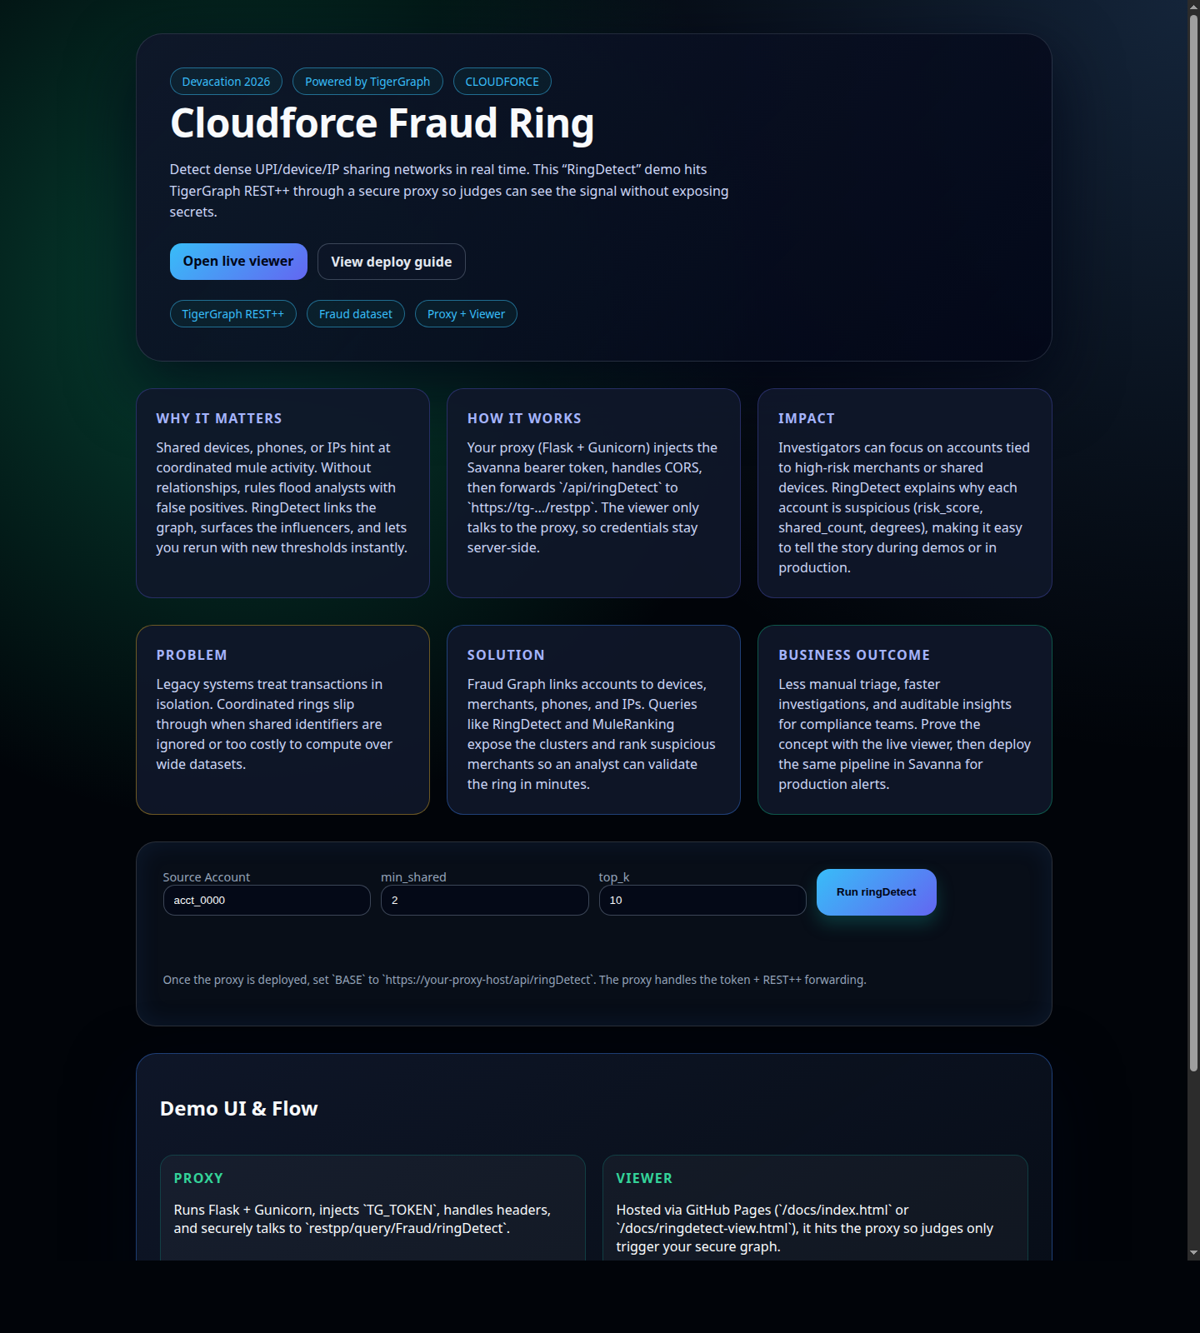
Live Demo
Presentation-ready UI and query results
Homepage / demo UI
This is the polished landing page that explains the problem, solution, and demo flow.
CLOUDFORCE | TigerGraph Hackathon

Slide 2
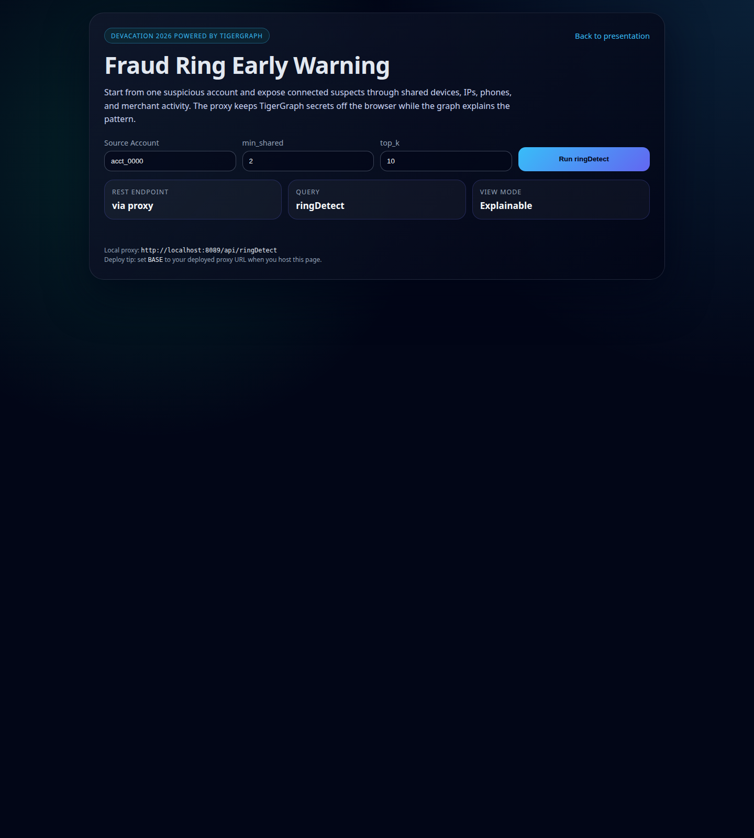
Query Evidence
ringDetect in the browser
Interactive viewer
Judges can run a seed account and see the connected suspects returned by the graph.
CLOUDFORCE | TigerGraph Hackathon

Slide 3
What It Shows
Why this demo is credible
A visual landing page that explains the problem in plain English.
A query UI that proves the graph returns results from a single account.
A proxy-based architecture that keeps TigerGraph secrets off the browser.
CLOUDFORCE | TigerGraph Hackathon

