Slide 1
Edu flex
By : Satyam Keshar
Sakshi Tyagi

Slide 2
Contents
Introduction
Advantages and Disadvantages
Flow diagram
Future
DFD
E learning vs traditional
Business Probability
Conclusion

Slide 3
“WELCOME TO EDUFLEX” – YOUR ADAPTIVE LEARNING COMPANION!

Slide 4

INTRODUCTION
In a rapidly evolving world, the ability to learn and adapt is more crucial than ever before. EduFlex is your dynamic partner in this journey, designed to flex and adapt to your unique learning needs.
At EduFlex, we believe that education should be as flexible as your aspirations. Whether you’re a student aiming for academic excellence, a professional seeking career advancement, or an individual hungry for knowledge, our platform is tailored to suit you.
Personalized Learning
Expert Educators
Immersive Experiences
Peer Collaboration
Career Advancement

Slide 5
Advantages
Flexibility in time.
Variation in course.
Lower cost.
Comfortable Leaning Environment.
Continue in profession.
Disadvantages
Difficulties with technology.
Difficulties with interface.
High rate of eagerness to participate.
Technology issues.

Slide 6
FLOW CHART
YES
NO
LOGIN
CHECK
VALIDITY
USER
HOME PAGE
REGISTRATIOON
PAGE

Slide 7

Future
65% post-secondary institute providing collage level online courses.
Large number of schools from western countries participating.
IIMB has tied up with edx platform.

Slide 8
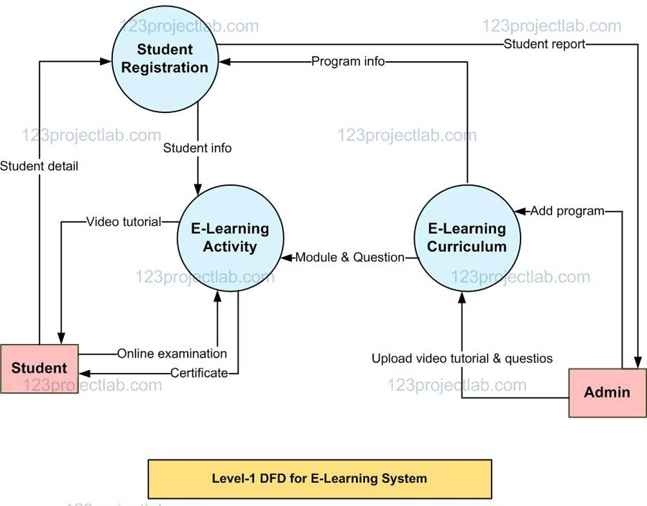

Slide 9
traditional
More Costly.
Expansive Taskforce.
Limited Technology.
Restricted Duration.
Restricted Accessibility.
Declining Growth Rate.
E – Learning
Less Costly.
Specific Taskforce.
Enhanced Technology.
Flexible Duration.
Global Accessibility.
Increasing Growth Rate.

Slide 10
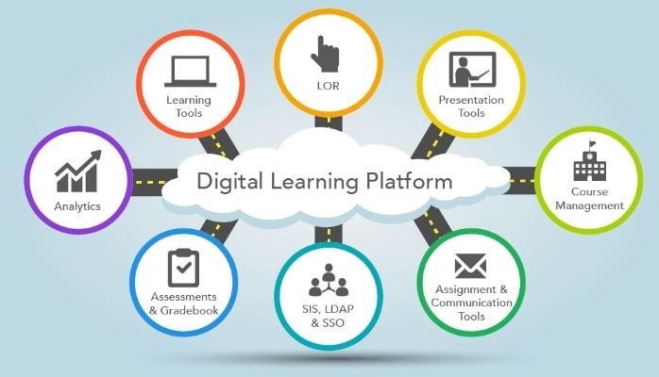

Slide 11
BUSINESS PROBABILITY
Big companies are investing.
Google capital invest $ 40 million in online education startup giant renaissance learning.
Online education giant khan academy’s revenue ass per 2012 data 15,795 million USD.
User of edx(provider of MOOC) – more than 5 million.

Slide 12
CONCLUSION
ICT and e-learning offers opportunity to schools.
Helping to break the educational barrier.
Need a lot of improvement.
Need to create awareness for online education.

Slide 13
Thank you

