Slide 1
Advanced File Security System
By: Satyam Mishra (21010124)
Supervised by: Dr. Khoirom Motilal Singh

Slide 2
Contents
Problem Statement
Project Purpose
Introduction
Project Workflow
Encryption Algorithms
Architecture
User Interface (UI)
Results
Comparison & Project Contribution
Performance
Future Work
Conclusion

Slide 3
1. Problem Statement
Importance of securing sensitive information.
Traditional methods of file security are inefficient and vulnerable.
Increasing demand for automated, secure file encryption systems.
Goal: Implement effective encryption algorithms for better file security.

Slide 4
2. Project Purpose
Manual file protection methods are labor-intensive and prone to breaches.
Need for advanced encryption algorithms like AES to ensure robust security.
Comparative study of different encryption frameworks to identify the most secure solution.
Project contributes to better file security management and secure data transmission.

Slide 5
3.Introduction
Cyber threats demand secure encryption like AES to protect sensitive data from breaches and attacks.
AES is a highly secure, efficient encryption standard widely used to protect sensitive data across various industries.
The goal is to implement AES and compare its performance, speed, and security against other encryption algorithms.
The aim is to evaluate AES's efficiency, speed, and robustness for effective and secure data protection.

Slide 6
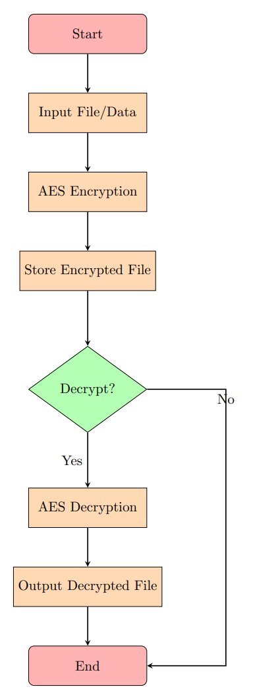
4. Project Workflow
Step 1: Data acquisition and preparation for encryption.
Step 2: Apply AES algorithm for encryption and decryption.
Step 3: Evaluate encryption performance (speed, security strength).
Step 4: Compare AES performance with other algorithms.
Step 5: Present findings and propose future improvements.

Slide 7
5. Encryption Algorithms
AES (Advanced Encryption Standard): A symmetric key encryption technique.
Supports key lengths of 128, 192, and 256 bits.
Known for speed and security.
Other Algorithms Compared:
DES (Data Encryption Standard): Less secure, shorter key size.
RSA (Rivest-Shamir-Adleman): Asymmetric encryption, slower but secure.
Objective: To establish AES as the most efficient and secure algorithm.

Slide 8
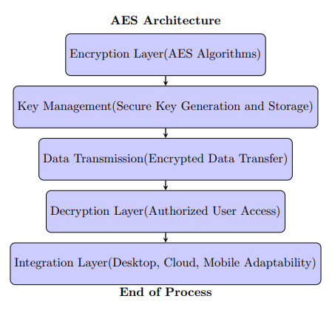
6. Architecture
Encryption Layer: Handles data encryption using AES algorithms.
Key Management: Secure key generation and storage for encryption and decryption.
Data Transmission: Encrypted data transmitted securely over the network.
Decryption Layer: Allows authorized users to decrypt and access data.
Integration: Adaptable for various platforms (desktop, cloud, mobile).

Slide 9
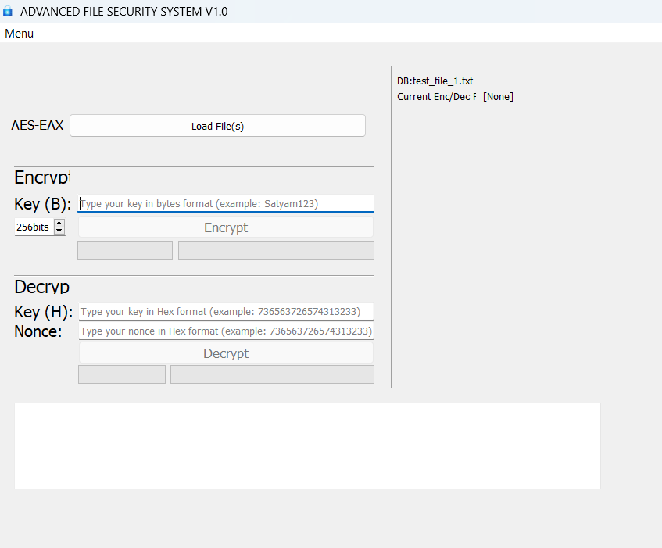
7. User Interface (UI)
Developed using PyQt5 for a user-friendly experience.
Features include:
File browsing for encryption/decryption.
Real-time progress bars to track the encryption process.
Key input fields for secure key management.
Error and status messages for user guidance.
Provides seamless interaction between the user and encryption system.

Slide 10
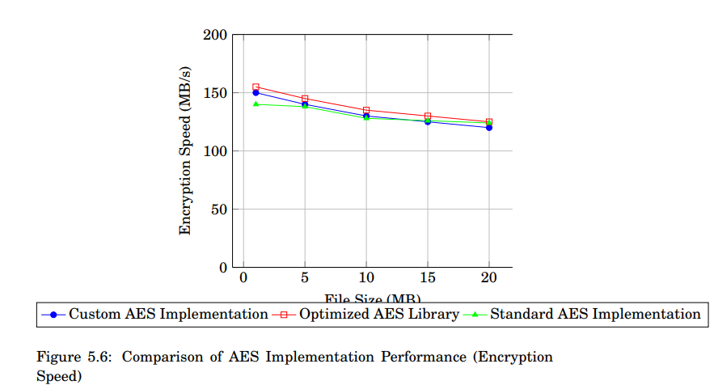
8. Results
AES Performance: Superior speed and security compared to other algorithms.
Encryption Speed: Average of 0.006 seconds per 1 MB file.
Decryption Speed: Average of 0.005 seconds per 1 MB file.
AES proves highly effective for real-time encryption and decryption.

Slide 11
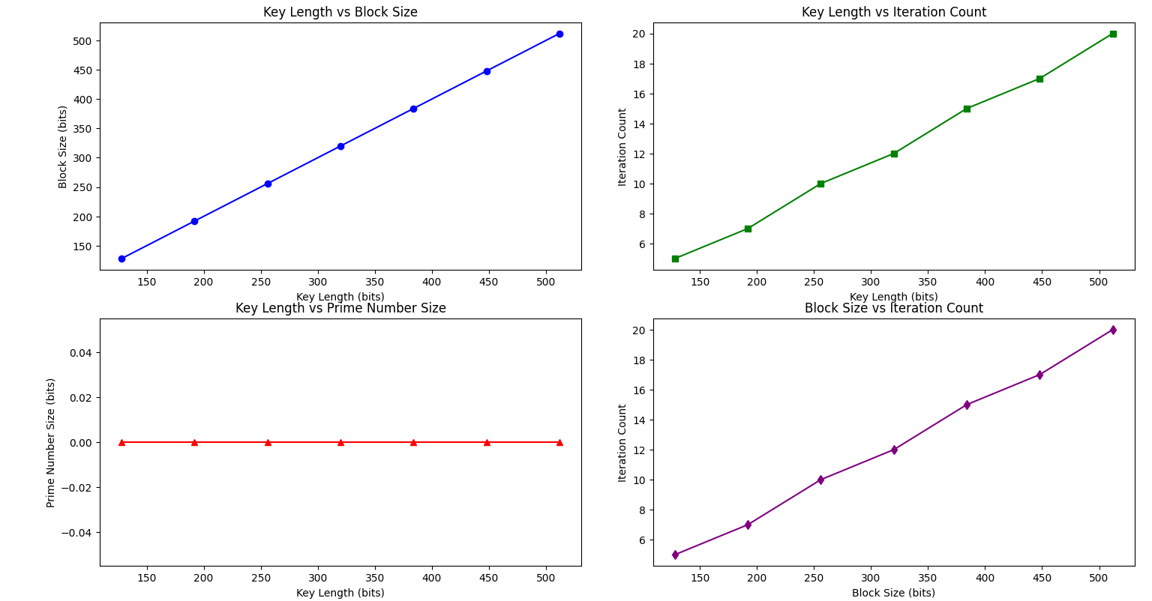
9. Comparison & Project Contribution
The project contribution is: "Integration of AES with dynamic key generation.“
AES outperforms DES and RSA in terms of both speed and data security.
Graph: Visual representation comparing AES, DES, RSA performance in terms of speed and file size handling.

Slide 12
10. Performance
Encryption Speed: AES encryption speed optimized for large Files.
Decryption Speed: Decryption matches encryption, making AES efficient for both operations.
Security: AES proved resistant to common cyberattacks.
Scalability: AES adaptable to various platforms (cloud, desktop, mobile).

Slide 13
11. Future Work
Quantum Cryptography: Explore post-quantum encryption methods to further secure future systems.
Hybrid Encryption Models: Combine AES with quantum-resistant cryptographic algorithms.
Parallel Computing: Explore the use of GPUs and FPGAs to further improve AES performance.

Slide 14
12. Conclusion
AES has been proven as an effective encryption standard for secure file handling.
It outperforms other encryption algorithms in terms of speed and reliability.
Project contributes to ongoing developments in file security, ensuring data confidentiality and integrity.
Future research will focus on combining AES with post-quantum encryption and enhancing key management.

Slide 15
Thank You !

