Slide 1
Laptop Price Predictor using Machine Learning
By Satyam Mishra

Slide 2
Contents
1. INTRODUCTION
2. LITERATURE SURVEY
3. SYSTEM DESIGN
4. IMPLEMENTATION AND DESIGN ANALYSIS
5. PERFORMANCE CHECK
6.FUTURE WORK
7.CONCLUSION

Slide 3
1.Introduction
In the dynamic landscape of consumer electronics, predicting laptop prices accurately is essential for consumers and retailers alike. This introduction unveils a cutting-edge approach: the 'Laptop Price Predictor Using Machine Learning.' Employing advanced algorithms within the realm of supervised learning, this model seeks to decode the intricate web of factors influencing laptop prices. Two pivotal aspects define this project:
Comprehensive Data Analysis: Harnessing specifications, brand reputation, user reviews, and market trends for feature extraction.
Optimized Model Training: Utilizing regression algorithms to establish correlations between features and laptop prices, paving the way for informed decision-making and competitive pricing strategies. This study stands at the intersection of machine learning and consumer electronics, promising a transformative tool for the laptop market.

Slide 4
1.1 Purpose
The primary purpose of using machine learning in the "Laptop Price Predictor" is to create a predictive model that can analyze various features of laptops and predict their prices accurately.
By leveraging machine learning algorithms, the model learns patterns and relationships within the dataset, enabling it to make informed predictions for unseen data.
This approach allows for the automation of price estimation based on relevant features such as processor speed, RAM, storage capacity, and other specifications.
The goal is to provide users with a tool that simplifies the decision-making process when purchasing laptops, offering accurate price estimates based on key characteristics

Slide 5
1.2 Machine Learning
Machine Learning (ML) is a subset of artificial intelligence (AI) that focuses on the development of algorithms and models that enable computers to learn from data.
There are three main types of machine learning:
Supervised Learning: The algorithm is trained on a labeled dataset, where the input data is paired with the corresponding correct output. The algorithm learns to map the input to the output, and once trained, it can make predictions on new, unseen data.
Unsupervised Learning: The algorithm is given data without explicit instructions on what to do with it. The system tries to learn the patterns and the structure from the data without labeled outputs. Clustering and dimensionality reduction are common tasks in unsupervised learning.
Reinforcement Learning: The algorithm learns by interacting with its environment. It receives feedback in the form of rewards or penalties as it navigates a problem space. The algorithm aims to learn the optimal actions to maximize cumulative reward over time.

Slide 6
1.3 Existing System
1. Rule-Based Systems: These systems rely on predefined rules and conditions to estimate laptop prices. Rules may be derived from market trends, historical data, or expert insights. While simple, they may lack adaptability to evolving trends.
2. Expert Systems: Expert systems integrate human expertise into the prediction process. Experts analyze market dynamics, technological advancements, and consumer preferences to formulate rules guiding price predictions. However, these systems heavily depend on the expertise of individuals.
3. Research Analysis: Some systems leverage comprehensive market research and analysis to predict laptop prices. This involves studying consumer behavior, competitor pricing, and economic factors. These predictions are based on a thorough understanding of market forces rather than computational models.
4. Statistical Models: Traditional statistical models, such as regression analysis, may be employed to establish relationships between different laptop features and prices. While not as dynamic as machine learning models, they can provide valuable insights.
5. Historical Data Analysis: Predictions based on historical sales data and trends form another category. By identifying patterns and correlations in past data, these systems aim to forecast future laptop prices.

Slide 7
1.4 Scope
Price Optimization:
Machine learning models can analyze historical data, market trends, and various features of laptops to optimize pricing strategies.
Customer Segmentation:
ML models can help identify customer segments based on preferences, buying behavior, and budget constraints.
Feature Importance Analysis:
ML models can reveal which features most significantly influence laptop prices.
Competitive Analysis:
Predictive models can analyze competitive pricing, helping manufacturers and retailers stay competitive in the market.

Slide 8
2.Literature Survey
1. Predictive Modeling in E-Commerce:
Explore studies on predictive modeling in the e-commerce domain, focusing on pricing prediction for electronic devices such as laptops. Investigate various machine learning algorithms and methodologies applied to predict product prices based on features and market trends.
2. Feature Selection for Price Prediction:
Examine research that discusses effective feature selection techniques for price prediction models. Identify features relevant to laptop pricing, such as specifications (RAM, processor, storage), brand reputation, and market demand. Understand how these features impact the pricing model.
3. Regression Models in Pricing Prediction:
Review literature on regression models utilized for pricing prediction. Understand the strengths and weaknesses of linear regression, polynomial regression, and advanced techniques like random forests or gradient boosting in the context of predicting laptop prices. Compare their predictive accuracy and computational efficiency.
4. Data Preprocessing Techniques:
Investigate literature on data preprocessing methods specific to pricing prediction models. Explore how researchers handle missing data, outliers, and categorical variables. Understand the impact of data normalization and standardization on model performance.
5. User Preferences and Sentiment Analysis:
Explore studies that incorporate user preferences and sentiment analysis into pricing models. Understand how customer reviews, ratings, and sentiment data influence the prediction of laptop prices. Consider the integration of natural language processing (NLP) techniques for sentiment analysis.

Slide 9
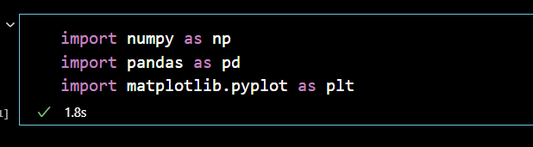
3. System Design
Laptop price is predicted by using Machine Learning. This system has a python main code with scikit -learn library which used to get our localization part done.
1. NumPy (np): A library for numerical operations in Python.
2. Pandas (pd): A library for data manipulation and analysis.
3. Matplotlib (plt): A plotting library for creating visualizations.
4. Seaborn (sns): A data visualization library based on Matplotlib that provides a high-level interface for drawing attractive and informative statistical graphics

Slide 10
3.1 Process Flow
In this section we will discuss the main idea behind the prediction of laptop price using machine learning. The three important flow processes in predicting laptop prices using machine learning are:
1. Data Preprocessing
2. Model Training
3. Model Evaluation and Export

Slide 11
3.2 Data Preprocessing
1. Handling Missing Values
2. Converting Data Types
3. Extracting Relevant Information
4. Creating New Features
5. Categorical Variable Encoding
6. Dropping Unnecessary Columns
7. Target Variable Transformation

Slide 12
3.3 Model Training
1. Splitting the Dataset
2. Defining a Pipeline
3. Training the Model
4. Making Predictions
5. Hyperparameter Tuning

Slide 13
3.4 Model Evaluation and Export
1. Model Evaluation
2. Model Export
3.Usage of Exported Model

Slide 14
4. Implementation and design Analysis
1. Data Loading and Exploration
3. Feature Engineering
4. Further Data Processing
5. Correlation and Analysis
6. Model Training
7. Model Evaluation
8. Model Export

Slide 15
3.2 Design Algorithm
The design of the machine learning model in the provided code involves two regression algorithms: Linear Regression and Random Forest Regression. Let's break down the implementation and compare the two algorithms.
Linear Regression
Random Forest Regression

Slide 16
Linear Regression
Linear regression is a statistical method used to model the relationship between a dependent variable and one or more independent variables by fitting a linear equation to the observed data. 4
The goal is to find the best-fitting straight line that minimizes the sum of squared differences between the observed values and the values predicted by the model.
The equation for a simple linear regression (with one independent variable) is:
Y = beta_0 + beta_1X + varepsilon
where:
Y is the dependent variable.
X is the independent variable.
beta_0 is the y-intercept (the value of ( Y ) when ( X ) is 0).
beta_1 is the slope of the line (the change in Y for a one-unit change in X ).
varepsilon is the error term, representing the unobserved factors that affect ( Y ) but are not accounted for by the model.
Linear regression is widely used in various fields for tasks such as predicting outcomes, understanding relationships between variables, and identifying trends. It's important to note that linear regression makes several assumptions about the data, including the linearity of the relationship, independence of errors, homoscedasticity (constant variance of errors), and normality of errors. Violations of these assumptions can affect the accuracy and reliability of the regression model.

Slide 17
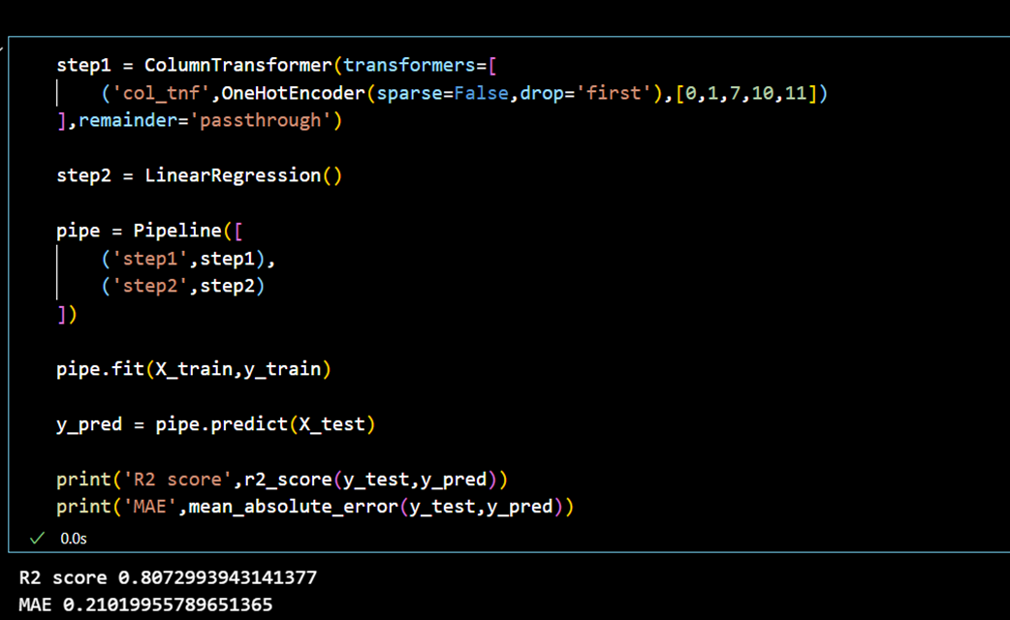
Linear Regression

Slide 18
Random Forest Regression
Random Forest Regression is an ensemble learning method that belongs to the family of decision tree-based models. It is an extension of the Random Forest algorithm, which is commonly used for both classification and regression tasks. Random Forest Regression builds multiple decision trees and merges their predictions to obtain a more accurate and stable prediction.
Here are the key concepts and characteristics of Random Forest Regression:
Ensemble Learning: Random Forest is an ensemble learning technique, meaning it combines the predictions of multiple models to improve overall performance and robustness.
Decision Trees: The base models in a Random Forest are decision trees. Each tree is constructed independently based on a random subset of the training data and a random subset of the features.
Randomization: Random Forest introduces randomness in the model-building process. It selects a random subset of data points and a random subset of features to build each tree. This helps prevent overfitting and improves the generalization of the model.
Bootstrapping: The algorithm uses bootstrapped samples (random samples with replacement) from the training data to build each tree. This results in a diverse set of trees, each trained on a slightly different subset of the data.
Prediction Aggregation: For regression tasks, the predictions of individual trees are averaged to obtain the final output. This averaging process helps to smooth out the noise and provide a more stable prediction.

Slide 19
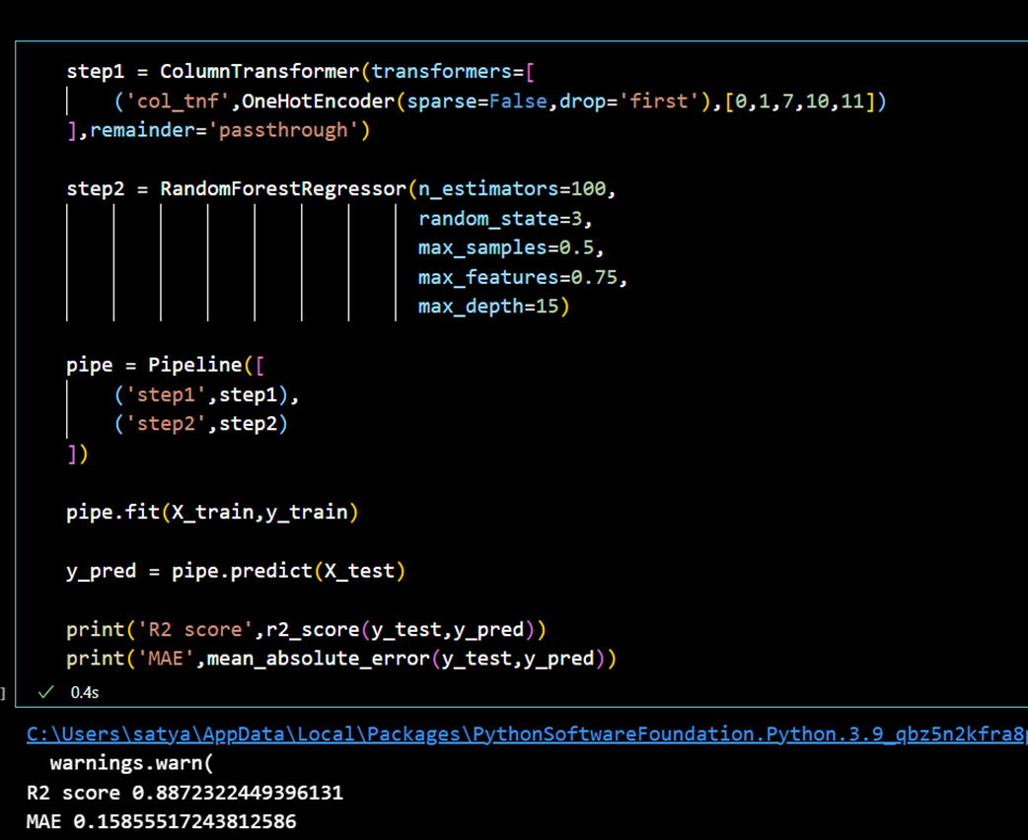
Random Forest Regression

Slide 20
Differences, Model Comparison, Comparison Results
Key differences :
Model Selection: Random Forest Regressor is chosen for its ensemble learning approach.
Hyperparameters: Specific hyperparameters such as the number of estimators, max samples, max features, and max depth are tuned.
Model Comparison:
•Linear Regression: It assumes a linear relationship between features and the target variable. Simple, interpretable, and works well when the relationship is linear.
•Random Forest Regression: It is an ensemble of decision trees, capturing non-linear relationships and interactions between features. Robust and less prone to overfitting.
Comparison Results:
The effectiveness of each model is evaluated using R2 score and MAE.
•These metrics help understand how well the models capture the variance in the target variable and how far, on average, predictions are from the actual values

Slide 21
Use Cases
The use cases for a project like "The Laptop Price Predictor" would typically revolve around assisting users in making informed decisions when purchasing laptops. Here are some potential use cases for such a project:
1. Price Comparison:
Users can input the specifications or features they desire in a laptop, and the predictor can compare prices across various online retailers. This helps users find the best deals and save money.
2. Budget Planning:
Individuals or businesses looking to purchase laptops for a specific budget can use the predictor to explore options that meet their financial constraints.
3. Feature Prioritization:
Users can input the features they prioritize in a laptop (e.g., processor speed, RAM, storage capacity) and receive predictions on how these preferences might affect the overall price.
4. Performance vs. Price Analysis:
The predictor could provide insights into the trade-offs between performance and price, helping users find a balance that suits their needs.

Slide 22
Use Cases
5. New Releases Analysis: Users can stay updated on the latest laptop releases and get predictions on their potential prices based on historical data and specifications.
6. Customization Guidance: For laptops that allow customization (e.g., upgrading RAM, storage), the predictor could offer guidance on the cost implications of different customization options.
7. Market Trends and Predictions: The project could analyze market trends to predict potential price changes in the near future, helping users decide when the best time to make a purchase might be.
8. Educational Purposes: The project could be used in educational settings to teach students about machine learning, data analysis, and predictive modeling using a real-world example.
9. Vendor or Brand Comparison: Users might want to compare prices and features between different laptop brands or vendors, and the predictor could facilitate this comparison.

Slide 23
Accuracy Measure
The accuracy measure of a laptop price predictor is typically quantified using metrics such as Mean Absolute Error (MAE), Mean Squared Error (MSE), Root Mean Squared Error (RMSE), or R-squared (R2) score for regression tasks.
These metrics evaluate the model's ability to predict prices accurately, with lower values indicating better performance. Accuracy, expressed as a percentage error, provides insight into the average magnitude of errors in predicted laptop prices.
For classification tasks, accuracy, precision, recall, and F1-score assess the model's success in categorizing laptops within certain price ranges. Achieving a high accuracy percentage reflects the model's effectiveness in price prediction.
Multiple Observation has been taken. The accuracy of the project is 88.7 %.

Slide 24
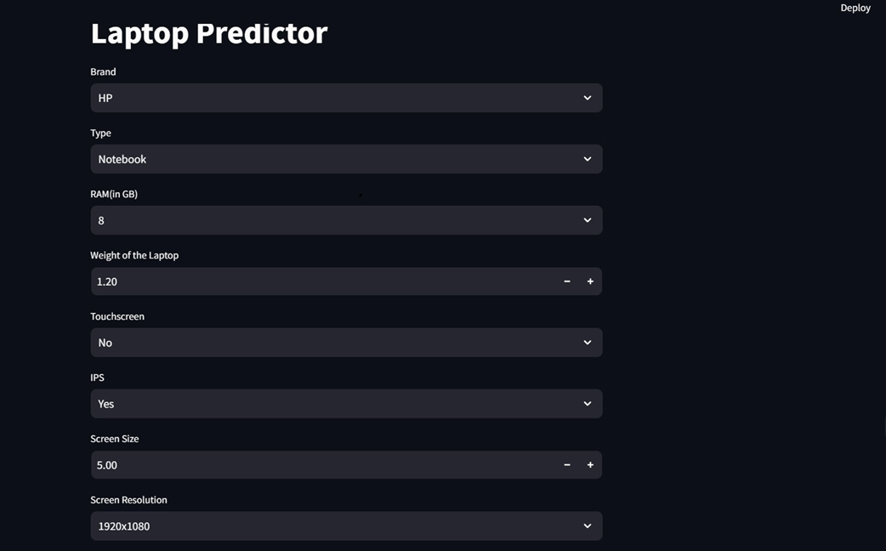
Performance Check

Slide 25
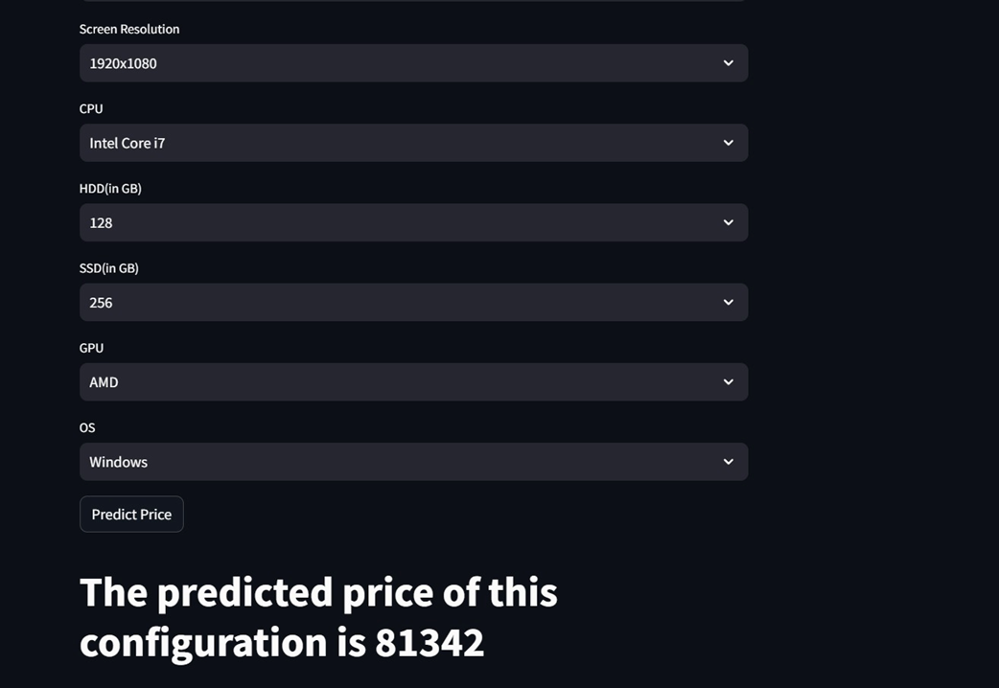
Performance Check

Slide 26
Future Work
There are several potential areas for future work in laptop price predictor using Machine Learning, such as: -
1. Advanced Feature Engineering: Explore additional features that might contribute to better model performance. This could include more detailed analysis of existing features or incorporating external datasets for richer information.
2. Hyperparameter Tuning: Conduct a thorough hyperparameter tuning process to optimize the parameters of the machine learning models. This can be done systematically to improve the predictive accuracy of the models.
3. Ensemble Methods: Investigate the use of ensemble methods such as stacking or boosting to combine predictions from multiple models. Ensemble methods can often lead to improved performance compared to individual models.
4.Deep Learning Approaches: Experiment with deep learning techniques, such as neural networks, to capture complex relationships within the data. Deep learning models might reveal patterns that traditional machine learning models might miss.

Slide 27
Future Work
5. Cross-Validation and Robustness Testing:Implement more robust cross-validation strategies to ensure that the model's performance is consistent across different subsets of the dataset. This helps in detecting overfitting or underfitting issues.
6. Deployment and Integration: Develop a user-friendly interface or deploy the model as a web service to make it accessible to a wider audience. Integration with other systems or platforms can also be explored.
7. Dynamic Pricing Model: If applicable, consider evolving the model into a dynamic pricing system that can adjust laptop prices in real-time based on market conditions, demand-supply dynamics, or other relevant factors.
8. Feedback Mechanism: Implement a feedback mechanism where user interactions and feedback on predicted prices are collected. This information can be used to continuously improve the model and enhance its accuracy.
9. Extended Dataset and External Data Sources: Gather more diverse and extensive datasets to improve the model's generalization. Integration with external data sources related to technology trends, economic indicators, or consumer preferences could add valuable insights.
10. Interpretability and Explainability: Enhance the interpretability of the model's predictions to build trust among users. Techniques such as SHAP (Shapley Additive explanations) values or LIME (Local Interpretable Model-agnostic Explanations) can be considered.

Slide 28
Conclusion
The project "Laptop Price Predictor" aimed to develop a machine learning model to predict laptop prices based on various features such as hardware specifications, brand, and operating system. The dataset was cleaned and preprocessed to handle missing values, convert data types, and extract relevant information.
Exploratory Data Analysis (EDA) revealed insights into the distribution of laptop prices across different brands, types, and specifications. Visualizations highlighted the impact of features like RAM, GPU brand, and screen resolution on laptop prices. Additionally, data engineering was performed to create meaningful features, such as total storage capacity and categorical variables for CPU and GPU brands.
The machine learning model was built using a pipeline that included one-hot encoding for categorical variables and regression algorithms. Linear regression and Random Forest regression were employed, and their performance was evaluated using metrics like R-squared score and Mean Absolute Error on the test set.

Slide 29
Conclusion
The Random Forest regression model demonstrated superior performance, indicating its effectiveness in predicting laptop prices. The final model was exported for future use. The analysis provided valuable insights for both consumers and manufacturers, offering a data-driven approach to understanding the factors influencing laptop prices.
In conclusion, the project successfully developed a machine learning model for predicting laptop prices, contributing to the field of price prediction in the tech industry. The insights gained from this project can assist consumers in making informed decisions and guide manufacturers in pricing strategies based on the importance of various features in influencing laptop prices.

Slide 30


