Slide 1
Capstone Project - The Battle of Neighborhoods
Selecting the best location to open an SUSHI BAR IN Manhattan, New York

Slide 2
Introduction/Business Problem
The City of New York is famous for its excellent cuisine. It's food culture includes an array of international cuisines influenced by the city's immigrant history.
Sushi restaurants have become so popular in the United States now it seems that there is one on every corner, not only in major cities but also in smaller cities. Starting a sushi restaurant can be a great business opportunity, but you need to distinguish yourself from others to enjoy long-term success.
New York City's demographics show that it is a large and ethnically diverse metropolis. It is the largest city in the United States with a long history of international immigration. New York City was home to nearly 8.5 million people in 2014, accounting for over 40% of the population of New York State and a slightly lower percentage of the New York metropolitan area, home to approximately 23.6 million. Over the last decade the city has been growing faster than the region. The New York region continues to be by far the leading metropolitan gateway for legal immigrants admitted into the United States.
New York City has also been a major point of entry for immigrants; the term "melting pot" was coined to describe densely populated immigrant neighbourhoods on the Lower East Side. As many as 800 languages are spoken in New York, making it the most linguistically diverse city in the world. English remains the most widely spoken language, although there are areas in the outer boroughs in which up to 25% of people speak English as an alternate language, and/or have limited or no English language fluency. English is least spoken in neighbourhoods such as Flushing, Sunset Park, and Corona.
With its diverse culture, comes diverse food items. There are many restaurants in New York City, each belonging to different categories like Chinese, Indian, and French etc.

Slide 3
Business Problem
My client wants to open his business in Manhattan area, so I focus on that borough during my analysis. We define potential neighborhood based on the number of sushi bars which are operating right in each neighborhood. Manhattan has full potential but also is a very challenging district to open a business because of high competition. New sushi bar should be open in an area that inadequate neighborhood in this way the bar can attract more customers. Therefore, this analysis necessary to ensure that we have enough customers and that we are not so close to other sushi places.
To find the answers to the following questions:
Q1) List and visualize all major parts of New York City that has great Indian restaurants.
Q2) What is best location in New York City for Indian Cuisine?
Q3) Which areas have potential Indian Restaurant Market?
Q4) Which all areas lack Indian Restaurants?
Q5) Which is the best place to stay if you prefer Indian Cuisine?

Slide 4
Data Selection
For this project we need the following data:
New York City data that contains list Boroughs, Neighbourhoods along with their latitude and longitude.
Data source : https://cocl.us/new_york_dataset
Description: This data set contains the required information. And we will use this data set to explore various neighbourhoods of New York City.
Indian restaurants in each neighbourhood of New York City.
Data source : Foursquare API
Description: By using this API we will get all the venues in each neighbourhood. We can filter these venues to get only Indian restaurants.
GeoSpace data
Data source : https://data.cityofnewyork.us/City-Government/Borough-Boundaries/tqmj-j8zm
Description: By using this geo space data we will get the New York Borough boundaries that will help us visualize choropleth map.

Slide 5
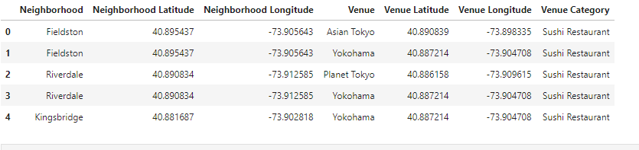
Data Selection
Next, we also used Google Map API to find their geographic coordinates of the 5 locations shortlisted for our sushi bar:
Table 2: Data frame containing geographic coordinates of our 5 shortlisted locations

Slide 6
Methodology
We begin by collecting the New York city data from the following link "https://cocl.us/new_york_dataset“
We will find all venues for each neighbourhood using Foursquare API.
We will then filter out all venues with Indian restaurant for further analysis.
Next using Foursquare API, we will find the Ratings, Tips, and Number of Likes for all the Indian Restaurants.
We will then sort Neighbourhoods and Borough the data keeping Ratings as the constraint.
Next we will consider all the neighbourhoods with average rating greater or equal 9.0 to visualize on map.
We will join this dataset to original New York data to get longitude and latitude.
Finally, we will visualize the Neighbourhoods and Borough based on average
Rating using python’s Folium library.

Slide 7
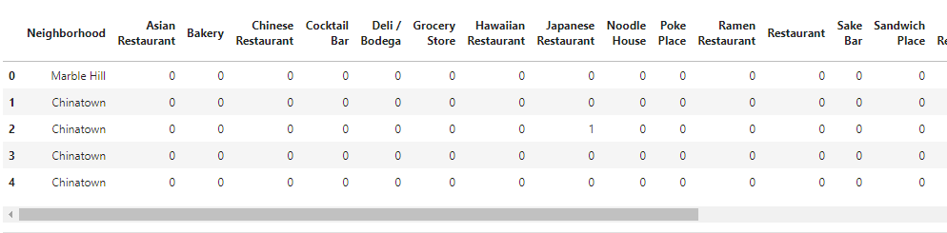
Methodology

Slide 8
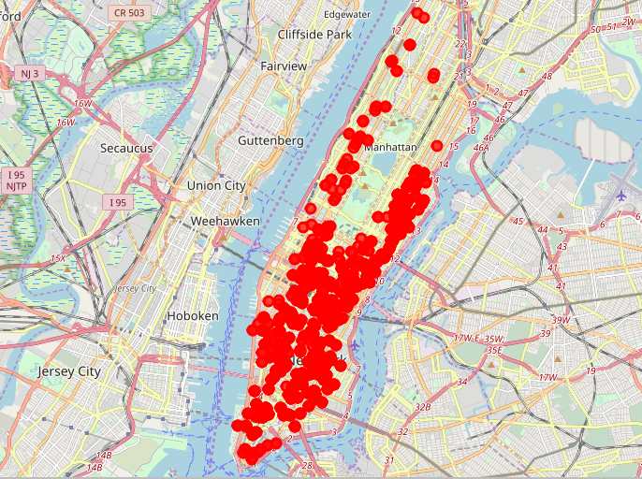
Methodology
Sushi bars in Manhattan

Slide 9
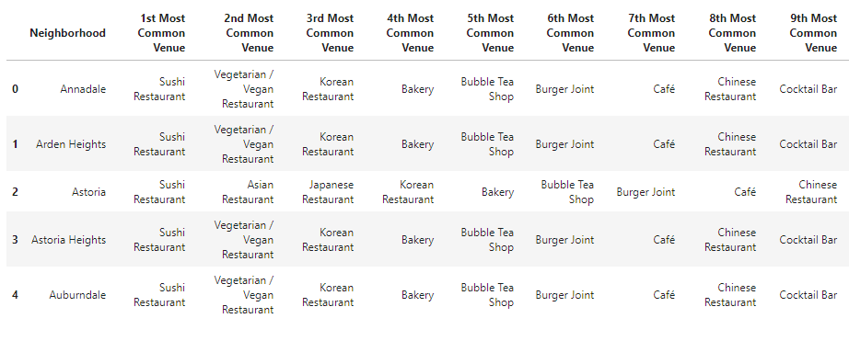
Methodology
Then using this feature to group the neighborhoods into clusters K-means clustering algorithm will be use to complete this task. And also, the Folium library to visualize the neighborhoods in Manhattan and its emerging clusters.

Slide 10
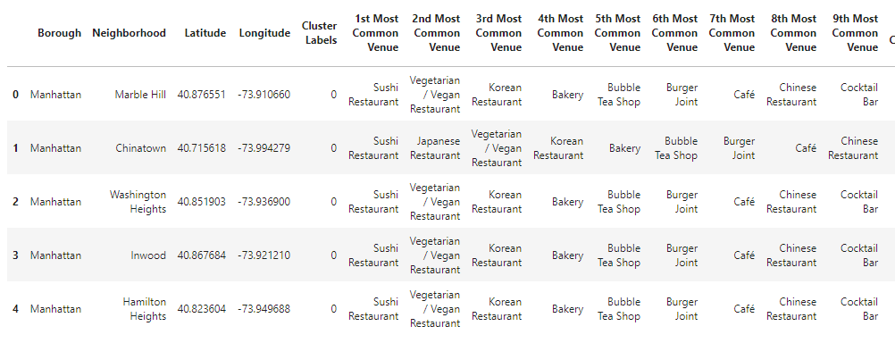
Results
Using K-mean to clustering data area with less number of sushi bars
Cluster 0

Slide 11
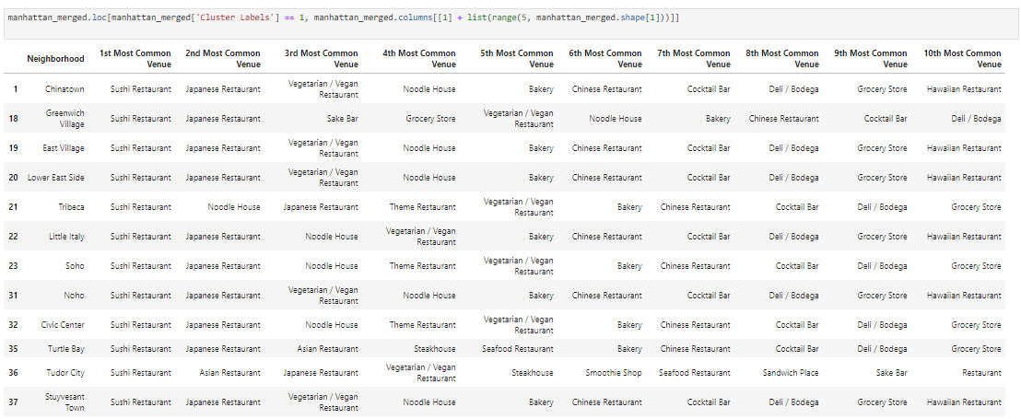
Result
Cluster 1

Slide 12
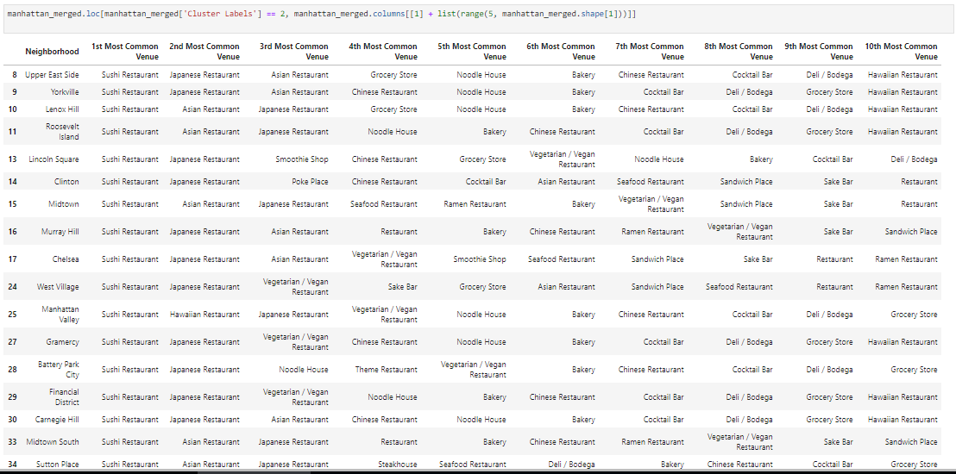
Result
Cluster 2

Slide 13
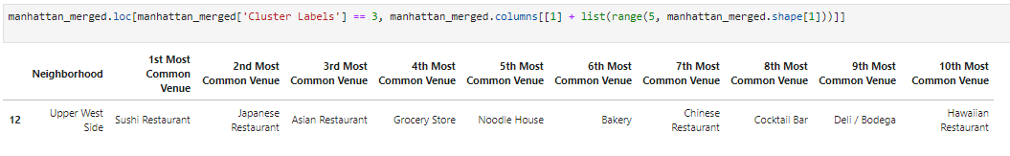
Result
Cluster 3

Slide 14
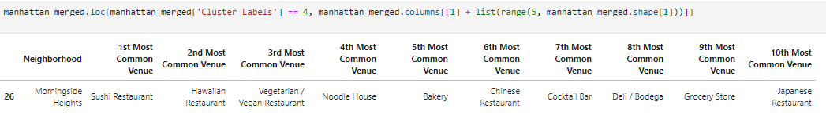
Result
Cluster 4

Slide 15
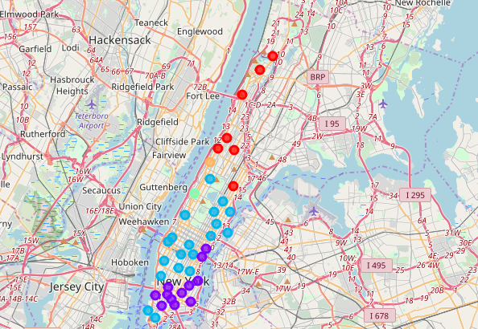
Result

Slide 16
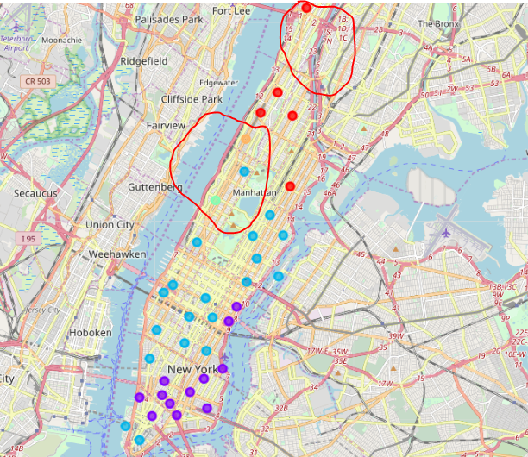
Result
Based on dataframe analysis above Cluster 3 (Upper West Side ) and Cluster 4 (Morningside Heights) areas are the best places to open a new sushi bar business.

Slide 17
Discussion
This analysis is performed on limited data. This may be right or may be wrong. But if good amount of data is available there is scope to come up with better results.
There is high competition in Midtown and Soho so it is very risky to open business in these areas.
Central Harlem has also potential where closes to Morningside Heights area.
It can be done more detailed analysis by adding other factors such as transportation, demographics of inhabitants.

Slide 18
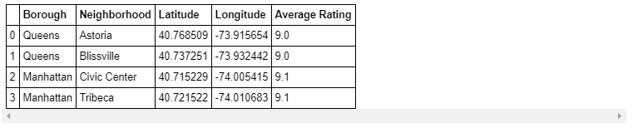
Conclusion
Although all of the goals of this project were met there is definitely room for further improvement and development as noted below. However, the goals of the project were met and, with some more work, could easily be devleoped into a fully phledged application that could support the opening a business idea in an unknown location.
So now we can answer the questions asked above in the Questions section:
Answers:
The following location in New York City has great Indian restaurants.
Astoria (Queens), Blissville (Queens), Civic Center (Manhattan) are some of the best neighbourhoods for Indian cuisine.
Manhattan have potential Indian Restaurant Market.
Staten Island ranks last in average rating of Indian Restaurants.
Manhattan is the best place to stay if you prefer Indian Cuisine.

