Slide 1
Load Balancer
Simulator
ALGORITHMS · PROJECT 27 · GREEDY + HEAP
FIVE SERVERS, BAR HEIGHT = WEIGHT
8
6
5
4
3
Demo scenario: the 10 AM Tatkal rush on RailDhaara, a fictional booking site
app-1
app-2
app-3
app-4
app-5
Satyam Nirala and Raghav Sihag
Notes:
About 0:20. Say the name, the course, and that the demo scenario is a fictional booking site.

Slide 2
10 AM: everyone arrives at once
100
req/s, a normal morning
Requests arriving per second in one simulated rush
400
req/s, the Tatkal rush (×4)
1,000
req/s, a sudden burst (×10)
Five servers sustain about 412 req/s in total. That figure is an estimate from our latency model.
Arriving per second
Fleet capacity (estimate)
Synthetic traffic and invented servers. No IRCTC data.
2
Notes:
About 0:45. Booking opens at a fixed time and the whole queue arrives together. That is the shape of load we model: 100 requests a second on a normal morning, four times that in the rush, ten times in a burst. The dashed line is what the five servers can sustain, an estimate. The rush brushes it. That is why the algorithms only separate under the spike.
Say it is synthetic: no IRCTC data.

Slide 3
Three ways to pick a server
Round Robin
Least Connections
Weighted Least Conn.
PICKS
PICKS
PICKS
Next healthy server, in a fixed order
Fewest open connections
Lowest connections ÷ weight
IGNORES
IGNORES
IGNORES
Load and server size
Server size
Response time
COST PER PICK
COST PER PICK
COST PER PICK
O(1), more when servers are down
O(log n), with a heap
O(log n), with a heap
Least Connections and Weighted Least Connections are greedy: each request goes to the best server now.
3
Notes:
About 0:40. Round Robin takes turns. Least Connections picks the server with the fewest open connections. Weighted Least Connections divides by the server's weight, so a big server is allowed more. The last two are greedy: each request goes to the best server at that moment, no look-ahead.

Slide 4
One heap, O(log n) per request
EXAMPLE: CONNECTIONS ÷ WEIGHT, LOWEST AT THE ROOT
EVERY OPERATION
app-3
1 ÷ 5 = 0.20
Pick
read the root, count it, sift down
O(log n)
← next pick
Request finishes
lower that server's key, sift up
O(log n)
app-1
2 ÷ 8 = 0.25
app-4
1 ÷ 4 = 0.25
Server dies or returns
remove it from the heap, or push it back
O(log n)
app-2
2 ÷ 6 = 0.33
app-5
2 ÷ 3 = 0.67
A lock covers pick and count together, so two requests never choose from the same stale count.
0.50 vs 0.74 µs
per operation at our 5 servers: the plain scan is faster
310× faster
than a scan at 50,000 servers (measured, Python)
4
Notes:
About 1:15. The servers sit in a min-heap keyed by connections over weight, so the least loaded one is always the root. A pick reads the root, counts the connection and sifts down. A finished request lowers a key and sifts up. A server going down is removed, coming back is pushed. All logarithmic. The lock covers pick and count together, so two requests can never choose from the same stale count.
Be honest about the numbers: at our five servers a plain scan is actually faster. The heap wins above roughly twenty servers.

Slide 5
Failover: noticing is the hard part
THE BALANCER ONLY KNOWS WHAT A CHECK TELLS IT
Refused requests after a kill, by check interval
Server dies
Marked down: nothing is routed after this
Next probe puts it back: traffic returns
Blind window: requests are refused
Server revived
Round Robin
Least / Weighted LC
+ passive check
Drain, not retry
Requests already in flight on a dying server finish. Bookings are not safe to replay.
Passive check, opt-in
After 3 refused requests in a row, mark the server down at once. Overload never counts.
5
Notes:
About 1:10. The server really dies at one moment, but the balancer only finds out at the next health check. In between it keeps sending traffic to a dead server and those requests are refused. That is the blind window. Least Connections is hit hardest because a dead server shows zero connections, so it looks like the least loaded one. A passive check fixes it: three refusals in a row and the server is marked down at once.
Decision: requests already in flight on the dying server finish. Bookings are not safe to retry.

Slide 6
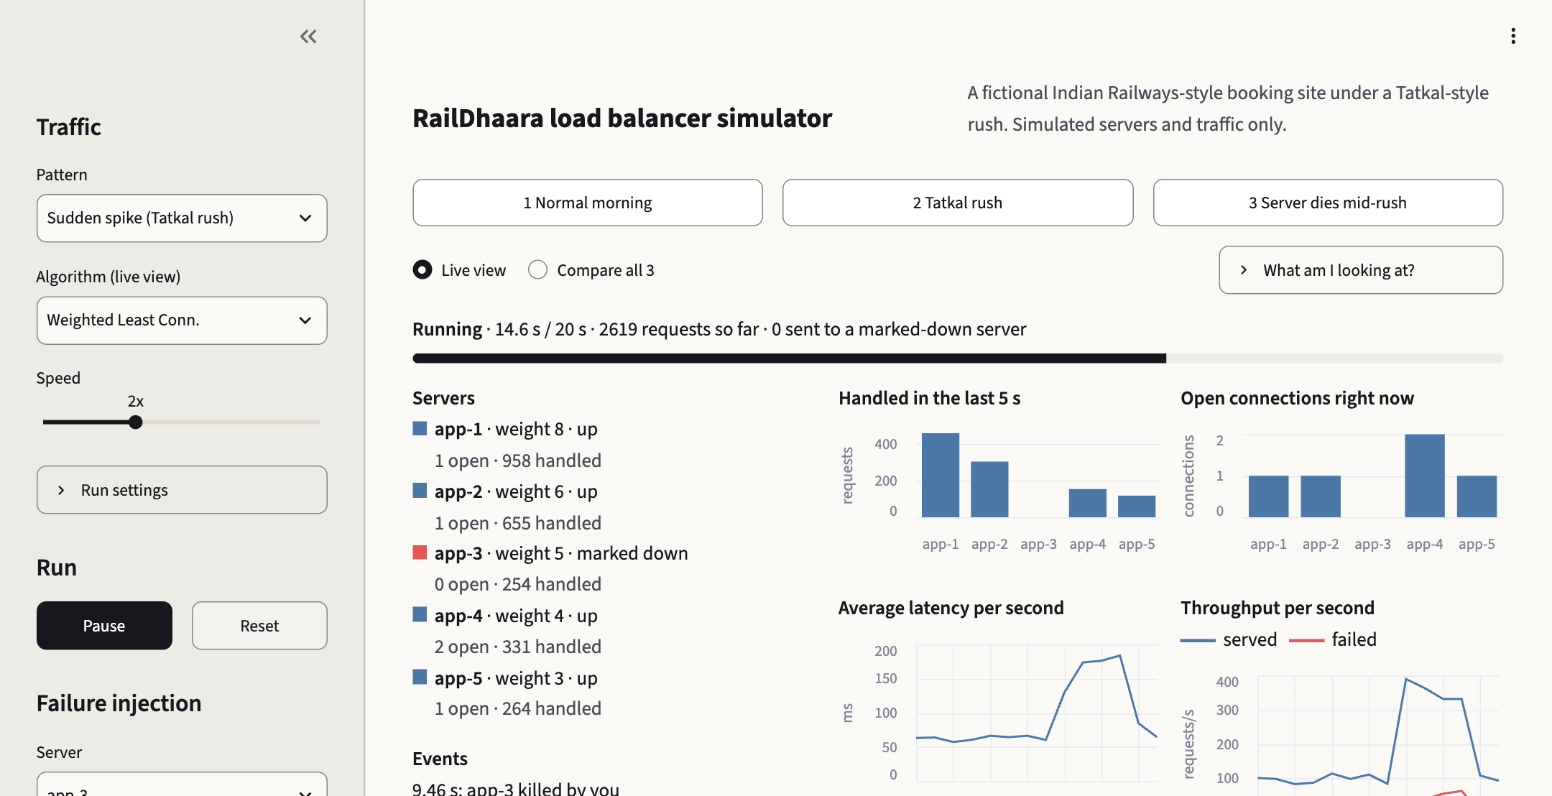
Watch the failover live
Live view
Per-server status, load in the last 5 s, open connections, latency and throughput.
Compare view
All three algorithms on the same traffic, side by side.
Kill and Revive
Act at the simulated moment you click, on all three algorithms at once.
Same engine as the CLI
Same seed, same numbers. A test checks it.
One live run: Tatkal rush, app-3 killed mid-rush. Counts differ from the tables, which use fixed scenarios.
6
Notes:
About 0:10, then switch to the browser. The dashboard runs the same engine as the command line, so the same seed gives the same numbers; there is a test for that. Kill and Revive take effect at the simulated moment you click.
Fallback: docs/fallback/ has the command-line tables and docs/screenshots/ has these screenshots.

Slide 7
Near capacity, weighting wins
 | Normal | Spike ×4 | Slow server | Burst ×10
● Round Robin | 0.0% · 79.3 ms | 10.8% · 112.0 ms | 1.3% · 221.3 ms | 31.4% · 112.6 ms
● Least Connections | 0.0% · 64.6 ms | 8.8% · 97.2 ms | 0.0% · 89.1 ms | 35.0% · 86.1 ms
● Weighted Least Conn. | 0.0% · 63.1 ms | 1.5% · 115.1 ms | 0.0% · 87.4 ms | 31.2% · 102.8 ms
Each cell: failed requests, then average latency of the requests that were served. 10,000 requests, seed 42. Lowest failure rate shaded.
Spike
Weighted LC fails 1.5%. Least Connections fails 8.8%, Round Robin 10.8%.
Burst
About 31% failing is the floor for any balancer: the burst is more than twice the fleet's capacity. Round Robin 31.4%, Weighted LC 31.2%.
The cost
In the spike Weighted LC averages 115.1 ms against 97.2 ms for Least Connections: it serves more of the load.
7
Notes:
About 0:45. Ten thousand requests per run. Each cell is the percentage of requests that failed and the average latency of the ones that were served. On a normal morning nothing fails. In the spike Weighted Least Connections fails 1.5 percent, Least Connections 8.8, Round Robin 10.8. In the burst nobody can win: it is more than twice what the fleet can sustain.
Say the cost out loud: in the spike Weighted Least Connections averages higher latency, because it serves more of the traffic.

Slide 8
The survivors run out of capacity
Success while app-1 is marked down, mid-spike
262
req/s the four survivors can sustain (estimate)
400
req/s the spike offers
So at most about 66% can be served, whatever the balancer does.
Control
app-1 dead from the first millisecond, no failover at all, steady 400 req/s: 63.0% / 58.0% / 65.0%
Round Robin
Least Connections
Weighted Least Conn.
Probe-only detection. With the passive check the figures move by under 2 points.
8
Notes:
About 0:50. We kill the biggest server, app-1, in the middle of the rush. Failover works: nothing is routed to the dead server. But a third of the requests still fail. The four survivors can sustain about 262 requests a second, an estimate from our latency model, and the rush offers 400. So no balancer can serve more than about 66 percent.
Control: with app-1 dead from the start and no failover at all, a steady 400 gives the same kind of numbers. It is capacity, not failover.

Slide 9
What this does not show
Synthetic
Simulated time
A kill is not a crash
Traffic is Poisson arrivals, the servers are invented, latency is a formula. No IRCTC data, no real network.
A virtual clock: no garbage collection, kernel queues or packet loss. Real threads are tested on the balancer, not on a network.
The server stops taking new requests; accepted ones finish. A power cut that drops them is not modelled.
An estimate
Small samples
Browser coverage
About 262 req/s for the survivors comes from the latency model and is good to a few points.
1,000-request runs differ by up to 9.5% in req/s between seeds. One fleet, one set of seeds.
Checked in Brave (Chromium), light and dark, and at 390 px in an iframe. Not on a phone, Safari or Firefox.
9
Notes:
About 0:30. Say these before they are asked. The traffic and the servers are invented. Time is simulated. A kill here means the server stops accepting new requests, not a power cut. The capacity figure is an estimate. Small runs are noisy. And the dashboard was checked in one desktop browser.

Slide 10
What to take away
1.5%
of requests failed with Weighted Least Connections in the spike, against 8.8% for Least Connections and 10.8% for Round Robin. Weigh the load by capacity.
147 → 3
requests lost in a 2 s blind window, cut to 3 by a passive check. How fast you notice a failure matters as much as how you route.
262 of 400
req/s the four survivors can sustain against what the spike offers, an estimate. No balancer fixes missing capacity.
github.com/satyamnirala187/load-balancer-simulator · 89 tests pass · Questions?
Notes:
About 0:35. Three results, each with its number. Then the repository and questions.

