Slide 1

Shri G.S Institute of Technology and Science
MINOR PROJECT
COLLEGE INFORMATION SYSTEM
Guided By :
Mrs. Puja Gupta
Dept. of Information Technology
Submitted By :
Divya Sharma (0801CA201018)
Sanskriti Dubey (0801CA201054)
Satyam Raghuvanshi (0801CA201056)
Yogeshwari Kumawat(0801CA201068)

Slide 2
CONTENT
INTRODUCTION
OBJECTIVE
TECHNOLOGY USED
HARDWARE/SOFTWARE REQUIRED
USER DISCRIPTION
MODULE DISCRIPTION
SCOPE

Slide 3
INTRODUCTION
College information system helps educational institutions manage their core activities .
Our module deals with all the operational activities which are related to Library management, Thesis management and Furniture allocation systems.

Slide 4
OBJECTIVE
Eliminate paperwork and save time.
Use the technologies and Server technology used in here to create strong and secured database connectivity.
Editing, adding and updating of Records is improved which results in proper resource management of College data.
To Increase security.

Slide 5
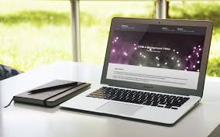
Technology used

Slide 6
Front-end
HTML
CSS
JAVASCRIPT
BOOTSTRAP

Slide 7
Back-end
DJANGO
DATABASE
SQLite

Slide 8
USERS
ADMIN
FACULTY
STUDENT

Slide 9
USERS TASK

Slide 10
ADMIN
A admin is a super user who enjoys all the privileges .
Add Update Delete Records.
Approve/Disapprove teacher/student account.
Add teacher/student account .
Can send instruction/notification to every Student.
Can give added permission to teachers

Slide 11
FACULTY
A person is required to create account and then gets approved by the admin.
Teacher can be assigned Multiple tasks by Admin.
View the list of students assigned to them.
Can evaluate thesis assigned by them.
Update Password(encrypted format)

Slide 12
STUDENT
A person has less privilege to the access of the system; the student can only view his own record by providing his username and password.
A person will be able to see the books issued, thesis marked etc.
If any comment or change of class schedule the student can see in his own profile only.

Slide 13
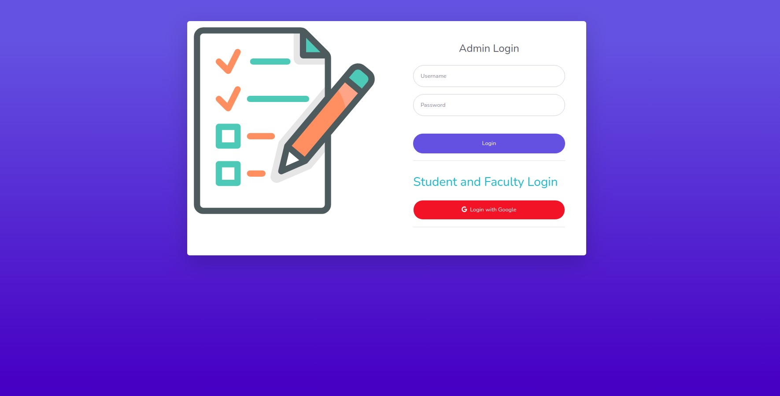
LOGIN
ALL THREE USER HAVE DIFFERENT LOGIN AND THEIR CREDENTIALS

Slide 14
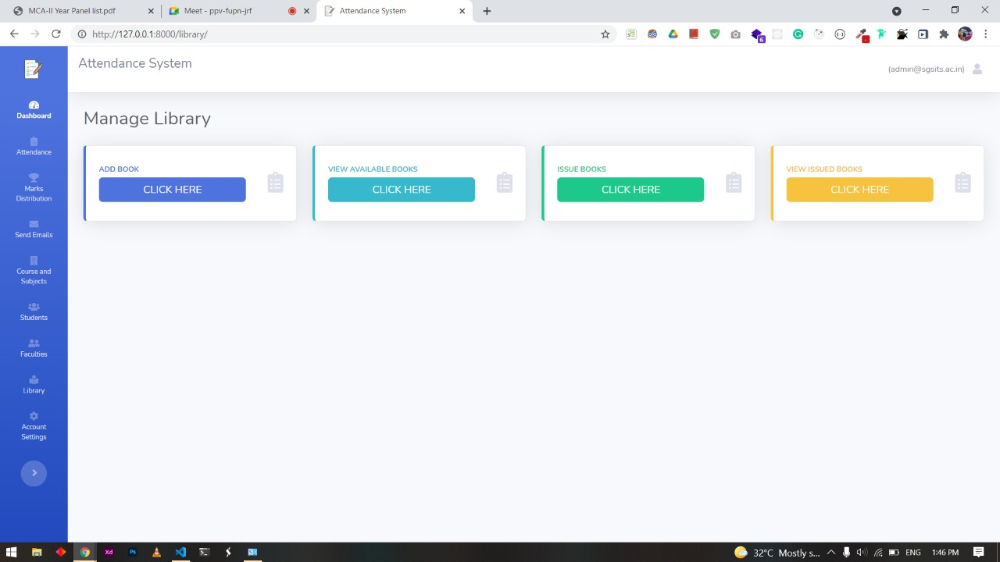
MODULE-1{Library management}

Slide 15
Available Features
Student Panel
Admin Panel
Add Books
List Books
Issue Books
Search Books
Auto Fine Charge
View Issued Books
View Available Students

Slide 16
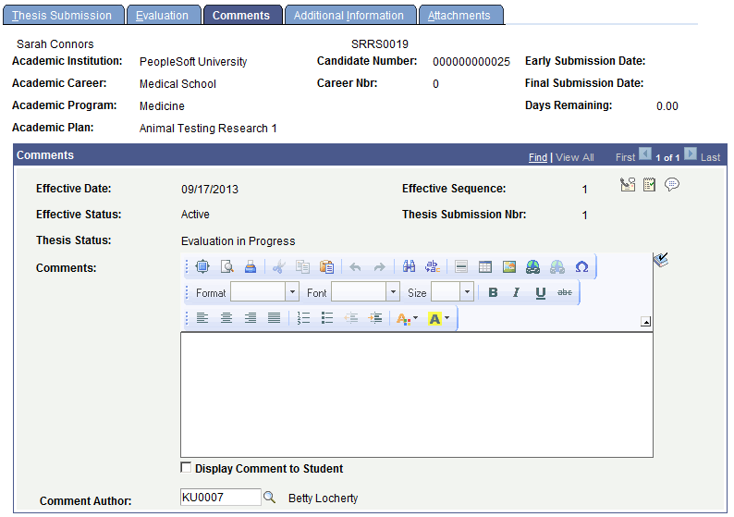
MODULE-2{Thesis management}

Slide 17
Available Features
Student Panel
Admin Panel
Add Thesis
Search Thesis
List Thesis
Evaluate Thesis
View Thesis

Slide 18
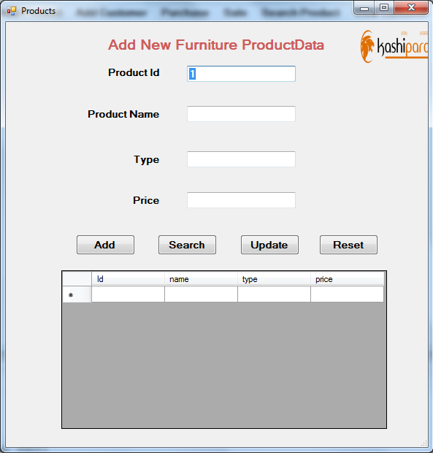
Module-3{Furniture management}

Slide 19
Available Features
Admin Panel
Categories
Add Furniture
Remove Furniture
Search Thesis
Count Furniture
Issue Furniture

Slide 20
HARDWARE REQUIREMENT
RESOURCE PLANNING
Laptop:
40GB HDD
4GB RAM
dual core processor
SOFTWARE REQUIREMENT
Visual Studio
Python-Django
SQLite Database

Slide 21

SCOPE
The scope of the project is the system on which the software is installed, i.e. the project is developed as laptop or phone application, and it will work for a particular school or college. But later on the project can be modified to operate it online.

Slide 22
THANKYOU

