Slide 1

By:
C.Jwalitha(513)
M.N.V.Satya Narayana(557)
K.Nikhil(543)
A.GideonPaul(504)
Under:
K.VenuGopal

Slide 2

Our current website is one of the best available designs in both architecture and layouts by the old standards.
In this project, we will embrace the latest trends in the field of Web design and development.
We will stringently stress on flexible design and good documentation.
Cross browser compatibility, elevating the performance of our site will be taken care of.

Slide 3

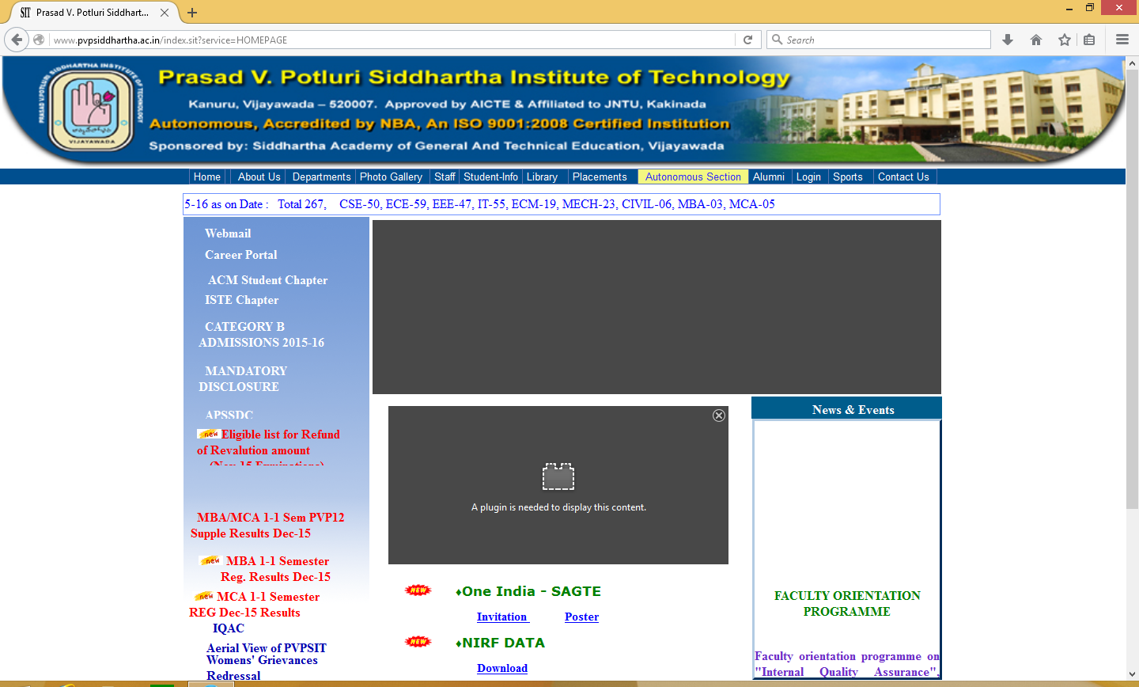

Slide 4

Data Redundancy.
Slow down of our server during results.
User Interface.
Multiple submission of student attendance.
Modification of data from back end.
Usage of Flash which is outdated

Slide 5

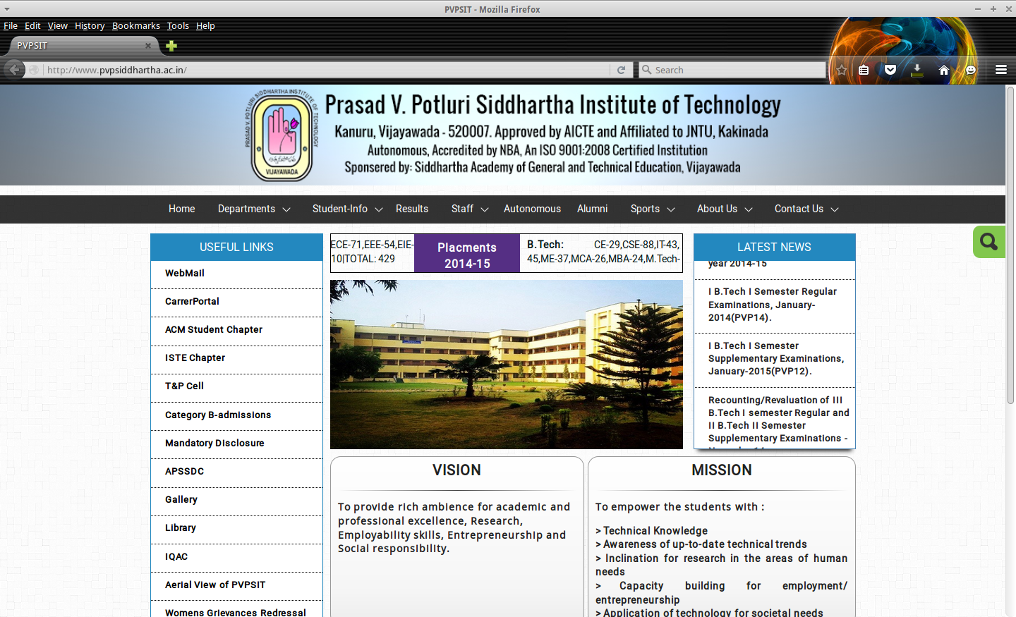

Slide 6

Enhancing the User Interface
Elevate the performance of the existing site
Conversion of PostGreSQL to MySQL
Content Management System

Slide 7

HTML 5
CSS 3
JAVA SCRIPT / JQUERY
PHP 5

Slide 8

Any modern Browser (old browsers are supported too)

Slide 9

Processor: Intel® Core™ 2 Duo CPU
RAM: 2GB
Clock Speed: 3.07GHz

Slide 10


Slide 11

Rich Client Interaction / Interface
Restructuring of Database
Rectification of Attendance module
Browser based Database Management

Slide 12
User Interface:
Previously our website is implemented with the basic HTML tags, in order to improve the look and feel we are using CSS, JQuery etc.
Providing a good navigation facility by avoiding the overlapped links
Included a slider which works on any kind of platform

Slide 13

Reconstruction of existing Database:
To maintain database in an easy manner, MySQL is introduced to our website, replacing the existing PostGreSQL.
Schema is refined
Reducing the redundancy by Normalizing the database

Slide 14
Rectification of Attendance Module:
Rectifying the multiple submissions problem
Generating the apt attendance report
Rectifying the divided lab batches attendance scenario

Slide 15
Client based Database Management:
Attempting to change the whole updating process through frontend

Slide 16


Slide 17
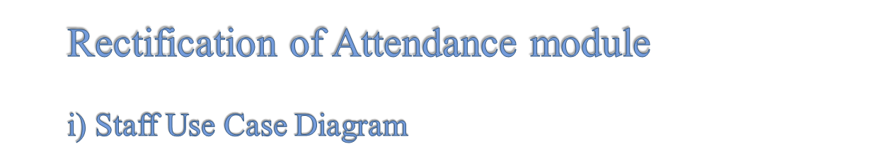
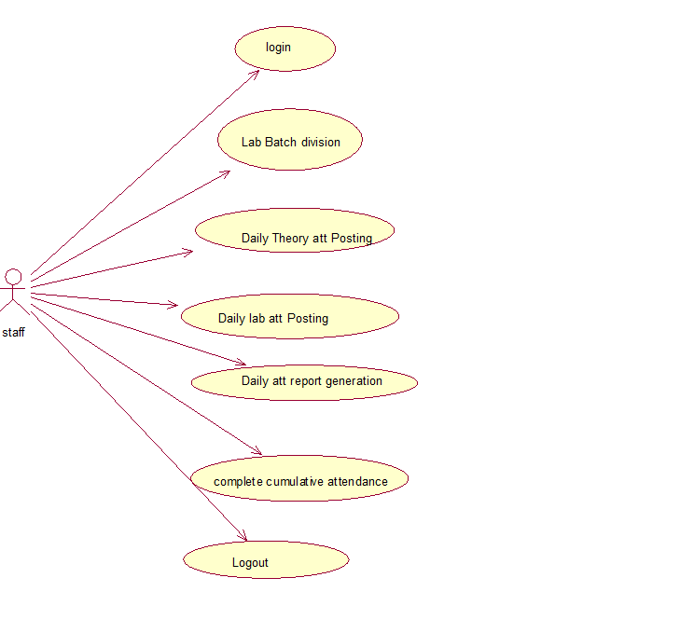

Slide 18
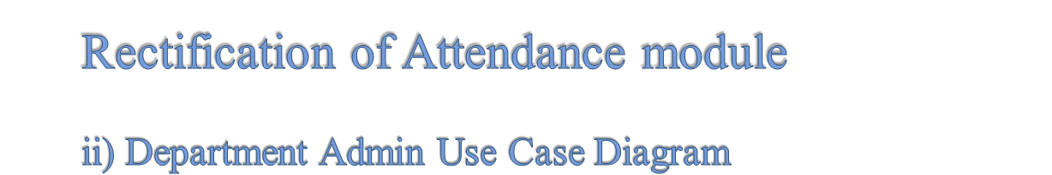
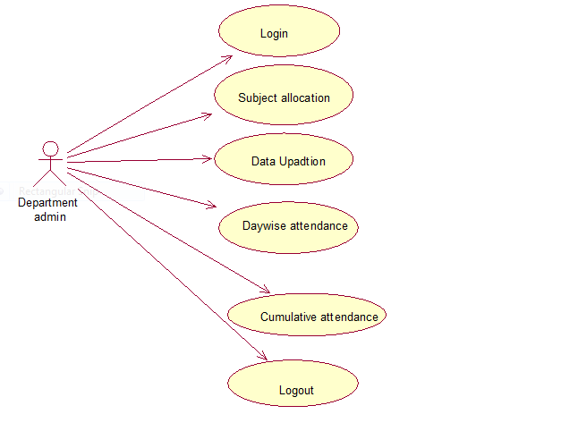

Slide 19

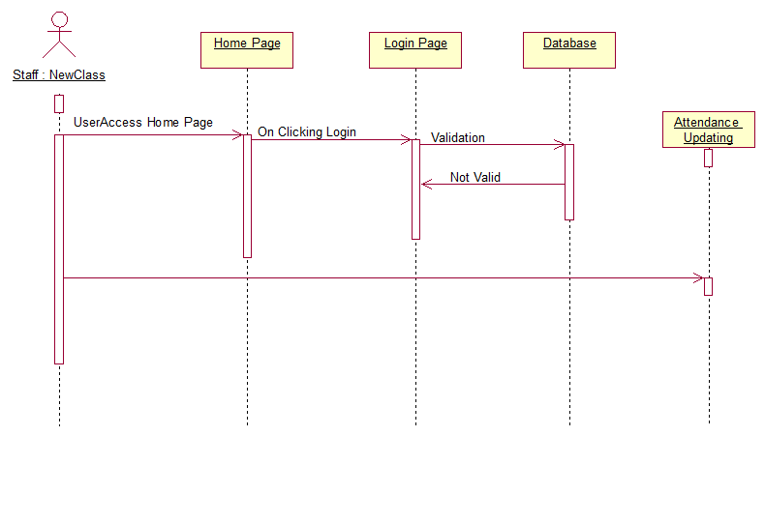

Slide 20

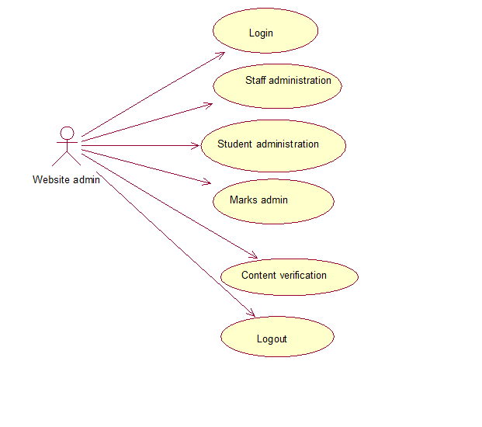

Slide 21

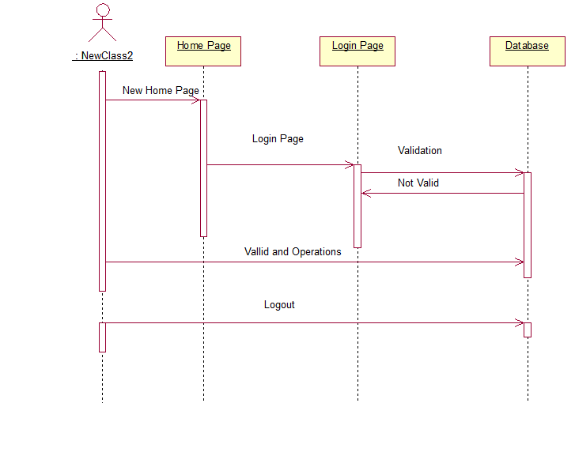

Slide 22


