Slide 1

Stock Market Analysis and Prediction
Submitted By:
Satyam Rokade (230343025040)
Ganesh Ingale (230343025020)
Sushant Bhabutkar (230343025051)
Amit Gavval (230343025017)
Guided By:
Mr. Prasad Deshmukh
Mr. Anay Tamhankar
1
24/08/2023

Slide 2
Introduction
Financial markets are highly volatile and generate huge amounts of data daily.
Stock price analysis is a critical area of research and is one of the top applications of machine learning.
There are numerous causes for this, including market volatility and a variety of other dependent and independent variables that influence the value of a certain stock in the market.
These variables make it extremely difficult for any stock market expert to anticipate the rise and fall of the market with great precision.

Slide 3
Objective Of Project :
To find out the best Machine Learning Algorithm model for Predicating the future stock value.
Stock Price Prediction using machine learning helps in discovering the future values of a company’s stocks and other assets.
Predicting stock prices helps in gaining significant profits.

Slide 4
System Architecture
Data Flow Diagram
Data Preprocessing
Plot Data
Train model ()
Predict Stock Price
Plot Predicted Vs Actual
Save Model
Fetch Data

Slide 5
Methodology :
Data Used :
Yahoo Finance data (2000 – Till date)
Data Preprocessing :
Cleaned & and transformed the data in the format.
Added Derived Columns (EMA)
Machine Learning Used :
Linear Regression
KNN
Elastic Net
Random Forest
LSTM
Visualizing the Data :
Visualised the data using Tableau.
6

Slide 6
Machine Learning Algorithms
Linear Regression :-
It works by finding the linear relationship between a set of input variables (e.g., historical prices, trading volumes, etc.) and the output variable (e.g., future stock closing price).
K-Nearest Neighbour :-
K-Nearest Neighbors (KNN) is a type of machine learning algorithm that can be useful in stock market prediction due to its ability to classify new data points based on similarities to existing data points.

Slide 7
Machine Learning Algorithms
Elastic net regression:-
Elastic Net is a type of machine learning algorithm that can be useful in stock market prediction due to its ability to handle high-dimensional data with a large number of predictors.
Random Forest :-
Random Forest is a type of ensemble learning algorithm that can be useful in stock market prediction due to its ability to handle large datasets with complex relationships between variables.

Slide 8
Machine Learning Algorithms
LSTM (Long Short-Term Memory) :-
LSTM (Long Short-Term Memory) is a type of Recurrent Neural Network (RNN) that is particularly useful in stock market prediction because of its ability to capture long-term dependencies and patterns in time series data.

Slide 9
R2 Score Comparison Between Machine Learning Algorithms
Machine Learning Model | R2 Score
Linear Regression | 0.9999
K-Nearest Neighbour | 0.9866
Random Forest | 0.9998
Elastic Net Regression | 0.9941
LSTM | 0.9998

Slide 10
Predictions For Next Day (24-08-2023)
Actual Closing Price | 176.38
Linear Regression | 177.23
Random Forest | 177.22
KNN | 176.35
Elastic Net | 171.47
LSTM | 177.09

Slide 11
Data Visualization & Representation

Slide 12
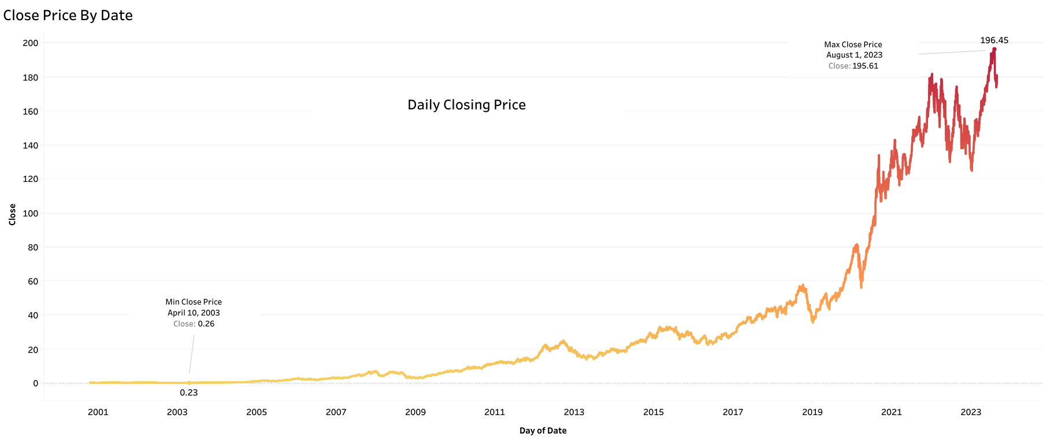
Daily Closing Price(Line Chart)

Slide 13
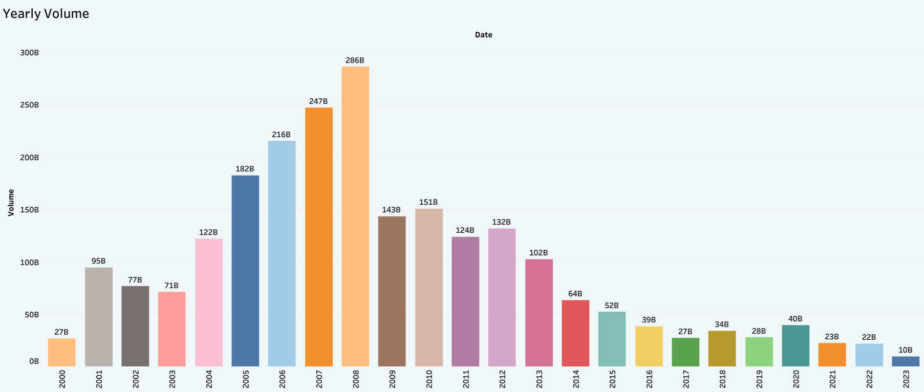
Yearly Volume

Slide 14
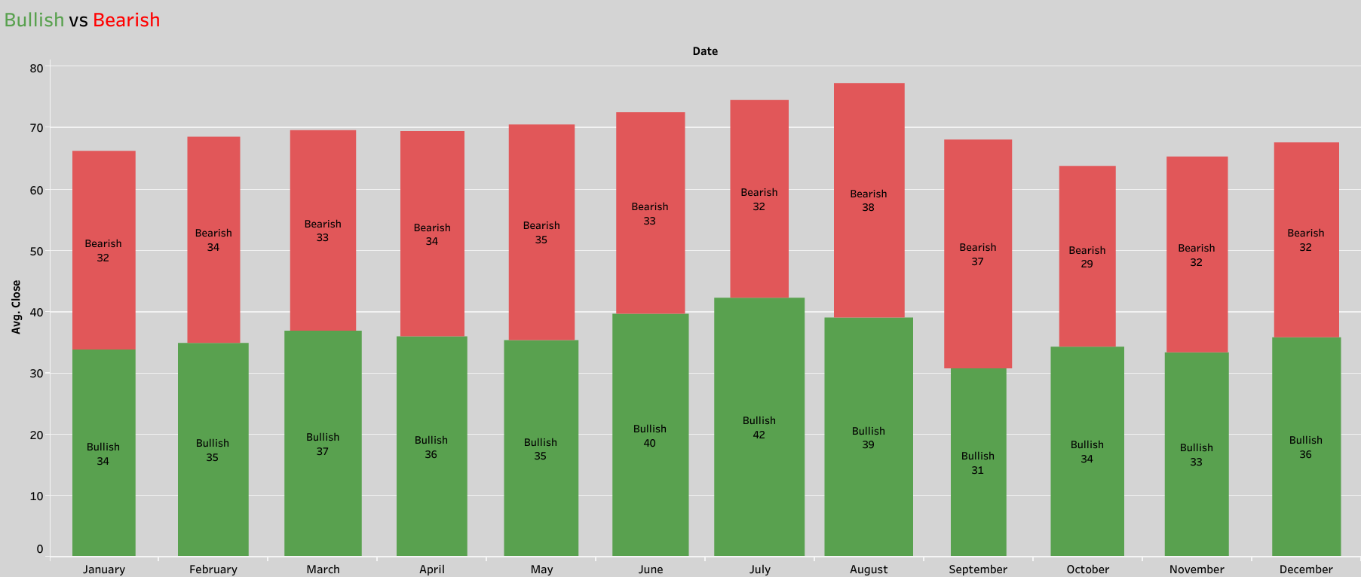
Bullish Vs Bearish

Slide 15
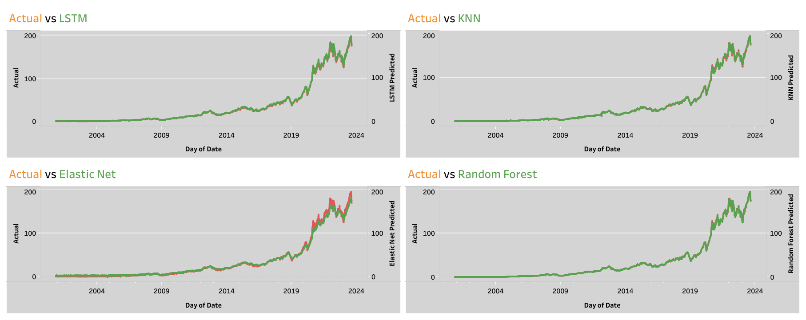
Actual Vs Predicted(Model-wise)

Slide 16
CONCLUSION
With the introduction of Machine Learning and its strong algorithms, the most recent market research and Stock Price Prediction using machine learning advancements have begun to include such approaches in analyzing stock market data. The Opening Value of the stock, the Highest and Lowest values of that stock on the same day, as well as the Closing Value at the end of the day are all indicated for each date.
Machine learning not only saves time and resources but also outperforms people in terms of performance.
We can see above in our proposed method, we train the data using existing stock dataset that is available. We use this data to predict and forecast the stock price of next day.

Slide 17
FUTURE ENHANCEMENT
The limitation of the proposed system is its computational speed, especially with respect to sliding-window validation as the computational cost increases with the number of forward day predictions.
The proposed model does not predict well for sudden changes in the trend of stock data.
This occurs due to external factors and real-world changes affecting the stock market.
We can overcome this by implementing Sentiment Analysis and Neural Networks to enhance the proposed model.

Slide 18
THANK YOU
18

