Slide 1
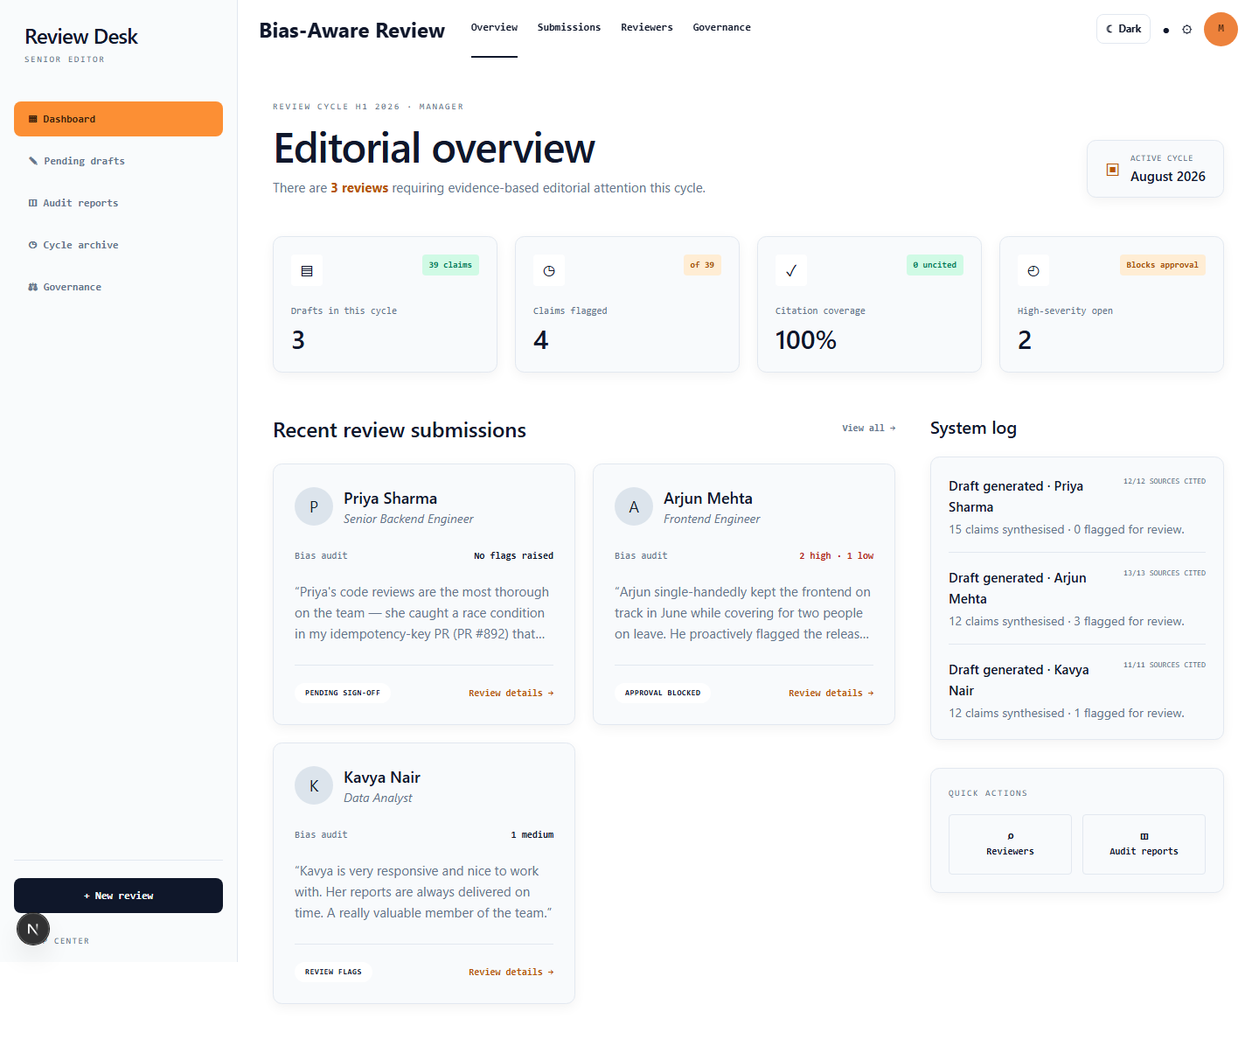
AGENTIC AI · PS-2
Bias-Aware 360°
Review Desk
Evidence-cited performance reviews with an independent bias audit and an enforced human approval gate.
NEXT.JS 15
n8n + GEMINI
SUPABASE
Team Claude's Plan
INNOVA HACK Chapter-1

Slide 2
THE PROBLEM
A performance review can amplify weak evidence
Managers must synthesize scattered feedback under time pressure—exactly where unsupported narratives can become official records.
Scattered evidence
High-stakes synthesis
Missing accountability
Self-assessment
Manager feedback
Peer comments
Goals and project outcomes
A single vague or recent opinion can outweigh objective outcomes. Traditional AI summarizers may make the narrative sound more confident—not more true.
Without citations, a separate audit, and a human decision gate, reviewers cannot explain where a conclusion came from or why it was approved.
Design principle
The system should refuse unsupported certainty, not merely generate polished prose.

Slide 3
OUR SOLUTION
A review pipeline with independent checks
Two agents perform different jobs; deterministic validators and a human approver constrain both.
1
2
3
4
5
Evidence
Synthesis agent
Validation
Bias-audit agent
Human gate
Self · manager · peers · goals · outcomes
Specific report claims with source IDs
Whitelist citations; drop uncited claims
5 failure categories + severity + reasoning
Edit · acknowledge · reject · approve
Agentic, not autonomous
The system can gather, reason, audit, and recommend—but it cannot finalize a harmful review without an explicit human action recorded in the audit trail.

Slide 4
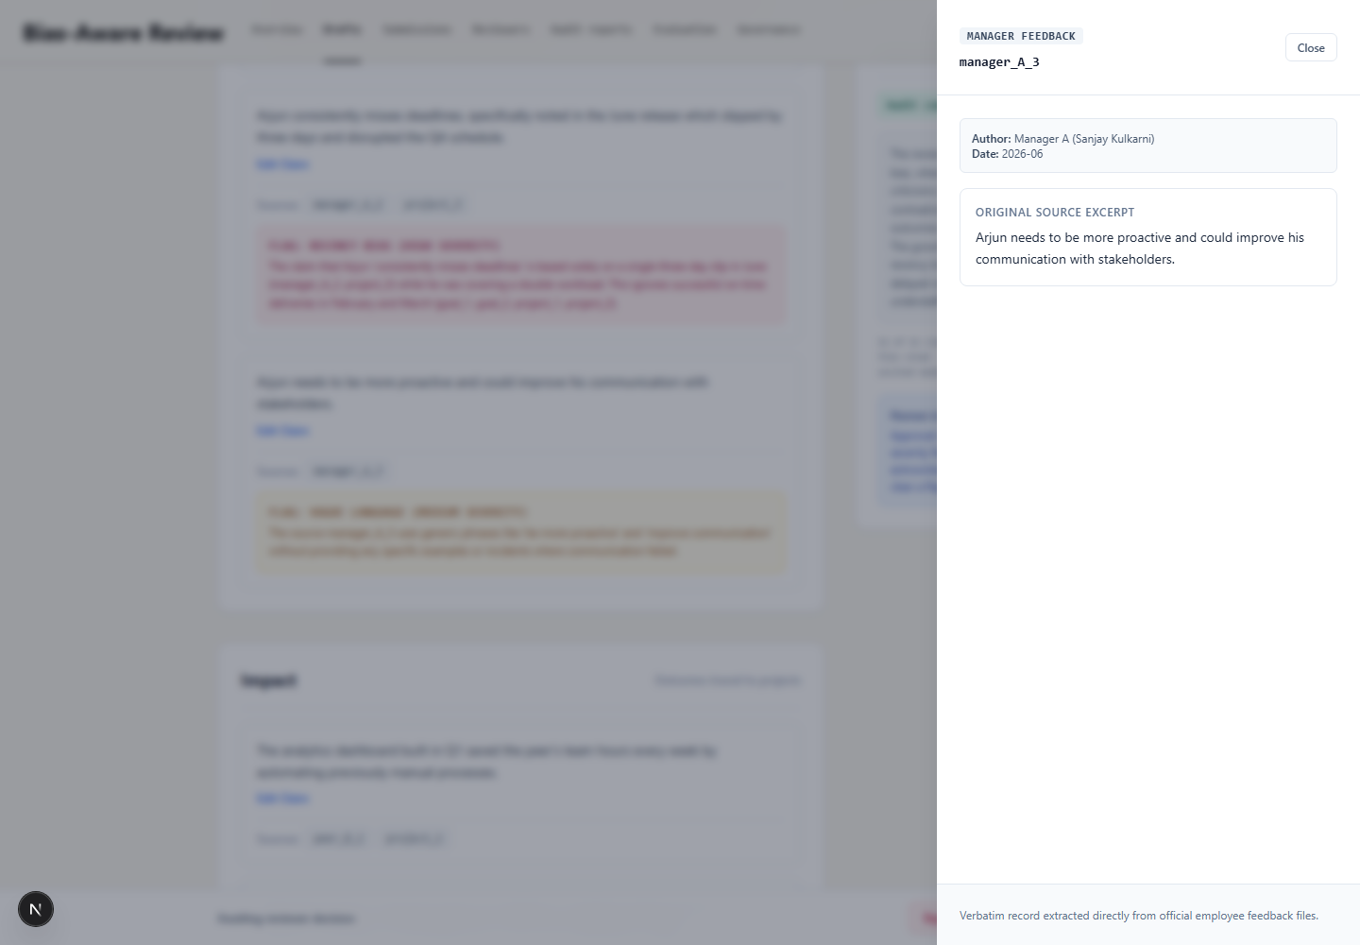
EVIDENCE GROUNDING
Every conclusion is inspectable
A claim is useful only when the reviewer can trace it back to the original sentence or objective record.
Claim-level citations
Every report claim carries one or more canonical source IDs.
Deterministic resolution
Missing or invented IDs are surfaced; citations are not trusted merely because the model emitted them.
Fail-closed audit
Missing, duplicate, malformed, or unknown audit references stop generation instead of appearing clean.

Slide 5
BIAS DETECTION
The second agent audits the first
It reviews every claim against all source evidence—not just the sources selected by the synthesis agent.
Unsupported claim
Recency bias
Single-source bias
No concrete support
Recent period dominates
One subjective voice
Vague language
Contradiction
Independent signal
No observable detail
Objective evidence conflicts
A non-LLM pre-check measures source concentration, time coverage, and peer-voice balance.
Why two signals?
Model-based semantic review catches harmful wording; deterministic arithmetic catches skewed evidence distribution. Neither is presented as a standalone fairness verdict.

Slide 6
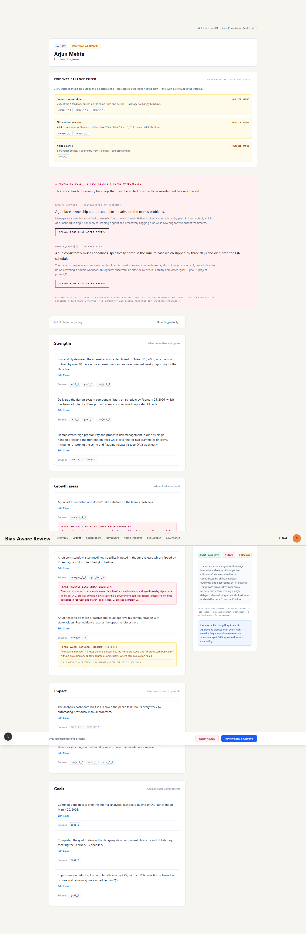
HUMAN IN THE LOOP
Approval is a server-enforced decision
The interface does not merely suggest review—the backend refuses unresolved high-severity approval attempts.
1 · Inspect
Open original citations and flag reasoning.
2 · Decide
Amend, explicitly acknowledge, or reject. Editing alone does not clear the original flag.
3 · Record
Actor, timestamp, action, field-level diff, and acknowledged references enter the audit trail.
HTTP 422
unresolved_high_severity_flags

Slide 7
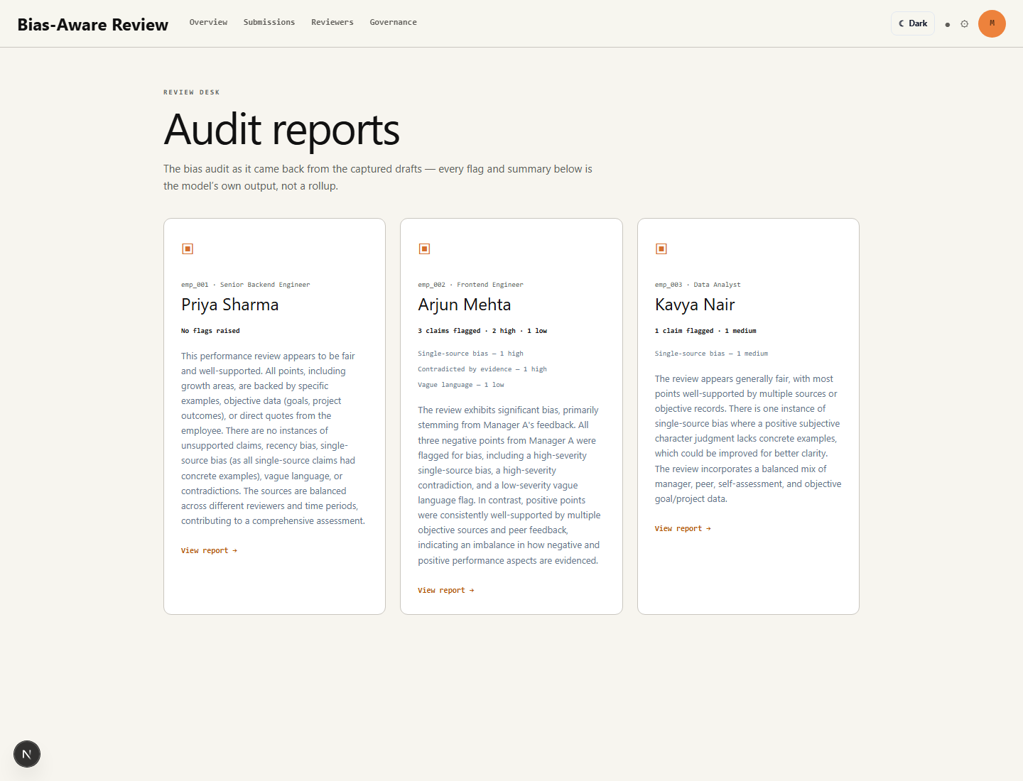
MEASURED PERFORMANCE
We expose misses instead of claiming perfection
Benchmark v1 compares captured outputs with human-adjudicated labels on 39 synthetic claims.
100%
66.7%
80.0%
83.3%
100%
Precision
Recall
Overall F1
Macro F1
Citation resolution
0 false positives
2 false negatives
balanced score
represented classes
all IDs resolve
Known weaknesses
2 missed vague-praise claims
No labeled recency-bias cases yet
No labeled unsupported-claim cases yet
Captured run; repeated-run consistency remains future work
Judge takeaway: the dashboard is both evidence and a product safety mechanism—it directs prompt tuning to measurable failure modes.

Slide 8
GOVERNANCE & PRIVACY
Implemented controls—and explicit boundaries
We distinguish actual safeguards from production controls that remain outside the hackathon scope.
Implemented in the prototype
Required before production
Server-only n8n webhook URL
Employee-scoped audit proxy
Runtime request/response validation
Synthetic demo and benchmark data
Field-level approval diffs
Honest governance disclosures
Authentication and role-based access
No live report persistence in localStorage
Consent and retention policy
Employee export / erasure workflow
Database RLS and append-only permissions
Signed server-to-server workflow requests
Responsible AI means making limitations inspectable—not hiding them behind a polished demo.

Slide 9
90-SECOND DEMO
Show the complete safety loop
Use the biased Arjun scenario to demonstrate grounding, detection, human control, and accountability.
01
Generate
02
Trace
03
Detect
Open Arjun Mehta and generate the draft.
Open a citation to show original source text.
Find “consistently misses deadlines” contradicted by outcomes.
04
Block
05
Decide
06
Audit
Attempt approval; show the server refusal.
Amend or acknowledge after review, then approve.
Open the final audit trail and evaluation page.
Live demo: bias-aware-360-review-system.vercel.app
Backup: captured reports keep the full journey available offline

Slide 10
WHY THIS PROJECT STANDS OUT
A review people can
question before it counts.
Grounded
Agentic
Accountable
Measurable
Every claim links to evidence.
Synthesis and audit are independent roles.
Human decisions and changes are recorded.
Precision, recall, F1, and misses are visible.
From scattered feedback to an inspectable decision—without pretending AI should be the final authority.
Thank you

