Slide 1

SMART INDIA HACKATHON 2026
TITLE PAGE
Problem Statement ID – 26104
Problem Statement Title- AI-Powered Real-Time Detection and Prevention of Voice Cloning Impersonation Attacks
Theme- Cyber Security & Safety
PS Category- Software
Team ID- TEAM26104E12
Team Name (Registered on portal)- Epoch12
12

Slide 2
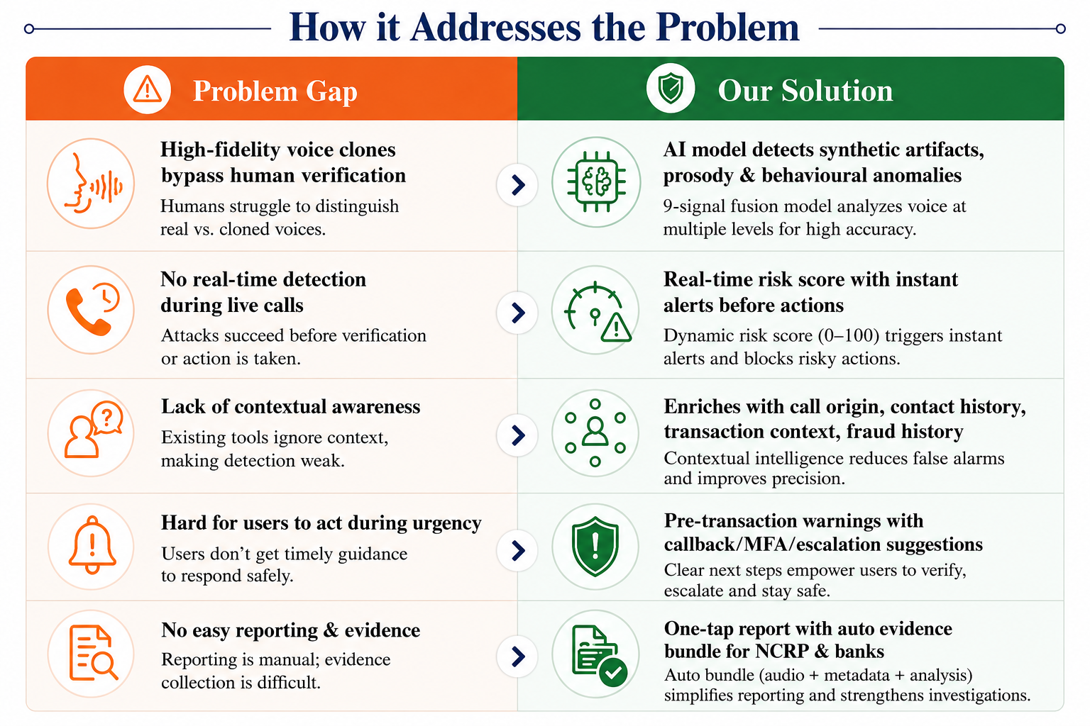
Epoch12
IDEA TITLE
VoiceShield AI – Real-Time Voice Integrity & Scam Prevention System
Proposed Solution (Describe your Idea/Solution/Prototype)
Real-time AI engine analyzes live voice for cloning, deepfake & impersonation during calls.
9-signal fusion model generates dynamic risk score (0–100) with contextual intelligence.
Instant alerts & action nudges (callback, MFA, escalate) before user takes any sensitive action.
Multi-platform protection: Android in-call, Web dashboard & Public API/SDK for enterprise integration.
Problem Gap | Our Solution
High-fidelity voice clones bypass human verification | AI model detects synthetic artifacts, prosody & behavioural anomalies
No real-time detection during live calls | Real-time risk score with instant alerts before actions
Lack of contextual awareness | Enriches with call origin, contact history, transaction context, fraud history
Hard for users to act during urgency | Pre-transaction warnings with callback/MFA/escalation suggestions
No easy reporting & evidence | One-tap report with auto evidence bundle for NCRP & banks
Innovation & Uniqueness
9-signal hard+soft fusion with psycho-linguistic coercion scoring.
Works in real-time with low latency (< 2 sec) on-device & cloud hybrid.
Built for Indian accents & multilingual speech with contextual enrichment.
2

Slide 3
Epoch12
TECHNICAL APPROACH
Technologies to be used
Methodology & Process (System Flow)
Layer | Technology | Why chosen
Frontend (Mobile) | React Native (Expo) | Cross-platform, in-call overlay, fast UI, large community
Frontend (Web) | React.js + Tailwind CSS | Responsive dashboard, rich visualization
Backend | Python (FastAPI) | High performance, async support, easy ML integration
AI / ML | PyTorch & torchaudio | State-of-the-art models, flexible research, real-time inference
Database | MongoDB Atlas | Scalable NoSQL, flexible schema for logs & metadata
Cache / Queue | Redis | Low-latency caching, real-time streams & session store
Hosting / Cloud | AWS (EC2, S3, Lambda) | Scalable, secure, global infra, easy CI/CD
Communication | WebRTC + Twilio | Real-time audio streaming & telephony integration
1
User initiates/receives a call (VoIP/Telephony/App)
2
Live audio captured & streamed (WebRTC)
3
Audio preprocessing (denoise, VAD, segmentation)
4
9-signal feature extraction (audio + biometric + NLP)
5
AI model inference & risk score generation (0–100)
6
Context enrichment (caller ID, history, transaction data)
7
Alerting & action nudges based on threshold
8
Feedback loop (user action & model retraining)
Prototype / Demo Status: Working prototype exists (Android in-call, WebRTC tap, AI inference pipeline). SIH-grade integration & enterprise APIs planned.
3

Slide 4
Epoch12
FEASIBILITY AND VIABILITY
@SIH Idea submission- Template Epoch12
Feasibility Analysis
Potential Challenges & Risks
Technical:
Risk | Impact (H/M/L) | Mitigation Strategy
Model accuracy on unseen accents / languages | H | Continuous training with Indian-accent datasets; active learning loop
Internet connectivity / latency issues | M | On-device pre-check + lightweight edge inference; async upload
Data privacy & compliance (DPDP Act 2023) | H | Data minimization, encryption, user consent, role-based access, audit logs
Scalability during peak traffic | H | Auto-scaling on AWS; load balancing; caching & queue-based processing
User adoption & false alerts | M | Explainable risk score, threshold tuning, user feedback to improve model
All core components are built using proven open-source tools & cloud services; real-time inference achieved (< 2 sec latency).
Operational:
Easy integration via APIs/SDKs, minimal training needed for end-users; supports multi-language & multi-accent.
Financial:
Uses cost-effective cloud infra; estimated ₹0.15 – ₹0.30 per call for cloud inference at scale.
4

Slide 5
Epoch12
IMPACT AND BENEFITS
Potential Impact on Target Audience
Benefits of the Solution
Banks, NBFCs, Fintechs
Telecom Operators & Call Centers
Social Impact
Economic Impact
Environmental Impact
Government Departments
Protects citizens from voice-clone scams & digital arrest fraud.
Builds trust in digital comms & telephony.
Empowers vulnerable users (elderly, rural) with AI shield.
Saves financial losses from fraudulent transfers.
Lowers verification cost for banks & enterprises.
Boosts productivity by reducing (elderly, rural) verification.
Reduces paper-based verification & reporting.
Optimized cloud infra with auto-scaling to save resources.
Enterprises (CXO Offices, HR, Finance)
Individuals (High-risk users)
Estimated Reach: 1+ crore users in first 2 years across India through partner ecosystems.
~70% reduction in successful voice-based fraud attempts*
Estimated savings of ₹500 – ₹1500 per prevented fraud case*
~90% reduction in paper usage for verification*
5

Slide 6
Epoch12
RESEARCH AND REFERENCES
Details / Links of the Reference and Research Work
1
ASVspoof 2019: A Large-Scale Public Database of Spoofing and Countermeasures for Automatic Speaker Verification – (B. Wen et al., 2019)
Benchmark dataset for synthetic speech detection.
2
In-the-Wild (ITW) Dataset – (Chung et al., 2019)
Real-world dataset for speaker verification under unconstrained conditions.
3
Voice Deepfake Detection with Deep Learning: A Survey – (J. Yi et al., IEEE Access, 2022)
Comprehensive survey of voice deepfake detection techniques.
4
Digital Personal Data Protection Act, 2023 – MeitY, Government of India
Legal framework for data privacy, consent, and data fiduciary obligations.
5
NCRP & 1930 Cyber Crime Reports – Ministry of Home Affairs
Official data on voice-clone scams and digital arrest fraud trends.
6

