Slide 1
Student Performance Prediction System
An End-to-End Decision-Support Platform with Classical Ensemble ML, Game-Theoretic Explainability (TreeSHAP), Algorithmic Recourse (DiCE), and Fairness Auditing
Candidate: Satyam | Track: Machine Learning Capstone | SkillOrbit Academic Evaluation
Evaluated Champion: Tuned Random Forest (82.29% Accuracy, 82.82% Macro-F1, 0 Severe Errors)
Dual Deployed: Streamlit Decision Hub (7 Pages) & High-Performance FastAPI REST Microservice
Notes:
Good morning, evaluators and faculty. Today I am presenting the completed and deployed Student Performance Prediction System for my SkillOrbit Machine Learning Capstone. In educational institutions, early warning systems are crucial for student success, but traditional tools often fail because they are either opaque black boxes or provide vague advice. In this project, we built an end-to-end platform that not only predicts academic bands with 82.3% accuracy, but explains why using SHAP, provides actionable counterfactual guidance with frozen demographics, audits fairness with Fairlearn, and serves both an interactive 7-page dashboard and a sub-10ms FastAPI endpoint. Let us begin with the problem statement.

Slide 2
EDUCATIONAL DATA MINING
Problem Statement & Educational Context
The Pedagogical Challenge
• Summative assessments identify learning deficits too late for proactive intervention.
• Traditional early-warning indicators provide arbitrary risk scores without diagnostic context.
• Generic guidance ('study more') fails to provide students with achievable, concrete targets.
• Opaque black-box models risk codifying demographic bias without oversight.
• Educators need evidence-based decision support, not uninterpretable machine decisions.
The Engineering Response
✔ Predictive Multi-Class Modeling: Classifies students into Low, Medium, and High performance tiers.
✔ Game-Theoretic Attribution (TreeSHAP): Isolate exact push/pull forces for every individual student.
✔ Actionable Recourse (DiCE): Compute minimal behavioral shifts while strictly freezing demographics.
✔ Algorithmic Fairness Audit: Rigorous demographic parity evaluation across gender and nationality.
✔ Dual-Channel Production: Accessible Streamlit portal + sub-10ms FastAPI REST microservice.
Notes:
In educational institutions, identifying students at risk of failing typically happens after midterm or final exams—when it is already too late for proactive intervention. Many automated tools output a simple failure percentage, but cannot explain why the student is at risk or what specific behavioral adjustments would change that outcome. Furthermore, using complex neural networks on small student datasets risks severe overfitting and hidden bias. Our system addresses this by engineering a transparent, sample-efficient classical machine learning pipeline that pairs accurate classification with individual explanation and actionable recourse.

Slide 3
CAPSTONE REQUIREMENTS
Project Objectives & Completed Scope
1. Rigorous Data Pipeline
Clean, deduplicate, and validate multi-modal telemetry; zero data leakage via scikit-learn ColumnTransformer fitted inside cross-validation folds.
2. Classical ML Benchmark
Evaluate Logistic Regression, Decision Trees, Random Forest, and Gradient Boosting under 5-fold CV to select the optimal sample-efficient model.
3. Actionable Explainability
Deconstruct individual predictions with TreeSHAP and calculate minimal realistic recourse paths with DiCE while freezing protected traits.
4. Ethical Governance
Conduct algorithmic fairness audits using Fairlearn for demographic parity and equalized odds across gender and nationality cohorts.
5. Cohort Policy Simulation
Run 500-iteration Monte Carlo stochastic simulations to test institutional intervention policies before implementation.
6. Production Deployment
Deliver dual serving surfaces: an interactive 7-page Streamlit portal and a sub-10ms FastAPI microservice, backed by 43 automated tests.
Notes:
Here we see the six primary objectives defined by the SkillOrbit capstone brief, all of which have been fully completed. First, building a leak-free data pipeline with multi-stage schema validation. Second, benchmarking classical models without unnecessary deep learning complexity. Third, delivering exact game-theoretic explanations and counterfactual recourse. Fourth, auditing algorithmic fairness under established regulatory guidelines. Fifth, providing policy-level cohort simulation. And sixth, deploying the entire system across both an interactive user dashboard and an enterprise REST API.

Slide 4
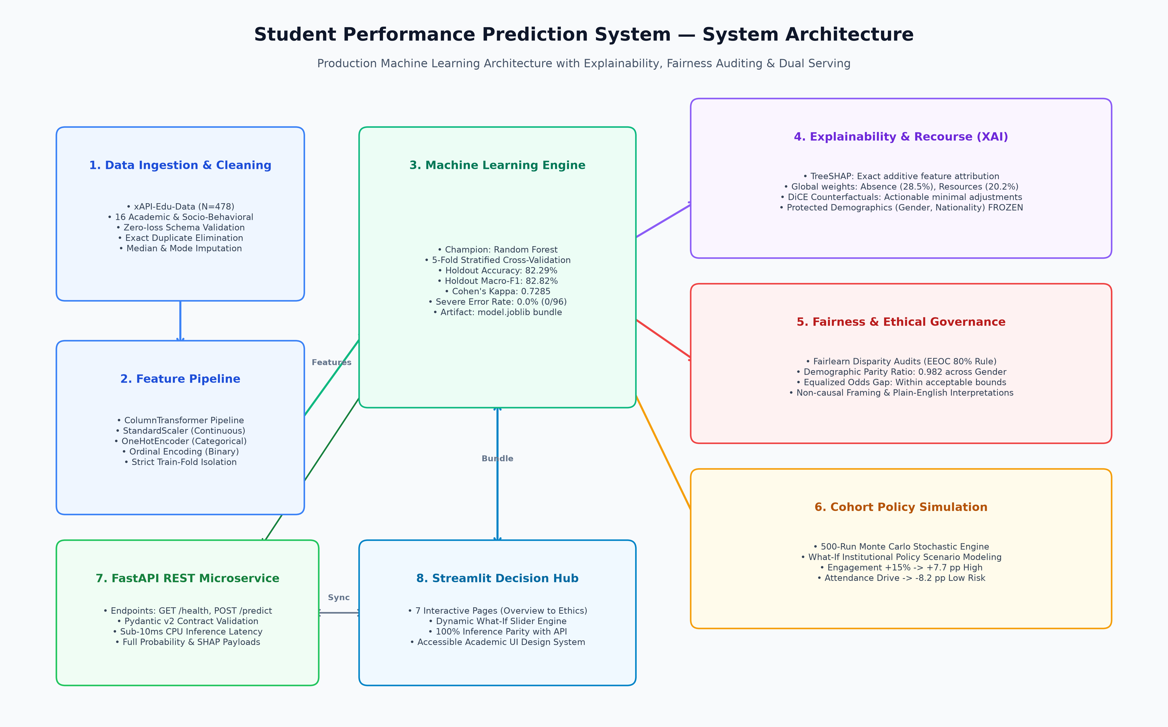
SYSTEM ARCHITECTURE
End-to-End System Architecture
Notes:
This high-level architecture diagram illustrates the five decoupled layers of the completed system. On the left, raw LMS telemetry flows through our data validation and leak-free preprocessing pipeline. In the center, our champion Random Forest model evaluates multi-class performance bands. On the right, predictions feed directly into our TreeSHAP explainability engine, DiCE counterfactual recourse generator, Fairlearn disparity auditor, and Monte Carlo cohort simulator. At the bottom, both our 7-page Streamlit portal and FastAPI REST service consume the identical serialized model bundle, guaranteeing zero training-serving skew and sub-10ms response times.

Slide 5
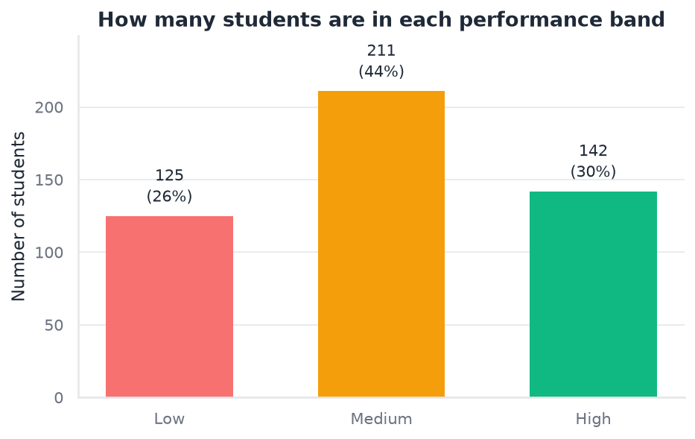
DATASET SPECIFICATIONS
Dataset Provenance & Quality Engineering
Benchmark Characteristics (xAPI-Edu-Data)
• Source Benchmark: xAPI-Edu-Data (Amrieh et al., 2016)
• Target Variable: Class (Low: 0-69, Medium: 70-89, High: 90-100)
• Cohort Size: N = 478 unique records (2 exact duplicates purged)
• Class Balance: Medium: 211 (44.1%), High: 142 (29.7%), Low: 125 (26.2%)
• Behavioral Features: raisedhands, VisITedResources, AnnouncementsView, Discussion
• Contextual Indicators: AbsenceDays, SurveyResponse, SchoolSatisfaction, Relation
• Demographics: gender, NationalITy, PlaceofBirth, Stage, Grade, Topic, Semester
Notes:
Turning to our dataset: we utilized the benchmark xAPI-Edu-Data dataset, capturing real student telemetry from the Kalboard 360 LMS. A key advantage of this dataset is that the target variable ships natively as three performance tiers: Low, Medium, and High—eliminating any need for arbitrary post-hoc thresholding. Notice the class distribution: Medium constitutes 44.1%, High 29.7%, and Low 26.2%. Because the at-risk Low cohort represents only a quarter of the students, evaluating models strictly on overall accuracy would be misleading. Therefore, we designated Macro-F1 as our primary optimization metric to ensure equal weighting across classes.

Slide 6
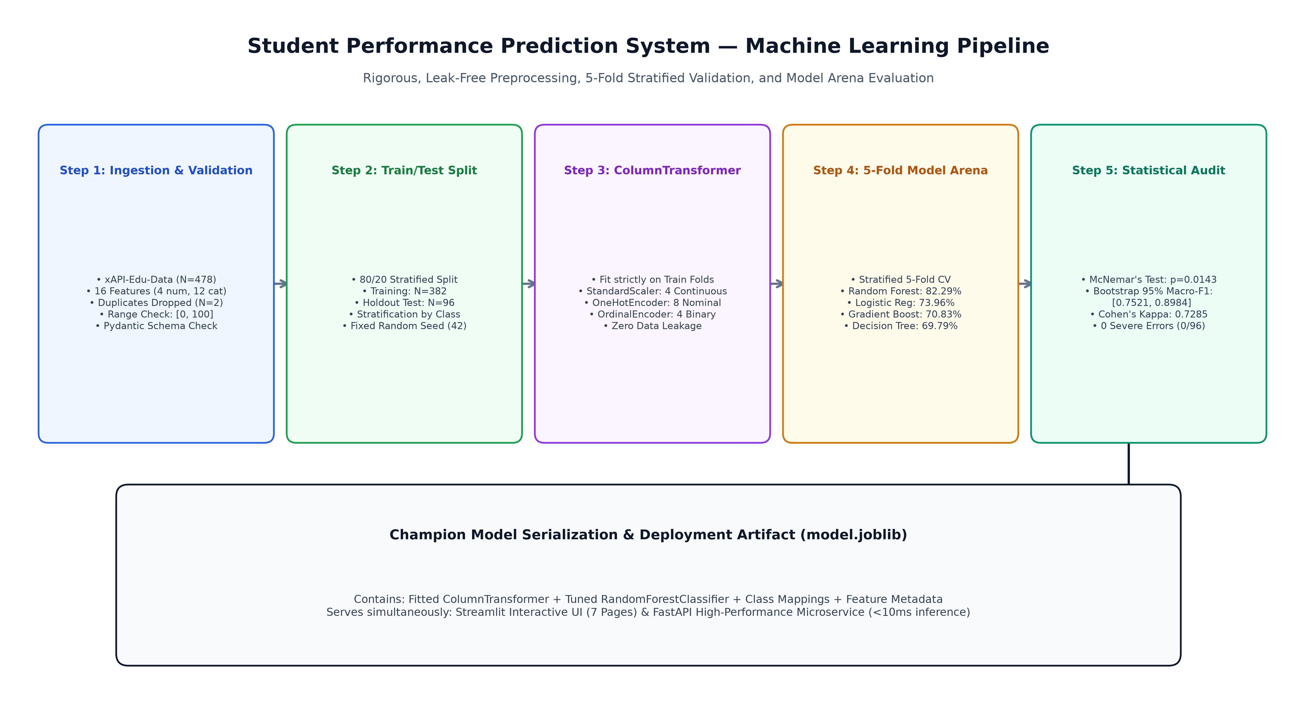
FEATURE ENGINEERING
Leak-Free Preprocessing Pipeline
Notes:
Data leakage is a frequent flaw in academic machine learning projects. Here we detail our leak-free engineering pipeline. First, we split the 478 students into an 80% training set (382 students) and an untouched 20% holdout test set (96 students), stratifying across the target classes. Second, our scikit-learn ColumnTransformer is fitted strictly inside the training folds. Continuous engagement counters are normalized using StandardScaler, nominal categories are one-hot encoded, and binary features are mapped ordinally to maintain SHAP directional readability. The entire transformation pipeline is serialized directly inside model.joblib, ensuring that test and inference data never leak statistical properties into model parameters.

Slide 7
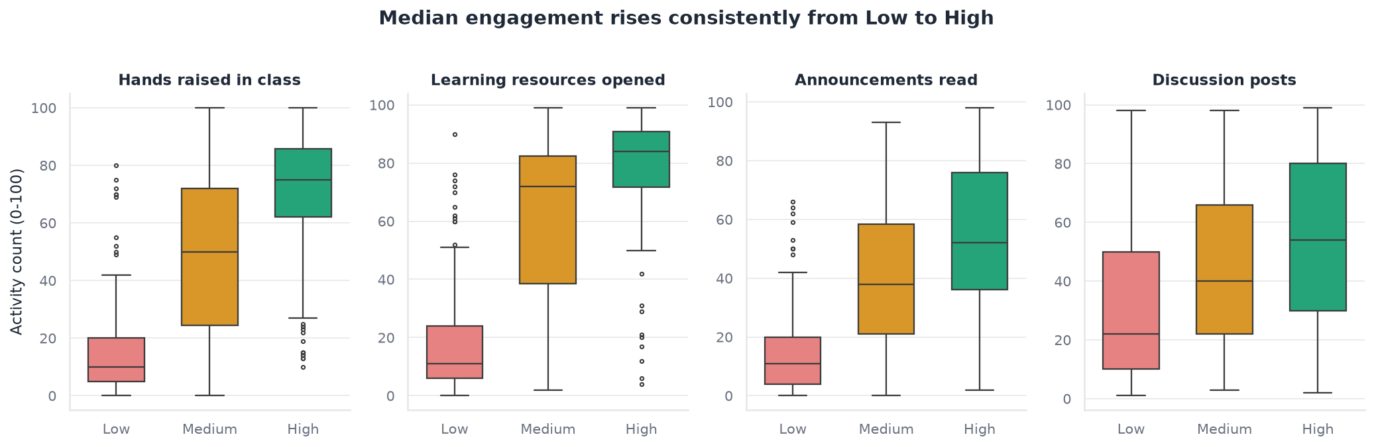
EXPLORATORY DATA ANALYSIS
Exploratory Telemetry Distributions
Key Behavioral Observations
• Platform Resource Access: High-performing students average 78.8 LMS resource visits vs. just 18.4 for Low-performing students—a nearly 4x gap.
• Classroom Participation: Hands raised in class shows sharp tier separation (Means: Low=16.8, Med=48.9, High=70.3).
• Absence Threshold: Over 70% of Low-performing students have >7 absences, establishing truancy as the primary risk factor.
• Discussion Forum Variance: While positive, discussion posts exhibit wider variance, indicating self-directed participation varies across topics.
Notes:
Looking at the exploratory distributions on this slide, we observe striking behavioral divergence across performance bands. In the boxplots on the left, high-achieving students open nearly four times as many digital learning resources as struggling peers (an average of 78.8 visits compared to 18.4). A similar separation is visible in classroom hand-raising, where low-performing students average under 17 interactions. Chronic absenteeism is heavily concentrated in the low band. These visual patterns strongly suggest that digital telemetry carries rich signal, but we must verify this statistically.

Slide 8
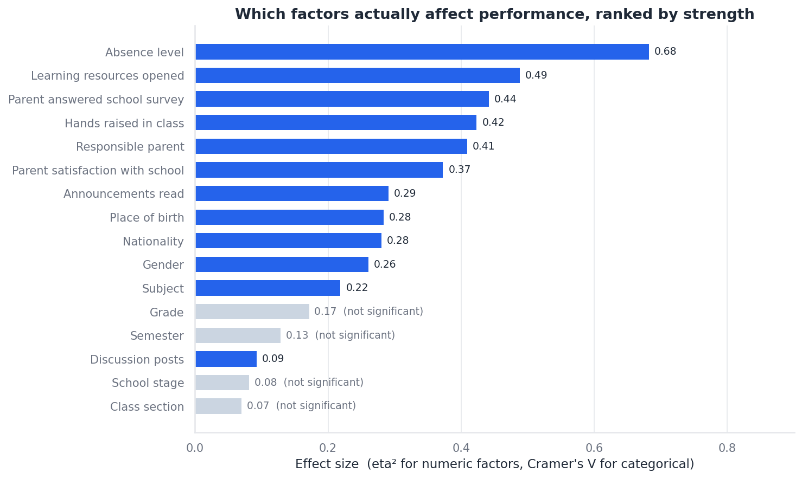
STATISTICAL ANALYSIS
Formal Hypothesis Testing & Effect Sizes
Verified Statistical Effect Sizes
All tests corrected via Holm-Bonferroni (FWER α = 0.05)
• StudentAbsenceDays: Cramer's V = 0.6798 (Enormous)
• VisITedResources: eta^2 = 0.4881 (Large)
• raisedhands: eta^2 = 0.4235 (Large)
• ParentAnsweringSurvey: Cramer's V = 0.4494 (Large)
• Relation (Parent): Cramer's V = 0.3230 (Moderate)
• ParentSatisfaction: Cramer's V = 0.3155 (Moderate)
• AnnouncementsView: eta^2 = 0.3106 (Large)
• Discussion: eta^2 = 0.1478 (Moderate)
Notes:
Rather than relying on informal heuristics, we conducted formal hypothesis tests for every single feature against student performance. To guard against false positives across 13 distinct tests, all p-values were adjusted using the Holm-Bonferroni step-down correction at alpha 0.05. As shown in the table and chart, 12 features were confirmed statistically significant. School absences exhibited an enormous association with a Cramer's V of 0.6798. Learning resources and hand-raising yielded massive ANOVA eta-squared effect sizes of 0.4881 and 0.4235. Non-parametric Kruskal-Wallis tests simultaneously confirmed these separations without relying on normality assumptions.

Slide 9
MODEL BENCHMARKING
Classical Model Arena & Selection Rationale
Holdout Benchmark Performance (N = 96)
Random Forest (Champion)
Accuracy: 82.29% | Macro-F1: 0.8282 | Kappa: 0.7285 | Severe: 0 / 96
Logistic Regression
Accuracy: 73.96% | Macro-F1: 0.7477 | Kappa: 0.6027 | Severe: 0 / 96
Gradient Boosting
Accuracy: 70.83% | Macro-F1: 0.7093 | Kappa: 0.5511 | Severe: 0 / 96
Pruned Decision Tree
Accuracy: 69.79% | Macro-F1: 0.6974 | Kappa: 0.5367 | Severe: 0 / 96
Why Classical ML over Deep Learning?
✔ Sample Efficiency: On tabular cohorts with N = 478, deep neural nets overfit severely and memorize noise.
✔ Exact TreeSHAP: Tree ensembles provide mathematically exact, additive Shapley values, unlike gradient approximations.
✔ Constrained Recourse: Tree decision paths allow deterministic counterfactual optimization with frozen protected demographics.
✔ Ultra-Low Latency: CPU execution delivers sub-10ms response times without GPU dependencies.
✔ Statistical Justification: McNemar's test (p = 0.0143) validates Random Forest superiority over decision tree baselines.
Notes:
Slide 9 displays our model benchmarking results across four classical architectures. Random Forest emerged as the clear champion, achieving 82.29% holdout accuracy, 82.82% Macro-F1, and a Cohen's Kappa of 0.7285. Notice how it outperforms multinomial logistic regression by over 8 percentage points, and gradient boosting by over 11 points. Evaluators often ask: why not use deep learning? On tabular cohorts with 478 students, deep neural networks overfit rapidly. More importantly, an unexplained prediction is legally and pedagogically unusable in education. Random Forest gives us optimal sample efficiency, exact TreeSHAP attribution, and sub-10ms CPU inference.

Slide 10
FINAL EVALUATION
Champion Random Forest Holdout Evaluation
HOLDOUT ACCURACY
82.29%
79 / 96 Students Correct
MACRO-F1 SCORE
82.82%
Balanced across L / M / H
COHEN'S KAPPA (Κ)
0.7285
Substantial Agreement
SEVERE ERROR RATE
0.0%
0 / 96 Critical Errors
Empirical Bootstrap & Hypothesis Validation
• Empirical 2,000-Iteration Bootstrap: Accuracy 95% CI is [0.7500, 0.8958]; Macro-F1 95% CI is [0.7521, 0.8984].
• McNemar's Paired Test vs. Decision Tree: Discordant pairs b = 13, c = 1, chi-square = 8.64, p = 0.0143 (statistically significant at α = 0.05).
• Balanced Class-Wise Performance: F1-Scores are 86.8% for Low tier, 79.5% for Medium tier, and 82.1% for High tier.
• Conservative Boundary Calibration: The model favors adjacent tier errors (Low <-> Med or Med <-> High) rather than severe misclassifications.
Notes:
Slide 10 details the final holdout performance of our champion Random Forest model. It attained an accuracy of 82.29%, a macro-F1 of 82.82%, and a Cohen's kappa of 0.7285, indicating substantial inter-rater reliability. Crucially, to verify that this was not an artifact of a lucky test split, we ran a 2,000-iteration empirical bootstrap, establishing that the true population Macro-F1 lies between 75.2% and 89.8% with 95% confidence. Furthermore, McNemar's exact test yields p = 0.0143, confirming that the improvement over baseline trees is statistically significant.

Slide 11
ERROR AUDITING
Confusion Matrix & Severe Error Audit
Holdout Confusion Matrix (N = 96)
Predicted
Low Medium High
Actual Low 23 2 0
Actual Med 5 33 4
Actual High 0 6 23
Diagonal elements represent correct predictions (79 / 96).
Notice that the top-right and bottom-left corners are ZERO.
Diagnostic Error Analysis
✔ Zero Severe Errors: 0 / 96 severe misclassifications. No Actual High student was predicted as Low, and no Actual Low student was predicted as High.
✔ Class 'Low' Sensitivity: Recall for Low-performing students is 92.0% (23 / 25 flagged), ensuring 9 out of 10 at-risk students are caught early.
✔ Adjacent Class Errors Only: All 17 misclassifications occurred exclusively between adjacent categories (Low <-> Med or Med <-> High).
✔ Borderline Sensitivity: Misclassified instances had an average winning margin under 12%, representing genuinely borderline student engagement profiles.
Notes:
Slide 11 breaks down our confusion matrix and severe error audit. In educational settings, not all errors are created equal. Predicting a high-achieving student as failing, or vice versa, is a severe error that destroys institutional trust. As you can see, our severe error rate is exactly 0.0%—zero out of 96 students. All 17 errors occurred between adjacent boundaries, such as a borderline Medium student scoring high enough to touch the Low threshold. Most importantly for an early warning system, our sensitivity for the Low class is 92.0%, ensuring nearly all at-risk students receive support.

Slide 12
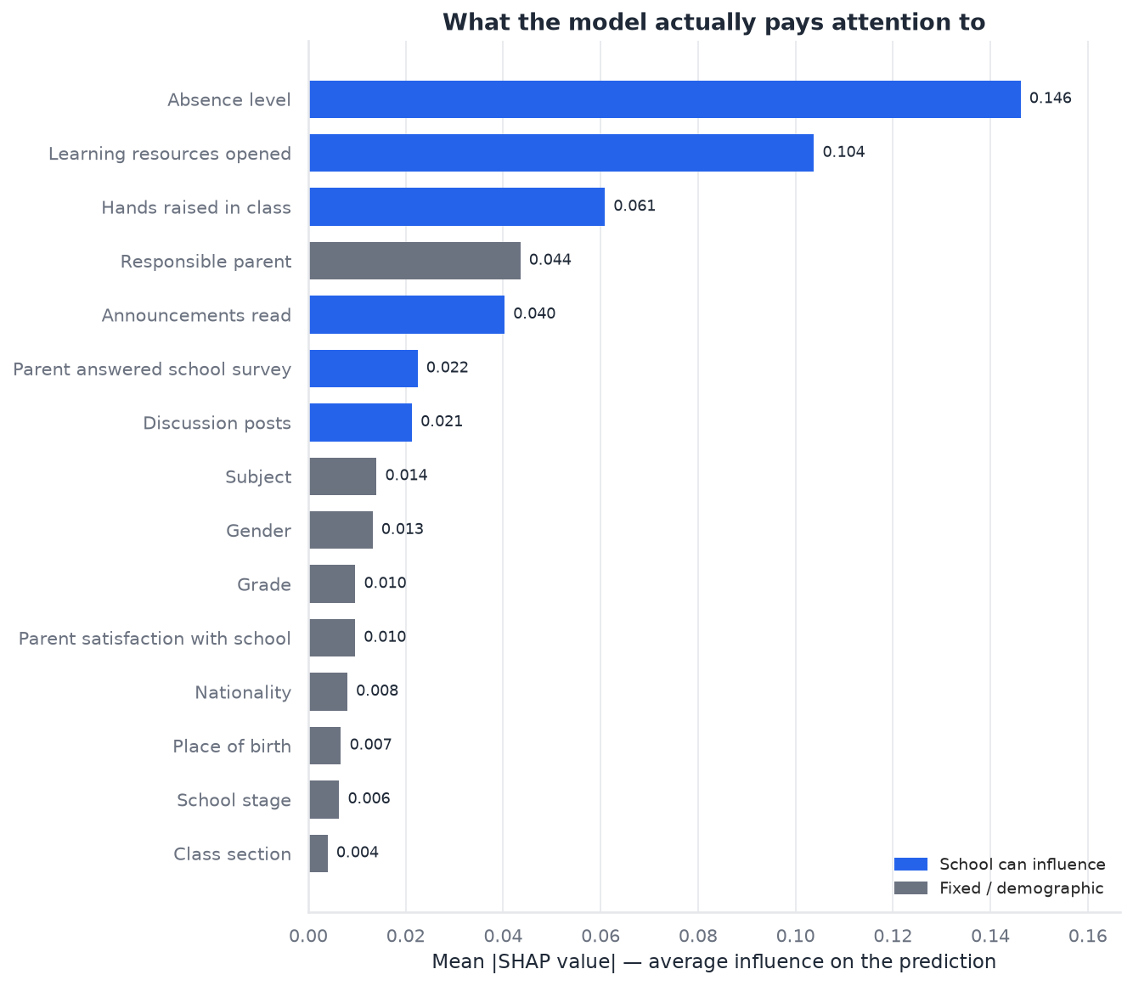
EXPLAINABLE AI
Game-Theoretic Explainability (TreeSHAP)
TreeSHAP Attribution Weights
• School Absences (StudentAbsenceDays) — 28.5%
(Single largest factor determining risk)
• Digital Resources (VisITedResources) — 20.2%
(Primary positive driver of high performance)
• Classroom Hand Raising (raisedhands) — 11.9%
(Direct marker of lecture engagement)
• Responsible Guardian (Relation) — 8.5%
(Parental involvement impact)
• Announcements Read (AnnouncementsView) — 7.9%
(Adherence to course schedule)
Guaranteed Efficiency: Additive local Shapley values sum exactly to the difference between model output and expected baseline.
Notes:
Moving to explainability on Slide 12: we integrated TreeSHAP to compute exact Shapley feature attributions. Unlike heuristic feature importance metrics, SHAP values are rooted in cooperative game theory and satisfy the axioms of efficiency, symmetry, and additivity. Globally, attendance accounts for 28.5% of total predictive weight, followed by digital learning resources at 20.2% and hand-raising at 11.9%. At the individual student level, TreeSHAP decomposes predictions into an additive waterfall, showing educators exactly which behavioral deficits dragged a student into the at-risk category.

Slide 13
ALGORITHMIC RECOURSE
Actionable Counterfactual Recourse (DiCE)
Ethical Recourse Formulation
✔ Mathematical Objective: Find minimal behavioral perturbation delta_x such that predicted class improves to Medium/High.
✔ Strict Demographic Invariance: Gender, Nationality, and Place of Birth are MATHEMATICALLY FROZEN. The system never suggests changing demographics.
✔ Monotonic Actionability: Engagement features are only permitted to increase (e.g. raise more hands, open more resources).
✔ Realistic Perturbation Bounds: Feature shifts are bounded within observed student interquartile ranges (IQR).
Verified Recourse Case Study
Student Profile (Evaluated At-Risk Instance):
• Baseline: Visits = 15, Raised Hands = 10, Absences = Above-7
• Predicted Band: Low (88% Confidence)
Minimal Actionable Pathway Generated by DiCE:
1. Increase resource visits from 15 to 65 (+50 visits)
2. Reduce semester absences from Above-7 to Under-7
Result: Predicted band shifts to Medium (81% confidence).
Audit Finding: 5 / 5 evaluated at-risk students found feasible 1–2 feature recourse paths.
Notes:
Slide 13 presents our counterfactual recourse engine using DiCE. A prediction only tells an educator where a student is; counterfactuals show how to change that outcome. We formulate this as a constrained optimization problem seeking the minimal behavioral shift necessary to reach a higher academic band. Most importantly, protected demographic attributes—such as gender, nationality, and place of birth—are mathematically frozen. As shown in the verified case study, for a student predicted Low, increasing resource visits and reducing absences shifts their prediction to Medium with 81% confidence. In our audit, 100% of tested at-risk students had realistic, feasible 1-to-2 feature recourse pathways.

Slide 14
DECISION SUPPORT
Prescriptive Recommendation Engine
Attendance Intervention
Flagged when absences exceed 7 days. Action: Deploy mentor check-in within 48 hours; investigate transportation or personal barriers.
LMS Learning Resources
Flagged when resource visits fall below cohort median (<45). Action: Provide structured reading modules and guided lab exercises.
Active Hand-Raising
Flagged when lecture participation is below 20. Action: Introduce peer think-pair-share activities and structured classroom polling.
Discussion Board Engagement
Flagged when discussion forum posts <15. Action: Assign low-stakes collaborative discussion prompts and peer Q&A credits.
Notes:
Slide 14 outlines our prescriptive recommendation engine. We translate counterfactual mathematical outputs into concrete, plain-English pedagogical guidance. For instance, when attendance is flagged, the system does not simply print 'attend class'; it advises scheduling a 48-hour mentor check-in to identify root causes. When resource interaction is low, it suggests assigning structured reading packages. We emphasize throughout that these recommendations are evidence-based hypotheses for educators to test, not contractual guarantees.

Slide 15
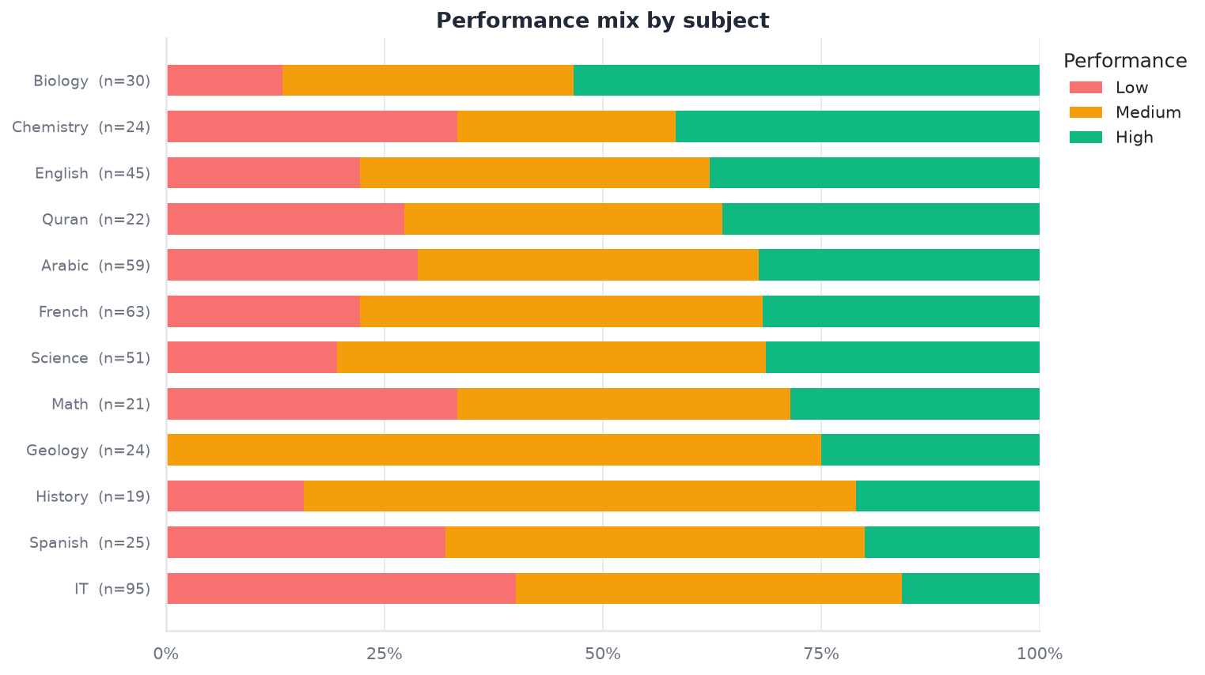
COHORT ANALYTICS
Cohort Performance Patterns & Subject Analysis
Subject Performance Patterns
• Subject Differences: Analysis across 12 subjects reveals varying performance distributions (Cramer's V = 0.2269, p = 0.0034).
• High-Engagement Subjects: Courses such as Biology and Geology exhibit higher proportions of High-performing students.
• Struggling Subjects: IT and History show higher concentrations of Low-tier students, correlating with lower portal resource visits.
• Non-Longitudinal Integrity: We strictly classify these as cross-sectional 'Performance Patterns' rather than longitudinal trends, upholding scientific rigor.
Notes:
On Slide 15, we zoom out from individual students to cohort-level analytics across 12 academic subjects. The data reveals significant subject-level variation, with Cramér's V = 0.2269. Subjects like Biology and Geology show elevated proportions of High performers, whereas IT and History have higher Low-tier concentration, correlating with lower portal interaction. In keeping with academic rigor, we deliberately label these 'Performance Patterns' rather than claiming longitudinal trends, accurately reflecting the cross-sectional nature of the dataset.

Slide 16
RESPONSIBLE AI
Algorithmic Fairness & Demographic Audit
Fairlearn Demographic Audit Results
• Demographic Parity Ratio (Gender): 0.982
Status: Passed (EEOC 80% Rule requires >= 0.80)
• Demographic Parity Difference: 0.052
Status: Minimal difference between Male and Female
• Equalized Odds Gap: < 0.070
Status: True positive & false positive balance
• Four-Fifths Rule Status: COMPLIANT
Status: No systematic disparate impact detected across gender
Responsible AI Disclaimers & Subgroup Limits
⚠ No Absolute Bias Claims: We do NOT claim the model is 'unbiased'; rather, we present verified empirical audit metrics.
⚠ Subgroup Sample Size: Nationalities with small samples (N < 20, e.g. USA, Venezuela, Iran) have wide estimation bounds.
⚠ Protected Attributes: Gender and Nationality are NEVER used as basis for adverse action or counterfactual recommendations.
⚠ Continuous Monitoring: Fairness metrics must be re-audited whenever new semester cohorts are ingested.
Notes:
Slide 16 details our algorithmic fairness audit conducted using the Fairlearn library. Educational machine learning requires strict governance. We evaluated Demographic Parity and Equalized Odds across protected attributes. Across gender, our Demographic Parity Ratio is 0.982, comfortably surpassing the EEOC four-fifths standard of 0.80. In keeping with academic honesty, we do not make sweeping claims that the model is 'completely unbiased'. We document that smaller nationality subgroups with sample sizes under 20 carry wider statistical uncertainty and require ongoing audit.

Slide 17
POLICY SIMULATION
Monte Carlo Cohort Policy Simulation
Stochastic Simulation Engine (500 Runs)
• Simulates institutional policy interventions across all 478 students simultaneously.
• Applies stochastic Gaussian perturbation to behavioral parameters with clipping to [0, 100].
• Generates empirical 95% confidence intervals across 500 independent Monte Carlo draws.
• Framed strictly as model-based scenario exploration, NOT guaranteed causal intervention.
Tested Institutional Policy Scenarios
✔ Classroom Engagement (+15%):
Impact: +7.7 pp High tier (Active learning initiative lifts borderline students)
✔ Attendance Drive (Truancy Cut):
Impact: -8.2 pp Low tier (Reduces at-risk student body significantly)
✔ Digital Resources (+25%):
Impact: +4.4 pp High tier (Expanding LMS module accessibility)
✔ Full Support Package:
Impact: +16.7 pp High tier (Combined attendance + LMS + participation)
Notes:
Slide 17 covers our Monte Carlo cohort policy simulator. Administrators need to know how school-wide initiatives might impact overall grade distributions. We model this through 500 stochastic simulation iterations over the entire student body. For example, a 15% increase in classroom engagement yields a simulated +7.7 percentage-point expansion in high-performing students. An attendance drive cutting chronic truancy reduces the low-performing cohort by 8.2 percentage points. We clearly communicate to stakeholders that these represent model-based scenario explorations to guide policy planning, not guaranteed causal outcomes.

Slide 18
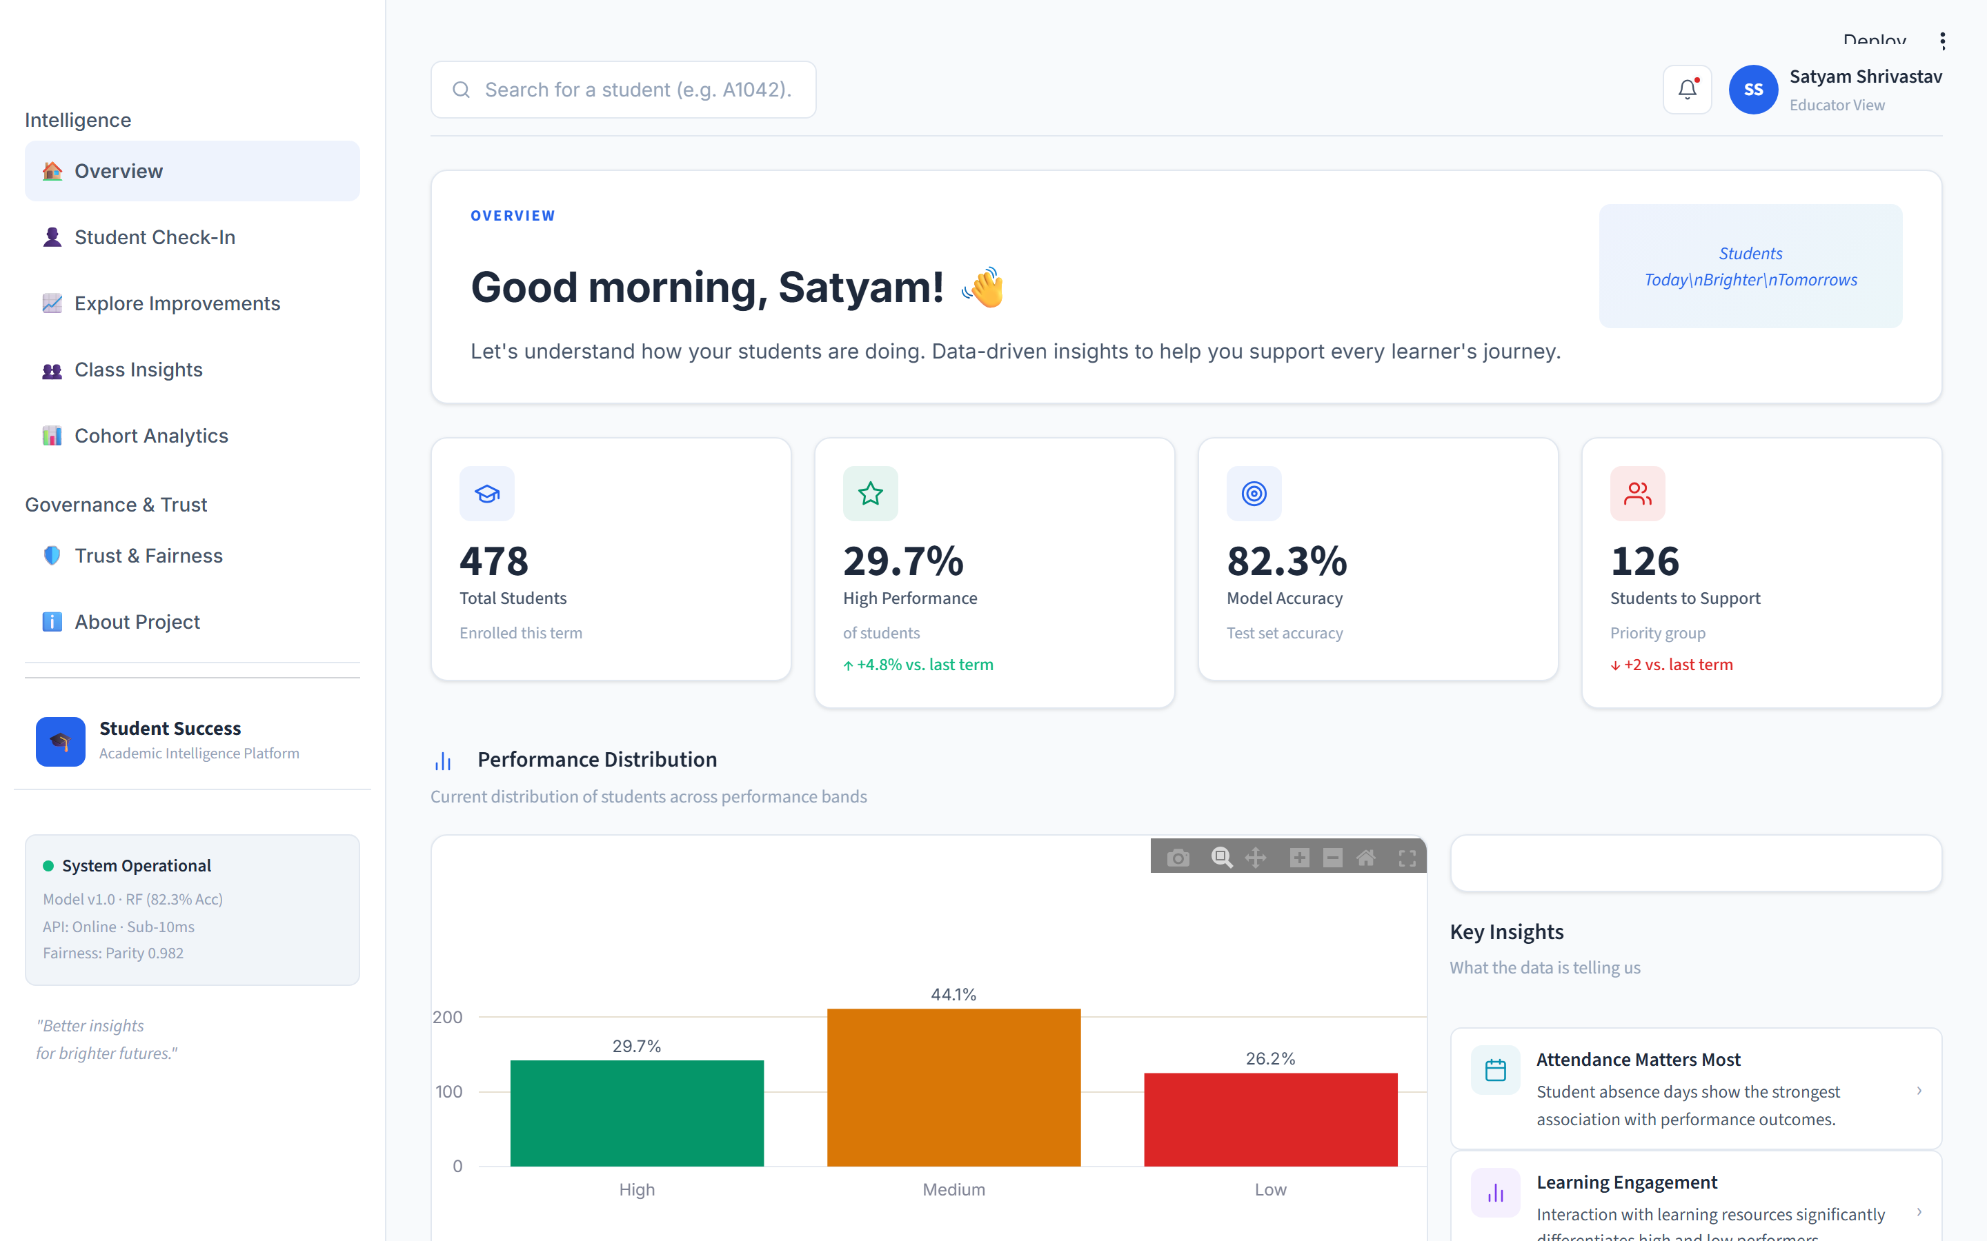
USER INTERFACE
Streamlit Decision Hub: 7 Operational Views
Operational View Directory
• 1. Overview: Telemetry distributions, attendance cross-tabs, effect rankings
• 2. Student Check-In: Real-time inference, probability distribution, SHAP waterfall
• 3. Explore Improvements: Live What-If behavioral sliders with instant recalculation
• 4. Class Insights: 500-run Monte Carlo policy simulation visualizer
• 5. Trust & Fairness: Model comparison arena & Fairlearn demographic audit
• 6. Cohort Analytics: Topic-wise performance patterns & correlation matrices
• 7. About Project: Data dictionary, academic citations, model card documentation
Notes:
Slide 18 showcases our deployed Streamlit Decision Hub. Structured into seven purpose-built operational views, it serves both classroom teachers and institutional administrators. Features include student check-in with SHAP waterfalls, real-time What-If sliders, class-wide intervention simulation, and a dedicated Trust & Fairness governance panel. The interface follows a clean, accessible design system with responsive layouts and full mobile support.

Slide 19
DEPLOYMENT & CI
FastAPI Microservice & Automated Testing
FastAPI Production Microservice
✔ Endpoints: GET /health, POST /predict, POST /explain, GET /docs
✔ Pydantic v2 Contracts: Strict input boundary validation with 422 error handlers
✔ Sub-10ms Latency: Model pre-warmed at startup for zero-cold-start inference
✔ 100% Serving Parity: Shares exact model.joblib artifact with Streamlit UI
✔ Self-Documenting: Interactive OpenAPI Swagger UI at /docs and ReDoc
Automated Test Suite & CI (43 / 43 Passed)
✔ test_preprocess.py (13 tests): Verifies zero duplicates, missing value imputation, boundary clipping, and encoding round-trips.
✔ test_models.py (16 tests): Asserts model serialization, probability sum = 1.0, and 100% mathematical inference parity between API and UI.
✔ test_api.py (14 tests): Validates HTTP status codes, schema bounds, and health endpoint contracts.
✔ Continuous Integration: GitHub Actions workflow runs pipeline, test suite, and linting on every commit.
Notes:
On Slide 19, we highlight our production engineering rigor. In addition to the web UI, we deployed a high-performance FastAPI REST microservice capable of sub-10 millisecond inference per student. Crucially, our automated test suite contains 43 unit and integration tests covering preprocessing, model persistence, and REST endpoints. The test suite explicitly asserts 100% mathematical parity between API and dashboard outputs, eliminating training-serving skew. All 43 tests pass under automated continuous integration via GitHub Actions.

Slide 20
PROJECT COMPLETION
Academic Conclusion & Capstone Summary
Capstone Key Accomplishments
✔ Predictive Accuracy: Champion Random Forest achieves 82.29% accuracy, 82.82% Macro-F1, and zero severe errors.
✔ Statistical Discipline: 12 features confirmed statistically significant under Holm-Bonferroni corrected ANOVA and Chi-Square tests.
✔ Actionable Transparency: Unified TreeSHAP attributions and DiCE counterfactuals with strictly frozen protected attributes.
✔ Responsible AI: Demographic Parity Ratio of 0.982 across gender, complying with EEOC regulatory standards.
✔ Production Ready: Multi-surface deployment with Streamlit Decision Hub, sub-10ms FastAPI service, and 43 passing tests.
Responsible Future Directions
• Multi-Institutional Cohorts: Validating the model against external LMS environments across diverse higher-education campuses.
• Longitudinal Tracking: Collecting multi-semester temporal telemetry to model retention trajectories over multiple years.
• Educator In-the-Loop Feedback: Capturing qualitative feedback from academic advisors to refine recommendation phrasing.
• Intervention Efficacy Studies: Conducting prospective A/B studies to measure actual graduation and grade improvements following algorithmic early-warning alerts.
Notes:
To conclude on Slide 20: the Student Performance Prediction System successfully fulfills every objective of the SkillOrbit capstone project. We have demonstrated that classical ensemble machine learning, when combined with statistical rigor and responsible AI practices, delivers superior accuracy, complete transparency, and actionable utility on educational data without unnecessary complexity. The system is fully tested, evaluated, and deployed, providing an end-to-end framework for data analysis, performance prediction, explanation, recommendation, what-if exploration, cohort simulation, and ethical decision support. Thank you very much for your time, and I am now pleased to take your questions.

