Slide 1




LIVE WEBINAR
Monday, June 10 2024 | 02:00 PM EST
Essential Strategies for Infection Control in Nursing Homes and Long-Term Care Facilities.
Speaker s
Nicholas Massimiano
National Sales Manager, Empire Bio Diagnostics

Slide 2


Agenda
About Us
What is ATP?
Demonstration of CleanRead™ Contamination Monitoring System
Q & A

Slide 3
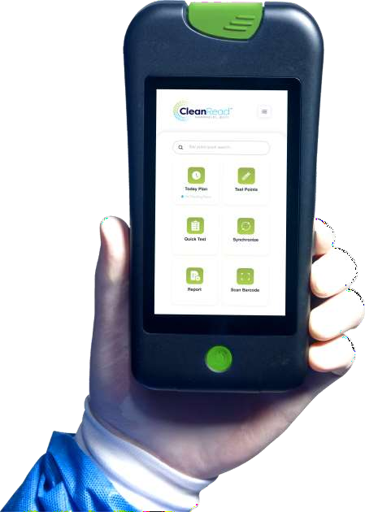
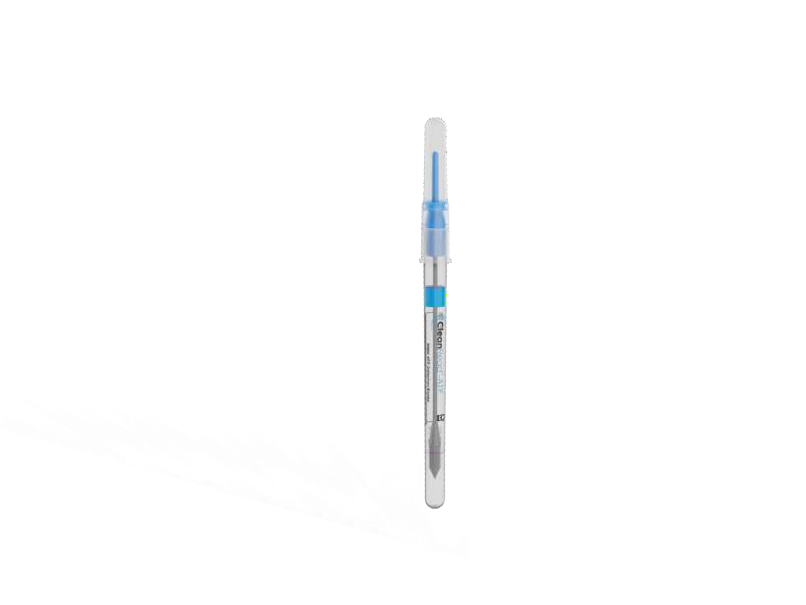
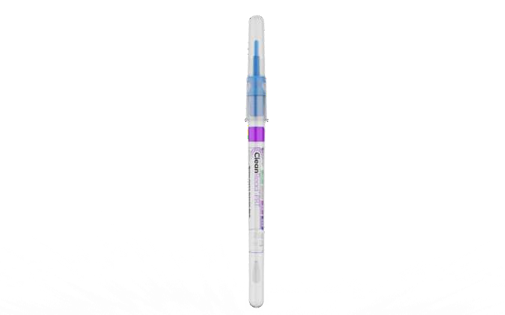
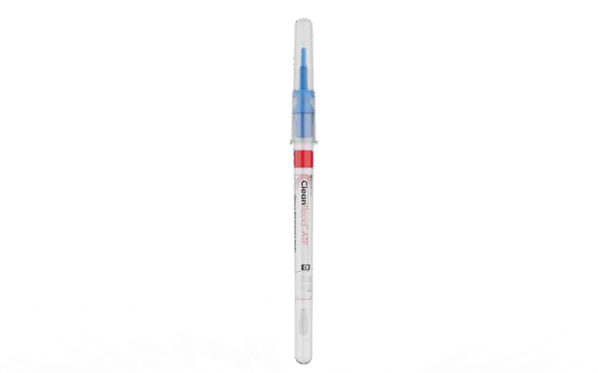
About Us
Empire Bio Diagnostics
Develop, manufacture, and distribute products and technologies for cleaning verification and inspection of endoscopic instruments and surfaces.
8 years of servicing the healthcare industry through
distributor private labeling .
Swabs produced in ISO Certified Class VII Clean Room.
All products manufactured and assembled in the US at
our Hicksville, NY headquarters.
We ship our products domestically as well as globally.
Our Products
CleanRead™ Handheld unit
CleanRead™ Collection swabs (surface, water, protein)
Borescopes for Medical Scopes

Slide 4


Introduction to ATP
What is ATP?
ATP stands for Adenosine Triphosphate (ATP)
Adenosine Triphosphate (ATP) is a universal energy molecule found in all animal, plant, bacterial, yeast, and mold cells
Present in microbial contamination (smaller amounts)
Does not identify specific microorganisms
Does indicate the presence of microbial activity or
contamination
How ATP Detection Works?
Reaction with Luciferase/Luciferin. Contact emits light proportional to ATP amount.
Measured as RLU (Relative Light Unit).
Higher RLU indicates higher contamination levels

Slide 5



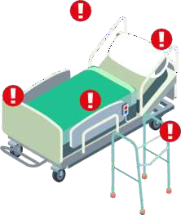

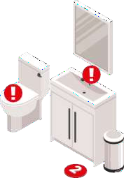

Where is ATP?
Determine Contamination
Levels
ATP is everywhere so test to assess intensity
Some ATP levels are acceptable
High levels indicate the need for recleaning, attention or further analysis
High Touch Points to
Test
Exam and Operating Rooms
Medical Equipment (including scopes)
Waiting
Areas
Counter s
Beds and Bed Rails
BP Cuffs
Restrooms (Toilets,
Faucets)
Computer
s

Slide 6

How to remove / reduce ATP
There are several methods to remove/reduce
ATP :
Enzymatic Cleaners
Black light solution
Ultraviolet Light
Gel application
Spray mists

Slide 7
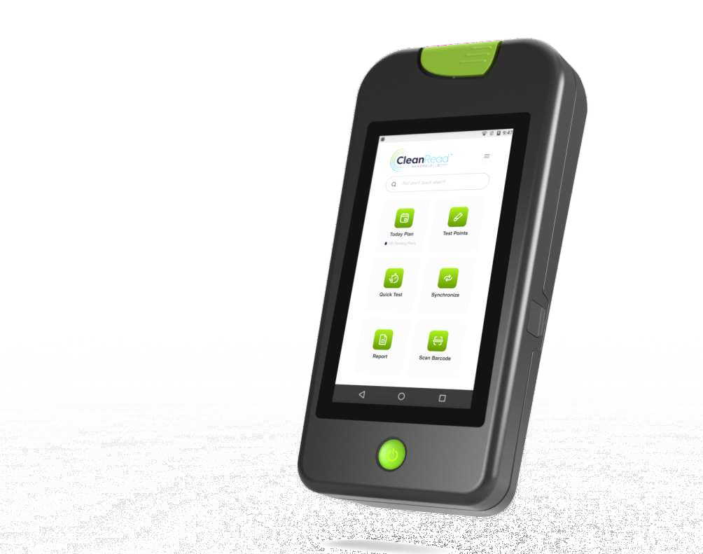
How to test for ATP – CleanRead™ Meter
Testing with CleanRead™ meter
Results in 15 seconds after collection with the swab
Quick Test, daily scheduler, and AI scheduling
RFID & Barcode
Scanners
Touch Screen (5 INCH) with customizable dashboard
Wireless and Cloud Based User Friendly Interface with off line capabilities
Comprehensive reports, charts and
analyses
Fully HIPAA Compliant

Slide 8
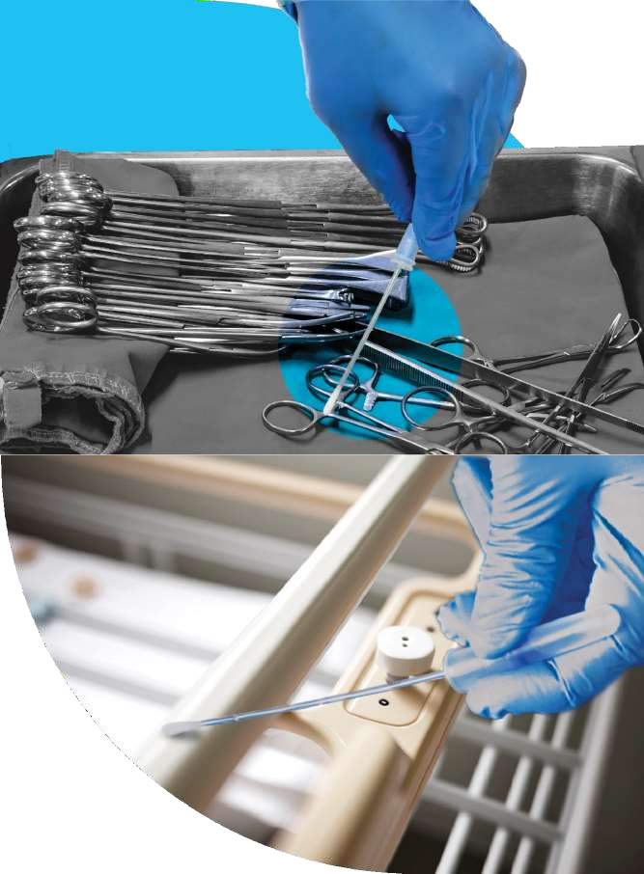
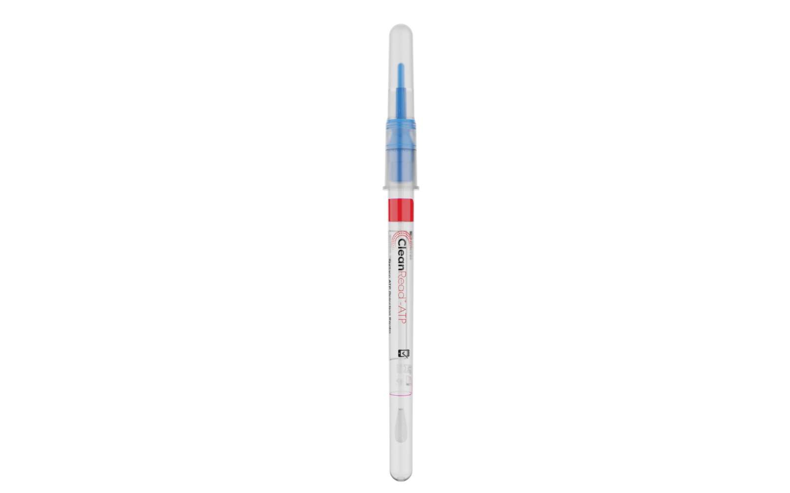
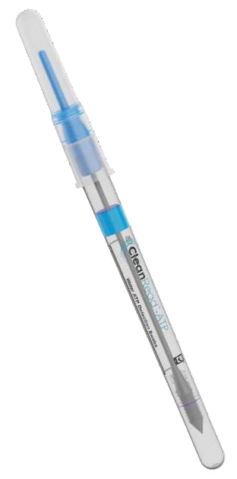

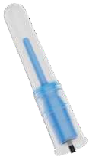
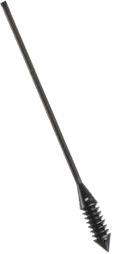
ATP Testing Instruments – CleanRead™ Swabs
CleanRead™-ATP Swabs
All-in-one sampling device
13-month shelf life at refrigerated temperatures
4-week shelf life at room temperatures
Unique liquid-stable reagent
Tolerant to temperature abuse and sanitizers

Slide 9
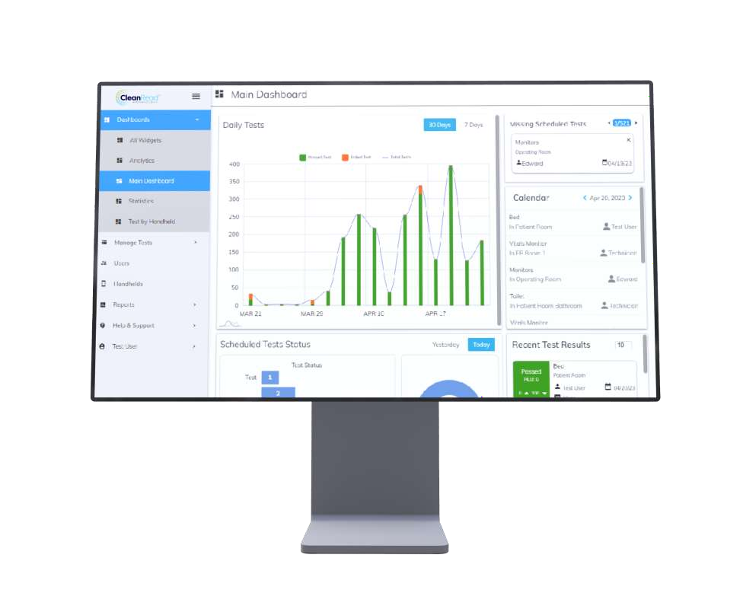
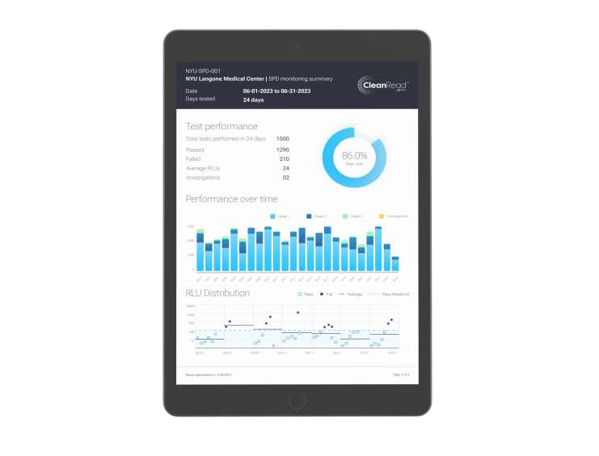
CleanRead™ Contamination Monitoring System.
Comprehensive dashboard and
reports

Slide 10
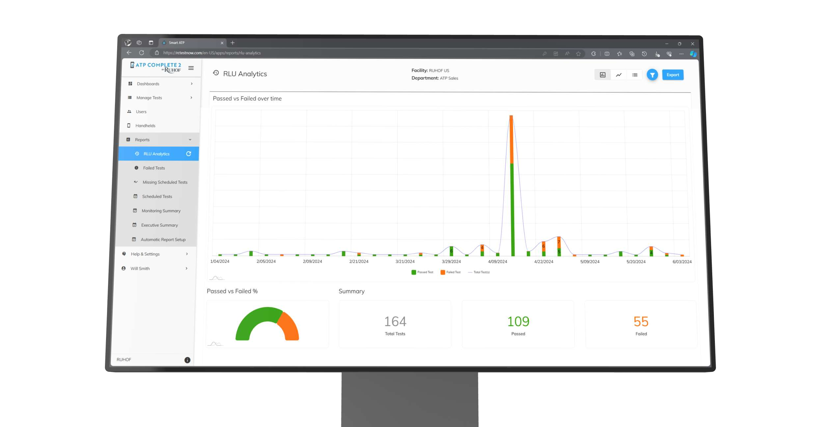
CleanRead™ Contamination Monitoring System
RLU
Analytics

Slide 11
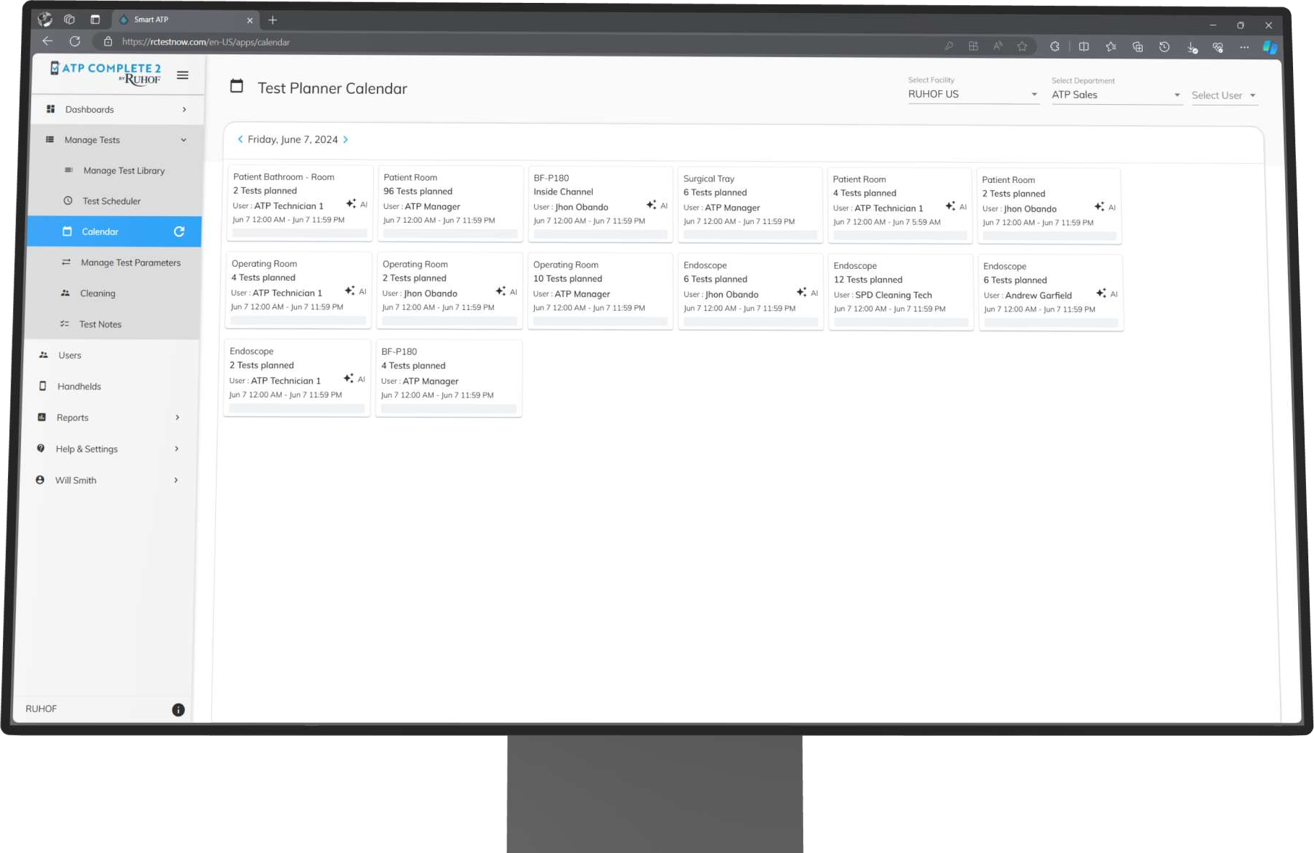
CleanRead™ Contamination Monitoring System.
Test
Scheduler

Slide 12
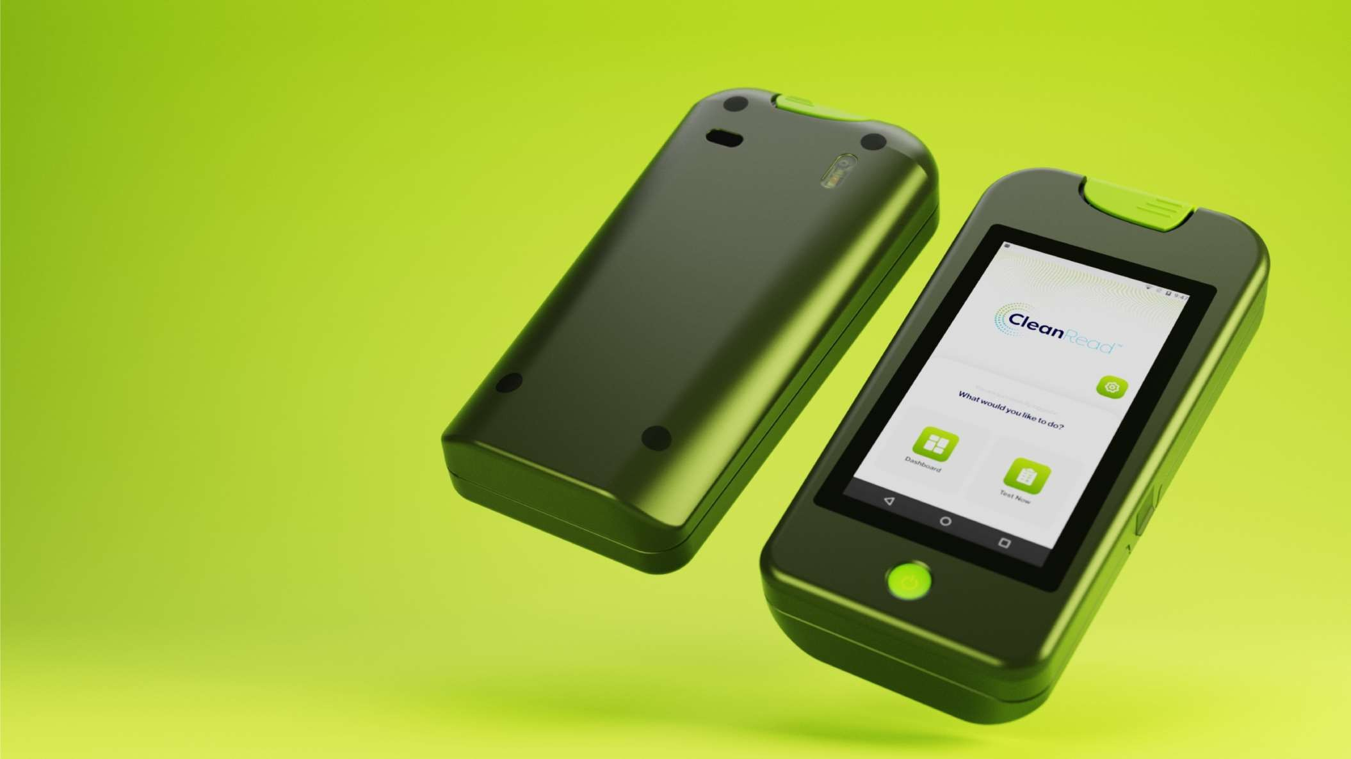

Q& A

Slide 13
Thank you!

