Slide 1
Customer Shopping
Behavior Analysis
Data Intelligence Report · Python · SQL · Power BI
3,900
$59.76
3.75 ★
4
Transactions
Avg Purchase
Avg Rating
Categories
Comprehensive analysis of 3,900 customer transactions across Clothing, Accessories, Footwear & Outerwear

Slide 2
Executive Summary — Key Metrics at a Glance
3,900
$59.76
3.75 ★
73%
Total Customers
Avg Purchase Amount
Avg Review Rating
Non-Subscriber Rate
3,116
$157.9K
839
50%
Loyal Customers
Male Revenue
High-Spend Disc. Users
Max Discount Rate (Hat)
Customer Shopping Behavior Analysis | Overview

Slide 3
Revenue & Sales — Category and Gender Breakdown
Key Insight
Clothing dominates revenue at $104K — 1.2x Accessories.
Male customers generate 67.7% of total revenue vs Female 32.3%.
Customer Shopping Behavior Analysis | Revenue Analysis

Slide 4
Revenue by Age Group — Who Spends the Most?
Young Adults drive highest total revenue ($62.1K) while Middle-aged has the largest customer count (1,070). Senior customers also spend above average at $68.69 avg.
Customer Shopping Behavior Analysis | Age Group Analysis

Slide 5
Product Performance — Ratings, Popularity & Discount Dependency
Customer Shopping Behavior Analysis | Product Analysis

Slide 6
Customer Segmentation — Loyalty & Subscription Behaviour
Customer Shopping Behavior Analysis | Segmentation Analysis

Slide 7
Shipping Preferences & Discount Impact
Customer Shopping Behavior Analysis | Discount & Shipping Analysis

Slide 8
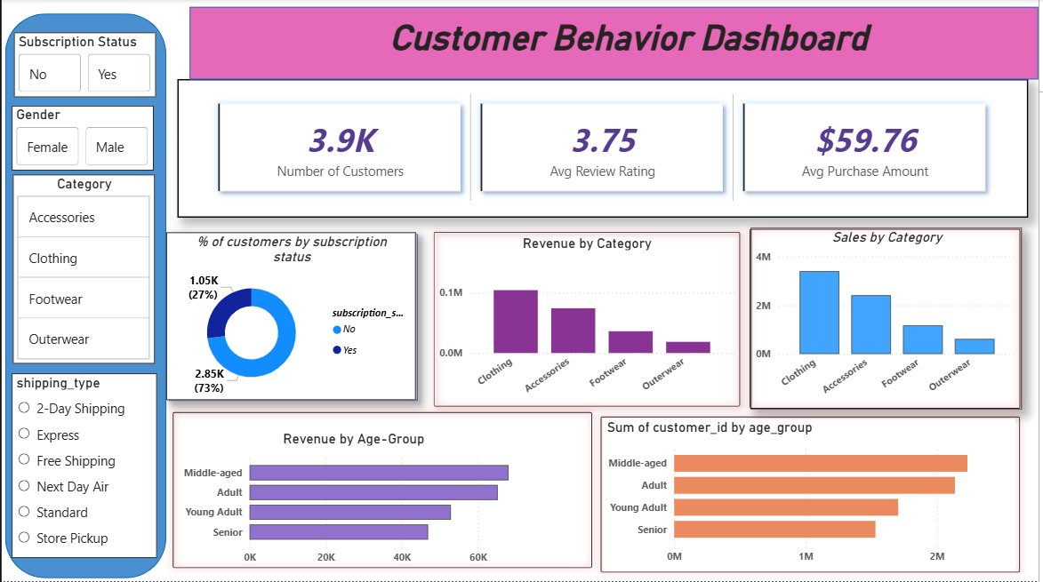
Power BI Interactive Dashboard
Dashboard features: Subscription Status · Gender · Category · Shipping Type slicers for dynamic filtering

Slide 9
Business Recommendations
🎯
Boost Subscriptions
🏅
Loyalty Programme
💸
Revise Discount Policy
Only 27% subscribe. Launch exclusive perks — early access, free shipping, loyalty points — to accelerate conversion.
80% are Loyal customers. Introduce tiered rewards to retain them and move 701 Returning users to Loyal status.
Hat, Sneakers & Coat near 50% discount dependency. Shift to value-added bundles instead of blanket price cuts.
⭐
Amplify Top-Rated Products
📦
Shipping Upsell
👥
Targeted Age Marketing
Gloves (3.86), Sandals (3.84) & Boots (3.82) are top-rated. Feature in homepage banners and email campaigns.
Express shipping correlates with higher baskets ($60.48). Nudge carts above $60 toward Express at checkout.
Young Adults drive most revenue ($62.1K). Tailor creative by segment — trend content for young, value for adults.

Slide 10
Thank You
Customer Shopping Behavior Analysis | Data Intelligence Report
3,900
$233K
80%
10
Transactions
Total Revenue
Loyal Customers
SQL Queries
Prepared using Python · PostgreSQL · Power BI | Data: 3,900 customer transactions

