Slide 1

Super Store Sales Dashboard Analysis
The Super Store Sales Dashboard is pivotal for evaluating the immense world of sales data, carving out insightful reports on profits, sales trends, and customer engagement. Powerful visual tools like donut charts, line graphs, and maps transform raw data into digestible analytics, allowing businesses to make strategic decisions backed by evidence. In this analysis, we delve into the dynamic elements that are a driving force behind the numbers. What follows is a closer examination of each key metric and its implications.

Slide 2
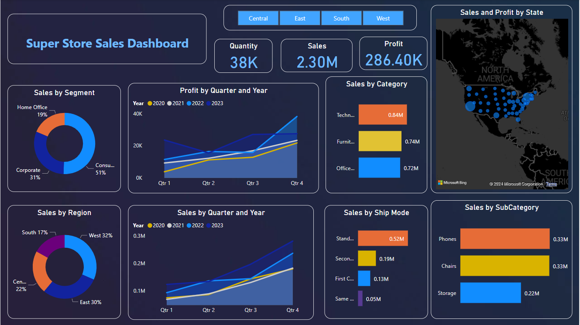

Slide 3
Sales by Segment and Region
Customer Segments
Regions
A critical insight from the dashboard is the dominance of Consumer sales, grabbing a majority at 51%. Distinctly, this contrasts with the Home Office segment, which lags at 19%.
The West region emerges as a market stronghold, contributing 32% to the sales chart. With a competitive spirit, the East follows at 30%, while the South anchors at 17% - an area perhaps requiring strategic marketing interventions.
Profit by Quarter and Year
1
Growth Trend
The upward trajectory in profits from 2020 to 2023 across every quarter reflects a narrative of growth and consistent business performance, potentially signaling a robust strategic approach.
2
Annual Performance
Each year carving its distinct path on the graph, we see that the store has not just maintained but augmented its profitability, attributing success to adaptations and perhaps market expansion strategies.

Slide 4


Sales by Category
Technology
0.84M
Furniture
0.74M
Office Supplies
0.72M
The competitive landscape of sales sees Technology reigning supreme with impressive figures of 0.84 million, closely followed by Furniture. This indicates a buzzing market with a high appetite for tech products.
Sales by Ship Mode
Standard Shipping
Same Day Shipping
Undoubtedly the most preferred, Standard shipping mode sits at the top with 0.52 million in sales, aligning with customer preferences for economical and reliable delivery options.
The niche Same Day shipping option, though smaller at 0.05 million in sales, represents a fast-paced consumer segment potentially willing to pay a premium for immediate service.

Slide 5
Sales by Sub Category
1
Phones & Chairs
2
Storage Solutions
Phones and Chairs both had sales of 0.33 million, showing that consumers have diverse needs that are catered to with equally vigorous sales strategies.
Storage solutions had sales of 0.22 million, reflecting an increasing demand for organizational products in both office settings and remote workspaces.
Sales and Profit by State
Regional Impact
Market Dynamics
Sales and profit density varies across states, with larger circles pinpointing pivotal revenue-generating regions that are crucial to the store's financial health.
An array of factors, perhaps including local economic conditions and marketing effectiveness, contribute to this geographic distribution of fiscal success.

Slide 6
Key Performance Indicators
38K
2.30M
286.40K
Quantity
Sales
Profit
The sheer volume of product turnover, a quantifiable testament to demand and operational capacity.
Reflecting the mammoth scale of transactions, the sales figure speaks to the breadth of market reach.
The endgame metric for any business, underscoring profitability and investment potentials.

Slide 7
THANK YOU

