Slide 1
TEAM SE
Sorting Visualiser
Fraser Robb (s1308002)
Satya Pahari (s1282006)

Slide 2
TABLE OF CONTENTS
01
02
03
04
05
Introduction
Design Philosophy
Current Features
Task and Introduction
Architecture and Design Patterns
Sorting Algorithms and additional features
Application Demo
Future Expansion Ideas
Practical Demonstration of the Team SE application
Future possibilities and expansion

Slide 3
01
Introduction

Slide 4

Composition
JAVA
Swing
AWT
JUnit
Development Environment: Visual Studio Code
Language
GUI
GUI
Tests
The entire program is written using JAVA
The main library used to implement the GUI
AWT was also used for GUI (event creation, etc.)
The unit tests are written using JUnit library

Slide 5
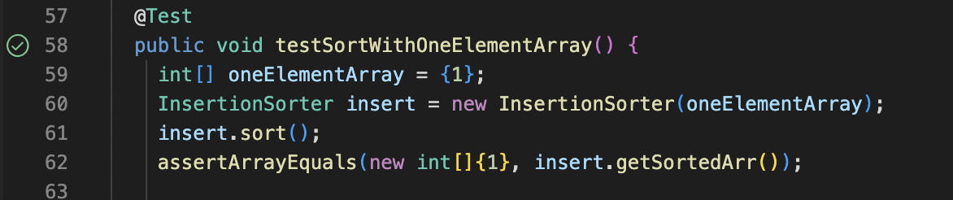
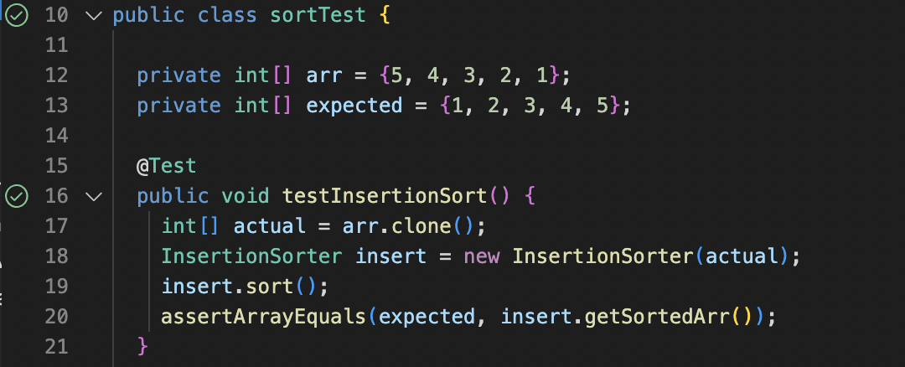
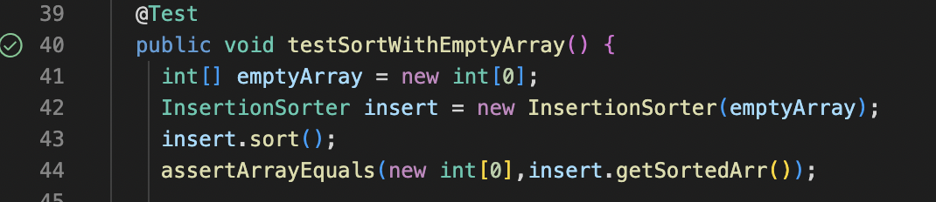
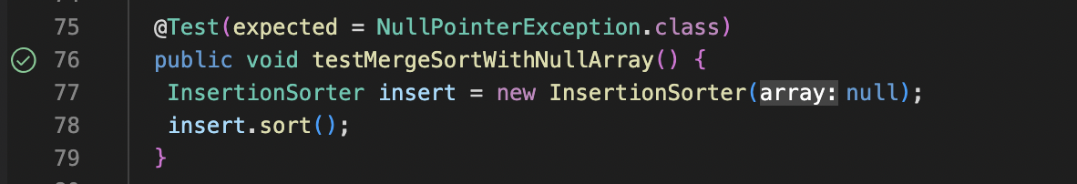
Testing (JUnit)
One element array
A populated array
Empty Array
Null test

Slide 6
02
Design Philosophy

Slide 7
MVC: How it works
Model
View
Controller
Represents real-world concepts that the system
deals with.
This is the user interface and handles user input/output.
decision-making/business-logic part

Slide 8
WHY MVC?

Slide 9
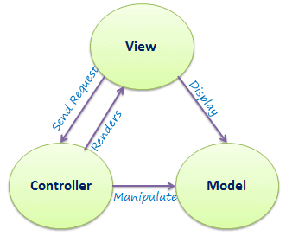

Slide 10
Advantages
Expandability
Decoupling

Slide 11
Design Patterns
Strategy Pattern
Observer
Pattern

Slide 12
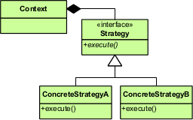
Strategy Pattern

Slide 13
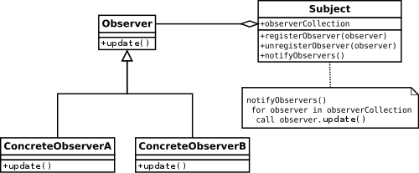
Observer Pattern

Slide 14
03
Features

Slide 15
FEATURES CHART
Sorting application
Information window
Main Menu / Selection Window
Visualizer window

Slide 16
SELECTION WINDOW - SORTING ALGORITHMS
1
2
3
BUBBLE SORT
SELECTION SORT
INSERTION SORT

Slide 17
Selection Window / Main Menu
First window that appears when you run the program.
The user can choose:
Type of Sort
Type of data generation
Number of elements
Go to information

Slide 18
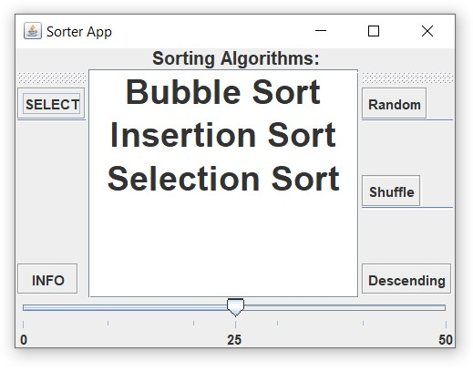

Slide 19
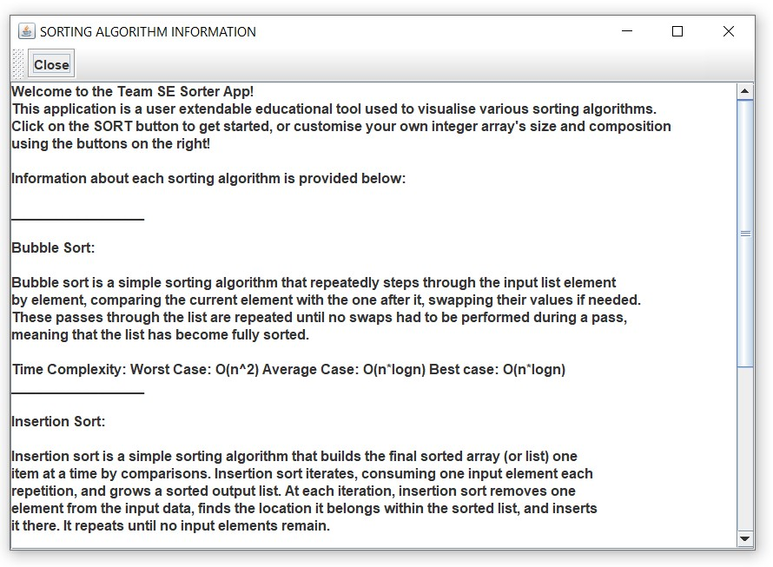
Information Window
A fun little extra screen we added to display details about each sorting algorithm and its time complexities.

Slide 20
Visualizer Window
This is the window where the visualization of the sorts/swaps occur.
We have used bars to represent the numbers.

Slide 21
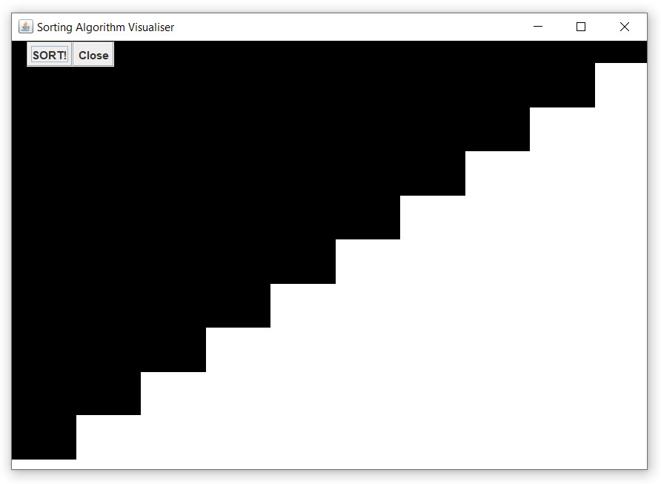

Slide 22
04
Application Demo

Slide 23
05
Future Expansions

Slide 24
Expansion Ideas
GUI
The GUI could be made for user friendly and eye catching
Add sorts
Since its expandable we can add many more sorting algorithms
Input elements
Instead of a slider the user can input the number of elements directly for accuracy.

Slide 25
