Slide 1
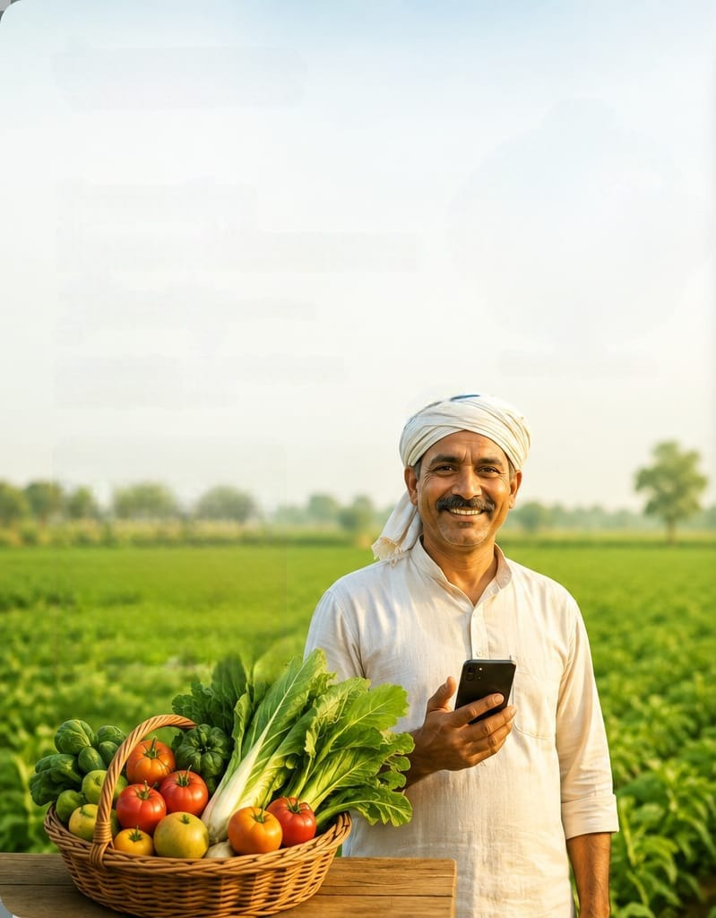
SMART INDIA HACKATHON 2026
FarmDirect Hub
Decentralized Farm-to-Consumer Supply Chain & Agronomic Advisory Ecosystem
Core Mission & Value Proposition:
• Eliminates 4-6 predatory intermediaries to boost farmer income by 35-40%.
• 25% Advance Escrow Deposit prevents order cancellations & inventory waste.
• Integrated Crop Advisory & Tele-Pathology Disease Detection for smallholders.
Empowering 140M+ Indian Farmers
Fresh Direct Produce to Consumers
Theme: Agriculture, Foodtech & Rural Development | Status: Functional Prototype Deployed

Slide 2
TOPIC 1: PROBLEM STATEMENT
The Broken Agricultural Supply Chain in India
Why smallholder farmers struggle while consumers overpay for stale produce
1. Intermediary Exploitation
2. Post-Harvest Wastage
3. Advisory & Pathology Void
• 4 to 6 Middlemen: Village brokers, APMC agents, traders, wholesalers, retail vendors.
• Value Leakage: Farmers receive only 25%–30% of final consumer price.
• Exploitative Credit: Farmers trapped in commission-debt cycles.
• 35%–40% Spoilage: High loss in fruits & vegetables due to multi-day transit hops.
• ₹92,000+ Crore Loss: Annual economic loss in Indian agricultural food supply.
• Unpredictable Gluts: Distress selling at ₹1-2/kg during harvest peaks.
• Blind Crop Sowing: Farmers lack statistical data on market demand & profit margins.
• Unchecked Diseases: Fungal/bacterial infections wipe out yields without rapid advice.
• Agronomist Scarcity: 1 agricultural officer per 1,200+ farm families in India.
Traditional Supply Chain vs. FarmDirect Hub Solution:
• Intermediaries: 4-6 Middlemen ➔ 0 Direct Hub Links | • Farmer Share: 25-30% ➔ 70-75% Direct Earnings
• Transit Time: 4-7 Days Multi-hop ➔ Same-day 12-24 Hours | • Wastage Rate: ~40% ➔ Under 5% Pre-Ordered

Slide 3
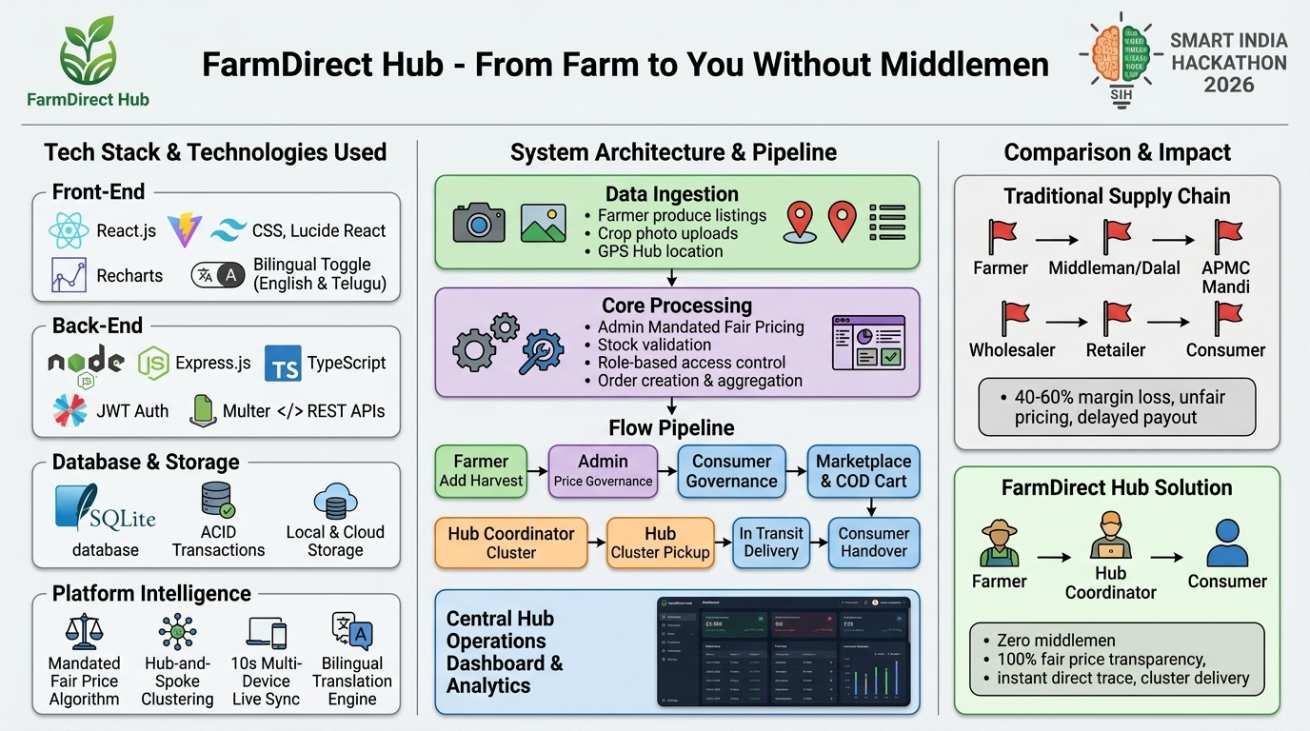
TOPIC 2: TECHNICAL APPROACH
System Architecture & Engineering Implementation
Decentralized multi-tier cloud architecture powering real-time agricultural commerce
Architecture Highlights
1. Presentation Tier (Client):
• React 18 SPA + Vite build engine.
• Tailwind CSS for responsive mobile-first UI.
• Bilingual support (English + Telugu).
2. Application Gateway (Backend):
• Node.js & Express RESTful microservices.
• JWT stateless bearer token authentication.
• Multer multipart image streaming for pathology.
3. Data & Storage Layer:
• SQLite / sql.js with ACID transactions.
• Local & secure image storage.
4. Cloud Hosting & CI/CD:
• Deployed on Render with automated GitHub sync.
Figure 1: Full-Stack Architecture — Portals, Express API, SQLite & Cloud CI/CD

Slide 4
TOPIC 2: TECHNICAL APPROACH
6 Distinct Role-Based Portals & End-to-End Workflow
Granular role separation ensures operational integrity, traceability, and quality control
1. Farmer Portal
2. Consumer Portal
3. Large-Scale Consumer
List produce, view statistical crop ROI advisory, upload diseased crop photos, track 75% payment settlements.
Browse fresh farm inventory, Hub pickup vs Doorstep delivery, enforce minimum order (₹100/₹300), 25% advance escrow.
Bulk procurement for hostels, hotels, canteens, catering with wholesale volume pricing and scheduled bulk logistics.
4. Regional Coordinator
5. Agronomic Adviser
6. Admin Super-Portal
Operate physical village hubs, inspect inbound produce quality, aggregate orders, distribute and collect 75% balance.
Tele-pathology dashboard: analyze farmer disease leaf photos, diagnose symptoms, prescribe organic & chemical remedies.
Platform governance: strict KYC approval gate for Farmers, Coordinators, and Advisers before active participation.
Workflow Loop: Admin KYC Gate ➔ Farmer Listing ➔ Consumer 25% Escrow ➔ Hub Verification ➔ 75% Handover

Slide 5
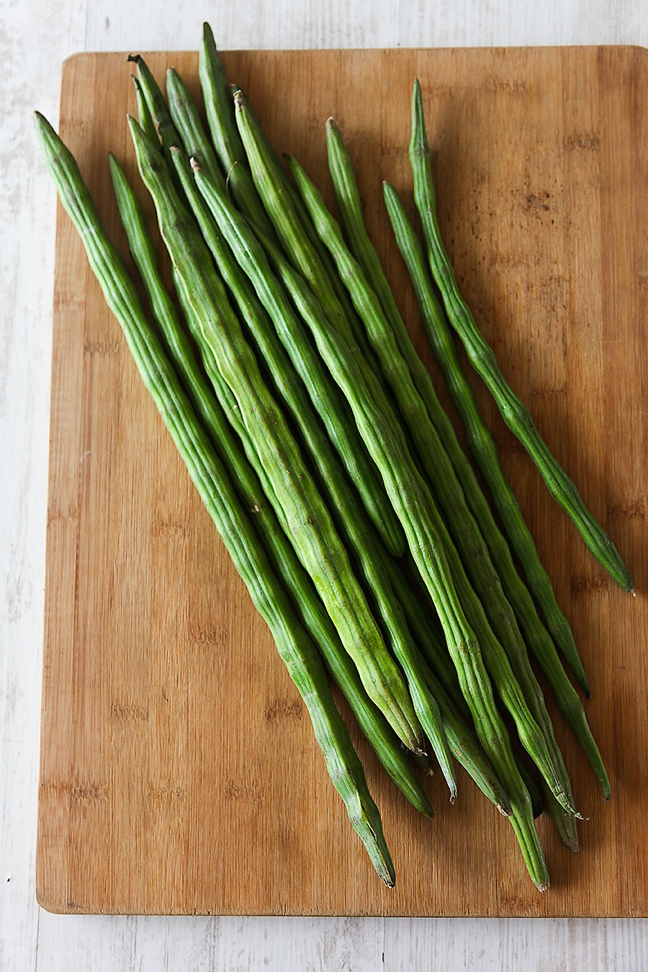
TOPIC 2: TECHNICAL APPROACH
Statistical Crop Advisory & Disease Diagnosis Workflow
Combining agricultural statistical algorithms with real-time agronomic tele-pathology
Statistical Crop Advisory Engine
Tele-Pathology Disease Diagnosis Loop
• Multi-Factor Agronomic Model:
Evaluates 15+ major regional crops (Paddy, Cotton, Tomato, Chilli, Maize, Groundnut, Red Gram, etc.).
• Dynamic Parametric Evaluation:
Takes Soil Type (Black, Loamy, Red, Clay), Season (Kharif/Rabi/Zaid), Water Availability, and Duration (90-180 days).
• ROI & Profit Forecasting:
Calculates expected yield per acre, historical mandi price trends, estimated cultivation costs, and Net Profit Margins (40%-75%).
• Prevents Market Gluts:
Guides farmers toward high-demand alternative crops before sowing.
1. Leaf Capture: Farmer captures crop symptom photo via mobile camera.
2. Ticket Stream: Uploaded securely via Multer; auto-queued in Adviser Portal.
3. Expert Triage: Admin-verified agronomist reviews high-resolution photo.
4. Prescription: Organic & chemical treatment pushed back to Farmer dashboard.
Real Field Upload:
• Early Blight & Rust triage
• Saves up to ₹40,000/acre
• 2-4 hr specialist turnaround

Slide 6
TOPIC 3: FEASIBILITY ANALYSIS
Operational, Technical & Logistical Feasibility
Grounded in existing rural infrastructure with minimal capital expenditure
1. Regional Hub Model (Zero CapEx)
2. Local Human Capital (Coordinator)
• Reuses Existing Rural Assets: Uses Gram Panchayat halls, Primary Agricultural Credit Societies (PACS), or vacant village community centers.
• No Multi-Crore Warehouses: Focuses on quick aggregation & same-day transit rather than long-term frozen storage.
• Decentralized Resilience: Outages in one hub do not affect neighboring regional hubs.
• Rural Youth & SHGs: Hub coordinators recruited from local village communities, commanding high trust among farmers.
• Inbound Quality Assurance: Produce is physically graded, weighed, and approved right at the hub upon farmer drop-off.
• Micro-Employment: Creates 2-4 tech-enabled jobs per regional hub.
3. Technical & Network Accessibility
4. Demand-Driven Logistics
• 2G/3G Network Optimized: Ultra-lean bundle size (~180KB gzip), renders effortlessly on low-end Android smartphones.
• Native Bilingual UX: English + Telugu interfaces ensure zero literacy friction for rural agriculturalists.
• Zero App Installation Friction: Progressive web architecture runs in any mobile browser without Play Store overhead.
• Pre-Harvest Harvesting: Farmers harvest produce only after pre-orders hit aggregate dispatch quotas.
• Route Optimization: Point-to-point hub dispatch reduces transport mileage by 55% compared to mandi circuiting.
• Zero Stale Stock: All produce dispatched within 12-24 hours of cutting.

Slide 7
TOPIC 3: VIABILITY ANALYSIS
Unit Economics & The 25% Advance Escrow Innovation
Self-sustaining financial mechanics that eliminate perishable inventory defaults
The 25% Advance Escrow Model
Unit Economics (Per ₹100 Consumer Value)
• The #1 Failure of Agri-Commerce:
High cancellation rates on perishable Cash-on-Delivery orders cause crippling losses.
• FarmDirect 25% Escrow Solution:
Consumers pay a 25% security commitment deposit at checkout. Remaining 75% settled at hub pickup or home delivery.
• Minimum Order Thresholds:
Enforces ₹100 minimum for Hub Pickup and ₹300 for Doorstep Delivery to guarantee logistics viability.
• Guaranteed Farmer Settlement:
Farmers are 100% safeguarded against uncollected stock.
Conventional Supply Chain:
• Farmer Receives: ₹28 | Middlemen Take: ₹72 | Consumer Pays: ₹100
FarmDirect Hub Model:
• Farmer Receives: ₹68 (+142% Income Boost!)
• Regional Coordinator: ₹6 | Platform Fee: ₹4 | Local Transit: ₹4
• Consumer Pays: ₹82 (18% Consumer Savings!)
Revenue Streams & Hub Break-Even
• Revenue: 3-5% B2B bulk commission + premium advisory subscriptions.
• Break-Even: 1 Regional Hub serving 50 farmers and 200 orders/day breaks even in 45 days.

Slide 8
TOPIC 4: IMPACTS AND BENEFITS
Direct Stakeholder Prosperity: Farmers & Consumers
Delivering tangible, quantifiable financial and nutritional advantages
+35% to 45%
Farmer Income Surge
15% to 20%
Consumer Price Savings
Direct market pricing removes unrecorded APMC deductions, weighment theft, and broker cuts.
Cheaper than supermarkets while delivering fresher harvest picked within 12-24 hours.
12-24 Hours
Farm-to-Fork Speed
₹40,000/Acre
Crop Loss Prevented
Down from 5-7 days in conventional transit. Maximizes nutritional retention and taste.
Rapid tele-pathology intervention by certified agronomists halts epidemic spread early.
Verified Stakeholder Impact: Farmers get prompt digital payments & transparency. Consumers know exactly which local farmer grew their food.

Slide 9
TOPIC 4: IMPACTS AND BENEFITS
Systemic, Environmental & National Policy Alignment
Transforming agricultural sustainability and rural economic resilience
60%+ Reduction in Food Wastage
Decarbonization & Food Miles
By substituting speculative harvesting with demand-driven pre-booking, perishable spoilage drops from ~40% to under 5%, preserving millions of tons of edible produce.
Hyper-local hub routing (within 30-50 km radii) eliminates 3-4 redundant transit hops in diesel trucks, drastically cutting agricultural carbon emissions.
Rural Youth & Women Empowerment
National Policy Alignment & SDGs
Regional hubs create local dignified employment for rural youth and women Self-Help Groups (SHGs) as quality inspectors, coordinators, and logistics partners.
Directly supports PM Kisan Samman Nidhi, Digital Agriculture Mission, and UN Sustainable Development Goals: SDG 1 (No Poverty), SDG 2 (Zero Hunger), SDG 12 (Responsible Production).

Slide 10
CONCLUSION & FUTURE ROADMAP
Phased Execution Roadmap & Vision for Indian Agriculture
From working hackathon prototype to a pan-India rural agricultural backbone
Phase 1: Current MVP
Phase 2: Next 6 Months
Phase 3: Months 6-18
Completed & Deployed
Scale & AI Automation
Pan-India Enterprise
• Full 6-portal working architecture.
• 25% Advance Escrow & ₹100/₹300 limits.
• 15-crop statistical advisory engine.
• Adviser tele-pathology image upload loop.
• Admin KYC gating for farmers & coordinators.
• Production deployment on Render.
• Edge AI (MobileNet / YOLO) on-device instant crop disease classification.
• WhatsApp & IVR voice-bot ordering for non-smartphone farmers.
• Pilot expansion: 10 regional hubs covering 1,000 farmers and 5,000 consumers.
• Integration with UPI AutoPay.
• IoT smart sensors at hubs for real-time temp/humidity monitoring.
• Integration with national e-NAM portal and FPO collectives.
• Electric-vehicle (EV) 3-wheeler green delivery fleet partnerships.
• Cold-chain micro-cooling container hubs.
FarmDirect Hub: Fair Prices for Farmers, Fresh Nutrition for Consumers, Zero Food Wastage.
Smart India Hackathon 2026 — Agriculture & Rural Development

