Slide 1
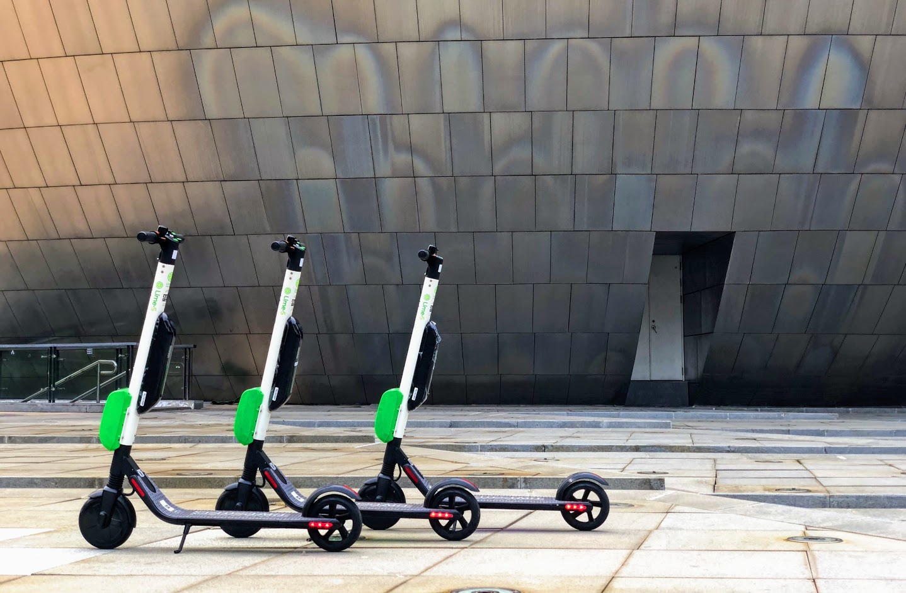
SCOOT
SMART MOBILITY
MADE SIMPLE
Nandi Satyaraj reddy(Sunny)
Christ university, Bengaluru

Slide 2
OBJECTIVE
Our idea was founded on a simple question: how do we ensure future generations will not only be able to live on a healthy planet, but thrive?
Our company aims to provide a sustainable solution to the first and last mile transportation problem by helping people move around their cities in an affordable and convenient way while eliminating their carbon footprint. We are here to empower future generations to change their behaviour so we can save this planet together.
Scoot is not just a tech mobility company. We are a people and relationships company first and foremost. And we're committed to building with you.

Slide 3
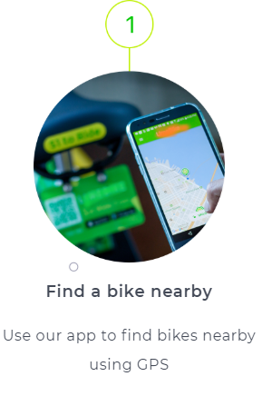
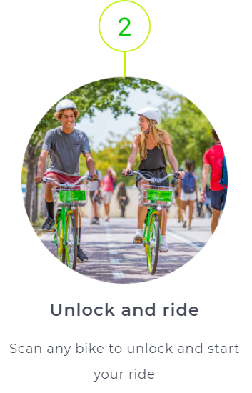
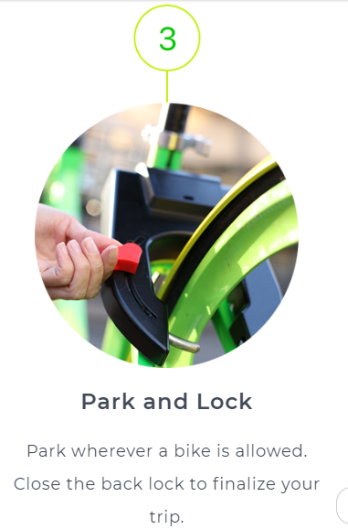
Riding is as easy as:

Slide 4
Your Ride Anytime From electric scooters to smart bikes, experience the excitement of scoot’s smart mobility fleet.

Slide 5

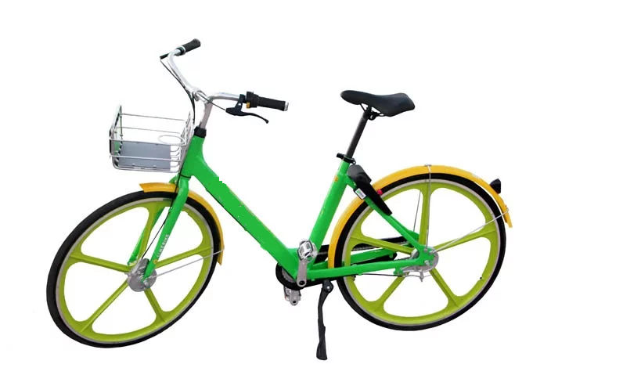
SMART BIKE
Scoot bike single speed bikes are perfect for cruising in style.
3G, GPS-enabled and equipped with classic spoke less wheels, they're the definition of making a single-speed statement.

Slide 6

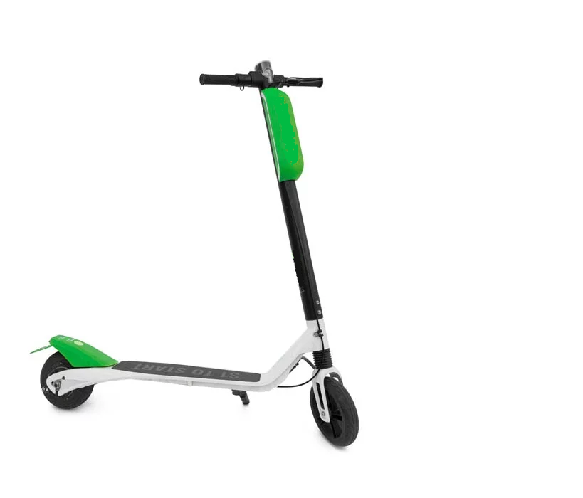
Electric Assist SCOOT-S
Getting around town has never been so simple, nor so fun!
With the push of a button, our scoot-s electric scooter will carry you effortlessly across the city.

Slide 7

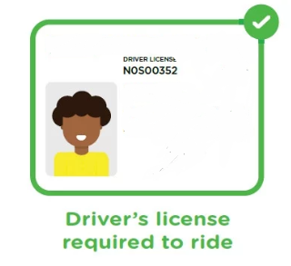

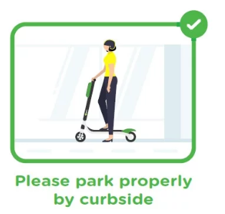

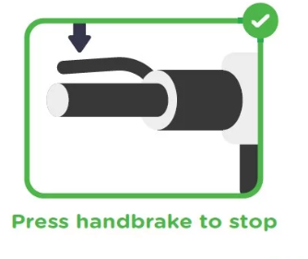
SCOOT-S Etiquette

Slide 8

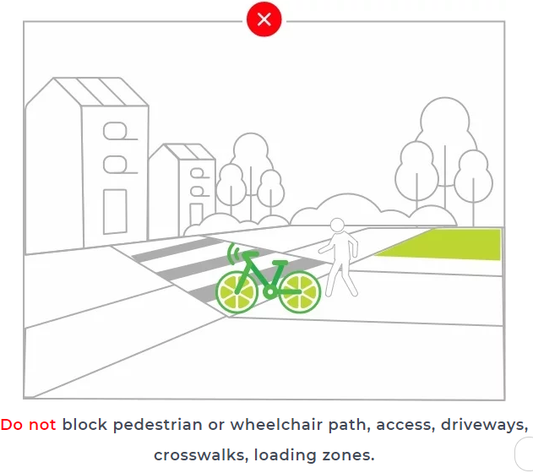
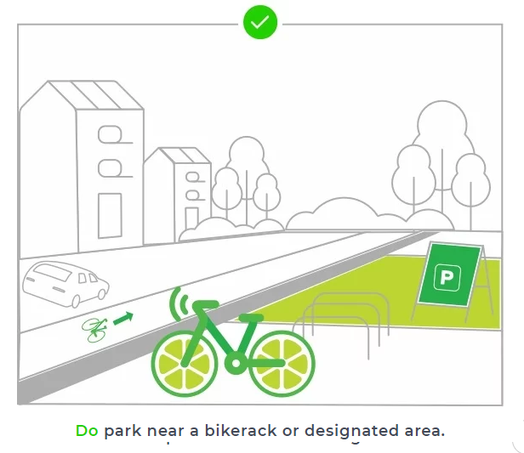
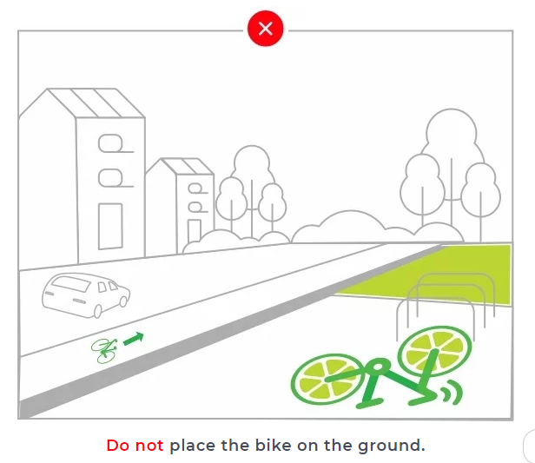
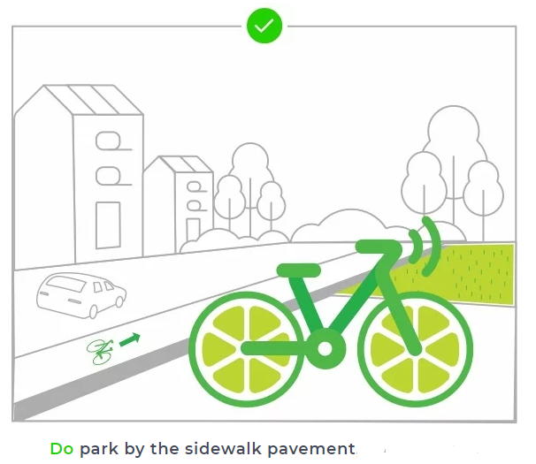
Parking Dos and Don'ts

Slide 9
GPS
With our comprehensive GPS data, cities like Hyderabad have a powerful resource to help plan for and maintain safer roads and bikeways.
We can also serve all areas of the community, including those traditionally underserved by public transportation or traditional bike shares.

Slide 10
SCOOT FOR CITIES
Serving cities is at the core of Scoot’s mission. From electric scooters to smart bikes, our dock free smart mobility solutions reduce traffic congestion, promote healthy living, and solve the all-important challenge of the first and last mile. And that’s just the beginning.

Slide 11
JOIN THE SCOOT MOVEMENT

Slide 12
PLEASE PROVIDE YOUR VALUABLE ADVICE ON THIS! KINDLY LET ME KNOW IF YOU HAVE ANY QUESTIONS.

