Slide 1

Give For Society
REG. 1255/2017 • HYDERABAD
- MENSTRUAL HYGIENE & DIGNITY INITIATIVE
Sthree
Swabhiman
Dignity, awareness, and safe infrastructure for 1,23,000 adolescent girls across 275 government residential institutions in Telangana.
★ TELANGANA GOVERNOR'S EXCELLENCE AWARD 2025

Slide 2


CSR PARTNERSHIP PROPOSAL ACADEMIC YEAR 2026-27
IN PARTNERSHIP WITH
MJPTBCWREIS
GOVERNMENT OF TELANGANA
01

Slide 3
• STHREE SWABHIMAN
02 • EXECUTIVE SUMMARY
- EXECUTIVE SUMMARY
A government-partnered programme to end period absenteeism, shame, and unsafe disposal across 275 campuses.
Sthree Swabhiman is a structured Menstrual Hygiene Management initiative for adolescent girls in MJPTBCWREIS residential schools and junior colleges across Telangana — combining annual awareness, sanitary napkin starter kits, permanent incinerator infrastructure, and Training of Trainers. | IMPLEMENTING AGENCY | Give For Society
The programme is endorsed by a Memorandum of Collaboration with the Secretary, MJPTBCWREIS, and a pilot launched in November 2025 in Warangal reached 1,200+ students. | GOVT. PARTNER | MJPTBCWREIS
 | INSTITUTIONS | 275 girls-only campuses
^8.04cr 1 yr 3 yr TOTAL FUNDING ASK PROGRAMME CYCLE TO SELF-RELIANCE | REACH | ~1,23,000 girls annually

Slide 4
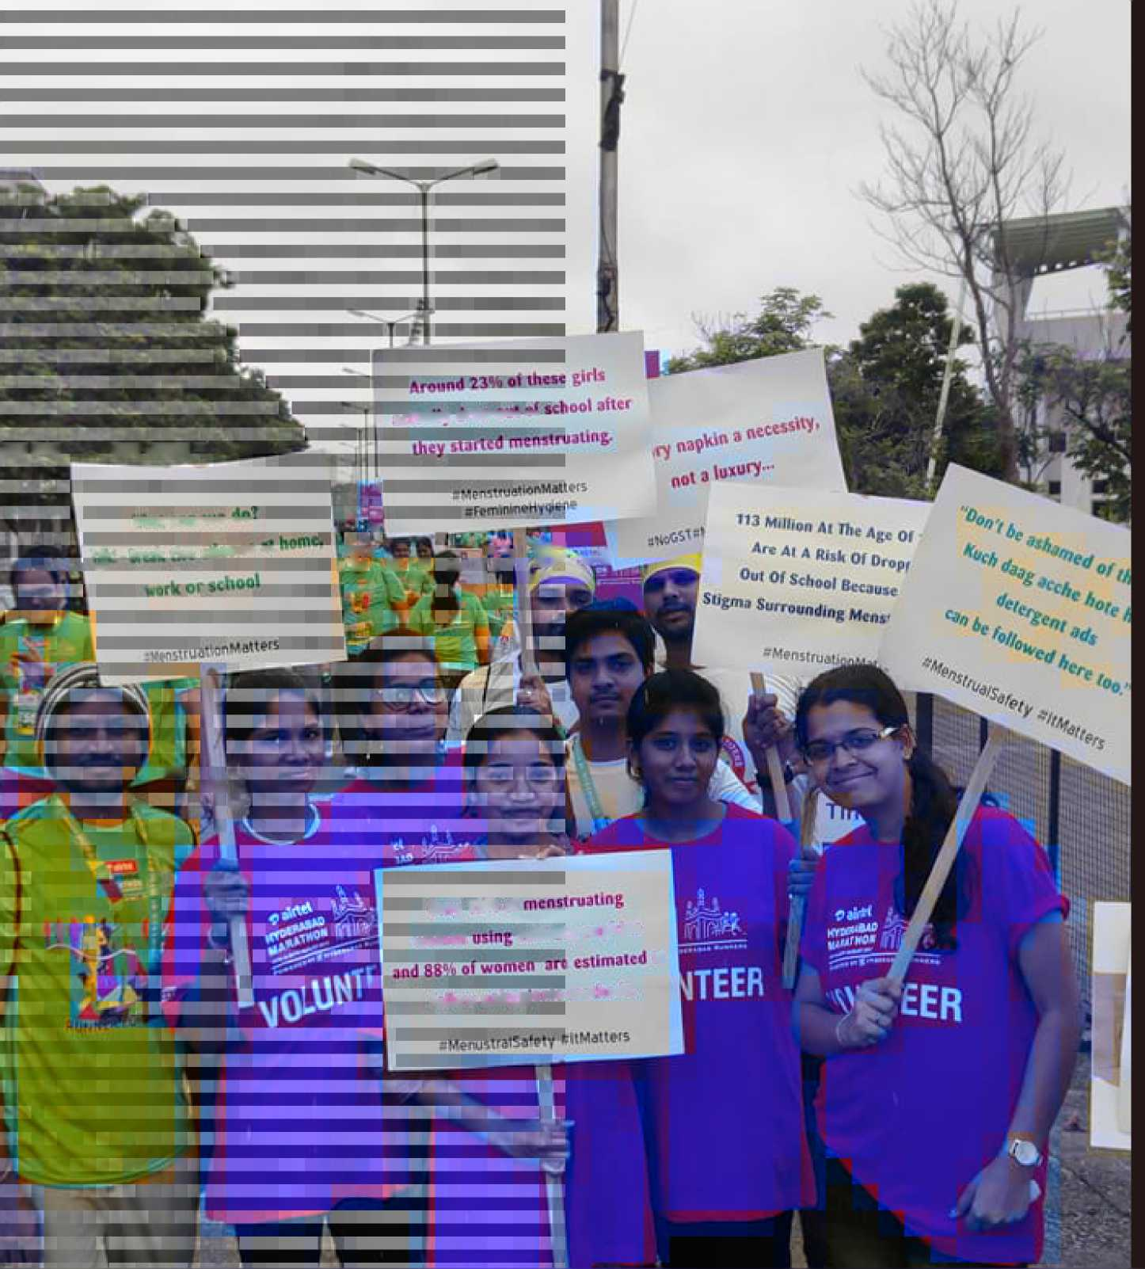
 |  |  | ^ILliUlV ITTB^Vu* “'
tav .-. «iiH^{h} ■
 |  |  | i
 |  |  | imrOTTWr-— | 1 M | _ -
f | 1 | 1 | _'• •
 |  |  | t*' . Lrr-il ihi tlltflCC *■ | TC J J J |  | i ^ v4
— Vi. |  |  | 1 *Fi ■':r' ’■"’- | s V-, | + ■ * lr 1:
u | . | 1, | .,1.
 |  | ■
— |  |  | Ul
Only w* Df
9!iii SUh*^ ^{na}P^{hl,li} ; »
IoLLqw tmili4!<nk
melhods.

Slide 5
03 • THE PROBLEM
- THE PROBLEM
For a girl in a rural residential school, her period costs her jive school days every month.
Across MJPTBCWREIS campuses, menstruation collides with three failures at once: no awareness, no reliable products, and nowhere safe to dispose of waste. The result is silence, shame, and absence. ★
★ TELANGANA GOVERNOR'S EXCELLENCE AWARD 2025
STHREE SWABHIMAN • 03

Slide 6



• STHREE SWABHIMAN
04 • WHY IT MATTERS
- FOUR REALITIES OF PERIOD POVERTY
The scale of the gap, in four numbers.
4-5
SCHOOL DAYS LOST
Days each girl in a residential institution misses every month due to menstruation.
SAFE DISPOSAL SITES
Most MJPTBCWREIS campuses have no incinerator — waste is openly burned or buried.
STRUCTURED SESSIONS
The number of menstrual hygiene sessions most girls receive in their entire schooling.
UNSAFE ALTERNATIVES
Of rural girls still use cloth, paper or ash in place of sanitary protection.
Source: Programme baseline survey; MJPTBCWREIS pilot, Warangal Dist., Nov 2025.

Slide 7
• STHREE SWABHIMAN
05 • OUR RESPONSE
- OUR RESPONSE
A four-part programme, delivered annually, designed to graduate to institutional self-reliance by Year 3.
PILLAR 01 • AWARENESS
Structured MHM sessions in every institution, every year.
One-day workshops on menstrual cycle, hygiene, myth-busting, and emotional well-being — delivered in Telugu.
PILLAR 02 • ACCESS
Starter kits placed in the hands of every newly-enrolled girl.
12 sanitary napkin packs per girl, with a user guide and demonstration on safe disposal practice.
PILLAR 03 • INFRASTRUCTURE
Permanent eco-friendly incinerators on every campus.
Two units per institution — a one-time capital investment with a 10+ year service life and on-site training.
PILLAR 04 • CAPACITY
Training of Trainers, so the programme outlives our presence.
Lady wardens, science teachers, and peer-mentor students are certified to deliver content independently.
275 SESSIONS / YR
88,000 KITS / YR
550 UNITS INSTALLED
825+ TRAINED

Slide 8
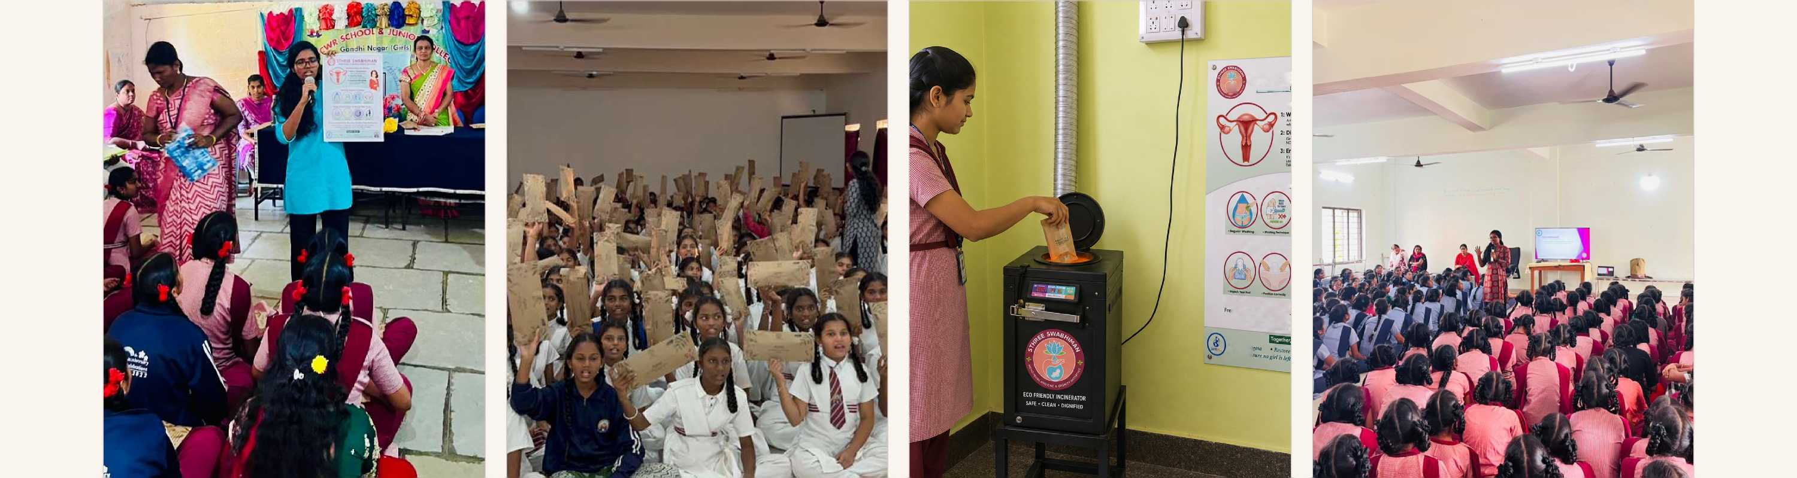
• STHREE SWABHIMAN
06
PROGRAMME COMPONENTS
- WHAT EACH GIRL RECEIVES
Four interventions, delivered together on every campus.
m
STHREE
MENSTRUAL
Undei
Essential Hyi
Using Sanitary Pads -
Our Commitment To You: Fr
^^^{ono,hi}«^{h}-q^{ual}*)'-
attending to manage their p. Empower Yourself. [
‘Shatter sty 'Anil make.
02 ■ ACCESS
Sanitary napkin starter kits in every girl's hands.
12 packs per newly-enrolled girl, with a printed user guide and live demonstration on safe disposal practice.
03 ■ INFRASTRUCTURE
Permanent eco-friendly incinerators on every campus.
Two units per institution. One-time capital investment with a 10+ year service life and first-year maintenance contract.
One-day MHM workshop in every institution.
Menstrual cycle, hygiene, myth-busting, emotional well-being & incinerator use. Telugu flipbooks + facilitator script.
Training of Trainers, so the programme outlives us.
Lady wardens, science teachers and senior peer mentors are ToT-certified to sustain delivery from Year 2 onwards.

Slide 9
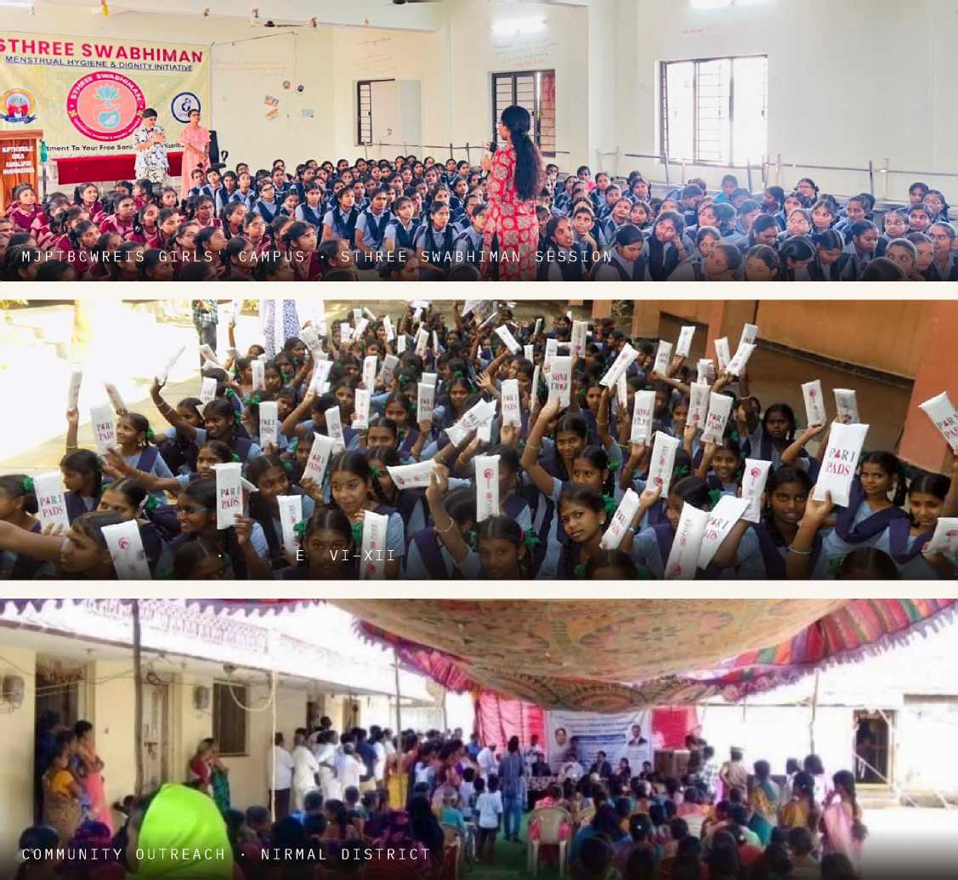
• STHREE SWABHIMAN
07 • WHO WE REACH
WHO WE REACH
Targeting the most underserved adolescent demographic in the state.
275 1.23l 88 k 10
INSTITUTIONS
146 schools & 129 jr. colleges
GIRLS / YR
Classes VI-XII + Intermediate I & II
KIT RECIPIENTS
Newly enrolled each year
DISTRICTS
All erstwhile districts of Telangana
COMMUNITY COMPOSITION
■ BC
■ SC
■ ST
■ MINORITY
KIT DISTRIBUTION
CLASS
S
Every girl reached studies in a government residential institution from a BC, SC, ST, or minority community — the demographic with the steepest barriers to menstrual health, and the lowest baseline of awareness.

Slide 10


• STHREE SWABHIMAN
08 • IMPLEMENTATION PLAN
- IMPLEMENTATION PLAN
A five-phase annual cycle, anchored to the MJPTBCWREIS academic calendar.
APR - JUN - JUL - MAR
QTR
PHASE 03
Awareness & Distribution
One-day MHM workshop per institution. Starter kits distributed to every newly-enrolled girl.
G
PHASE 04
Institution-led
Continuity
Trained staff and peer mentors carry messaging independently. IEC materials displayed campus-wide.
PHASE 05
Monitoring & Reporting
Quarterly warden check-ins, district field visits, incinerator audits, and a year-end impact report.
PHASE 01
Planning
Institution lists finalised, principals coordinated, site assessments for incinerators completed.
PHASE 02
Infrastructure & Capacity
550 incinerators installed. ToT workshops with staff. Peer mentors trained on each campus.
APR - MAY
MAY ~ JUN
JUN ~ JUL
AUG ~ MAR
QUARTERLY
★ KEY ACTIVITIES CLUSTER AROUND SCHOOL REOPENING, SO EVERY NEW GIRL IS REACHED AT THE START OF THE YEAR.

Slide 11
• STHREE SWABHIMAN
09
SUSTAINABILITY MODEL
- SUSTAINABILITY MODEL
By Year 3, every campus runs the programme on its own — without NGO dependency.
YEAR GIVE FOR SOCIETY INSTITUTION
1 | Full implementation. Sessions, kits, incinerators, ToT delivered end-to-end. | Observe, nominate focal persons, host facilitation.
2 | Partial support. Joint | Lead delivery with NGO
 | sessions co-delivered with | guidance; manage
 | institution staff. | incinerators independently.
3 | Remote only. Refresher | Run programme fully
 | content and technical | independently; maintain
 | helpline. | infrastructure.
The investment lasts beyond the funding year. Incinerators have a 10+ year service life. IEC materials are reusable. Trained staff stay on campus. Peer mentors graduate into the next cohort.
+ No recurring product procurement after Year 1 starter kit.
+ Self-financing pipeline routed through MJPTBCWREIS allocations.
+ Programme survives staff transfers via documented curriculum.

Slide 12



• STHREE SWABHIMAN
10 • IMPACT & KPIS
- IMPACT & KPIS
What we measure, and what we commit to deliver.
r£i |  | Oo r*r\
275 |  | 1.23l
INSTITUTIONS COVERED |  | GIRLS WITH AWARENESS
0
OO OO * |  | 275
STARTER KITS |  | AWARENESS SESSIONS
a |  | o' r\
550 |  | 825+
INCINERATORS LIVE |  | TRAINERS CERTIFIED
OUTCOME 01
Period-related school absence
OUTCOME 02
Girls using safe sanitary products
OUTCOME 03
Institutions running independently
YR 1 0%
YR 2 ~60%
4-5
4
v
~50%
BASELINE
Baseline vs follow-up survey
AFTER YR 1
Target t
AFTER YR 1
YR 3
100%
BASELINE
Pre/post attendance logs • days/month
% of girls
% self-delivering - institution staff & peer mentors

Slide 13
• STHREE SWABHIMAN
11
SDG & POLICY ALIGNMENT
- SDG & POLICY ALIGNMENT
Contributing to five UN Sustainable Development Goals.
SUSTAINABLE DEVELOPMENT
GOAL
w
Good Health
and Well-being
SUSTAINABLE DEVELOPMENT GOAL
SUSTAINABLE DEVELOPMENT GOAL
SUSTAINABLE DEVELOPMENT GOAL
SUSTAINABLE DEVELOPMENT GOAL
4
5
6
10
■0
$
o
Quality
Education
Gender
Equality
Clean Water & Sanitation
Reduced
Inequalities
Promotes menstrual hygiene; reduces RTIs & UTIs; protects physical & emotional wellbeing.
Cuts menstruation-driven absenteeism; preserves school attendance & academic continuity.
Challenges period stigma; ensures equitable access to dignity, knowledge & menstrual care.
550 eco-friendly incinerators end open-burn pollution across all 275 campuses.
Exclusively serves BC, SC, ST & minority adolescent girls — India's most underserved.
NATIONAL POLICY ALIGNMENT
BETI BACHAO BETI PADHAO
SWACHH BHARAT MISSION
NEP 2020
COMPANIES ACT 2013
SCH . VII (I, II, III)

Slide 14
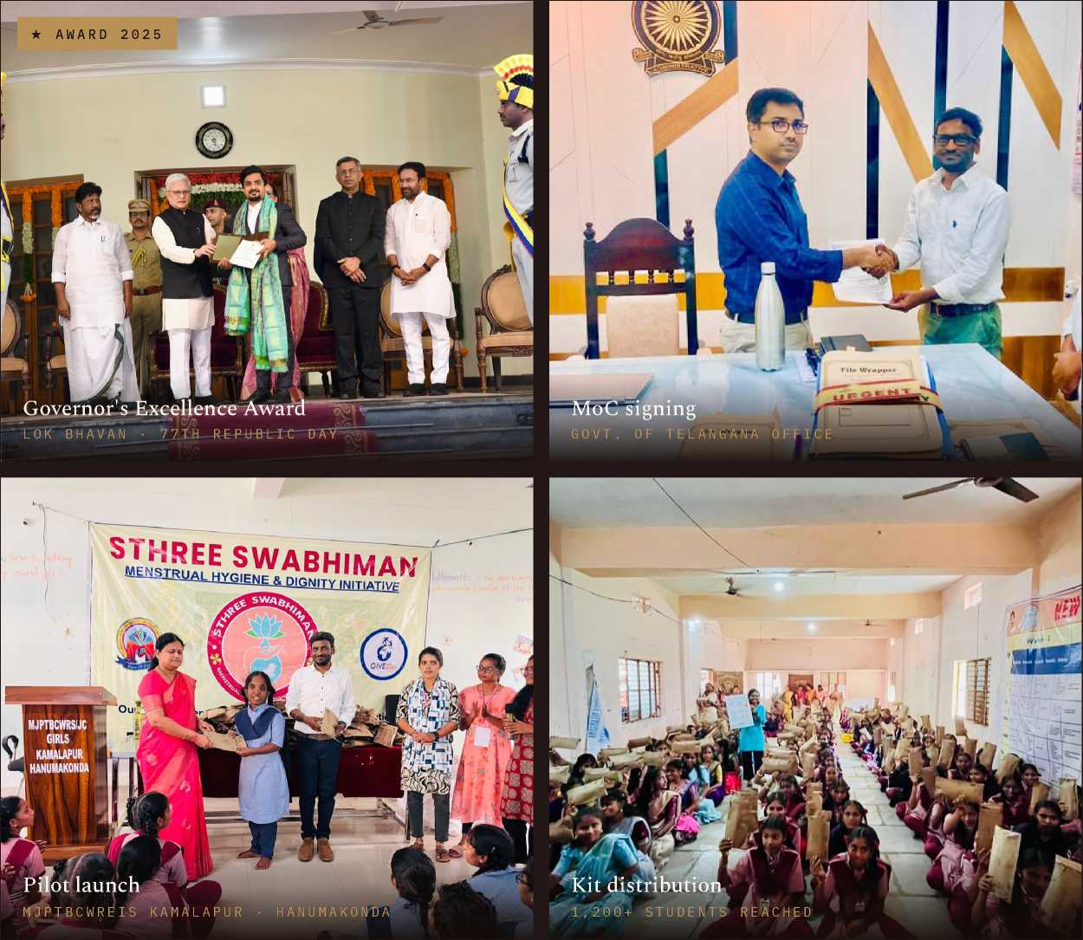



• STHREE SWABHIMAN
12 • WHY GIVE FOR SOCIETY
- WHY GIVE FOR SOCIETY
Government-endorsed, award-recognised, with a pilot already in the ground.
TELANGANA GOVERNOR'S EXCELLENCE AWARD 2025
Corporate Volunteering — Organisation Category. Conferred by Hon'ble Governor Shri Jishnu Dev Varma on the 77th Republic Day, Lok Bhavan, Hyderabad.
MOC WITH MJPTBCWREIS
Memorandum of Collaboration signed with the Secretary, MJPTBCWREIS — Lr.No.C2/3357/2025. Full institutional access across 275 girls-only campuses.
PILOT DELIVERED • NOV 2025
1,200+ students reached in Warangal District. End-to-end workshop, kit distribution, and incinerator install documented.

Slide 15
• STHREE
SWABHIMAN
13 • BUDGET OVERVIEW
- BUDGET OVERVIEW
TOTAL PROGRAMME COST • ANNUAL
^8.04er
INR Eight Crores Four Lakhs Sixty-Six Thousand • ^8,04,66,000
PER-GIRL COST
t600
Year of awareness +12 napkin packs + incinerator share.
CAPITAL LIFESPAN
10+ yr
Incinerators are a one-time investment; recurring cost drops year-on-year.
SCALE DISCOUNT
~10%
Estimated bulk procurement savings at full statewide volume.
A • AWARENESS
?68.75l
Sessions, ToT, peer mentor training, logistics.
B • STARTER KITS ^5.28 Cr
88,000 girls x 12 packs x ?45 + packaging & logistics.
C • IEC MATERIALS
^8.25 l
Telugu flipbooks, wall charts, lamination treatment.
D • INCINERATORS
^1.38cr
550 units, installation, first-year maintenance.
E • M&E + MANPOWER
?62.16l
Field coordinators, M&E officer, field visits & reports.
8.5% OF TOTAL
65.6% OF TOTAL
1.0% OF TOTAL
17.1% OF TOTAL • ONE-TIME
7.7% OF TOTAL

Slide 16
• STHREE SWABHIMAN
- DETAILED BUDGET BREAKDOWN
Every line item — verifiable through Schedule VII utilisation certificates.
COMPONENT A Awareness & Capacity Building |  | ^68,75,000
Facilitator costs | f2,500 x 275 | ^25,00,000
Training of Trainers workshops | Lump sum | ^20,00,000
Peer mentor training materials | Lump sum | ?15,00,000
Logistics & coordination | Lump sum | ?8,75,000
COMPONENT C IEC Materials |  | ?8,25,000
Telugu flipbooks & visual aids | Lump sum | ^4,12,500
Wall charts and posters | Lump sum | ?2,75,000
Lamination & durability treatment | Lump sum | ?1,37,500
COMPONENT E
^62,16,000

Slide 17
14 • DETAILED BUDGET
COMPONENT B Sanitary Napkin Starter Kits |  | ?5,28,00,000
Sanitary napkins | 88,000 x 12 x f45 | ?4,75,20,000
Packaging & user guides | Lump sum | ?22,00,000
Logistics & distribution | Lump sum | ?30,80,000
COMPONENT D ■ ONE-TIME CAPITAL Incinerators (550 units) |  | U,37,50,000
Incinerator units | 550 x f20,000 | ?1,10,00,000
Installation & electrical | f6,000 x 275 | ?16,50,000
First-year maintenance | 275 institutions | ^8,25,000
Training on op. & maintenance
Lump sum
?2,75,000

Slide 18
• STHREE SWABHIMAN
15 • FOR CSR PARTNERS
- WHAT CSR PARTNERS RECEIVE
Visibility, verification, and compliance — bundled with the impact.
☆ 01 |  | m 02
RECOGNITION |  | RECOGNITION
Named partner across all 275 campuses |  | Branded plaques on 550 incinerators
Co-branding on Telugu IEC materials, session backdrops, and |  | Permanent metal plaques on every unit — a 10+ year visibility
partner credits delivered to 1,23,000 girls. |  | footprint anchored to real infrastructure.
i*
REPORTING
Quarterly progress reports with photo evidence
Distribution records, install logs, and institution-wise data — formatted for CSR committee review.
© 04 |  | 0 05 |  | Ini 06
REPORTING |  | COMPLIANCE |  | COMPLIANCE
Annual impact report & field-visit access |  | Full Schedule VII certification |  | Government-endorsed delivery chain
Year-end documentation, sample field visits, and third-party |  | Utilisation certificates and expenditure data for Companies Act 2013 |  | Delivered under a signed MoC with MJPTBCWREIS — full
verification on request. |  | Schedule VII (Clauses i, ii & iii). |  | cooperation, named focal persons, audit-ready records.

Slide 19

• STHREE SWABHIMAN
16 • CALL TO ACTION
- CALL TO ACTION
Partner with us — to reach 1,23,000 girls across 275 campuses, starting this academic year.
ROADMAP TO PARTNERSHIP
Partnership conversation
A 45-minute review with your CSR committee — fit, scale, disbursement.
THE ASK
?8.04c
For one full academic year of statewide delivery. Full, partial, or component-specific commitments welcomed.
Site visit & pilot review
Optional visit to the Warangal pilot — observe a session, inspect an install, meet wardens.
MoU & milestone-linked disbursement
Sign the MoU; launch with the April-May planning phase.
First reach — June 2026
First girls receive kits, training, and access to safe disposal at academic year-start.
OR SCOPE DOWN THE PARTNERSHIP
^1.38 Cr ^68.75 l ^2.92 l
ALL 550 INCINERATORS STATEWIDE AWARENESS ADOPT 1 INSTITUTION
NEXT STEP
Sign the MoU. Reach the first girls by June.

Slide 20



THANK YOU
17 / 17
No girl should miss school because of her period.
No campus should lack a safe way to dispose of menstrual waste. Your CSR partnership makes both possible — for 1,23,000 girls, across 275 institutions,
starting this academic year.
IMPLEMENTING AGENCY
Give For Society
Reg. 1255/2017
PROGRAMME
Sthree Swabhiman
Menstrual Hygiene & Dignity
GOVERNMENT PARTNER
MJPTBCWREIS
Govt. of Telangana
r E M AIL PROTECTED! • HYDERABAD, TELANGANA • MOC LR . NO.C2/3357/202 5
★ TELANGANA GOVERNOR’S EXCELLENCE AWARD 2025
STHREE SWABHIMAN • CSR PARTNERSHIP PROPOSAL

