Slide 1


Inferrix AI Agent: AI-Driven Operations for Smart Hospitality

Slide 2

Value Statement :Why Agentic AI solution
With the AI Agent tool provide by AIonOS, Inferrix team can manage alarms, devices, and maintenance using simple, natural language—no technical expertise required. This means faster response times, fewer errors, and a more comfortable, reliable environment for your guests. Our solution empowers your staff, reduces costs, and sets the stage for a smarter, more efficient hotel operation

Slide 3
Pain Points/Problem Statement
Manual alarm and device management is slow, error-prone, and requires technical expertise.
Missed or delayed responses to alarms can lead to equipment failure, guest discomfort, and higher costs.
Existing dashboards are complex and not user-friendly for all staff (non-engineers)

Slide 4
AIonOS Solution
Inferrix AI Agent: Natural language, real-time, intelligent operations.
Staff can interact with the system using plain English—no technical training required.
Unified, modern UI for alarms, devices, and telemetry.

Slide 5
USP of AI Solution from AIonOS
No hardcoded data/logic
Enterprise security features
Modern, responsive UI
Robust Intelligent AI Agent
Real-time Data Integrations with Inferrix APIs
Multi-LLM support (Google Gemini ,OpenAI)
NFRs(Reliability,Maintainability,Performance,Security,Scalability,Code Quality) and best practises of SDLC has been assured

Slide 6
Feature Summary
Natural language queries about alarms, devices, telemetry
Real-time data from live Inferrix sensors
Professional UI with proper error/exception handling
Secure architecture (client-side authentication and server-side authorization)
Scalable solution ready for production deployment

Slide 7
6 Business Benefits for Inferrix
1. Faster Incident Response & Reduced Downtime
Natural language alarm management enables even non-technical staff to quickly identify, acknowledge, and resolve critical issues.
Real-time alerts and summaries ensure that no alarm goes unnoticed, reducing the risk of equipment failure and guest discomfort.
2. Intuitive, User-Friendly Operations
Staff can interact with the system using plain English—no need for complex dashboards or technical training.
Reduces onboarding time and empowers more team members to take action.

Slide 8
3. Proactive Maintenance & Cost Savings
AI-driven insights combine device telemetry with external data (e.g., weather) to predict potential issues before they escalate.
Enables preventive maintenance, reducing emergency repairs and extending equipment life.
4. Centralized, Real-Time Visibility
Unified view of all devices, alarms, and telemetry across the property.
Managers and engineers can monitor, control, and troubleshoot from anywhere, improving operational efficiency.

Slide 9

5. Scalable & Future-Proof
Easily adapts to new devices, locations, and use cases as your infrastructure grows.
Ready for integration with advanced analytics, automation, and control features.
6. Reduced Support Burden
AI agent can handle common troubleshooting queries, freeing up human support staff for more complex issues.
Faster problem resolution leads to higher guest satisfaction and lower operational costs.

Slide 10
How It Works : Live Demo
Sample Prompts:
Show me all critical alarms for Tower A
Acknowledge the high temperature alarm for Device X
List of all active devices
List devices with low battery
Show top 3 alarm types
Note: We will test above 2 red highlighted prompts for this demo

Slide 11
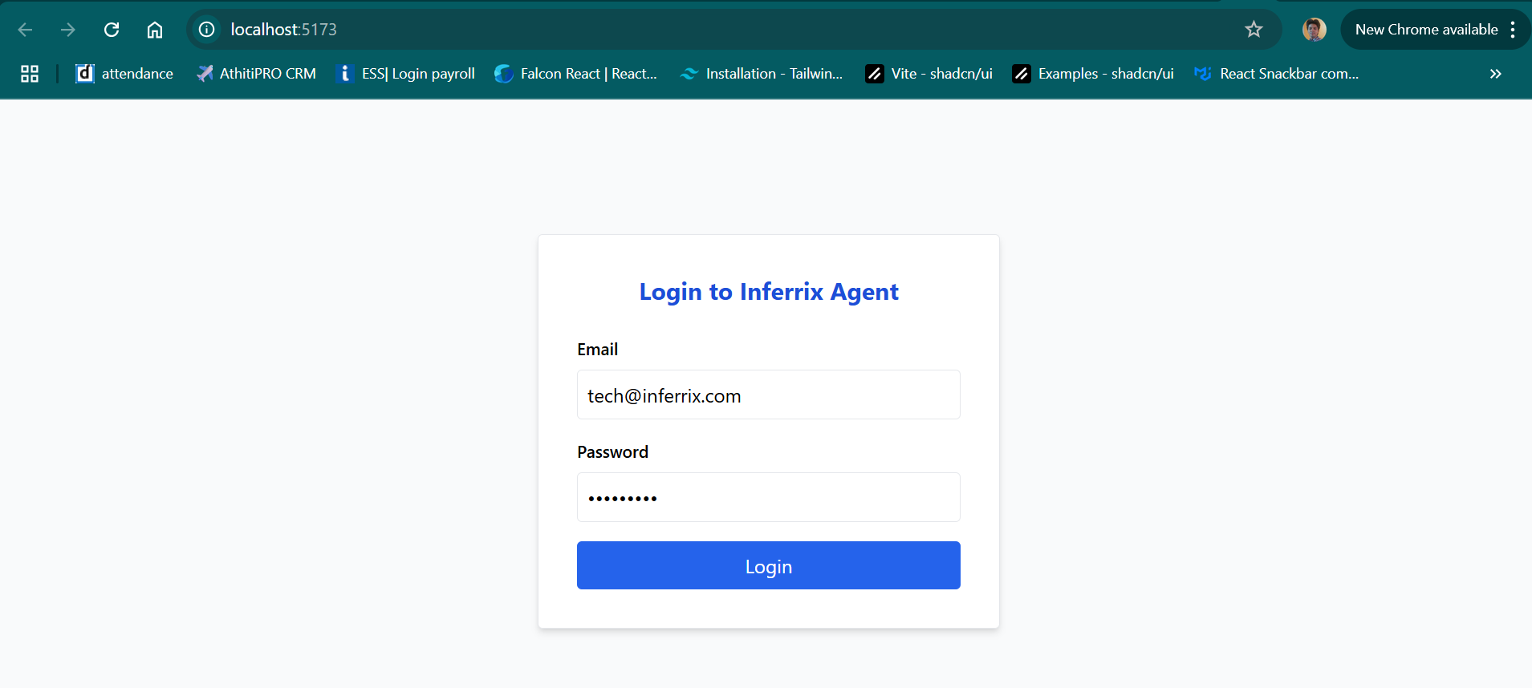

Slide 12
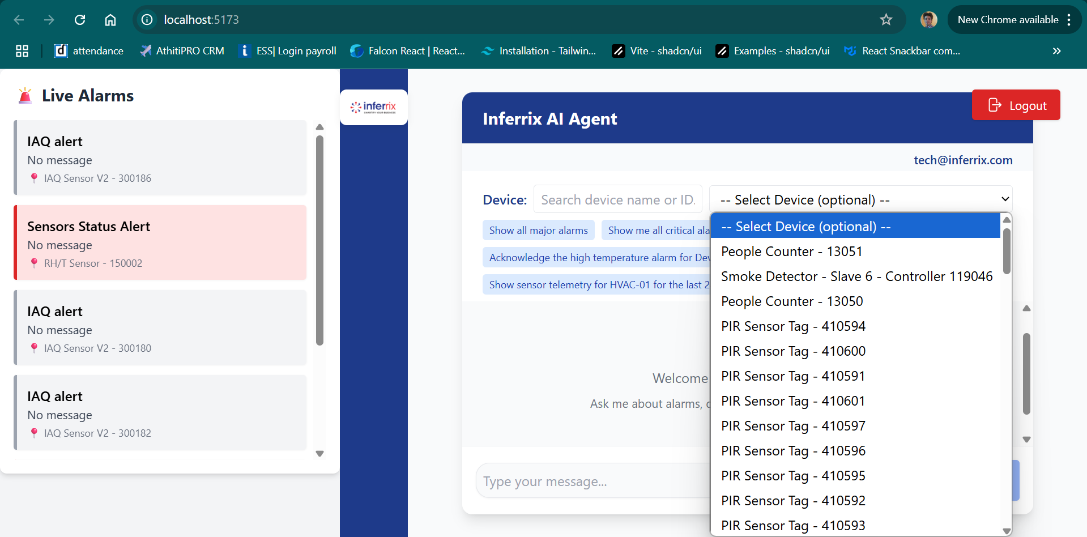

Slide 13
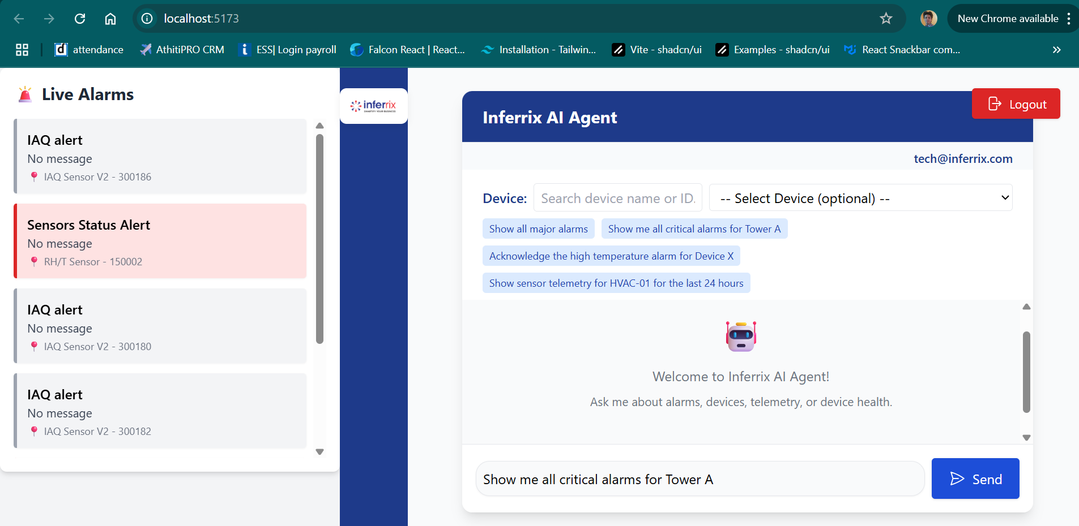

Slide 14
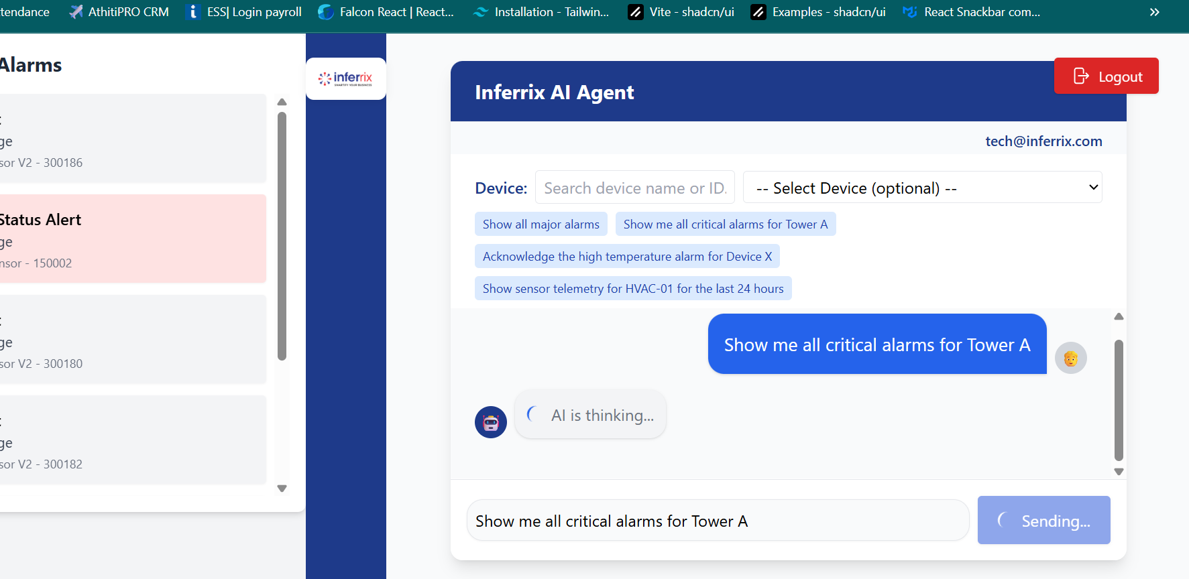

Slide 15
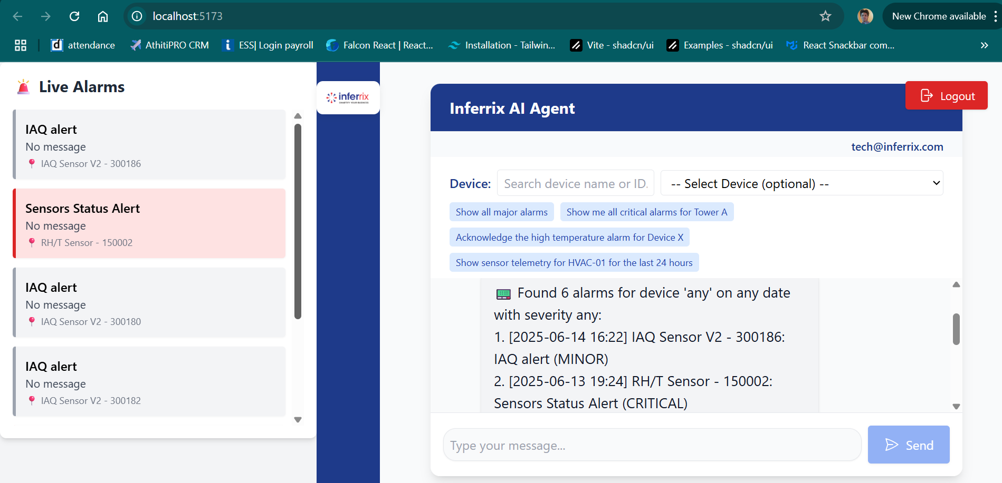

Slide 16
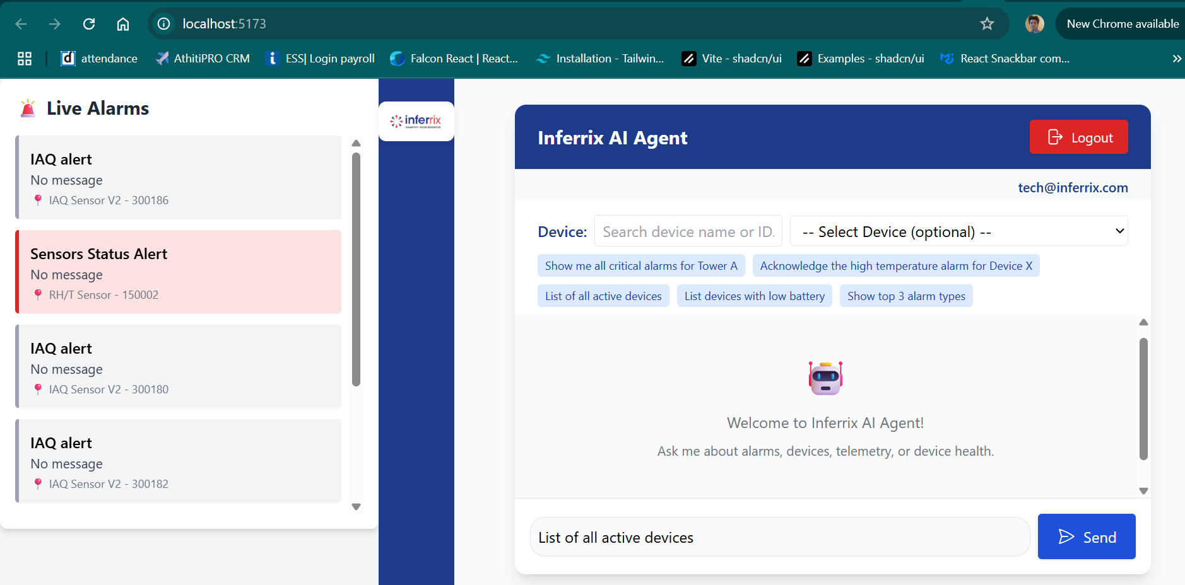

Slide 17
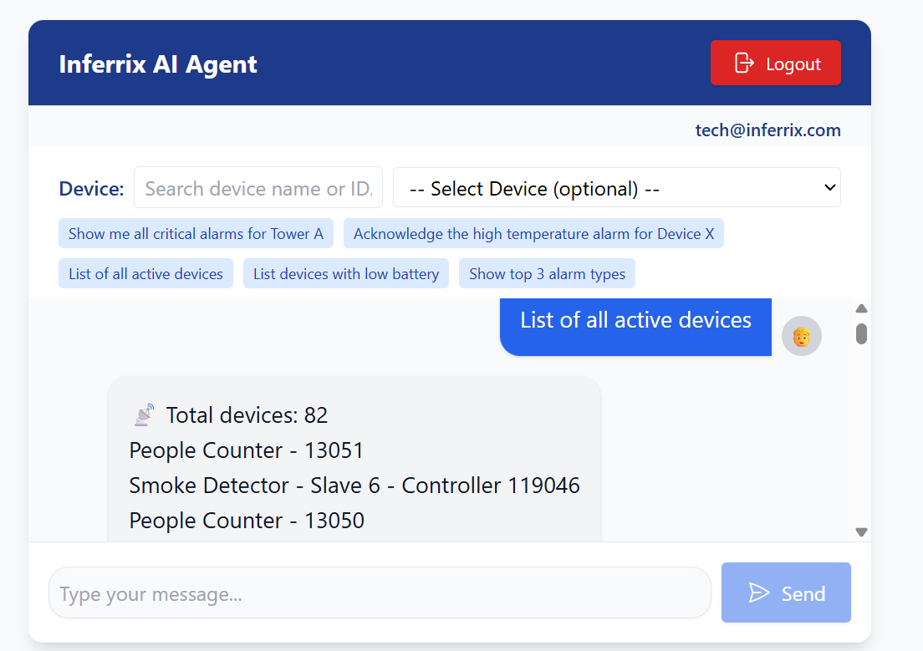

Slide 18
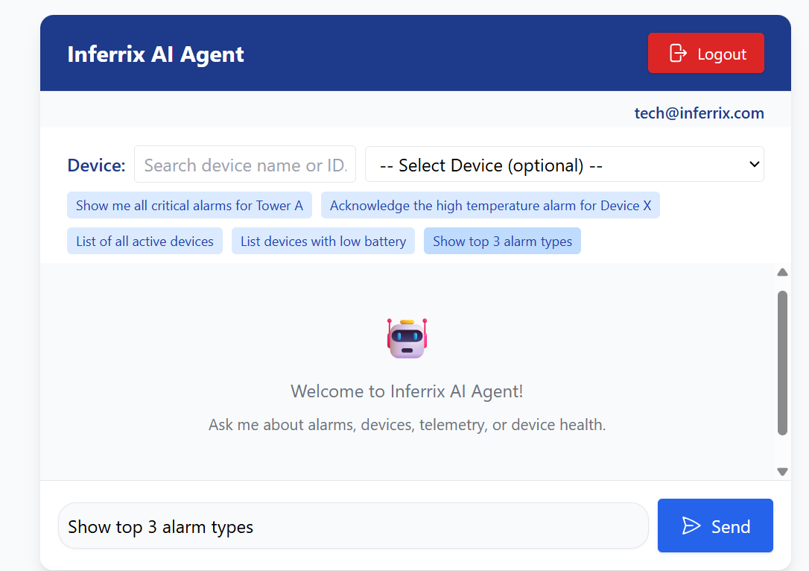
“Stop Button” :Stopping manually if AI takes lot of time

Slide 19
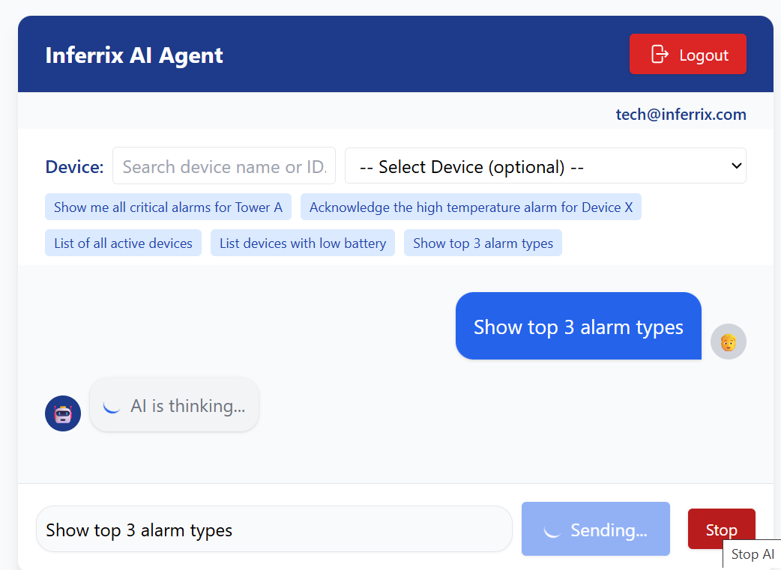

Slide 20
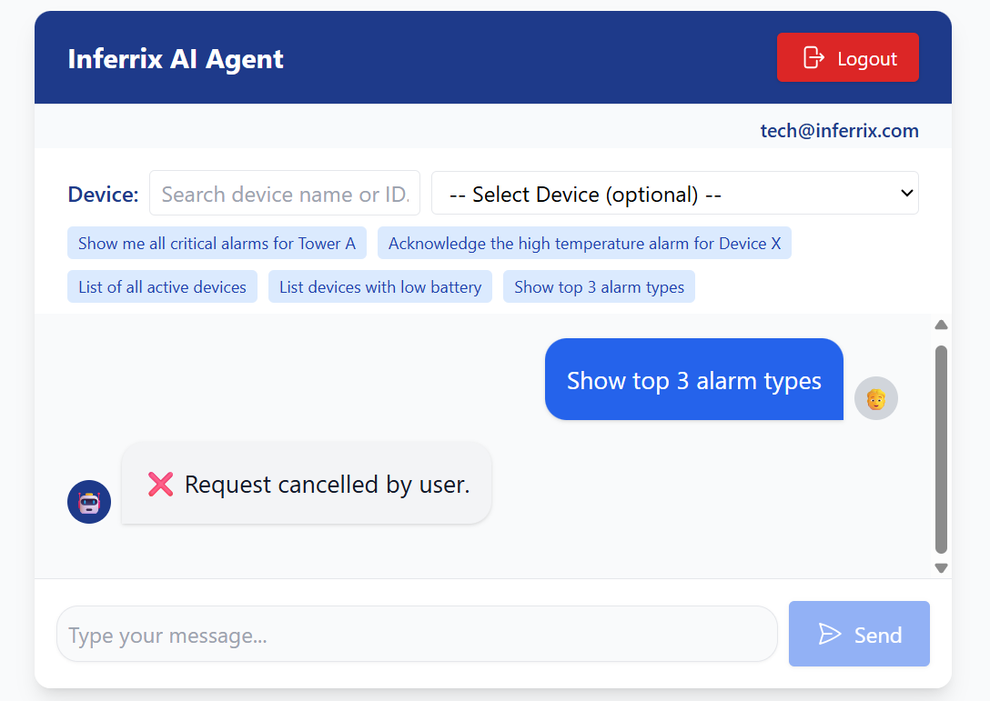

Slide 21
Future Vision
Proactive recommendations, device control, integration with other hotel systems.
Continuous learning and improvement as more data and use cases are added.

Slide 22

Q&A / Next Step
Invite questions and discuss how the solution can be tailored for Inferrix’s customers.

Slide 23
THANK YOU
WE CAN FURTHER ENHANCE THIS WITH MORE
ADVANCED/CUSTOMIZED FEATURES AND COVER
MOST OF 600+ APIS OF INFINNIX AS PER DEMAND

