Slide 1
RFID-STUDENT TRACKING SYSTEM
Project Advisor:
Dr. Usman Bhatti
Group Members:
Abdul Rehman Durrani 06-0104
Usman Zafar 06-0088
M. Ahsan Iqbal 06-0102
Fahad Tariq 06-0132

Slide 2
RFID Technology
A brief introduction to RFID technology and how
does it work
Radio Frequency IDentification (RFID) consists of a
transmitter chip/IC and a receiving
antenna/transceiver
Each transmitter chip has a unique identification
number commonly referred to as a RFID Tag
RFID tag-Embedded on student ID card

Slide 3
Introduction
Automated tracking of students at university using
RFID technology
Identification of students
Restricted entry in different areas of university
Record maintenance
Tracking and information handling in fast and
reliable manner
Reducing possibility of human error

Slide 4
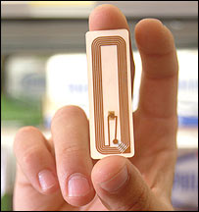
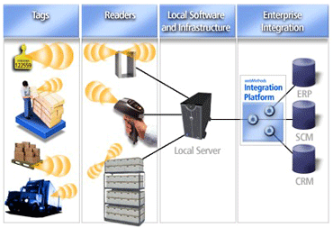

RFID Technology
RFID Tag
RFID Transceiver
RFID Application/Working

Slide 5
Why RFID ???
RFID is widely used because of its two distinct advantages i.e. Unique Identification & Automation.
Other benefits include:
RFID readers do not require a direct line of sight to
either active RFID tags or passive RFID tags
RFID tags can be read at much greater distances
(up to 300 feet)
RFID readers can read RFID tags much faster (forty
or more tags per second are possible)
RFID device does not need to be positioned
precisely relative to the scanner

Slide 6
Various Applications of RFID
Many universities and other institutions use RFID technology
to fulfill their security needs
Automotives (use RFID for anti-theft immobilizers)
Animal tracking
Asset tracking (Library books, pharmaceutical products)
Payments through contact less credit-cards & tokens
Supply chains (inventories and sales)
Attaching medical history to a patient(through RFID tag)
Automated toll-payment transponders
Fifty million house pets around the world have RFID tags
implanted in their bodies, to facilitate return to their
owners should they become lost

Slide 7
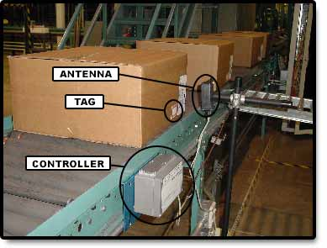
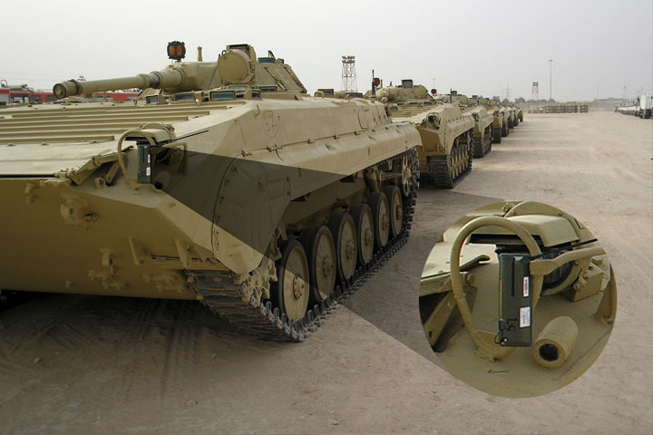
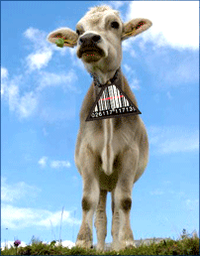

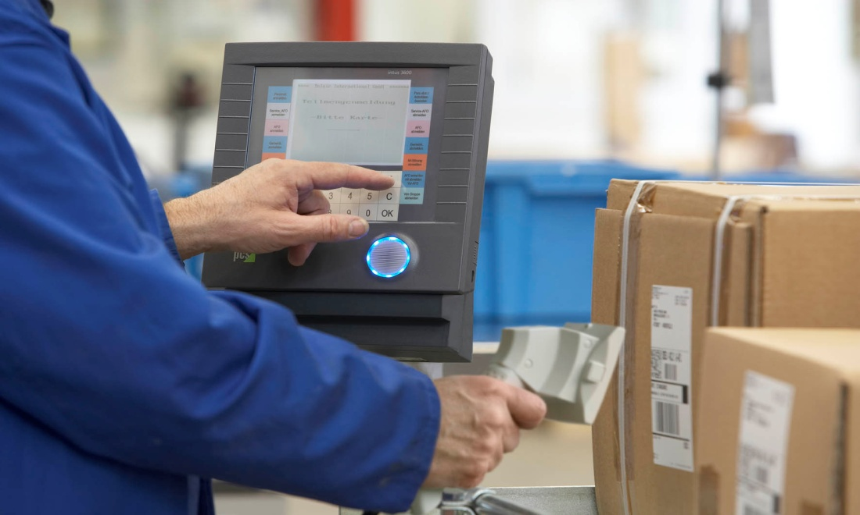
Applications of RFID Technology
A Tagged BMP (A Russian Carrier)
Tagged Animal
RFID wrist band for patient management

Slide 8
Intended Audience of Our System
Student (Primary users of system)
Faculty
Staff
Librarian
Hostel warden/administration
Security staff
Lab instructors/administration
Staff administrator

Slide 9
Functional Requirements
Following are the key functionalities of our system. Our key use cases are based on these requirements.
Attendance of students in class
Restricted entrance of students in labs
Book issuance from library
Restricted entrance of students in examination halls
Student’s entrance in university
Student’s entrance in hostels

Slide 10
ER Diagram

Slide 11
System Requirements
Hardware Requirements
Software Requirements
RFID Chips (10 cm or more distance)
A computer system having minimum requirements:
512 MB RAM
2 GHz Processor
1 GB Hard disk
LAN(Wired or Wireless)
RS-232 (9-pin) serial port cable & connectors to enable RFID transceiver with LAN
Windows based OS (Windows XP and later versions)
.Net framework (2.0)
SQL server 2000
Visual Studio 2005

Slide 12
Design Considerations
Performance & compatibility issues related to inter
process communications must be considered
Understandable, maintainable and reusable design
KISS principle (“Keep It Simple Stupid!”) must be
followed
Software must have easy to use features
User friendly interface should be provided
Built-in API’s of VB.net and ASP.net will be used for both user interface design and software & hardware interface
Speedy response from the system should be ensured

Slide 13
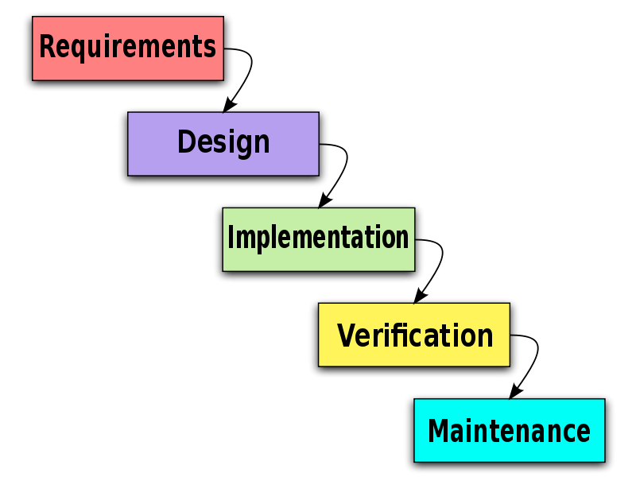
Development Methods
The method we have used in the development of our system is “Water Fall method”

Slide 14
Water Fall Development Lifecycle
The waterfall model is a sequential software development process, in which progress is seen as flowing steadily downwards (like a waterfall) through the phases of Conception, Initiation, Analysis, Design (validation), Construction, Testing and maintenance

Slide 15
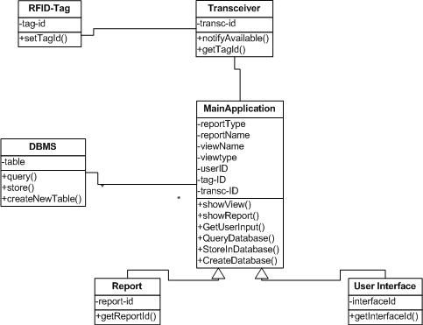
UML Diagram

Slide 16
System Architecture
Components & subcomponents
RFID Tag
Transceiver
Identification
Application layer
Library
Academic
Hostels
Main entrance
DBMS
Reports
Rights
Admin
Student
Faculty
Staff
Interface
RFID Tag
(Embedded on Id Cards of students)
Transceiver
Identification
Tracking
Application Layer
DBMS
Library
Academic
Reports/Output
Hostels
Main Entrance
History maintenance
Rights
Admin
Student
Faculty
Staff
Interface/GUI

Slide 17
Policies and Tactics
The whole project will be divided into layers. View,
database and logic will be handled in separate files , they
will be independent of each other
Rights will be implemented in the project to ensure
user’s authority, privacy & security
Coding guidelines such as camel case variable name ,
logical function name, indentation and commenting
each logical step will be used
Unit testing will be done at each step moreover test cases
will be made to do black box and white box testing
System deliverables will be made iteratively and testing
will be done on them

Slide 18
Work Done so far…
Research work for the understandability of RFID
technology and its use
Requirement gathering by visiting some of the
intended users of our system
Software Functional Specifications (SFS) & Software
Requirement Specifications (SRS)
High and Low level design
Working Prototype
GUIs

