Slide 1
Sports App
By
Satya Sailaja Mylapalli

Slide 2
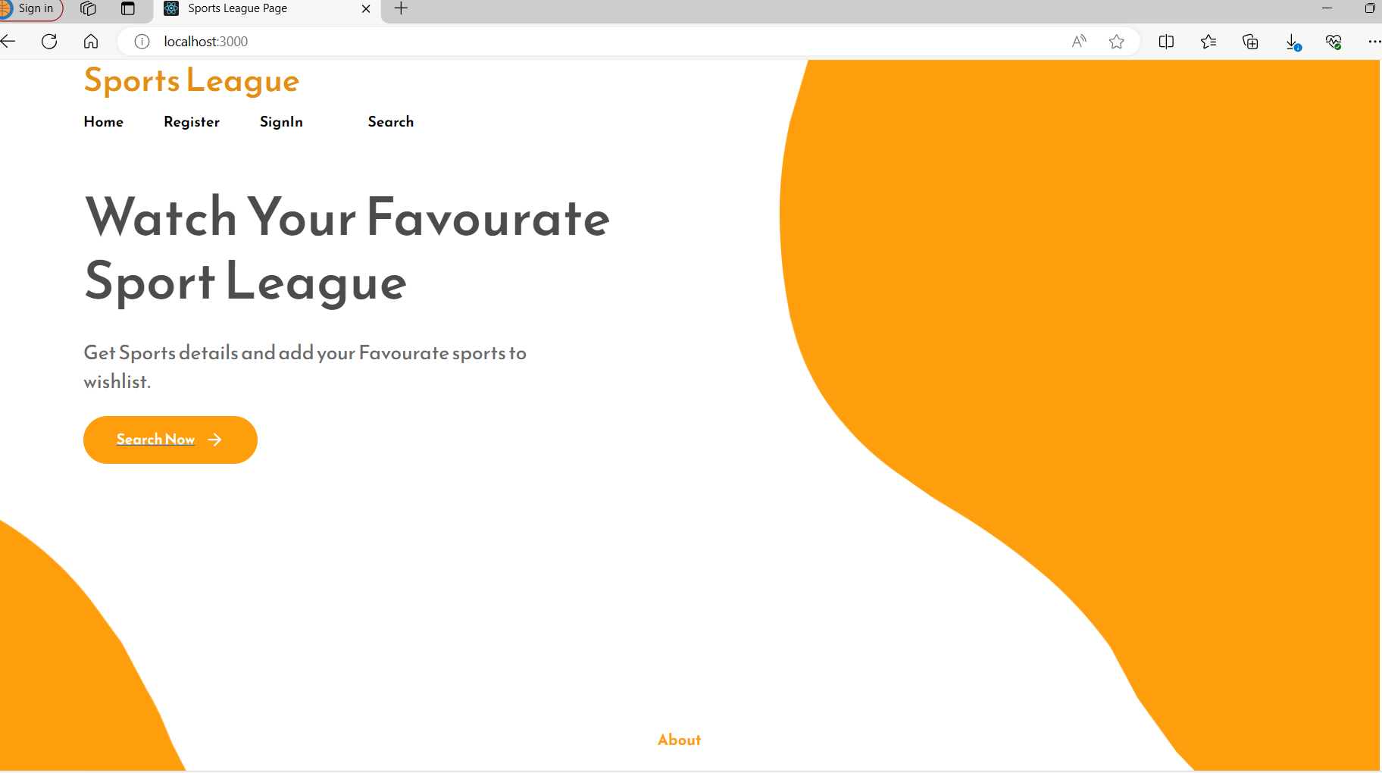
Home Page

Slide 3
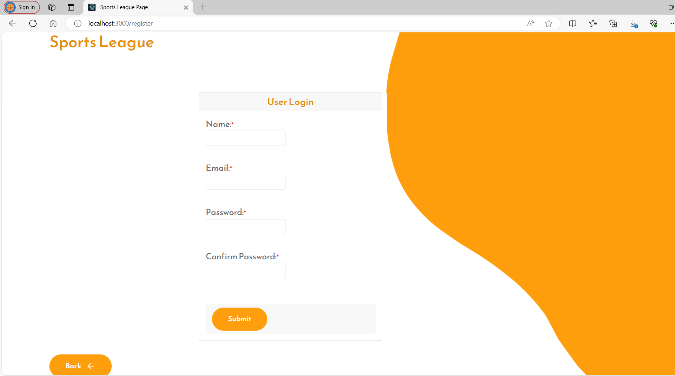
User Registration Page

Slide 4
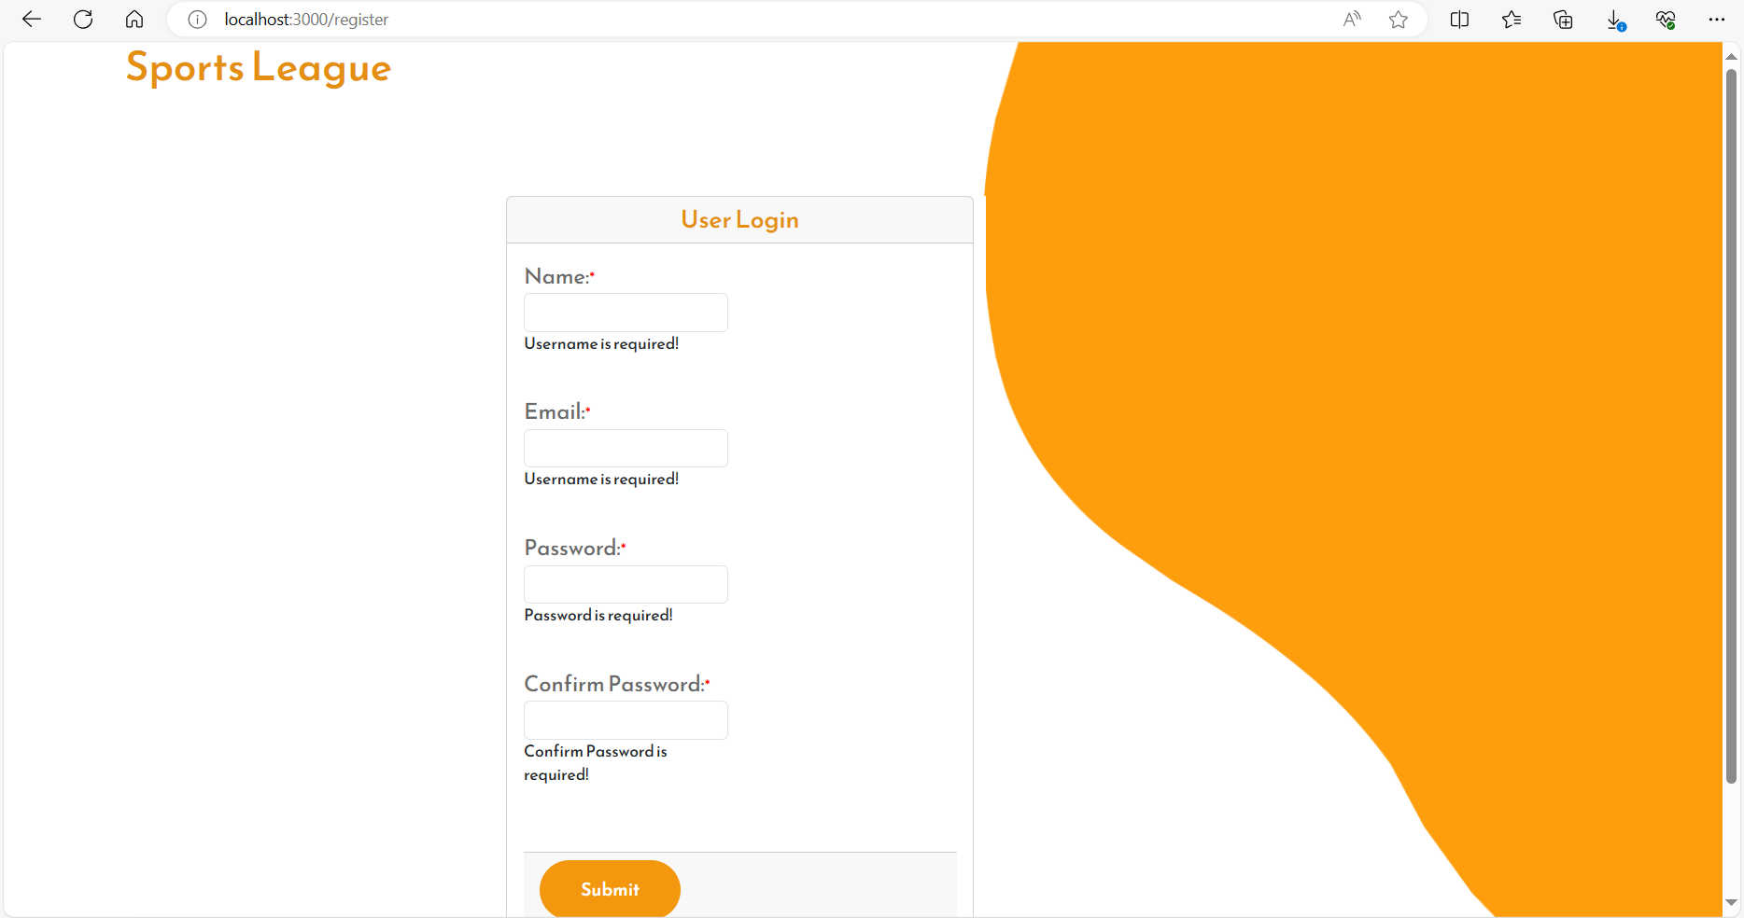
User Registration Page: All Fields Validation

Slide 5
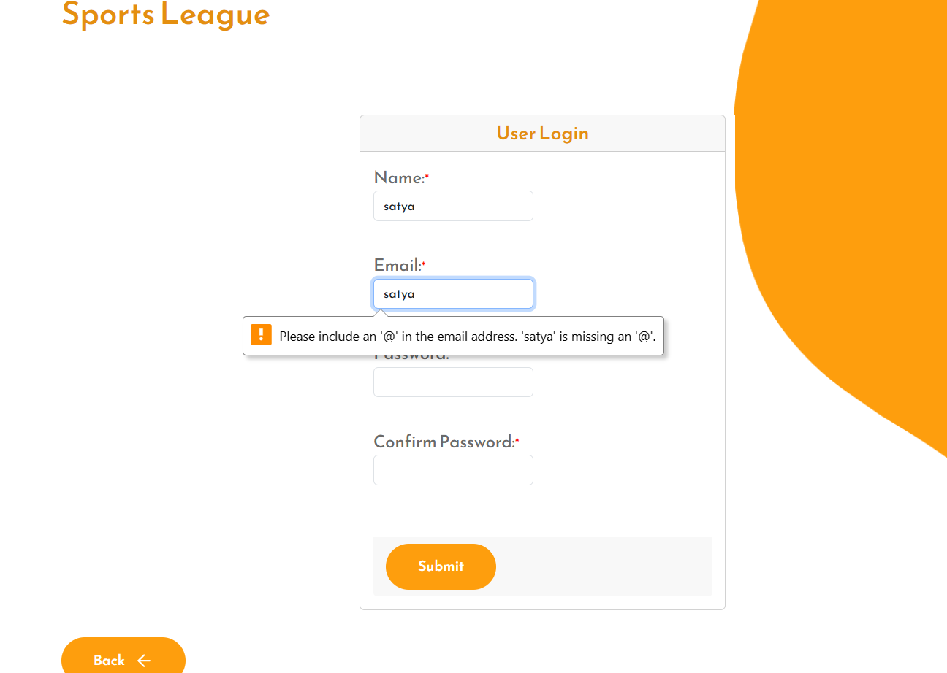
User Registration Page: Email Validation

Slide 6
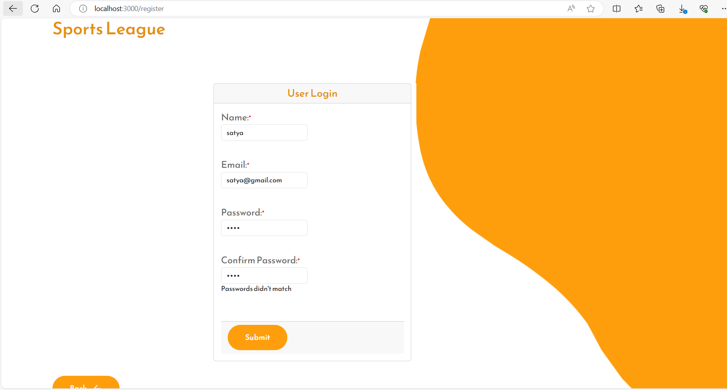
User Registration Page: Password Validation

Slide 7
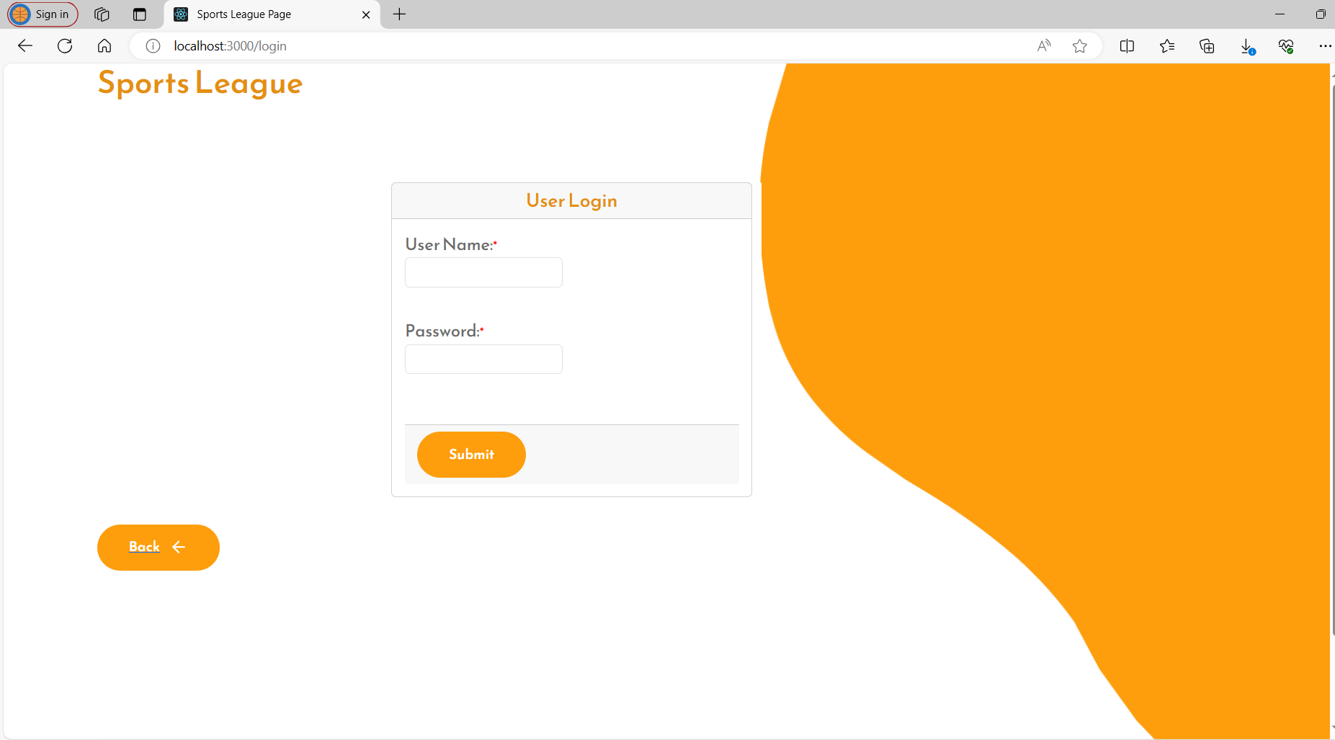
User Login Page

Slide 8
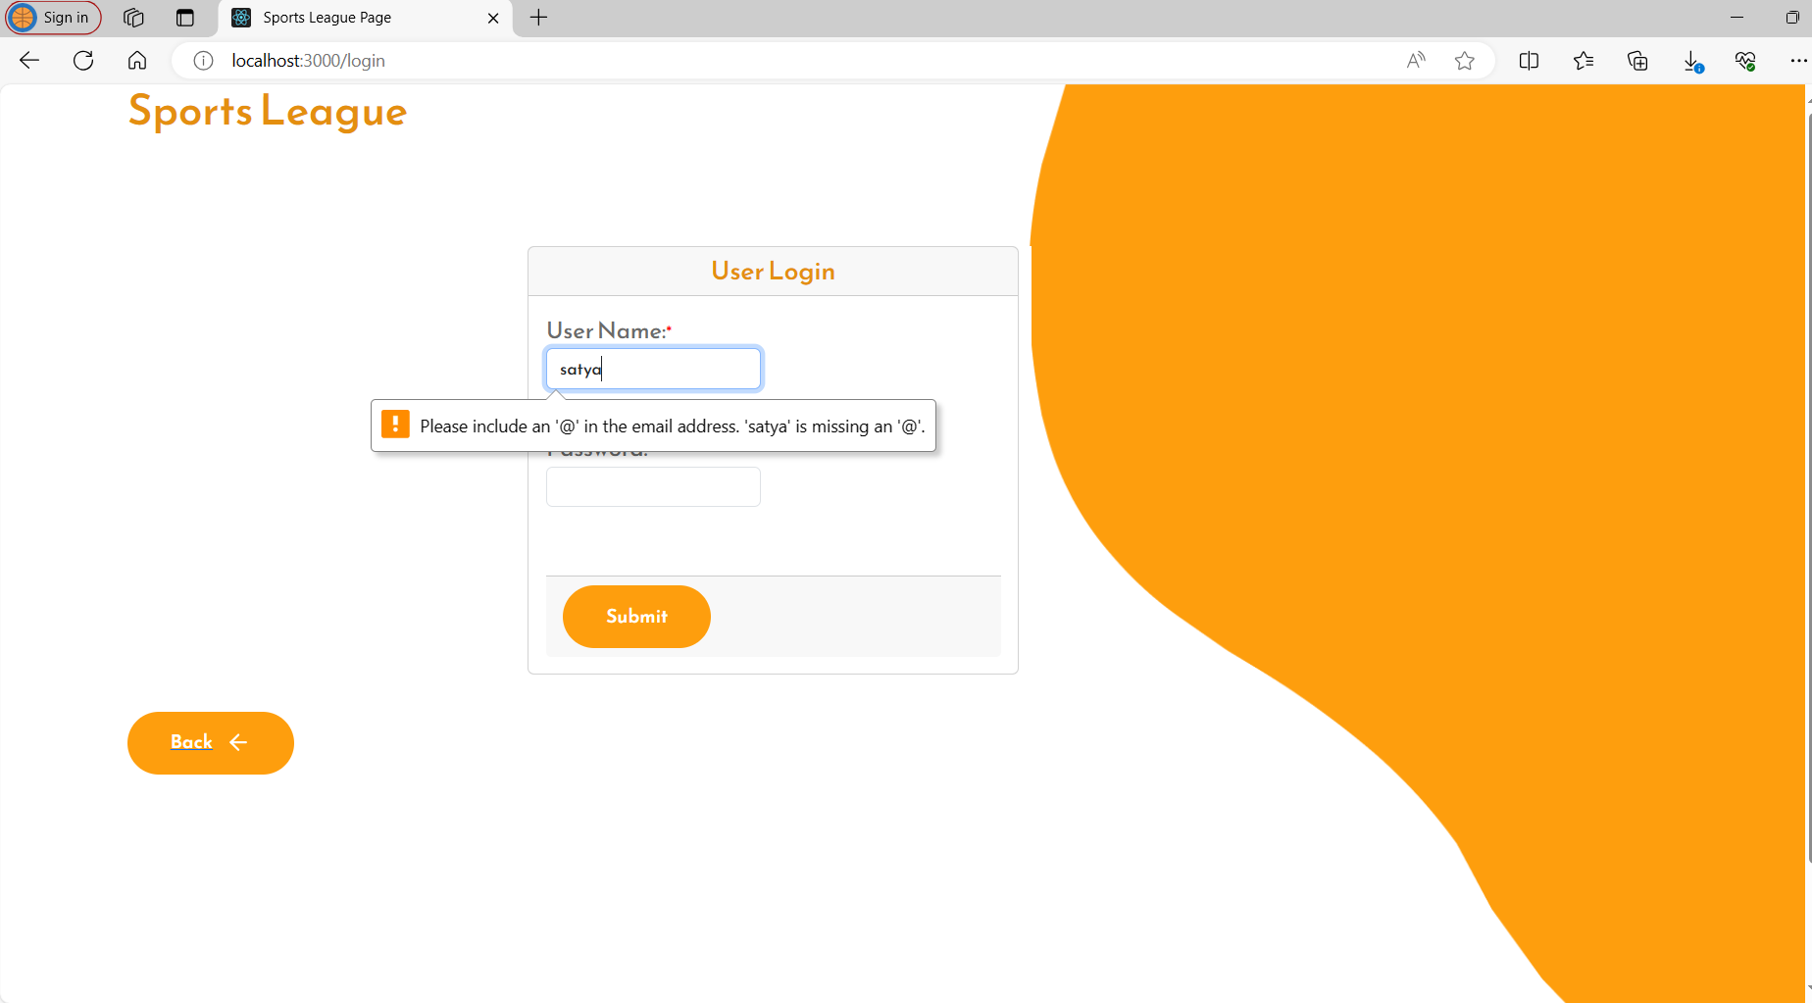
User Login Page: username validiation

Slide 9
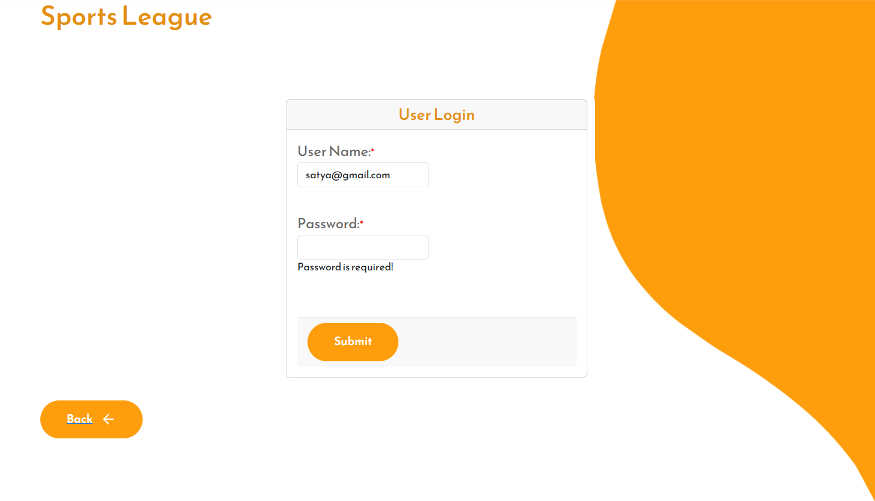
User Login Page: password validiation

Slide 10

Sports League Search Page

Slide 11
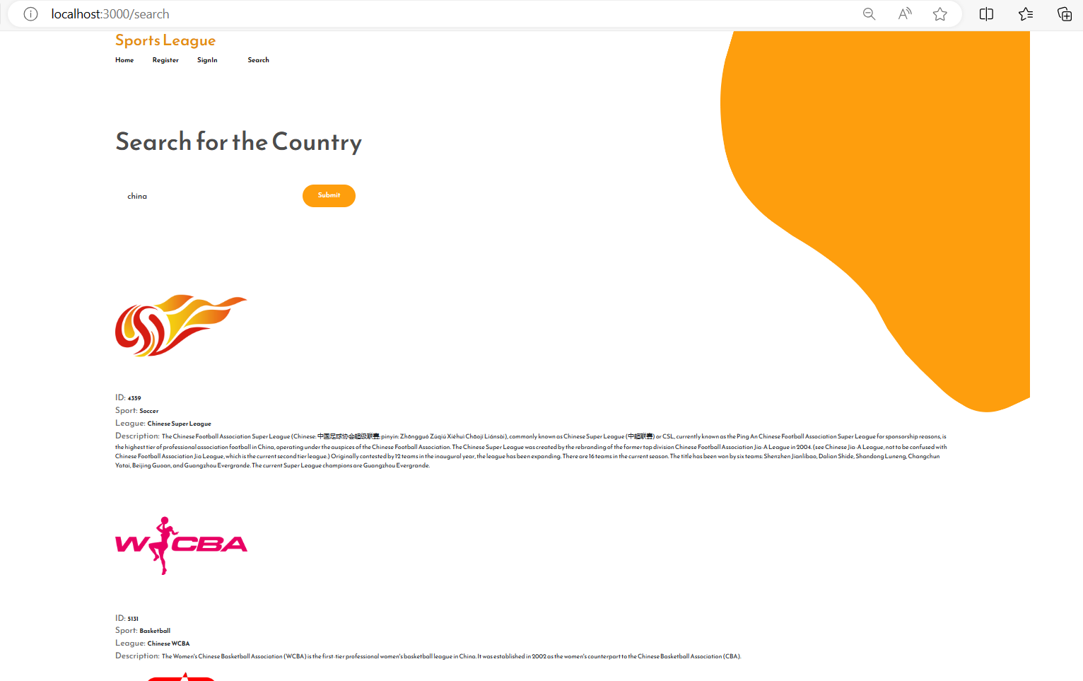
Sports League Data from Thirdparty API

Slide 12
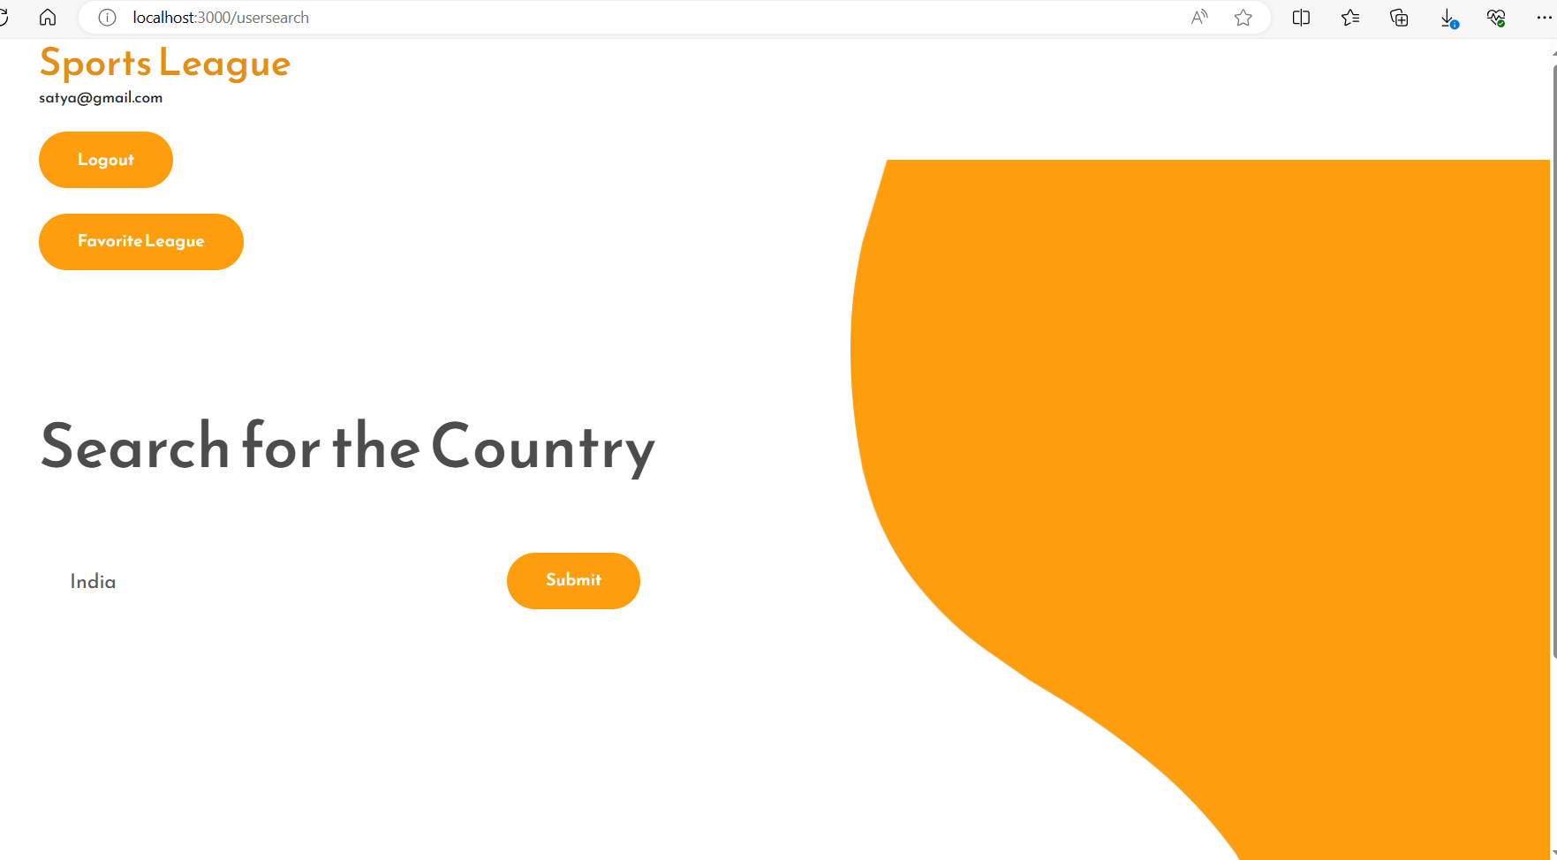
User Login: Home Page

Slide 13
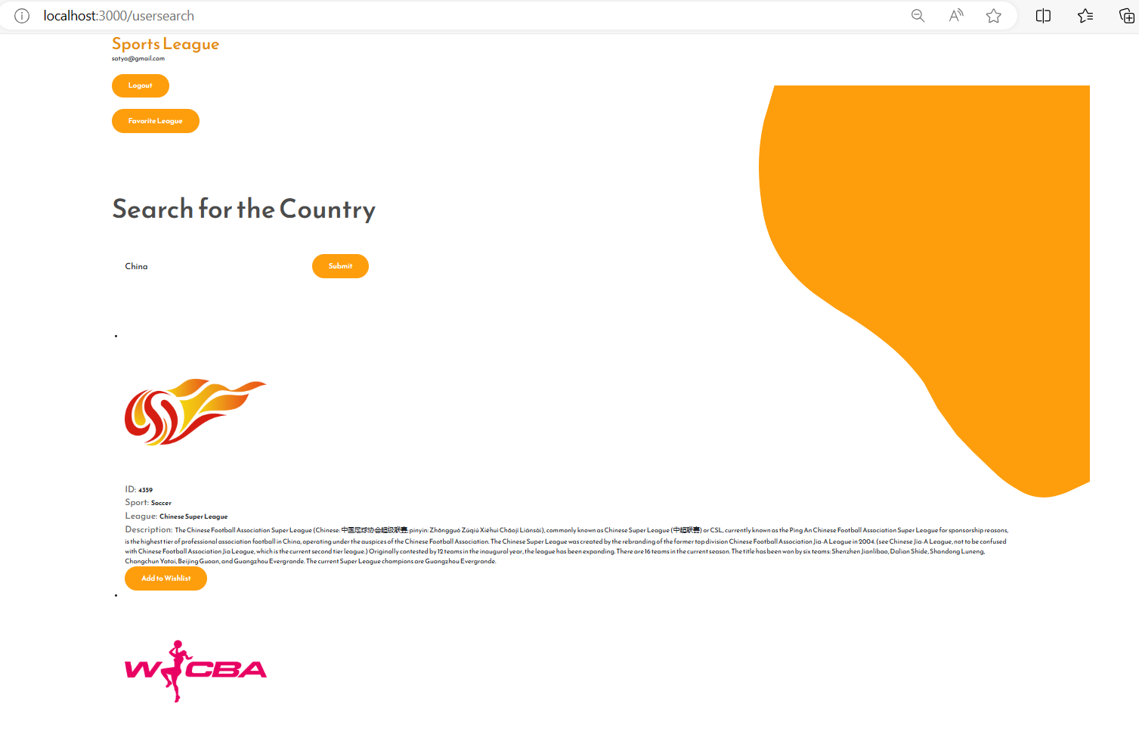
User Login: Search Page with addWishlist button

Slide 14
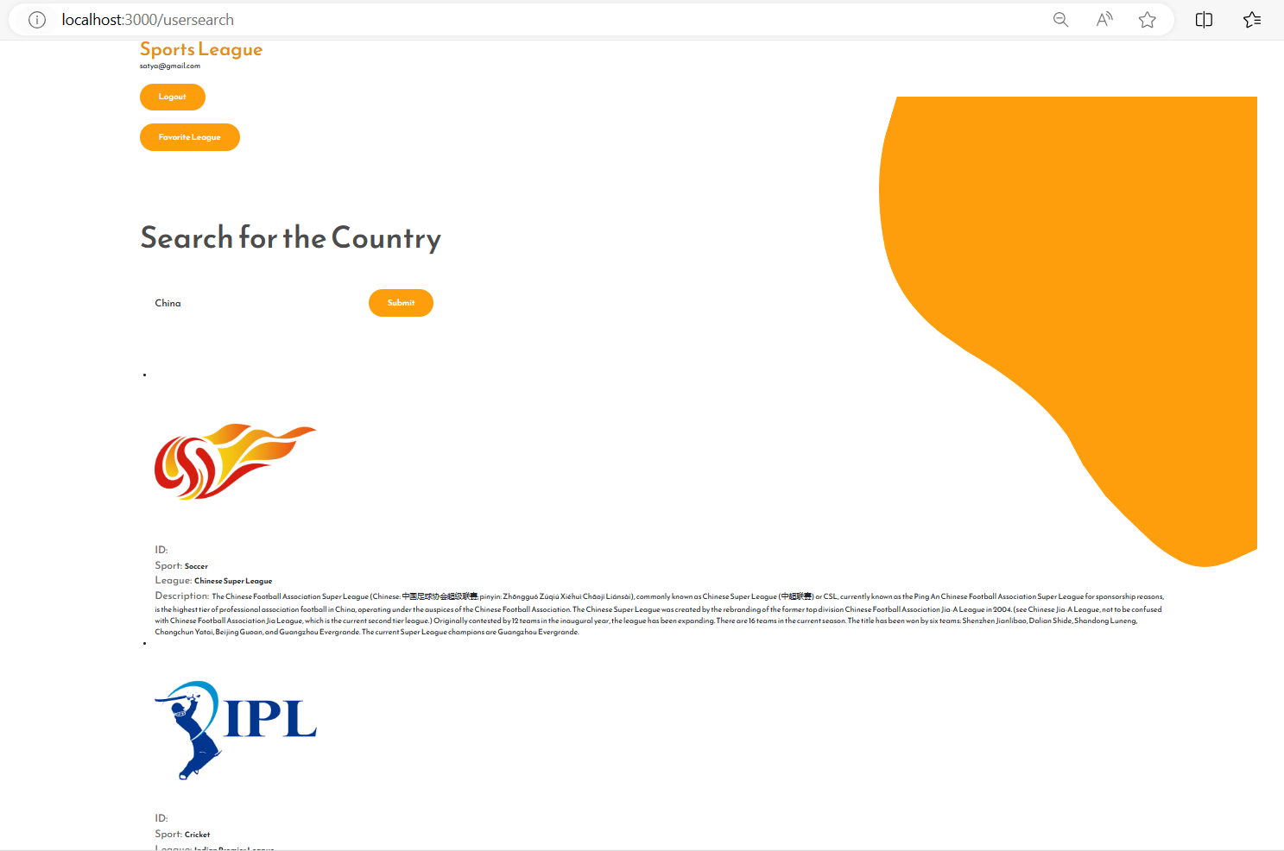
User Login : Favorite League Details

Slide 15
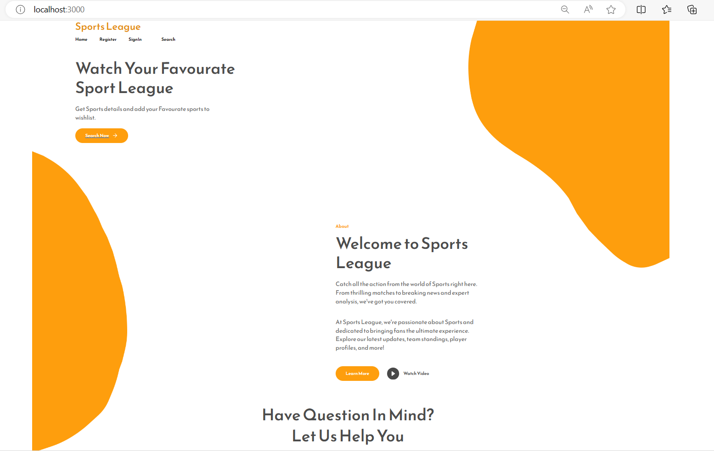
After Logout Return to Home Page

Slide 16
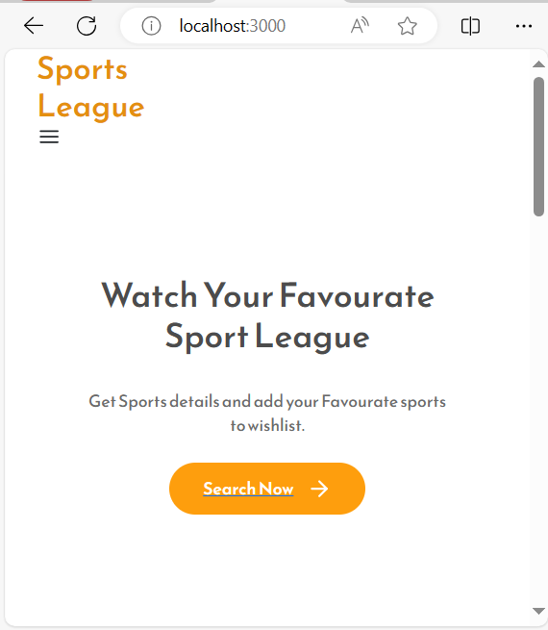
Responsive Home Page

Slide 17
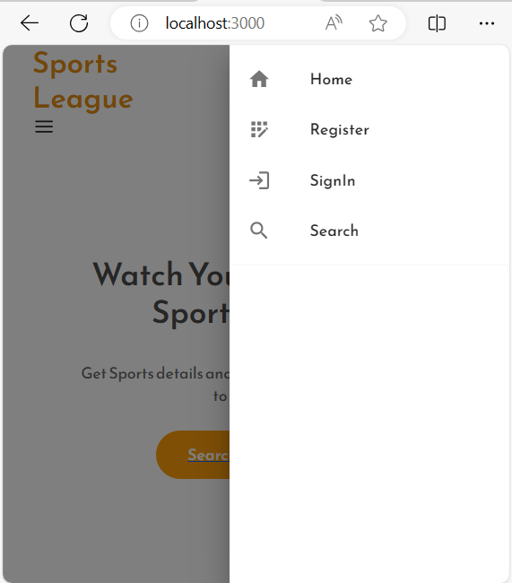
Responsive Home Page Options

Slide 18
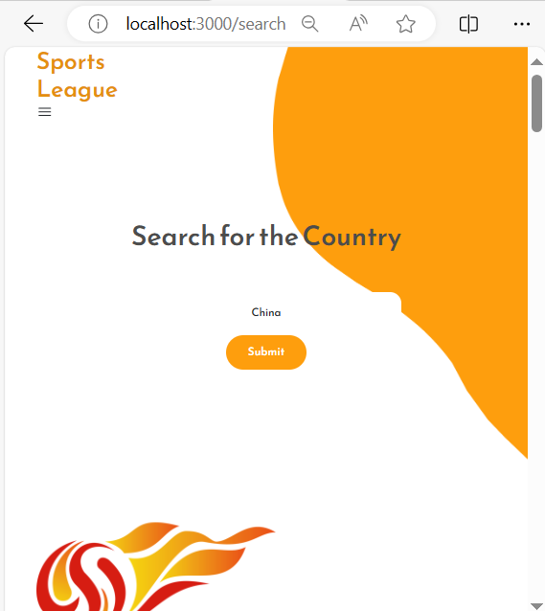
Responsive Search Page

Slide 19
Thank You

