Slide 1

ELURU COLLEGE OF
ENGINEERING AND TECHNOLOGY
SignNet-II:
(Approved by AICTE-NEW DELHI &
Affiliated to JNTU-Kakinada)
An End-to-End Transformer Architecture for Bidirectional Sign Language Translation
DEPARTMENT OF COMPUTER SCIENCE
AND ENGINEERING
ECET
Team Members
⚡ FINAL YEAR PROJECT · CSE
1. Tirumala Satya Sai Ram - 22JD1A05B2
2. Veeravalli Manohar - 22JD1A05B7
3. Kolusu Ganesh - 22JD1A05C6
Team Guided by:
Ch. Sindhu Priyanka, B.Tech, M.Tech,(Ph.D)
Associate Professor
Eluru College of Engineering & Technology

Slide 2
ABSTRACT
Project overview — what was built, how, and what was achieved
SIGNNET II overcomes communication barriers between Deaf and non-signers by replacing RNNs and LSTMs with a Transformer-based model. It uses dual-stream inputs and attention mechanisms to capture complex sign language patterns.
The system enables accurate bidirectional translation (sign-to-text and text-to-sign), achieves strong benchmark performance, and supports real-time use. With transfer learning for different dialects, it provides a scalable, robust, and inclusive solution
Eluru College of Engineering & Technology | Dept. of CSE | 2026

Slide 3
INTRODUCTION
SIGNNET II improves on traditional models like RNN and LSTM, which struggle with complex sign language patterns. It uses a Transformer-based architecture with self-attention and dual-stream inputs to process gestures and facial expressions effectively.
The model supports both sign-to-text and text-to-sign translation, ensuring better accuracy and contextual understanding. It performs well on benchmarks, offers real-time processing, and provides a scalable, practical solution for accessible communication between signers and non-signers
Eluru College of Engineering & Technology | Dept. of CSE | 2026

Slide 4
OBJECTIVE
Primary goals of the SignNet-II translation system
The primary objective is to develop an End-to-End Transformer-based Sign Language Translation system that accurately performs bidirectional translation and provides seamless real-time communication for the Deaf community.
1
Bidirectional Translation
4
Real-Time Inference
Develop a unified framework capable of translating both sign-to-text and text-to-sign, overcoming the limitation of one-way systems.
Optimize the model for low-latency inference to enable live video conferencing, webcam-based recognition, and mobile assistive device deployment.
2
Transformer-Based Architecture
5
Robustness & Scalability
Implement a high-performance Transformer model with dual-stream input processing and advanced self-attention mechanisms for superior accuracy.
Utilize transfer learning and data augmentation to ensure high robustness across diverse signers, regional dialects, and real-world noisy environments.
3
Multi-Modal Feature Fusion
Simultaneously process video frames, hand keypoints, and facial expressions using a multi-modal fusion strategy to capture the full linguistic nuance of gestures.
Eluru College of Engineering & Technology | Dept. of CSE | 2026

Slide 5
SCOPE
Boundaries and coverage of the SignNet-II project
✔ IN SCOPE
Dataset Scope
CIC-IDS2017 equivalent: sign language video datasets balanced across multiple gesture classes including continuous and isolated sign sequences.
Translation Scope
Bidirectional translation — sign-to-text (video/webcam input → text output) and text-to-sign (text input → sign animation output).
XAI Integration
Transformer self-attention visualization to explain which frame regions and keypoints most influence each translation decision.
Deployment Scope
Web-based Django application supporting dataset upload, model training, auto prediction, and live webcam-based sign recognition.
Eluru College of Engineering & Technology | Dept. of CSE | 2026

Slide 6
EXISTING SYSTEM
Overview of traditional sign language translation approaches
Traditional sign language translation systems primarily evolved from handcrafted computer vision features to deep learning architectures like RNNs and LSTMs.
Vanishing Gradients
One-Way Translation
High Latency
RNNs and LSTMs suffer from vanishing gradients making it hard to capture long-range contextual dependencies required for continuous signing.
Existing Transformer models remain restricted to one-way translation — either sign-to-text or text-to-sign — within isolated frameworks.
Systems exhibit poor generalization across diverse signers and suffer from high computational latency, making them impractical for real-time use.
Poor Multi-Modal Integration
Limited Dataset Generalization
Most existing systems process visual features in isolation without integrating hand keypoints, facial expressions, and optical flow simultaneously, reducing translation accuracy.
Systems trained on small datasets fail to generalize across different signing styles, regional dialects, and signer-specific variations, reducing real-world applicability.
Eluru College of Engineering & Technology | Dept. of CSE | 2026

Slide 7
DISADVANTAGES OF EXISTING SYSTEMS
Key limitations that SignNet-II overcomes
Limited Bidirectional Translation
Inadequate Modeling of Multimodal Features
1
2
Existing systems support only one-way translation (sign-to-text OR text-to-sign), not both simultaneously.
Failure to jointly process hand gestures, facial expressions, and optical flow leads to lower accuracy.
Challenges with Long-Range Dependencies
Performance Drop in Real-World Settings
3
4
RNN/LSTM architectures struggle to maintain context over extended signing sequences.
Lab-trained models degrade significantly in noisy, uncontrolled real-world environments.
High Computational Complexity and Latency
Insufficient Dataset Availability and Scalability
5
6
Sequential processing models cannot deliver the low-latency inference needed for live communication.
Limited labeled datasets prevent models from scaling to diverse signers and regional sign dialects.
Eluru College of Engineering & Technology | Dept. of CSE | 2026

Slide 8
PROPOSED SYSTEM
SignNet-II: Transformer-based bidirectional sign language translation
SIGNNET II is a pioneering transformer-based architecture that enables seamless, bidirectional translation between sign language and spoken text within a unified framework.
Multi-Modal Fusion
Advanced Self-Attention
Transfer Learning
Processes video frames, hand keypoints, and facial expressions simultaneously to capture the full linguistic nuance of gestures.
Masters complex spatial-temporal dynamics of continuous signing, effectively replacing the limitations of RNNs and LSTMs.
Enhanced through transfer learning and data augmentation, ensuring high robustness against signer variability and background noise.
Real-Time Inference
Bidirectional Translation
Scalable & Inclusive
Supports low-latency communication for live conferencing and mobile assistive devices with optimized inference pipeline.
Unlike traditional one-way systems, enables seamless sign-to-text AND text-to-sign translation in a single unified model.
Designed to adapt across various global dialects, providing a scalable, inclusive solution for the Deaf community worldwide.
Eluru College of Engineering & Technology | Dept. of CSE | 2026

Slide 9
ADVANTAGES OF PROPOSED SYSTEM
Key limitations that SignNet-II overcomes
Bidirectional Translation
Multimodal Feature Integration
1
2
Unlike existing one-way systems, SIGNNET II performs both sign-to-text and text-to-sign translation within a single unified model, enabling real-time two-way communication between signers and non-signers.
The system processes multiple input streams simultaneously — video frames, hand keypoints, and facial expression features — giving it a richer understanding of the linguistic nuances embedded in sign language gestures.
Advanced Attention Mechanisms
Scalability Across Sign Languages
3
4
Multi-head self-attention layers allow the model to dynamically focus on the most informative spatial and temporal cues, improving both recognition accuracy and translation fluency
Through transfer learning and domain adaptation techniques, the architecture can be extended to support multiple sign languages and dialects with minimal retraining
Real-Time Inference Capability
Robustness in Real-World Conditions
5
6
The system is optimized for low-latency inference, making it suitable for practical live scenarios such as video conferencing, assistive communication devices, and educational tools
Data augmentation and domain adaptation methods enhance the model's performance across varied signing styles, lighting conditions, backgrounds, and signer diversity — addressing a key weakness of existing systems.
Eluru College of Engineering & Technology | Dept. of CSE | 2026

Slide 10
SYSTEM REQUIREMENTS
Hardware and software specifications for SignNet-II
HARDWARE REQUIREMENTS
SOFTWARE REQUIREMENTS
System
Pentium IV 2.4 GHz
Operating System
Windows
Hard Disk
40 GB
Coding Language
Python
RAM
Framework
TensorFlow / PyTorch
512 MB
Libraries
OpenPose, OpenCV, NumPy
Eluru College of Engineering & Technology | Dept. of CSE | 2026

Slide 11
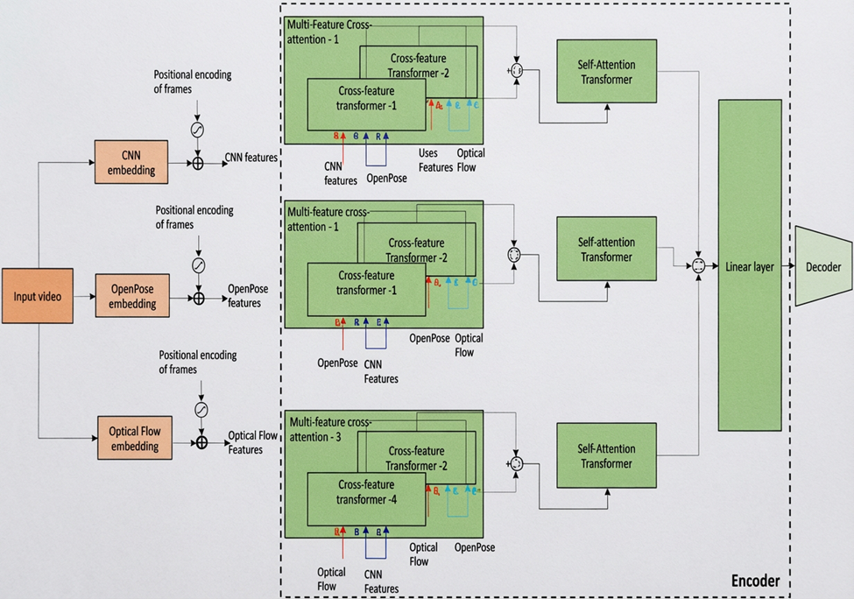
SYSTEM ARCHITECTURE
Transformer-based multi-stream encoder-decoder architecture
Eluru College of Engineering & Technology | Dept. of CSE | 2026

Slide 12
THANK YOU
SignNet-II: An End-to-End Transformer Architecture for Bidirectional Sign Language Translation
Eluru College of Engineering & Technology | Department of Computer Science and Engineering | 2026

