Slide 1
By
Satya Sandeep Kollipara
TO-LET FINDER

Slide 2
CONTENTS
Abstract
Introduction
Existing System
Proposed System
Modules Description
System Requirements
Design
Tables
Sample code
Testing and test cases
Output Screens
Conclusion
References
Future Enhancements

Slide 3
ABSRTACT
Generally, people search of houses for rent, just by roaming on road. This takes lot of time and the person may or may not get the home of his specified requirements.
Some of the house owners may not find free time to tell people about their house which is available for rent. This project deals with this problems of both tenants and house owners.
In this project, house owner will specify details about the city, address of the house, contact number, rent, and number of rooms available for a portion etc. which are needed for a tenant.
Tenants search for the houses which are available in his city, checks the specifications of the houses, finds the house which is apt for his requirements. He then contacts the owner and fixes the deal.

Slide 4
INTRODUCTION
The users search for houses which are available in the specific state and search for houses present in the city.
Owner will give the information of their house like address, contact number, number of portions present in the house etc.
Admin will look after the posts of the owner and maintains the website.

Slide 5
Existing System
People search for houses roaming on the road,this takes a lot of time.
The user may not get the specific information of the house.
The house owners face problem of providing info about house to all visitors of house for housing.

Slide 6
Disadvantages of existing system
It takes a lot of time to search the houses.
It is not efficient.
Not flexible.
Burden for owner and tenant too.

Slide 7
Proposed System
TO-LET FINDER is a WEB based application. Through this the Owners are registered online.
Their information is stored in the database the admin can easily access the details of the Owners.
The Users can search the information about different types of Houses in the selected location.
This application keeps the data in a centralized way which is available to all the users simultaneously.

Slide 8
Advantages of proposed system
Every process is automated and so, less time consumption.
Less burden for both owner and tenant.
It provides an easy way to find Houses.
No Extra travelling time, cost and effort is involved.
It is cost and time effective.

Slide 9
SYSTEM REQUIREMENTS
Hardware Requirements:
Processor : Pentium I3 2.80 GHz
Hard Disk : 80 GB or more
Monitor : 15 VGA color
Mouse : Optical Mouse
Keyboard : 110 keys enhanced
RAM : 4 GB or more
Software Requirements:
Operating System : Windows 7 or higher
Language : ASP. Net, C#
Front End : Microsoft Visual Studio 2012
Database : SQL Server Management Studio 2008

Slide 10
Modules Description
1. ADMIN Login:
The administrator is the ultimate controller of the application with the highest authority.
Once logged in, admin has the following features:-
a) Edit Profile :
It allows modifying the profile picture.
b) Change Password :
It enables admin to change his/her account’s
Password.
c) Users Posts :
Admin can see posts made by users and can delete them.
d) Edit :
It enables admin to add/update/delete the
information available about cities, states, types of house.

Slide 11
2. Owner Login:
It enables a person to login as a owner member or sign up if he/she has not Registered for the Website.
Once logged in, a owner member has the following features:-
a) Edit Profile:
It allows modification of the profile picture of the owner.
b) New Posts:
It allows the owner to post the details of the House
available for rent.
c) Delete Posts:
It enables owner to delete his older posts.

Slide 12
3. User Search:
User doesn’t need any authentication. Simply, he follow the following steps:
Enters the Website.
Selects state, city, type of house he wants and presses search button.
User then gets the related results in which he finds a house of his requirements and calls the owner to fix the deal.

Slide 13
UML DIAGRAMS
Class diagram:

Slide 14
Sequence diagram:

Slide 15
Activity diagram:
User Admin Owner

Slide 16
TABLES DESCRIPTION
Registration TABLE
FIELD NAME | DATA TYPE | KEY | DESCRIPTION
name | Varchar(50) | - | First name of the student.
Phone number | Varchar(50) | - | Number of the owner.
Password | Varchar(50) | - | Password of the owner.
Email id | Varchar(50) | Primary key | ID of the owner which is unique.
Profile Picture | Varchar(50) | - | Profile picture of the owner.
Security Question | Varchar(50) | - | Security Question of the Owner.
Answer | Varchar(50) | - | Answer of the Security Question.

Slide 17
Post TABLE
FIELD NAME | DATATYPE | KEY | DESCRIPTION
Post id | int | Primary key | ID of the owner. which is unique
Email | Varchar(50) | - | Proof of the owner.
Name | Varchar(50) | - | Name of the owner.
Phone number | Bigint | - | Phone number of the owner.
City | Varchar(50) | - | City of the post.
State | Varchar(50) | - | State of the post.
Address | Varchar(50) | - | Address of the post.
Type | Varchar(50) | - | Type of the house.
Price | int | - | Price of the house.
Image1 | Varchar(50) | - | Image1 of the house.
Image2 | Varchar(50) | - | Image2 of the house.
Image3 | Varchar(50) | - | Image3 of the house.
Image4 | Varchar(50) | - | Image4 of the house.
Image5 | Varchar(50) | - | Image5 of the house.
Image6 | Varchar(50) | - | Image6 of the house.
Image7 | Varchar(50) | - | Image7 of the house.
Image8 | Varchar(50) | - | Image8 of the house.
Image9 | Varchar(50) | - | Image9 of the house.
Image10 | Varchar(50) | - | Image10 of the house.

Slide 18
City TABLE
FIELD NAME | DATA TYPE | KEY | DESCRIPTION
City id | Int | Primary key | ID of the city is to be unique.
State id | Int | Foreign key | ID of the state i.e state id.
City name | Varchar(15) | - | Name of the city.
State TABLE
FIELD NAME | DATA TYPE | KEY | DESCRIPTION
State id | Int | Primary key | ID of the state is to be unique.
State name | Varchar(50) | - | Name of the state.

Slide 19
Question TABLE
FIELDNAME | DATA TYPE | KEY | DESCRIPTION
id | Int | Primary key | Unique number for the question.
Question text | Varchar(50) | - | Text of the question.
Type TABLE
FIELD NAME | DATA TYPE | KEY | DESCRIPTION
id | Varchar(50) | Primary key | Unique identification of type.
Type name | Varchar(50) | - | Type of the name.

Slide 20
SAMPLE CODE
using System;
using System.Collections.Generic;
using System.Web.UI;
using System.Web.UI.WebControls;
public partial class newpw : System.Web.UI.Page
{
protected void Page_Load(object sender, EventArgs e)
{
}
protected void btnSubmit_Click(object sender, EventArgs e)
{
con = new SqlConnection(str);
con.Open();
SqlCommand cmd = new SqlCommand("update registration set password=@pw where email=@email", con);
lblMsg.Text = "success";
Response.Redirect("http://localhost:59423/login.aspx?status=2");
} }

Slide 21
TESTING AND TEST CASES
The purpose of testing is to discover errors. Testing is the process of trying to discover every conceivable fault or weakness in a work product. It provides a way to check the functionality of components, sub assemblies, assemblies and/or a finished product
Software system meets its requirements and user expectations and doesn't fail in an unacceptable manner

Slide 22
DESCRIPTION | INPUT | Expected Behavior | Observed Behavior | Status P=passed F=failed
Username | Incorrect | Incorrect Username | Login is unsuccessful | F
Email id in Registration | Already Exists | Registration Unsuccessful | Registration Unsuccessful | P
Password | Correct | correct password | Successful login | P
Password | Incorrect | Incorrect Password | Unsuccessful login | F
Registration | Successful | Successfully Registered | Successfully Registered | P

Slide 23
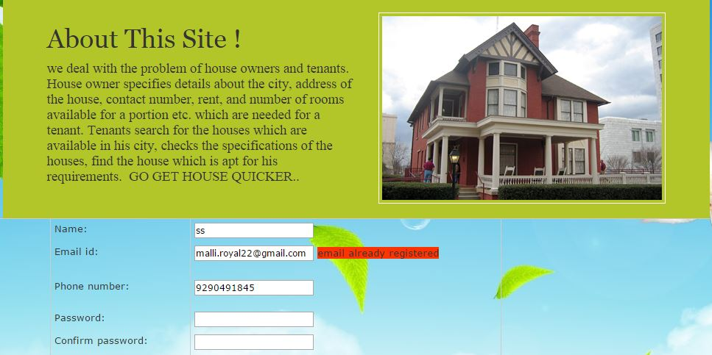
Owner Registration email already exists (Test case screen):

Slide 24
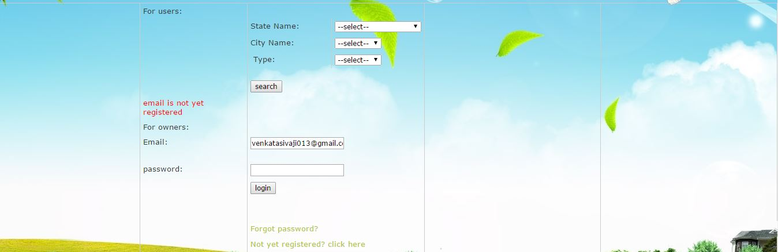
Email not yet registered (Test case screen):

Slide 25
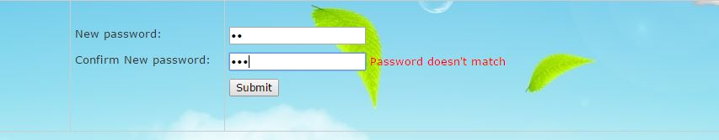
Password does not match (Test case screen):

Slide 26
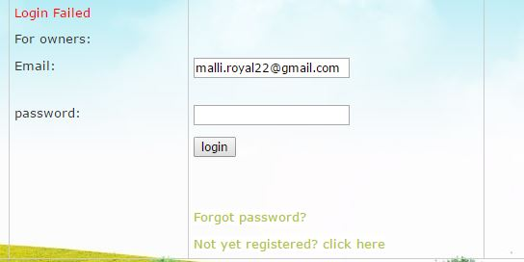
Entered Password is wrong (Test case screen):

Slide 27
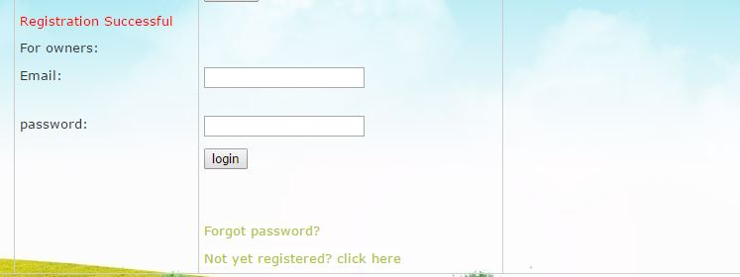
Registration Successful (Test case screen):

Slide 28
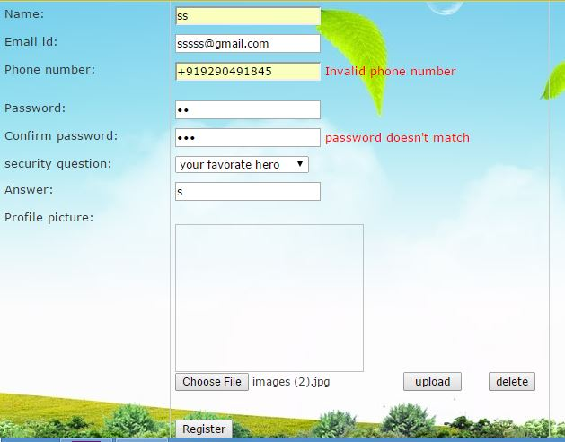
Registration Validators (Test case screen):

Slide 29
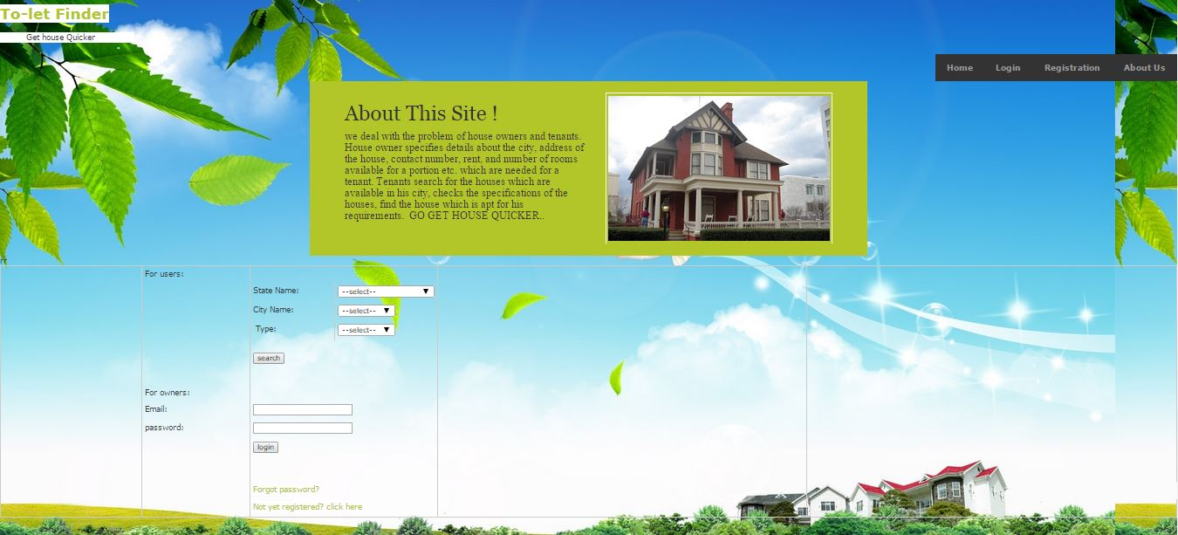
Output Screens:
Home page:

Slide 30
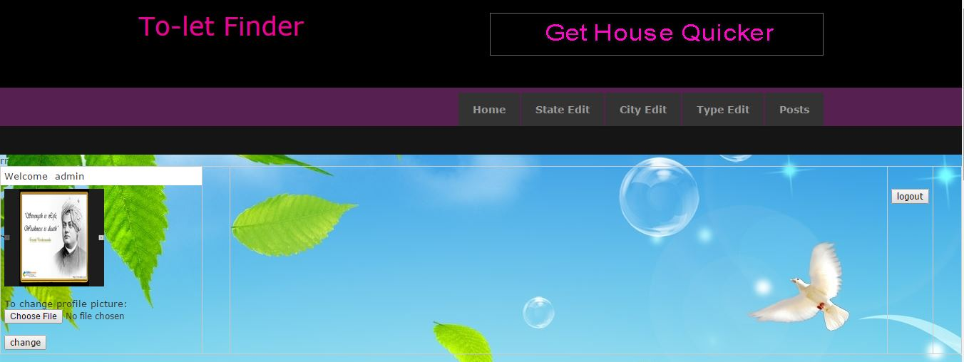
ADMIN HOME PAGE

Slide 31
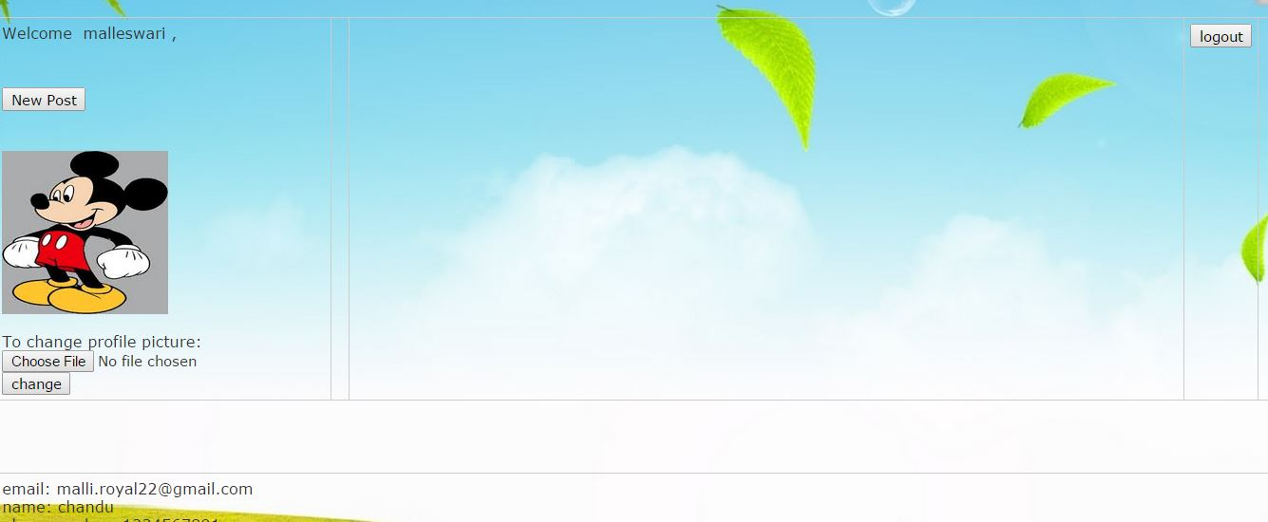
OWNER HOME PAGE

Slide 32
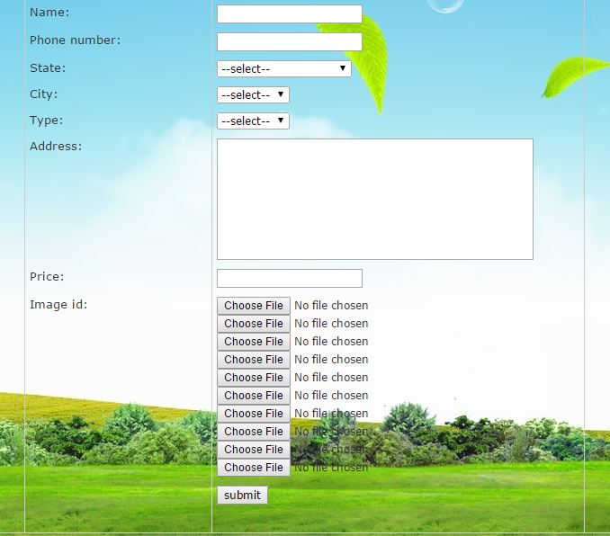
OWNER NEW POST

Slide 33
Conclusion
This software is automated (the communication between both tenant and the owner).
Than earlier techniques, this gives more flexibility for all its users.
The user easily searches the houses for rent.

Slide 34
REFERENCES
MICROSOFT .NET WITH C# : Microsoft.net series
ASP .NET 2.0 PROFESSIONAL : Wrox Publishers
ASP .NET WITH C# 2005 : Apress Publications
MICROSOFT ASP .NET 2.0 APP : Wrox Professional Guide
WEBSITES:
www.msdn.microsoft.com
www.microsoft.com
www.forums.asp.net
www.weblogs.asp.net
www.Google.com

Slide 35
Future Enhancements:
At present, this is restricted to houses only. In future, there is great scope for this i.e., it can be applied to lands, vehicles, articles which are available for rent or sale.

Slide 36
THANK YOU

