Slide 1

LENDING CLUB CASE STUDY EXPLORATORY DATA ANALYSIS
Group member:
Satyasravan Sankranti

Slide 2

Problem Statement:
Identify patterns which indicate whether a person is likely to default, which may be used for taking actions such as denying the loan, reducing the amount of loan, lending (to risky applicants) at a higher interest rate, etc.
Objective:
To perform EDA on loan data and to understand how consumer attributes and loan attributes influence the tendency of loans default

Slide 3
Dataset Availability
The data contains the information about past loan applicants and whether they ‘defaulted’ or not. The dataset does not have any information on loans which were not approved. Using given dataset, EDA concepts can be applied.
Datasets provided:
• loan.csv: The historical data for the approved loans which have either been fully-paid or Charged Off. It is in comma separated value (csv) file format
• Data_Dictionary.xlsx: It contains information about the various columns and their attributes. This is required for Data Understanding. File format is excel.

Slide 4
Analysis Approach
Data Cleaning:
Drop columns with all null values, single categorical value, random values
Impute null values for important columns
Check for percentage of errors in columns. There should not be more than 30 percent errors.
Derived Metrices:
Create derived Metrices for date, split into month and year.
Convert Quantitative values into categories.
Perform calculation of the ratios and percent.
Binning:
Create binning on intRateCategory, loan_amt, loan amount category etc.

Slide 5
Analysis Approach
Univariate Analysis:
Plot and understand data distribution and frequencies for numerical and categorical data.
Analyze the column variables against other segments variables.
Bivariate Analysis:
To analyze and understand how 2 variables influence each other.
Whether variable are correlated. Check for correlation between different variables.
Conclusion:
Plot graph and arrive at the observation based on graph data.

Slide 6
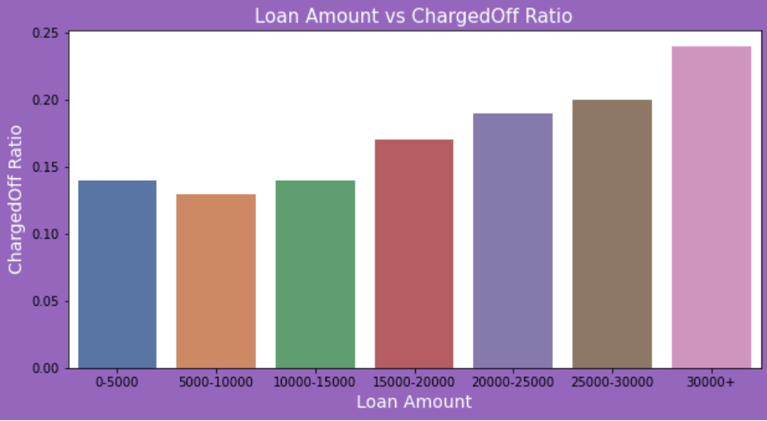
Observation and findings
Loan Amount which are greater > $30000 have more defaults

Slide 7
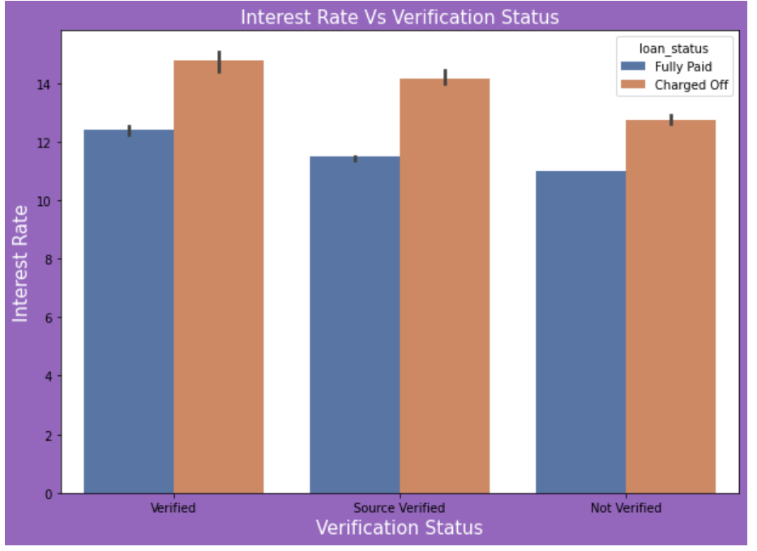
Observation and findings
2. Higher interest rate whish is greater than 14% have more defaults

Slide 8
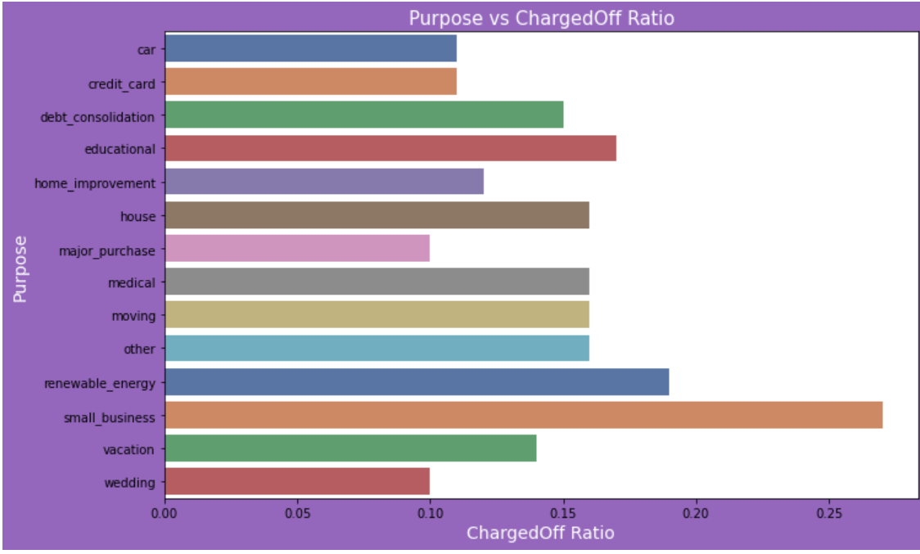
Observation and findings
3. Loan Purpose ( Small Business, Renewable Energy, Education) have more defaults

Slide 9
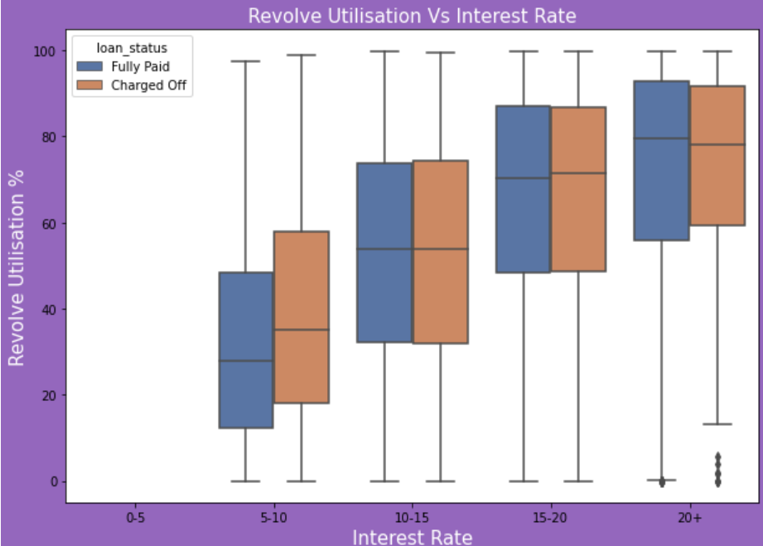
Observation and findings
4. Higher Revolve Utilization rate (> 80%) have more defaults

Slide 10
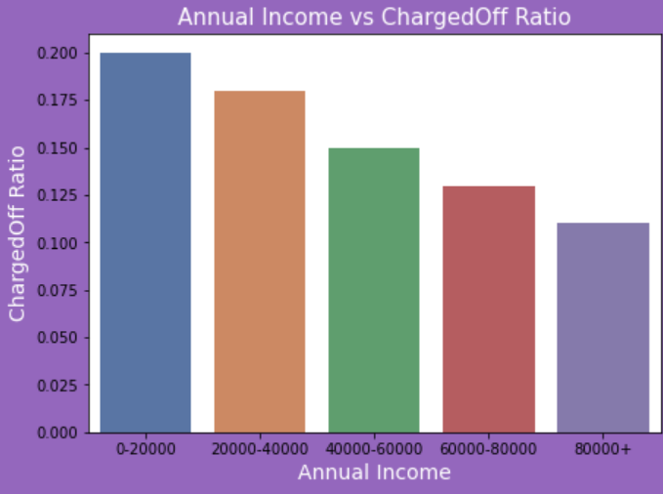
Observation and findings
5. Lower Annual Income (<20000) have more defaults

Slide 11
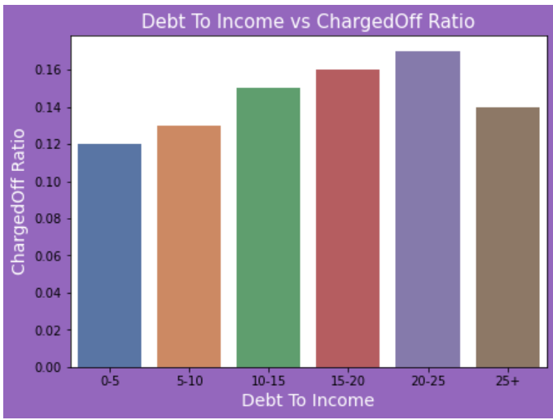
Observation and findings
6. Higher Debt To Income ratio is between (20% - 25%)

Slide 12
Recommendations
Better decision can be made using below points;
• Reduce the number of loans for income group >30,000.
Approve only for high income individual.
• Do not approve Loans having interest rate > 14%. Provide loan offer with lower loan amount and lower interest rate to avoid defaults
• Reduce the number of loan approvals for Loans for Small Business, Renewable Energy & Education sector.
• Avoid approving high value loans to individuals with Revolve Utilization rate > 80%.
•Do not approve high value Loans to individuals with Annual Income < $20000. Instead provide loan to high income group category.
• Do not approve high value loans to individuals having Debt To Income ratio > 20% - 25

