Slide 1
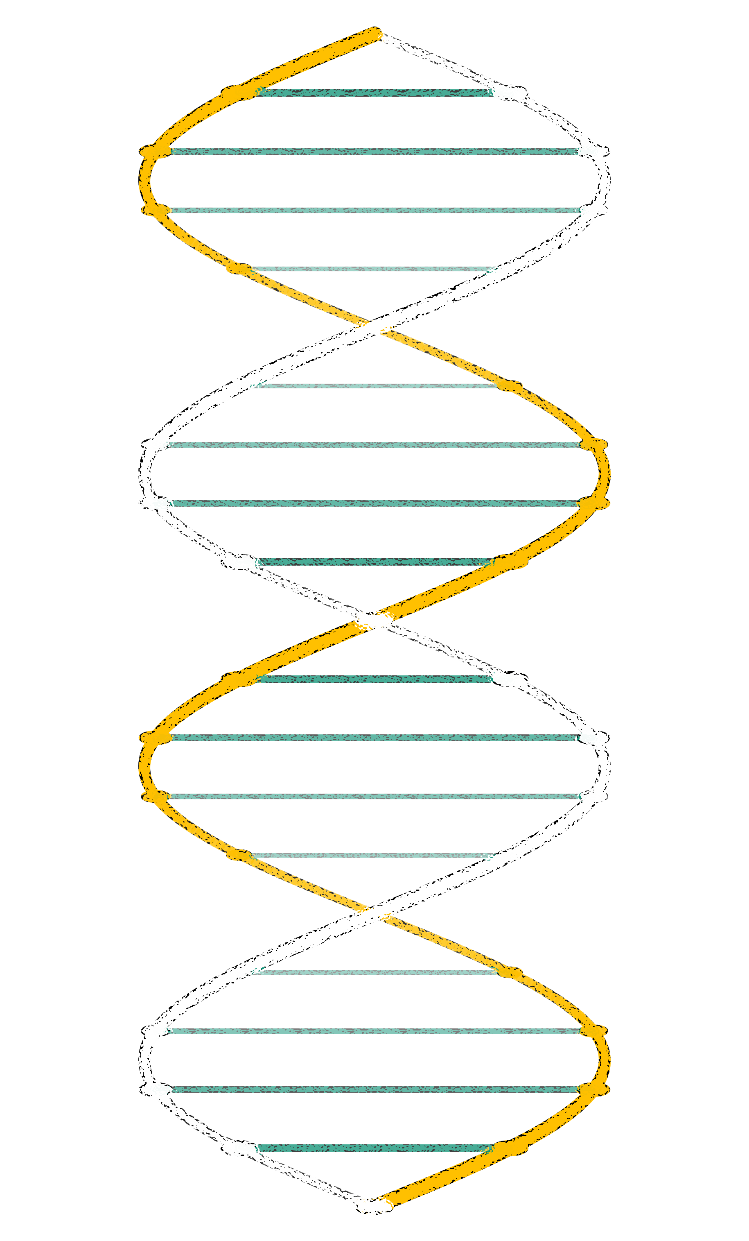
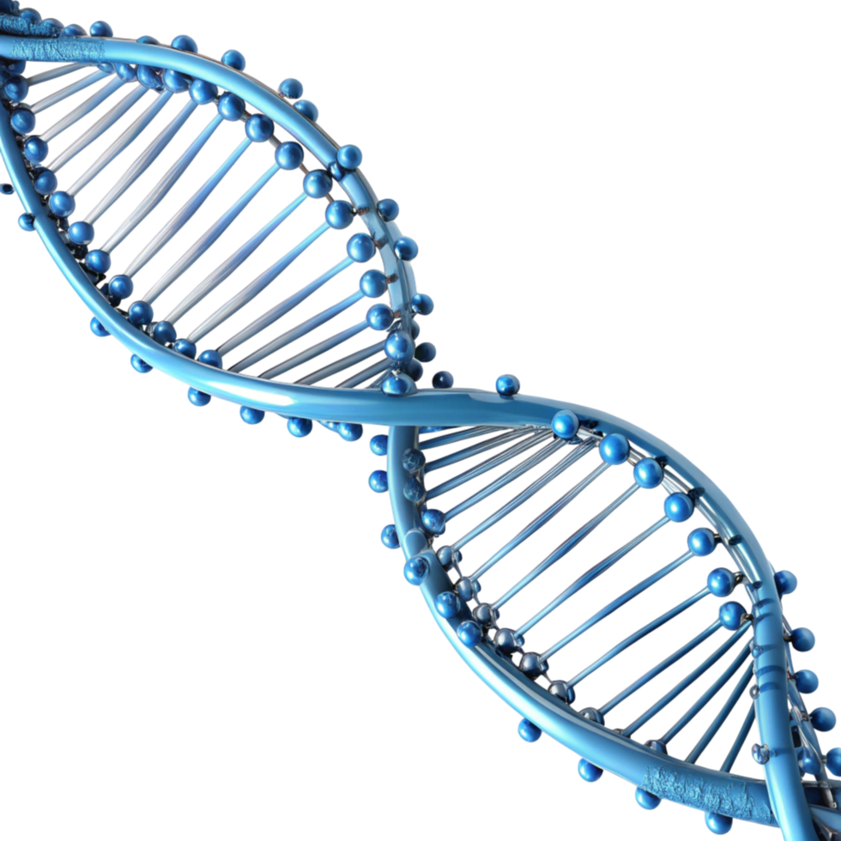
Computational Identification and Therapeutic Targeting of NUSAP1 in Breast Cancer -
Pathogenic nsSNPs Characterization, Structural Analysis, and Dual Virtual Screening of
Chemical and Phytochemical Compounds
Name: Satya Sri Kranthi
Roll No: DY22SBBU0BID020
Guide Name: Dr. A. Krishna Chaitanya

Slide 2
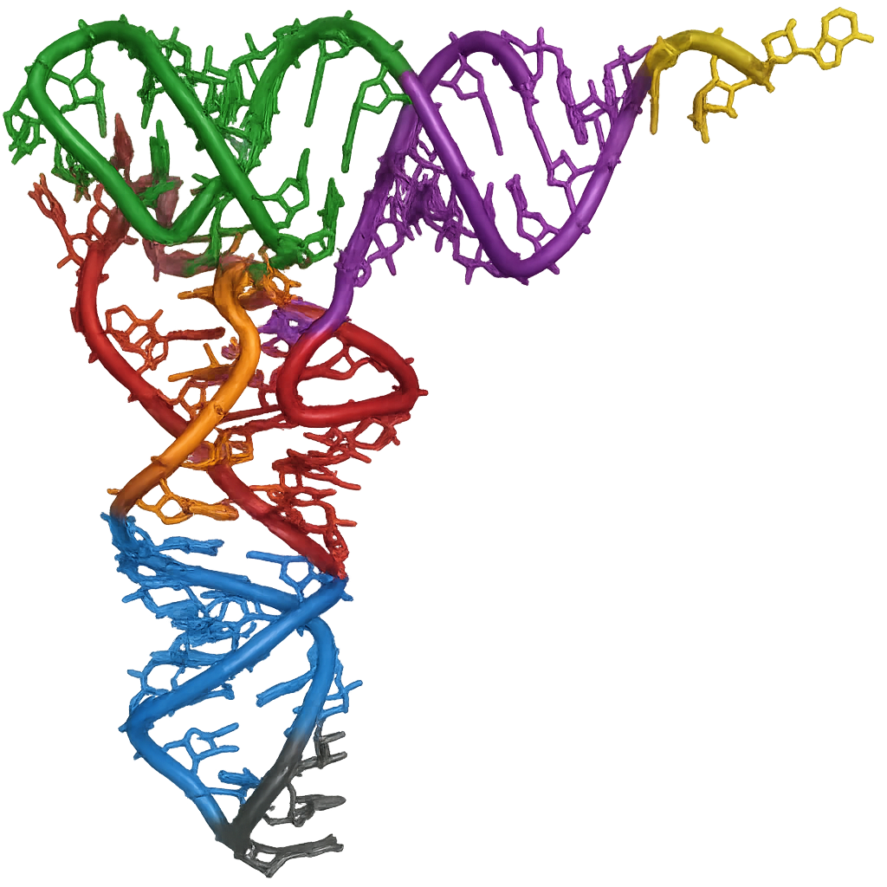
Aim of the study:
To identify a novel therapeutic target in breast cancer and discover potential lead compounds for NUSAP1 using computational approaches.
Objectives:
Collection of hub genes in breast cancer from published literature
Screen hub genes lacking therapeutic drug targets
Construct PPI networks & identify hub genes lacking therapeutic drug targets
Select candidate gene based on BRCA & pan-cancer expression.
Characterize deleterious nsSNPs of NUSAP1 computationally
Evaluate protein stability, structure & evolutionary conservation
Identify lead compounds using virtual screening (Mcule & IMPPAT)

Slide 3
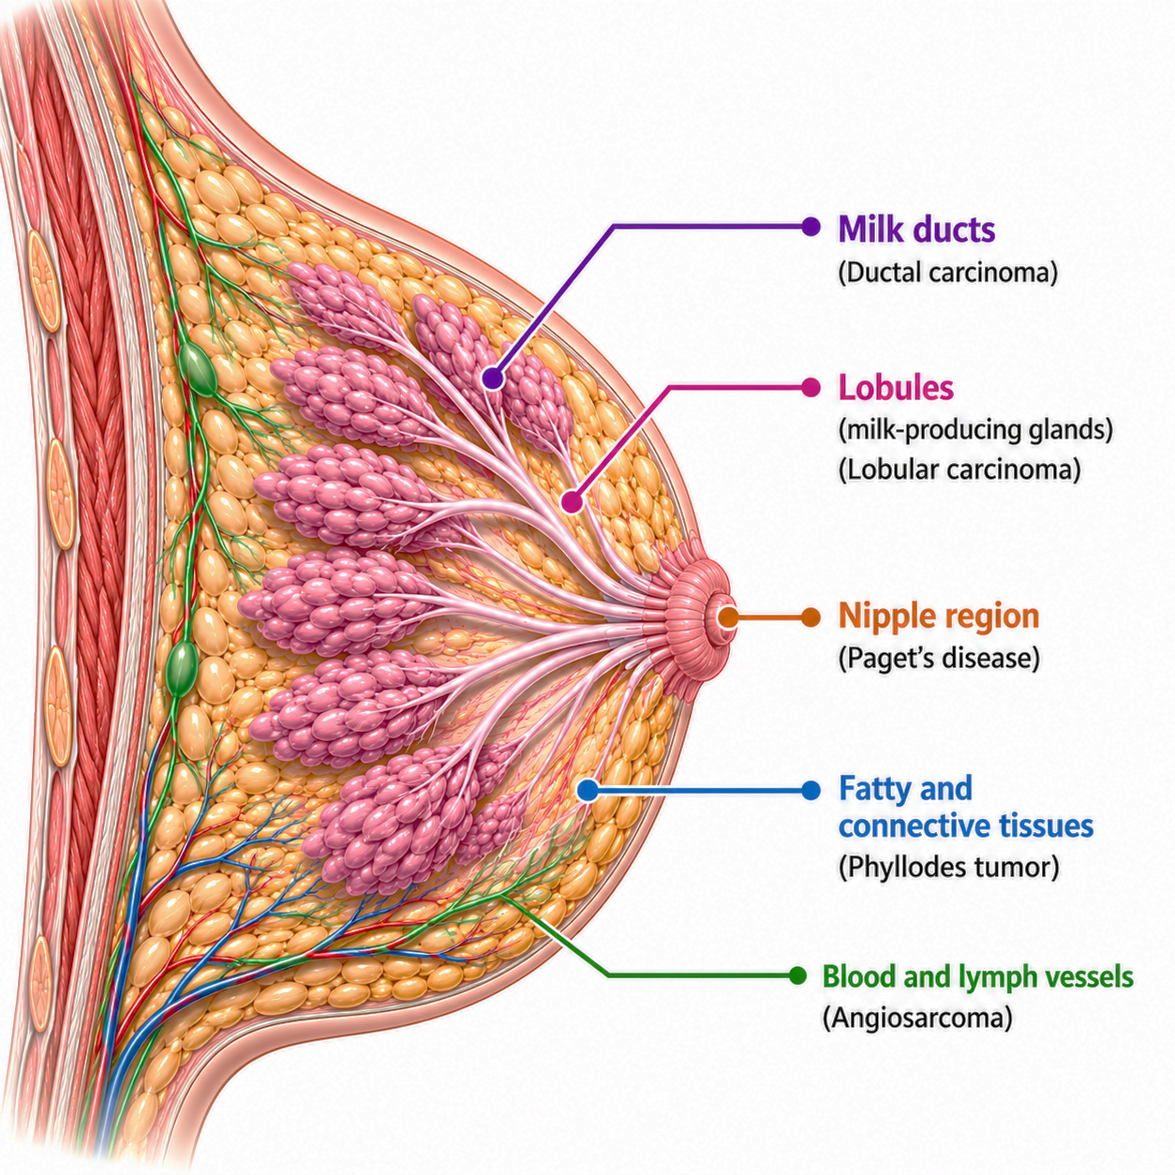
Literature review:
Breast cancer:
Workflow:
GEO datasets → Identification of significant genes → Venny tool [Common DEGs] → STRIING [Protein-protein interaction network] → Cytoscape [Identified hub genes]
Identification of DEGs and hub genes:
A disease in which breast cells grow uncontrollably, forming tumors.
Current treatment options include: Surgery, Hormone therapy, radiotherapy, and chemotherapy
A highly connected and centrally positioned gene in a protein-protein interaction network, where nodes are known as genes and edges are known as interactions between the genes.
Hub genes were identified via Cytuhubba plugin in Cytoscape using MCC algorithm.
87 hub genes reported from the published literature.
A microtubule-associated protein essential for mitosis and cell division.
It promotes cell proliferation, migration, and invasion.
Overexpressed in multiple cancers and associated with poor prognosis, increased metastasis, and reduced patient survival.
Reported hub genes:
NUSAP1 gene:

Slide 4
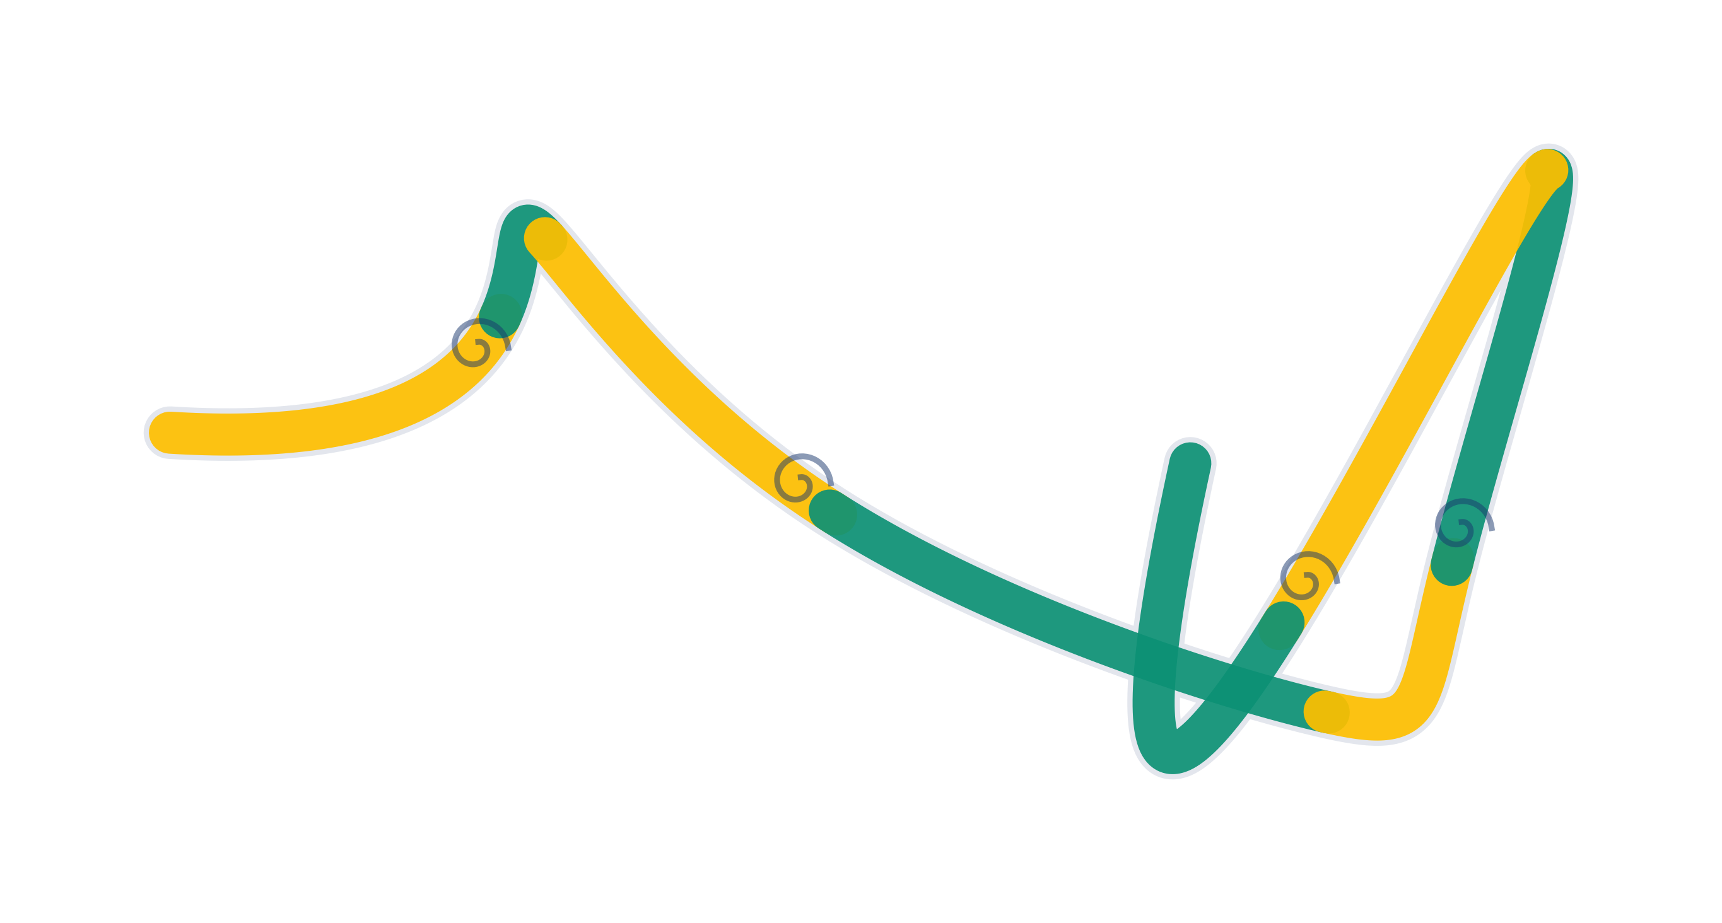
Research gaps:
01
36 of 87 hub genes have no known therapeutic drug targets in TTD
36
Hub genes without drug targets
02
NUSAP1 specifically lacks drug target data and is highly expressed in pan-cancer.
03
Pathogenic impact of NUSAP1 nsSNPs on protein stability is uncharacterized
04
No phytochemicals and chemical compounds have been evaluated against NUSAP1

Slide 5

Problem Formulation:
Can NUSAP1 be validated as a structurally significant druggable target in breast cancer through characterization of its pathogenic nsSNPs, and can lead compounds be identified against it via computational virtual screening?

Slide 6
Research Methodology:
Hub gene data collection
87 hub genes
TTD Screening
36 genes with no drugs
PPI Network
STRING + Cytoscape
GEPIA2 Expression
NUSAP1 Selected
1
2
3
4
nsSNPs Analysis
Collection of nsSNPs + Structural + Functional analysis
3D Modelling
AlphaFold - GalaxyRefine - SAVES
Dynamics(iMODS)
Virtual Screening
PrankWeb - Mcule - IMPPAT
5
6
7
8

Slide 7
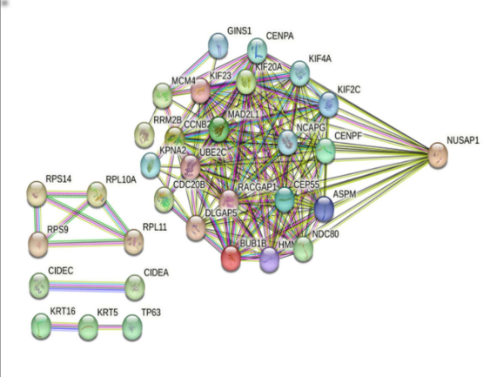
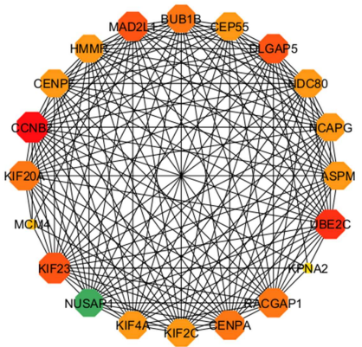
Results: Hub Gene Analysis-
87
Total hub genes
51
Hub genes with known drug target
36
Hub genes with NO drug targets
Protein-Protein interaction network of 36 genes
Top 20 hub genes of 36 genes

Slide 8
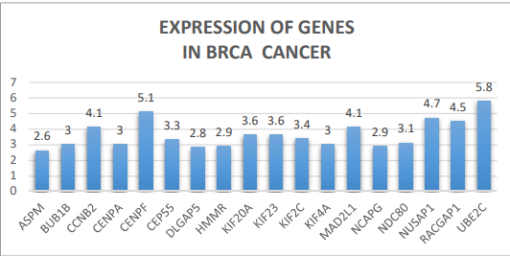
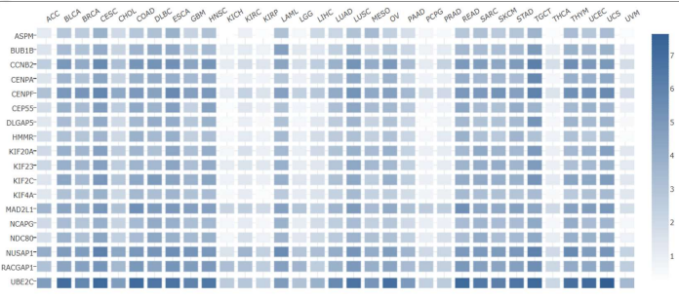
Results: NUSAP1 Selection-
Expression of top 20 hub genes in BRCA
Expression of top 20 hub genes in Pan-cancer
Why NUSAP1…..?
Top recurring hub gene across breast cancer datasets
Highly expressed in BRCA and in pan-cancer.
Top 10 ranking hub gene in CytoHubba.
CENPF is excluded as it is not overexpressed in pan-cancer.
NUSAP1 gene:
Protein: Nucleolar & Spindle – Associated Protein 1
Function: Microtubule – associated, important role in mitosis
Role in BRCA: Promotes proliferation, migration & invasion
Immune: Modulates tumor microenvironment
Prognosis: High expression → shorter patient survival
NUSAP1
Selected candidate gene

Slide 9
Results: NUSAP1 nsSNPs Functional analysis-
460
Variants from UniProtKB
3 + 1
Pathogenic Variants
1 variant – UniProtKB entry
Pathogenicity ranking based on MetaRNN score:
R434M > K404E > N386S > T114N
Variant | Change | ΔΔG Value MUpro | Stability I-Mutant 2.0 | MetaRNN score | Key HOPE findings
R434M | Arg → Met | −0.539 | Decrease | 0.823 | 100% conserved; charge lost; most damaging
K404E | Lys → Glu | −0.343 | Decrease | 0.727 | Charge reversal (+→−); near conserved; repulsion
N386S | Asn → Ser | −1.332 | Decrease | 0.335 | Located at highly conserved position, loss of hydrogen bonds
T114N (UniProtKB entry) | Thr → Asn | −0.407 | Decrease | 0.039 | Disordered, non-conserved region; least effect

Slide 10
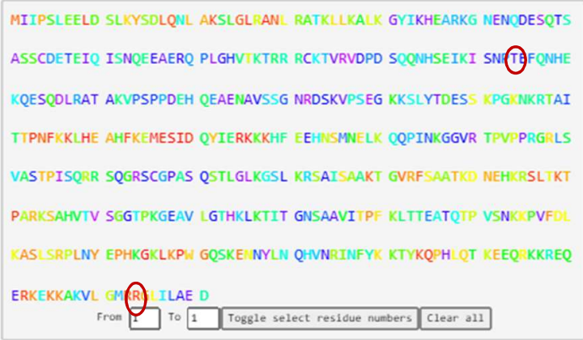
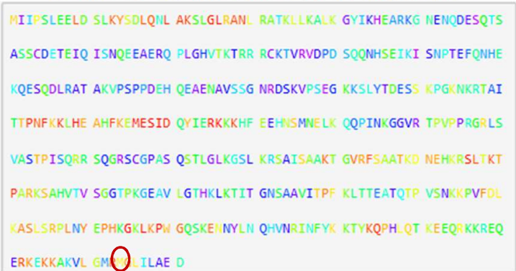
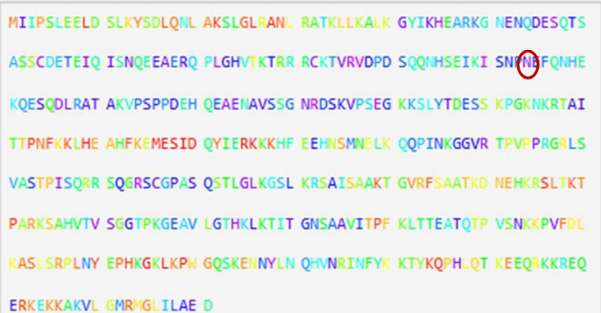
Results: Evolutionary Trace(ET) Conservation Analysis:
Wildtype - Most red regions
R434M variant - Red → Yellow
T114N variant - No change
Wildtype - Strong evolutionary conserved across the sequence which indicates the presence of functionally important residues.
Substitution of Arg → Met at position 434 decreases evolutionary conservation compared with Wildtype.
Substitution of Thr → Asn at position 114 shows no significant change in evolutionary conservation compared with Wildtype.

Slide 11
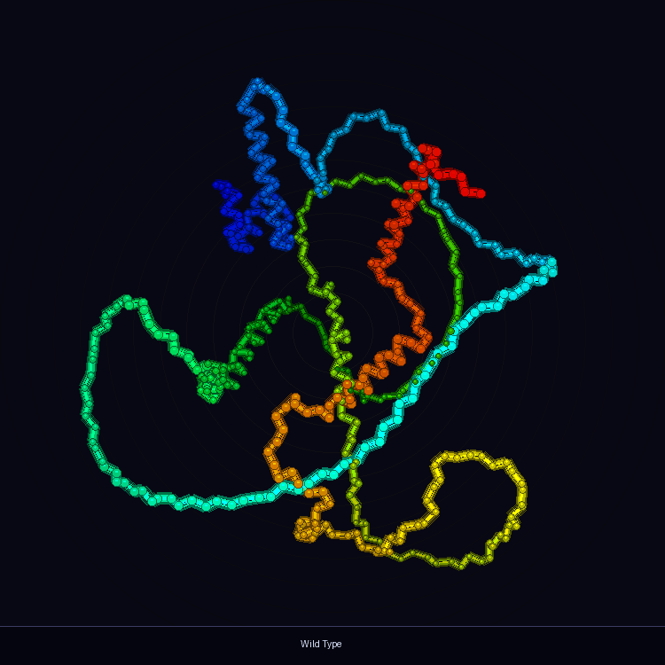
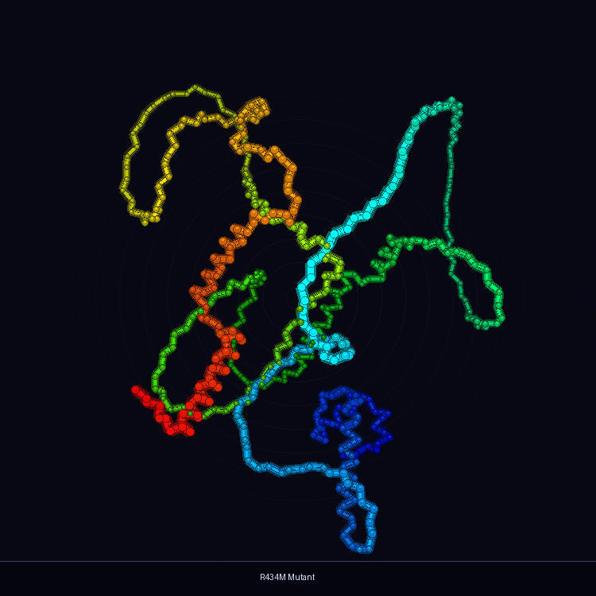
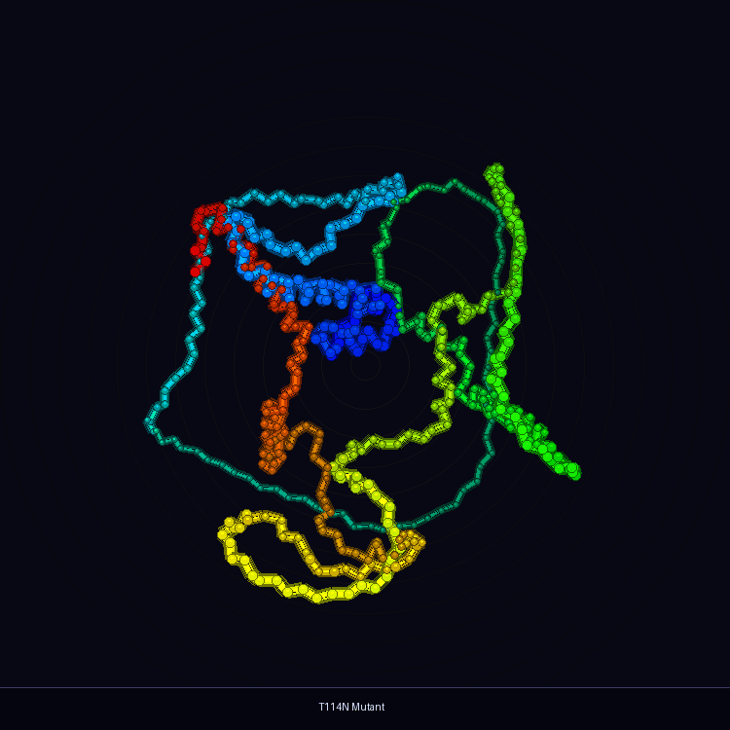
Results: Structural Modelling & Validation:
Wildtype structure
R434M variant structure
T114N variant structure
Structure Modelling
AlphaFold server
Structure Refinement
GalaxyRefine
Structure Validation
SAVES
Structure Validation Results
Structure | ERRAT score | Ramachandran favored | Quality of structure
Wildtype(WT) | 92.82% | 95.9% | Good
R434M variant | 97.16% | 95.6% | Good
T114N variant | 94.57% | 93.6% | Good

Slide 12
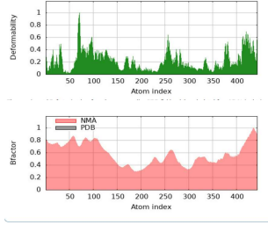
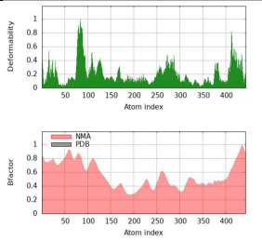
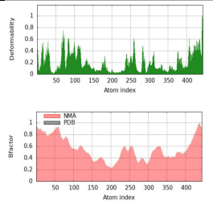
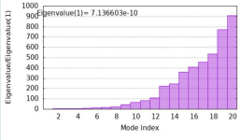
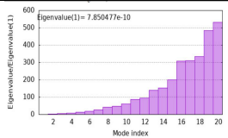
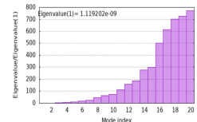
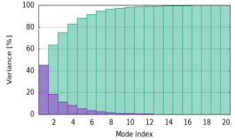
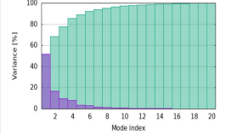
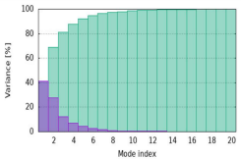
Results: Stability and Flexibility Analysis-
WT
R434M
T114N
Deformability Plot:
WT shows balanced flexibility across the protein
R434M: slightly reduced deformability at position 434 (more rigid)
T114N: increased deformability at position 114 (more flexible locally)
B-Factor Plot:
WT has well-distributed mobility
T114N shows greater changes in B-factor values than R434M
R434M is least affected - closest to WT behavior
Eigenvalue Plot:
WT: 7.136 × 10⁻¹⁰ (lowest - most flexible, least energy needed)
R434M: 7.850 × 10⁻¹⁰ (~10% stiffer than WT)
T114N: 1.119 × 10⁻⁹ (~57% stiffer - most rigid globally)
Variance Plot:
WT: Mode 1 contributes ~65% of total motion
R434M: Mode 1 drops to ~55% - motion spreads across modes 2 - 8
T114N: Mode 1 ~50% - most evenly distributed motion
Deformability Plot
Deformability Plot
Deformability Plot
B-Factor Plot
B-Factor Plot
B-Factor Plot
Eigenvalue Plot
Eigenvalue Plot
Eigenvalue Plot
Variance Plot
Variance Plot
Variance Plot

Slide 13
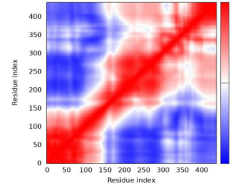
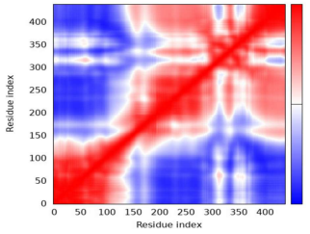
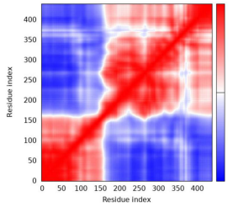
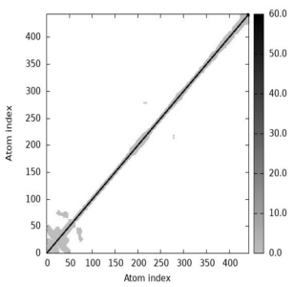
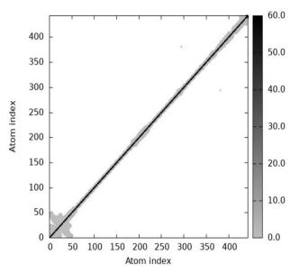
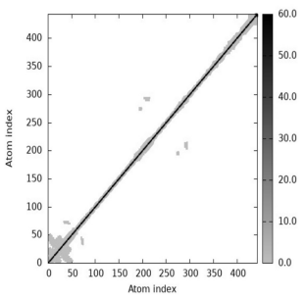
Covariance Plot:
Red = residues moving in the same direction (correlated)
Blue = residues moving in opposite directions (anti-correlated)
WT: Large red off-diagonal patches → strongly correlated residue movements - organized, efficient motion
R434M: Large blue anti-correlated patches replace red regions (residues 0 - 150 and 300 - 450) → disrupted communication
T114N: Most disrupted - loss of hydrogen bond at residue 114 breaks strongly connected movements seen in WT
Elastic Network Model (ENM):
Thick black diagonal = interactions between neighboring residues
Dark off-diagonal spots = long-range residue interactions
WT: Stable contact pattern with consistent interactions
R434M: Very similar to WT → mutation does not significantly affect overall structure
T114N: Few additional contact changes near N-terminal region → local structural perturbation at residue 114
Covariance Plot
Covariance Plot
Covariance Plot
Elastic Network Model
Elastic Network Model
Elastic Network Model
Native dynamics preservation ranking:
WT > R434M > T114N
Wildtype NUSAP1 maintains the most stable and functionally optimal protein dynamics
R434M shows moderate structural disruption - more pathogenic at sequence level but moderate dynamic effect.
T114N causes the greatest disruption to protein motion and residue communication despite lower pathogenicity score.

Slide 14
Results: Binding Pockets & Virtual Screening - Mcule:
Binding center:
  X: -19.2576
  Y: -10.2263
  Z: -15.8069
Binding site:
X = Y = Z = 20.0 Aº
Sampler
1,00,000
Mcule library
3 binding pockets identified
PrankWeb
LogP : ≤ 5
Hydrogen bond donors: ≤ 5
Hydrogen bond acceptors: ≤10
Molecular weight: ≤ 500 Da
Top docking scoring
100
Entries screened
Pocket | Score | Probability
Pocket 1 | 2.22 | 0.054
Pocket 2 | 1.54 | 0.022
Pocket 3 | 1.34 | 0.016
Performed virtual screening using Autodock Vina
34
Lipinski rule → OK
Excel
Cardiotoxicity | Lung toxicity
Carcinogenicity | Nephrotoxicity
Immunotoxicity | Neurotoxicity
Cell toxicity | Hepatotoxicity
Clinical toxicity | Oral Toxicity
Nutritional toxicity
Pocket 1
Based on highest score and high probability score.
Residues: A_197 & A_202
Center: (-19.2576, -10.2263, -15.8069)
Lipinski violations - 0
PAINS - 0
High GI absorption
Brenk alerts – 0
BBB – permeant
Bio-availability score – 0.55
9
ADME properties → OK
SWISSADME
4
Non-toxic leads
ProTox 3.0

Slide 15
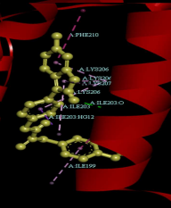
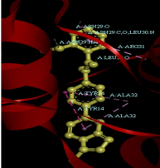
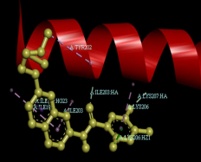
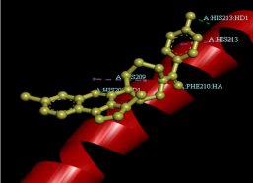
Four Non-Toxic Lead Compounds - Mcule Library
MCULE-3003239086-0-1
Binding energy: -7.628 kcal/mol
Log P: 4.12
Bio-availability score: 0.55
GI-absorption: High
PAINS: 0
Brenk Alerts: 0
Lipinski violation: 0
2D-Interactions:
Van der Waals: GLU197
Conventional hydrogen bonds: ILE203
MCULE-4544406282-0-1
Binding energy: -6.483 kcal/mol
Log P : 2.24
Bio-availability score: 0.55
GI-absorption: High
PAINS: 0
Brenk Alerts: 0
Lipinski violation: 0
2D-Interactions:
Van der Waals: ASN29, GLN18
Conventional hydrogen bonds: LEU30
MCULE-6557310118-0-1
Binding energy: -6.826 kcal/mol
Log P : 4.50
Bio-availability score: 0.55
GI-absorption: High
PAINS: 0
Brenk Alerts: 0
Lipinski violation: 0
2D-Interactions:
Van der Waals: MET196, GLU197
Carbon hydrogen bonds: LYS206
MCULE-6724108984-0-1
Binding energy: -7.171 kcal/mol
Log P: 3.55
Bio-availability score: 0.55
GI-absorption: High
PAINS: 0
Brenk Alerts: 0
Lipinski violation: 0
2D-Interactions:
Van der Waals: GLU197, ASP200
Carbon hydrogen bonds: MET196, PHE193

Slide 16

Results: Virtual Screening – IMPPAT database:
Downloaded from IMPPAT database
~17,000
Phytochemical compounds
Selected based on binding energies after performing Autodock Vina
10,638
Lipinski rule → OK
Binding center:
  X: -19.2576
  Y: -10.2263
  Z: -15.8069
Binding site:
X = Y = Z = 20.0 Aº
LogP : ≤ 5
Hydrogen bond donors: ≤ 5
Hydrogen bond acceptors: ≤ 10
Molecular weight: ≤ 500 Da
Top
100
Phytochemical compounds
Lipinski violations - 0
PAINS - 0
High GI absorption
Brenk alerts – 0
BBB – permeant
Bio-availability score – 0.55
8
ADME properties → OK
SWISSADME
4
Non-toxic leads
ProTox 3.0

Slide 17
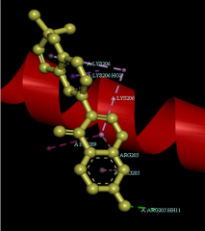
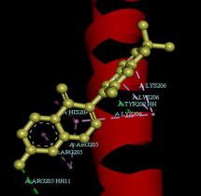
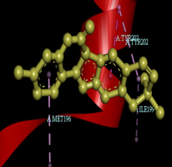
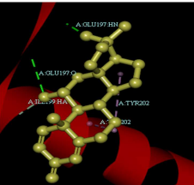
Four Non-Toxic Lead Compounds – IMPPAT database
Corylin
Binding energy: -6.555 kcal/mol
Bio-availability score: 0.55
GI-absorption: High
PAINS: 0
Brenk Alerts: 0
Lipinski violation: 0
2D-Interactions:
Van der waals: GLU197, TYR202, PHE210
Conventional hydrogen bonds: ARG205
Puerarone
Binding energy: -6.666 kcal/mol
Bio-availability score: 0.55
GI-absorption: High
PAINS: 0
Brenk Alerts: 0
Lipinski violation: 0
2D-Interactions:
Van der waals: GLU197, PHE210
Conventional hydrogen bonds: ARG205, TYR202
Sophoracoumestan A
Binding energy: -6.639 kcal/mol
Bio-availability score: 0.55
GI-absorption: High
PAINS: 0
Brenk Alerts: 0
Lipinski violation: 0
2D-Interactions:
Van der waals: ILE203
Steroid-like compound
Binding energy: -7.084 kcal/mol
Bio-availability score: 0.55
GI-absorption: High
PAINS: 0
Brenk Alerts: 0
Lipinski violation: 0
2D-Interactions:
Van der waals: MET196, SER198, ILE203
Carbon hydrogen bonds: ILE199
Conventional hydrogen bonds: GLU197

Slide 18
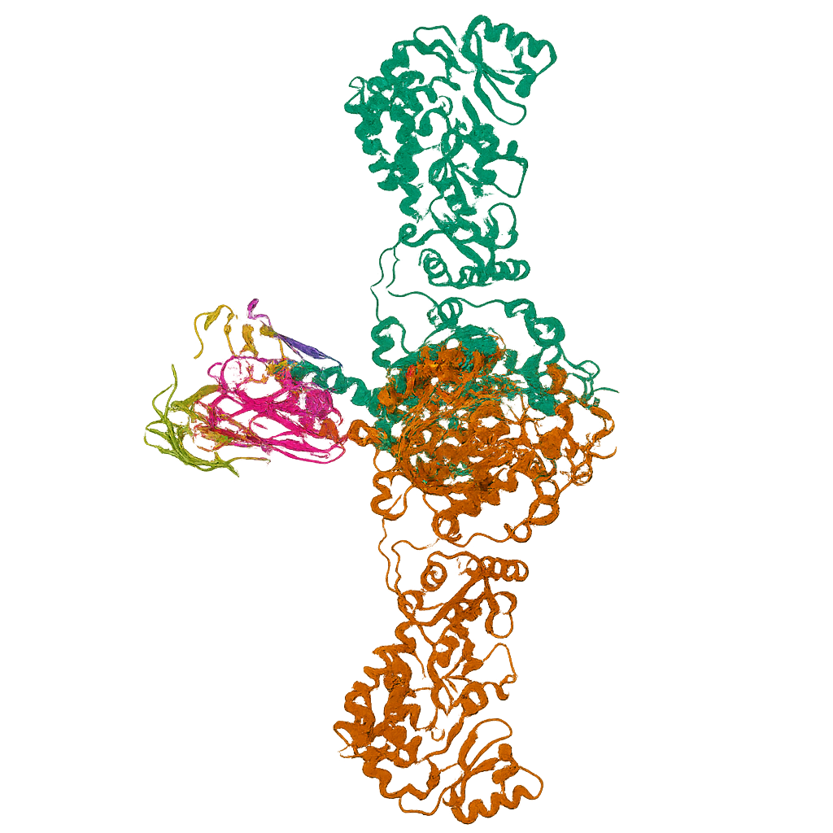
Conclusions:
Comprehensive in silico pipeline successfully identified NUSAP1 as a novel druggable target in breast cancer among 87 hub genes.
All four NUSAP1 variants (T114N, N386S, K404E, R434M) are destabilizing - ΔΔG values are negative; confirmed by both I-Mutant 2.0 and MUpro.
3D structural models (AlphaFold) validated with high stereochemical quality - ERRAT scores >90% and Ramachandran favored >93% for all structures.
Wildtype NUSAP1 exhibits optimal native dynamics for protein function; both variants significantly alter flexibility, stiffness, and residue communication.
Pathogenic variant sites (114, 434) lie outside the identified drug-binding pocket, indicating the pocket used for screening remains structurally conserved - supporting the reliability of the lead compounds.
Virtual screening from Mcule and IMPPAT libraries identified 8 non-toxic lead compounds with favorable ADME profiles targeting NUSAP1 Pocket 1.

Slide 19
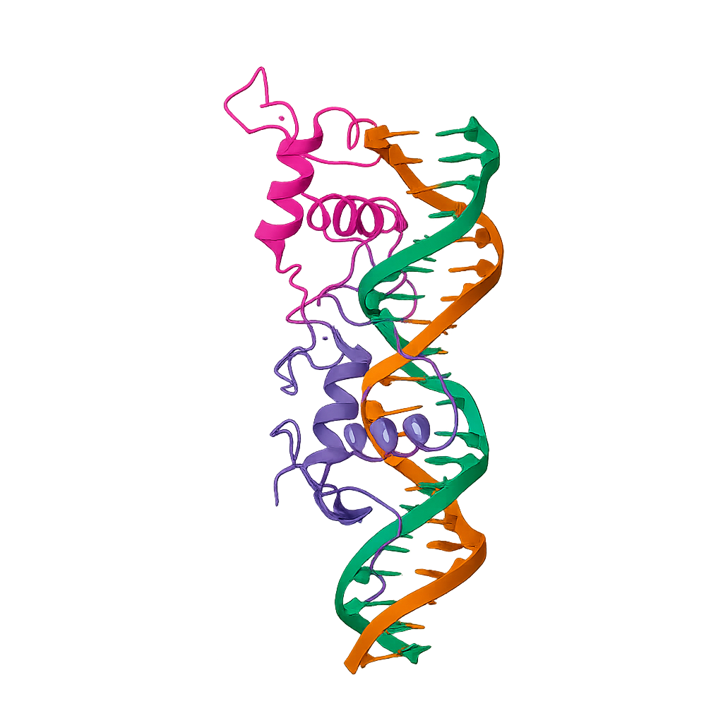
Further Scope of Research:
Molecular Dynamics (GROMACS)
RMSD - overall structural stability
RMSF - flexible region identification
Radius of Gyration - protein compactness
Full trajectory analysis of WT, R434M & T114N
In Vitro & In Vivo Validation
Validate lead compounds in NUSAP1-overexpressing BC cell lines
Animal model studies for promising candidates
Confirm computational predictions experimentally

Slide 20
References:
Zheng, H., et al. (2023). Comprehensive pan-cancer analysis reveals NUSAP1 is a novel predictive biomarker for prognosis and immunotherapy response. International Journal of Biological Sciences, 19(14), 4689–4708. — Key biological justification for NUSAP1 as your target.
McLaren, W., et al. (2016). The Ensembl Variant Effect Predictor. Genome Biology, 17(1), 122. — Identification of pathogenic nsSNPs.
Islam, M. S., Tanha, T. H., Zarin, N., Haque, S., Shiddiky, M. J. A., Lam, A. K., & Gopalan, V. (2025). Computational analysis and molecular dynamics insights into deleterious SNPs of the HFE gene. Journal of biomolecular structure & dynamics, 1–24. Advance online publication. https://doi.org/10.1080/07391102.2025.2593504
Zeng, X., Shi, G., He, Q., & Zhu, P. (2021). Screening and predicted value of potential biomarkers for breast cancer using bioinformatics analysis. Scientific reports, 11(1), 20799. https://doi.org/10.1038/s41598-021-00268-9
Liu, Z., Liang, G., Tan, L., Su, A. N., Jiang, W., & Gong, C. (2017). High-Efficient Screening Method for Identification of Key Genes in Breast Cancer Through Microarray and Bioinformatics. Anticancer Research, 37(8), 4329– 4335. https://doi.org/10.21873/anticanres.11826
Wu, Y., Jin, J., Zhang, Y., Huang, X., Wang, H., Huang, Y., & Xie, H. (2026). Downregulation of the lncRNA PGM5P4-AS1 predicts poor prognosis and drives breast cancer progression through miR-3664-5p/KLF9. Cancer biology & therapy, 27(1), 2606474. https://doi.org/10.1080/15384047.2025.2606474
Fang, E., & Zhang, X. (2017). Identification of breast cancer hub genes and analysis of prognostic value using integrated bioinformatics. Cancer biomarkers: section A of Disease markers, 21(1), 373–381. https://doi.org/10.3233/CBM-170550.
Torgovnick, A., & Schumacher, B. (2015). DNA repair mechanisms in cancer development and therapy. Frontiers in Genetics, 6, 157. https://doi.org/10.3389/fgene.2015.00157

Slide 21
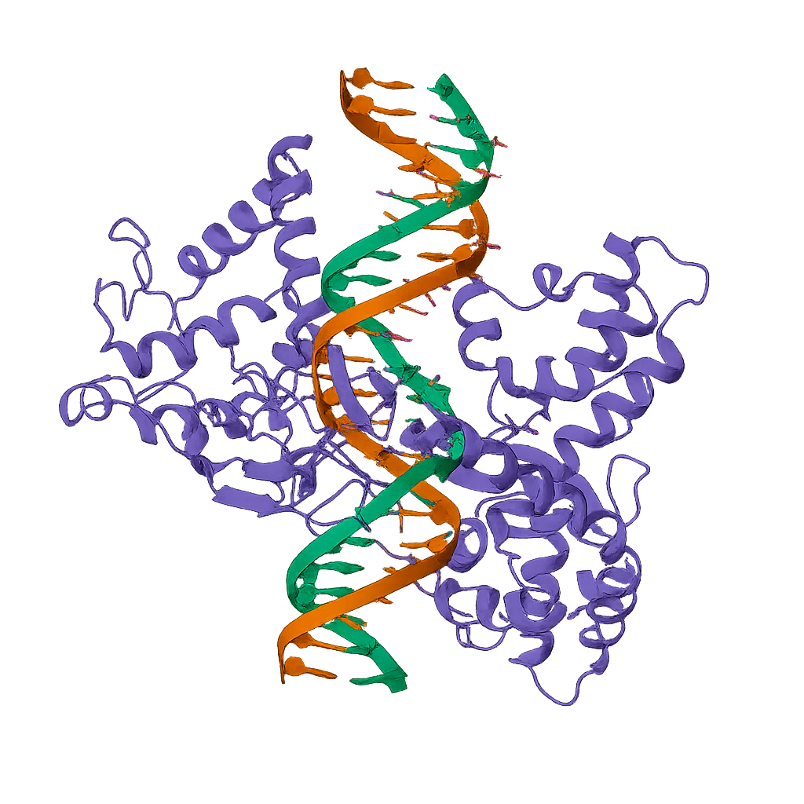
Thank You
Questions & Answers
Special Thanks To
Dr. A. Krishna Chaitanya

