Slide 1
Online Food Ordering System
K. Ajay
K. Satya Sri

Slide 2
Problem Statement & Objectives
Problem Statement -
The Online Food Ordering System aims to develop a database that efficiently manages restaurant information, menu items, customer details, food orders, and payment transactions. It provides a structured way to manage customer orders, track payment statuses, maintain order history, and generate restaurant sales reports. The system helps organize food ordering operations and retrieve information accurately using SQL queries.
Objectives:
To design and develop an efficient Online Food Ordering database.
To manage restaurant, menu, and customer information.
To maintain customer orders and track order status.
To manage payment transactions and payment status.
To generate restaurant-wise revenue and sales reports.
To retrieve customer order history.
To identify the most popular and frequently ordered food items.

Slide 3
Database Design
RESTAURANTS (RESTAURANT_ID PK, RESTAURANT_NAME, LOCATION, CUISINE)
MENU (MENU_ID PK, RESTAURANT_ID FK, ITEM_NAME, PRICE, AVAILABILITY)
CUSTOMERS (CUSTOMER_ID PK, CUSTOMER_NAME, PHONE, CITY)
ORDERS (ORDER_ID PK, CUSTOMER_ID FK, MENU_ID FK, QUANTITY, ORDER_DATE, ORDER_STATUS)
PAYMENTS (PAYMENT_ID PK, ORDER_ID FK, PAYMENT_METHOD, AMOUNT, PAYMENT_STATUS, PAYMENT_DATE)

Slide 4
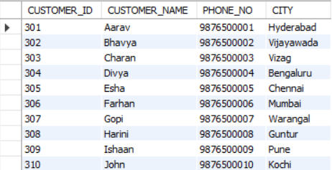
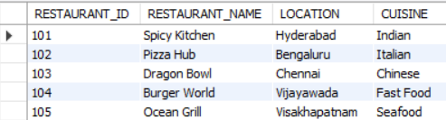
Sample Data
CREATE TABLE RESTAURANTS (RESTAURANT_ID INT PRIMARY KEY, RESTAURANT_NAME VARCHAR(50), LOCATION VARCHAR(30), CUISINE VARCHAR(20));
CREATE TABLE CUSTOMERS (CUSTOMER_ID INT PRIMARY KEY, CUSTOMER_NAME VARCHAR(20), PHONE_NO VARCHAR(15), CITY VARCHAR(20) );

Slide 5
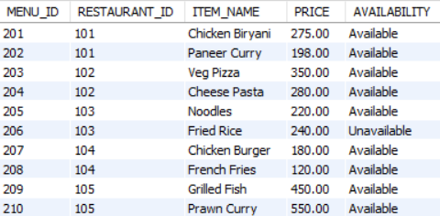
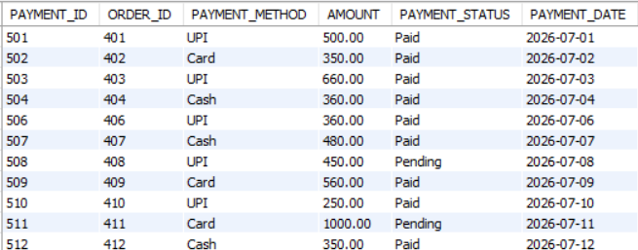
CREATE TABLE PAYMENTS (PAYMENT_ID INT PRIMARY KEY, ORDER_ID INT, PAYMENT_METHOD VARCHAR(10), AMOUNT DECIMAL(10,2), PAYMENT_STATUS VARCHAR(20), PAYMENT_DATE DATE, FOREIGN KEY (ORDER_ID) REFERENCES ORDERS(ORDER_ID) );
CREATE TABLE MENU (MENU_ID INT PRIMARY KEY, RESTAURANT_ID INT, ITEM_NAME VARCHAR(40), PRICE DECIMAL(10,2), AVAILABILITY VARCHAR(20), FOREIGN KEY (RESTAURANT_ID) REFERENCES RESTAURANTS(RESTAURANT_ID));

Slide 6
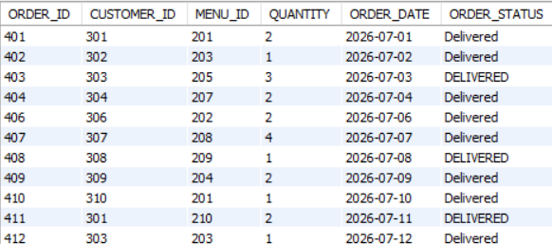
CREATE TABLE ORDERS(ORDER_ID INT PRIMARY KEY, CUSTOMER_ID INT, MENU_ID INT, QUANTITY INT, ORDER_DATE DATE, ORDER_STATUS VARCHAR(20), FOREIGN KEY (CUSTOMER_ID) REFERENCES CUSTOMERS(CUSTOMER_ID), FOREIGN KEY (MENU_ID) REFERENCES MENU(MENU_ID) );

Slide 7
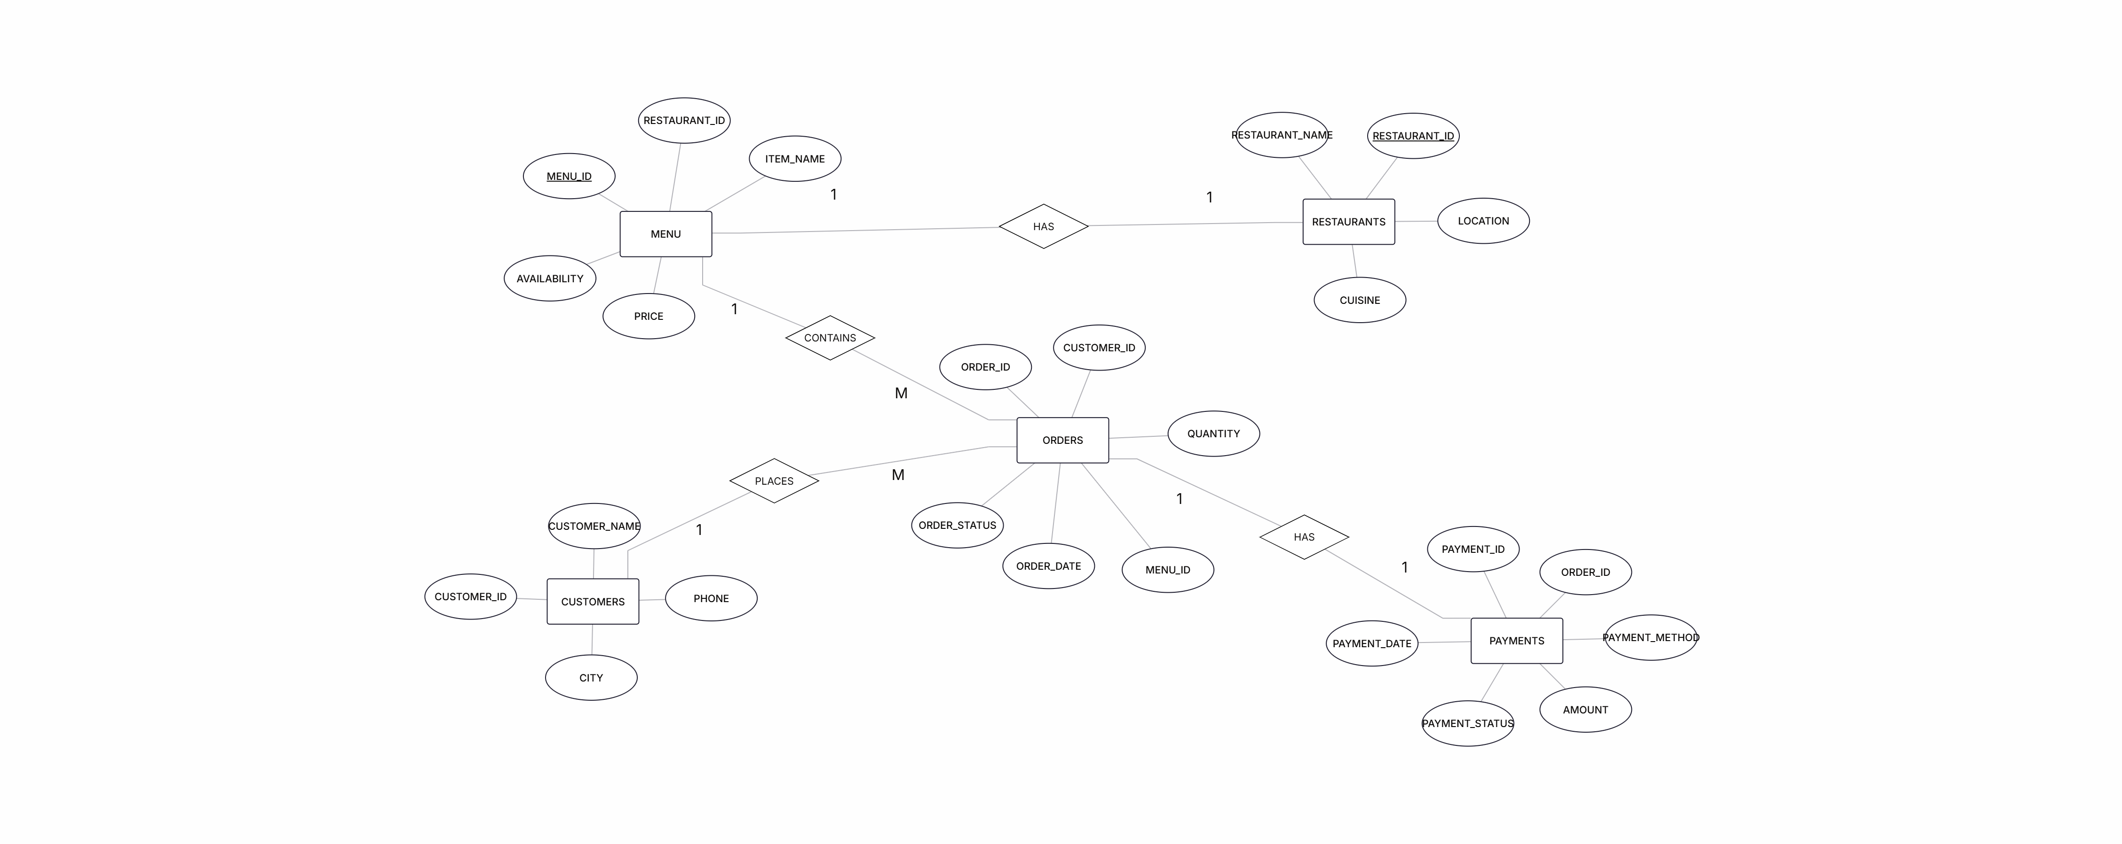
ER Diagram

Slide 8
CRUD Operations queries
C- CREATE (INSERT) - Add new records
INSERT INTO RESTAURANTS VALUES (101,' SPICY KITCHEN', ‘HYDERABAD ’, ’ INDIAN ’),(102,'PIZZA HUB’, 'BENGALURU’, 'ITALIAN’), (103, 'DRAGON BOWL', 'CHENNAI’, 'CHINESE'),(104,'BURGER WORLD', 'VIJAYAWADA', 'FAST FOOD’), (105,’ OCEAN GRILL', 'VISAKHAPATNAM', 'SEAFOOD’);
R- READ (SELECT) - Retrieve records
SELECT * FROM RESTAURANTS;

Slide 9
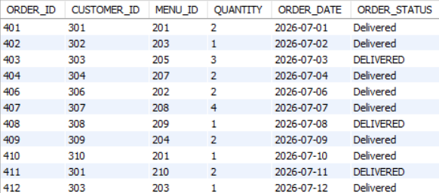
CRUD Operations queries
U – UPDATE - Modify records
UPDATE ORDERS SET ORDER_STATUS = 'DELIVERED' WHERE ORDER_STATUS = 'PREPARING’;
D – DELETE - Remove records
DELETE FROM PAYMENTS WHERE ORDER_ID = 405;
DELETE FROM ORDERS WHERE CUSTOMER_ID = 305 AND ORDER_STATUS = 'CANCELLED';

Slide 10
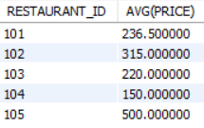
Aggregate functions queries
Used to perform calculations on multiple rows of a table and return a single result.
COUNT() – Counts the total number of records.
SUM() – Calculates the total sum of values.
AVG() – Calculates the average of values.
MAX() – Returns the highest value.
MIN() – Returns the lowest value.
SELECT RESTAURANT_ID,AVG(PRICE) FROM MENU
WHERE AVAILABILITY = "AVAILABLE" GROUP BY RESTAURANT_ID;

Slide 11
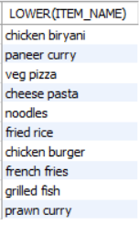
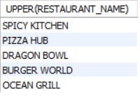
String Modification functions queries
Used to manipulate, modify, and transform text data stored in database columns.
UPPER() – Converts all characters into uppercase.
LOWER() – Converts all characters into lowercase.
REPLACE() – Replaces a specified word or character with another.
REVERSE() – Reverses a string.
SELECT UPPER(RESTAURANT_NAME) FROM RESTAURANTS;
SELECT LOWER(ITEM_NAME) FROM MENU;

Slide 12
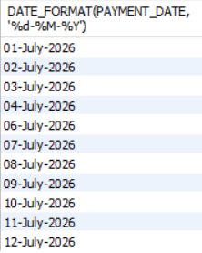
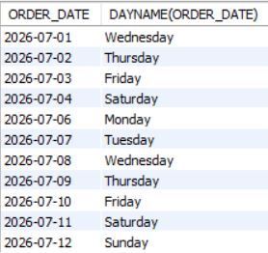
Date functions queries
Used to retrieve, manipulate, format, and perform calculations on date and time values stored in a database.
NOW() – Returns the current date and time.
CURTIME() – Returns the current time.
DAYNAME() – Returns the weekday name.
DATE_FORMAT() – Formats a date into a specified format.
SELECT DATE_FORMAT( PAYMENT_DATE, '%d-%M-%Y’)
FROM PAYMENTS;
SELECT ORDER_DATE, DAYNAME(ORDER_DATE) FROM ORDERS;

Slide 13
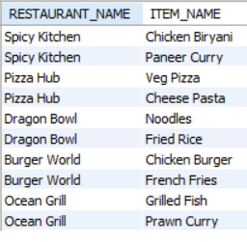
Joins
Used to combine data from two or more tables based on a related column between them.
INNER JOIN - Only matching records
LEFT JOIN - All left + matching right
RIGHT JOIN - All right + matching left
FULL JOIN - All matching and non-matching records
CROSS JOIN - All possible combinations
SELF JOIN - Joins a table with itself
SELECT RESTAURANTS.RESTAURANT_NAME, MENU.ITEM_NAME
FROM RESTAURANTS JOIN MENU
ON RESTAURANTS.RESTAURANT_ID = MENU.RESTAURANT_ID;

Slide 14

Multiple Joins
Multiple joins allow you to combine data from more than one table in a single query.
SELECT RESTAURANTS.RESTAURANT_NAME
FROM RESTAURANTS
LEFT JOIN MENU
ON RESTAURANTS.RESTAURANT_ID = MENU.RESTAURANT_ID
LEFT JOIN ORDERS ON MENU.MENU_ID = ORDERS.MENU_ID
WHERE ORDERS.ORDER_ID IS NULL;

Slide 15

Sub Queries
A Subquery is a query written inside another SQL query. The result of the inner query is used by the outer query to retrieve or manipulate data.
Single-Row Subquery – Returns only one row from the inner query
Multiple-Row Subquery – Returns more than one row from the inner query.
Correlated Subquery – Depends on the outer query and executes logically for each row processed by it.
SELECT DISTINCT CUSTOMERS.CUSTOMER_NAME FROM CUSTOMERS
JOIN ORDERS ON CUSTOMERS.CUSTOMER_ID = ORDERS.CUSTOMER_ID
JOIN PAYMENTS ON PAYMENTS.ORDER_ID = ORDERS.ORDER_ID
WHERE PAYMENTS.AMOUNT >
(SELECT AVG(PAYMENTS.AMOUNT) FROM PAYMENTS);

Slide 16
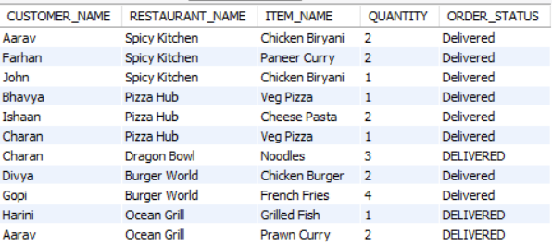
Views
Views in SQL are virtual tables created using SQL queries. They display data from one or more existing tables without storing the actual data separately. Views help simplify complex queries and provide easy access to specific data.
CREATE VIEW CUSTOMER_ORDER_HISTORY
AS SELECT CUSTOMERS.CUSTOMER_NAME, RESTAURANTS.RESTAURANT_NAME, MENU.ITEM_NAME,ORDERS.QUANTITY, ORDERS.ORDER_STATUS
FROM CUSTOMERS JOIN ORDERS ON CUSTOMERS.CUSTOMER_ID = ORDERS.CUSTOMER_ID JOIN MENU ON ORDERS.MENU_ID = MENU.MENU_ID JOIN RESTAURANTS ON MENU.RESTAURANT_ID = RESTAURANTS.RESTAURANT_ID;
SELECT * FROM CUSTOMER_ORDER_HISTORY;

Slide 17
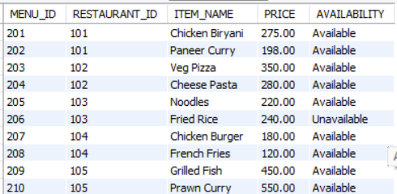
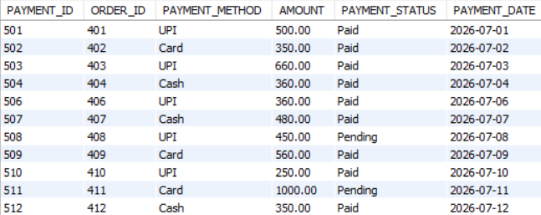
Transaction Control Language
Used to manage database transactions.
COMMIT – Permanently saves all changes made in a transaction.
ROLLBACK – Undoes changes made in the current transaction that have not been committed.
SAVEPOINT – Creates a temporary point within a transaction to which we can roll back.
START TRANSACTION;
UPDATE MENU SET PRICE = PRICE + 50 WHERE MENU_ID = 210;
SAVEPOINT SP1;
UPDATE PAYMENTS SET PAYMENT_STATUS = 'PAID' WHERE PAYMENT_ID = 511;
ROLLBACK TO SP1;
COMMIT;

Slide 18

Stored Procedures
A stored procedure is a precompiled SQL code that can be saved and reused. If you have an SQL query that you write over and over again, save it as a stored procedure, and then just call it to execute it.
CREATE DEFINER=`root`@`localhost` PROCEDURE `ALL_ORDERS` (IN C_ID INT)
BEGIN
SELECT ORDERS.ORDER_ID, MENU.ITEM_NAME, ORDERS.QUANTITY, ORDERS.ORDER_DATE, ORDERS.ORDER_STATUS
FROM ORDERS JOIN MENU ON ORDERS.MENU_ID = MENU.MENU_ID
WHERE ORDERS.CUSTOMER_ID = C_ID;
END
CALL ALL_ORDERS(301);

Slide 19
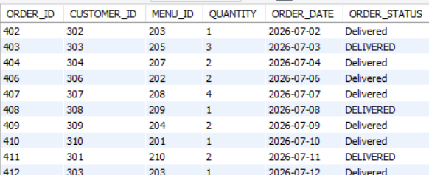
Triggers
A trigger is a special database object that automatically executes when an INSERT, UPDATE, or DELETE operation occurs on a table.
CREATE TABLE ORDERS_ARCHIVE (ORDER_ID INT,CUSTOMER_ID INT, MENU_ID INT,QUANTITY INT,ORDER_DATE DATE,ORDER_STATUS VARCHAR(20));
CREATE DEFINER=`root`@`localhost` TRIGGER `restaurant_online_food`.`orders_BEFORE_DELETE` BEFORE DELETE ON `orders` FOR EACH ROW
BEGIN
INSERT INTO ORDERS_ARCHIVE VALUES (OLD.ORDER_ID, OLD.CUSTOMER_ID, OLD.MENU_ID, OLD.QUANTITY, OLD.ORDER_DATE, OLD.ORDER_STATUS);
END
DELETE FROM ORDERS WHERE ORDER_ID = 401;
DELETE FROM PAYMENTS WHERE ORDER_ID = 401;
SELECT * FROM ORDERS_ARCHIVE;

Slide 20
THANK YOU

