Slide 1

Integrating Machine Learning Techniques for Plant Disease Detection and Fruit Classification
DEPARTMENT OF ELECTRONICS AND COMMUNICATION ENGINEERING
UNDER THE GUIDANCE OF
Mr. Thati Jagadeesh M. Tech, M.S.. (Ph. D)
Associate professor
HOD of ECE department
TEAM MEMBERS:
R. Satya Sri Ranjani (20NE1A04E1)
SK. Nagulbi (20NE1A04F8)
T. Kiran Kumar Reddy (20NE1A04F9)
SK. Abdul Razak (21NE5A0416)

Slide 2
CONTENTS
Abstract
Introduction
Literature Survey
Problem Statement
Proposed Methodology
Results and Discussion
Advantages
Applications
Future Scope
Conclusion
References

Slide 3
ABSTRACT
.
Agriculture is considered as a backbone of economy and source of employment in the developing countries like India.
Agriculture activities are broadly categorized into three major areas: pre-harvesting, harvesting and post harvesting.
Machine learning is the current technology which is benefiting farmers to minimize the losses in the farming.
The main objective of this project is latest machine learning application in agriculture to alleviate the problems in the two areas harvesting and post-harvesting.

Slide 4
INTRODUCTION
Among the various applications of agricultural technology, plant disease detection and fruit classification have emerged as crucial areas with significant implications for global food security and economic prosperity.
Early detection and accurate identification of these diseases are essential for timely intervention and effective management.
Fruit classification plays a vital role in ensuring product quality, facilitating efficient distribution , and meeting consumer preferences.
The ability to accurately classify fruits based on various attributes such as size, shape, color, and ripeness is essential for optimizing harvesting, sorting.

Slide 5
LITERATURE SURVEY
S.No | Author Of the Base Paper | Title | Published Year | Methodology | Problems Faced
1. | Barbedo JGA | Plant disease detection | 2019 | CNN | Low accuracy
2. | Hossain MS, Al Hammadi M, Muhammad G | Fruit Classification | 2019 | VCG-16 | More Complexity
3. | Sofu MM, Er O, Kayacan MC, Cetisil B | Automatic Apple Sorting | 2016 | VCG-16 | Limited Capability

Slide 6
S.No. | Author Of the Base Paper | Title | Published Year | Methodology | Problems Faced
4. | Kushtrim B, Demetrio P, Alexandra B | Real time fruit detection | 2019 | CNN | Ambiguity
5. | Ucat RC, Dela Cruz JC. | grading classification of cavendish banana | 2019 | CNN | High Complexity
6. | Pawar, S. E. ., V. Surana, A. ., Sharma, P. ., & Pujeri, R. | Fruit Disease Detection and Classification | 2023 | Hybrid CNN | Low Capability

Slide 7
PROBLEM STATEMENT
Develop a machine learning model that can accurately detect and classify
plant diseases based on images of leaves .
The model should be able to identify common diseases affecting crops and
provide timely recommendations for treatment.
Additionally, the model can also be extended to classify different types of
fruits based on their visual characteristics, aiding in automated fruit sorting
and quality control processes.
This would help farmers detect diseases early, prevent crop losses, and
ensure the delivery of high-quality produce to consumers

Slide 8
PROPOSED METHODOLOGY
AGRICULTURE TASKS
CLASSIFICATION
AGRICULTURE TASKS
CATEGORIZATION
HARVESTING
POST
HARVESTING

Slide 9
BLOCK DIAGRAM
Agriculture task categorization
Harvesting
Post-Harvesting
Data Acquisition
Faster R-CNN
Input Image
Back Bone CNN
HOG Feature pyramid
Feature Map
RPN
Sliding Feature Map
Multi Scale RPN
Fast R-CNN
Enhanced ROI pooling
Fully Connected
Detected Object as Output
Plant Disease Detection Based on Skin Colour
Fruit Classification Based on Size and Colour

Slide 10
Input Image: The input image is the raw visual data that is provided to the model for object detection.
Backbone Convolutional Network: The backbone CNN plays a crucial role in capturing hierarchical and meaningful features from the input images, which are then used by subsequent layers for tasks like object detection or image segmentation
HOG feature pyramid: Histogram of oriented gradient is a feature that is computed at different scales within the pyramid, allowing to detect objects of various sizes.
Feature Map: Feature mapping involves selecting or designing a set of functions that map the original data to a new set of features that better capture the underlying patterns in the data.

Slide 11
Multi Scale RPN: A Multi-Scale RPN is an enhancement of the objects of different sizes within the same image. Objects can appear small, medium, or large, and a multi-scale approach helps in detecting objects at various sizes.
Sliding Feature Map: The sliding operation slid over the feature map, and for each position, the network evaluates whether there is an object present or not.
Enhanced ROI Pooling: Region of Interest (ROI) pooling is used for utilizing single feature map for all the proposals generated by RPN in a single pass. ROI pooling solves the problem of fixed image size requirement for object detection network.

Slide 12
Fully Connected: A Fully Connected layer (FC layer), also known as a dense layer, is a type of layer in a neural network where each neuron or node in the layer is connected to every neuron in the previous layer. In simpler terms, each neuron in a fully connected layer receives input from all the neurons in the previous layer.
Detected object as output: We can detect the disease of plant based on skin color and fruit classification is done based on size and color.

Slide 13
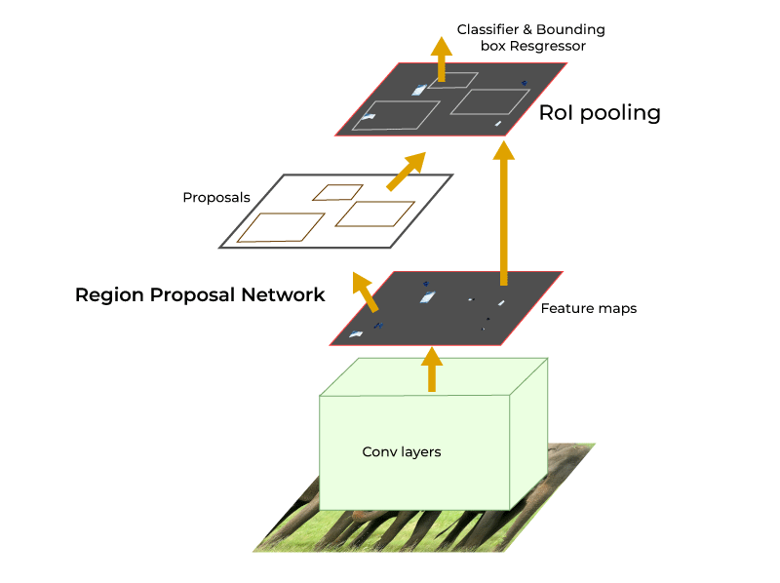
FASTER R-CNN ARCHITECTURE

Slide 14
FASTER R-CNN
Faster R-CNN (Region-based Convolutional Neural Network) is a popular and
powerful object detection framework in the field of computer vision.
Fast R-CNN architectures, aiming to improve both speed and accuracy in object
detection tasks.
The key innovation of Faster R-CNN lies in its integration of a Region Proposal
Network (RPN) with the convolutional neural network (CNN) architecture.
By sharing convolutional features between the region proposal and object
detection tasks, Faster R-CNN achieves significant speed improvements over its
predecessors.

Slide 15
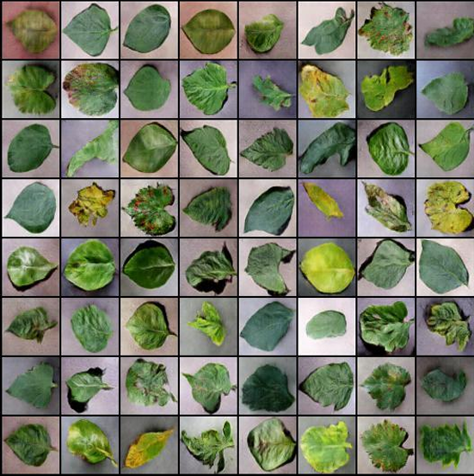
RESULTS AND DISCUSSION
TRAINED IMAGES FOR PLANTS DISEASE DETECTION
These are the images of leaves which are trained by using Faster R-CNN technique
for plant disease detection from reference ./new-plant-diseases-dataset

Slide 16
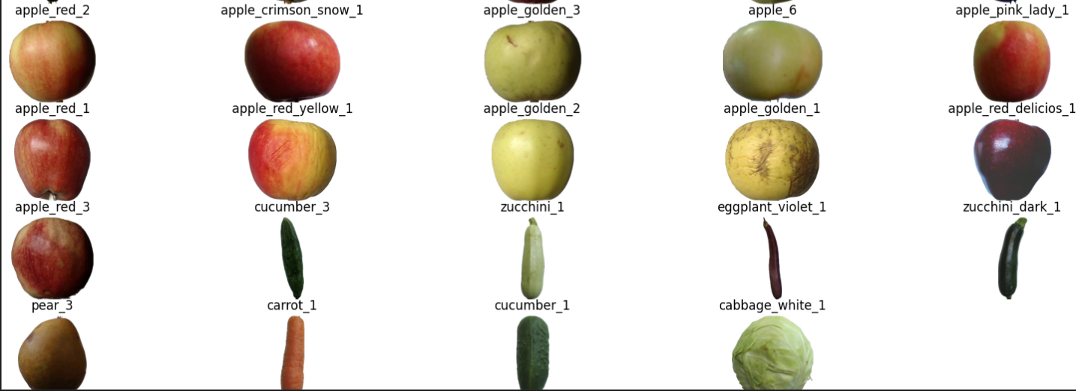
TRAINED IMAGES FOR FRUIT CLASSIFICATION
These are the images of fruits which are trained by using Faster R-CNN technique
for fruit prediction from reference http://bit.ly/kaggle-creds

Slide 17
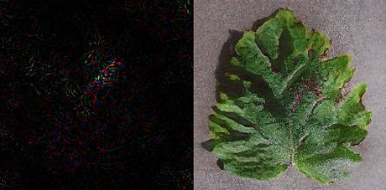
QUALITATIVE RESULTS PLANT DISEASE DETECTION
Fig:1
Fig:2
The second image is the input image which has disease on the leaf.
The disease is detected as “Apple Black rot” after giving the input image.
The disease is detected by using Faster R-CNN technique based on colour.

Slide 18
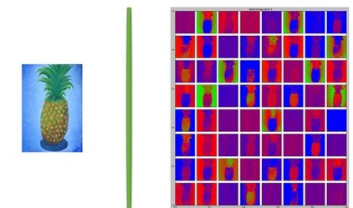
QUALITATIVE RESULTS FOR FRUIT CLASSIFICATION
Fig 3
The input image is identified as a pineapple based on shape, size and color after
the training done by Faster R-CNN technique.

Slide 19
QUANTITATIVE RESULTS FOR PLANT DISEASE DETECTION
Architecture | Accuracy
AlexNet | 0.8124
VGG19 | 0.8275
DenseNet | 0.8390
Faster R-CNN | 0.8653
The Faster R-CNN technique has a parameter called Region Proposal Network
(RPN) which is used detect the different size of images within the same image
and also enhance whether the image is present or not.
Therefore, it doesn’t need any external proposal method to detect the selective
region.
RPN has a specialized and unique architecture in itself like classifier and regressor.
Classifier determines the probability of a proposal having the target object.
Regression regresses the coordinates of the proposals.

Slide 20
QUANTITATIVE RESULTS FOR FRUIT CLASSIFICATION
Architecture | Accuracy
AlexNet | 0.8821
VGG19 | 0.957
DenseNet | 0.9256
Faster R-CNN | 0.9678
The technique Faster R-CNN contains RPN so, it doesn’t require any proposal
methods.
Whereas, remaining techniques need external proposal methods .
So, By using external methods it decreases accuracy.
Therefore, Faster R-CNN has high accuracy compared to remaining techniques.

Slide 21
ACCURACY FOR PLANT DISEASE DETECTION

Slide 22
ACCURACY FOR FRUIT CLASSIFICATION

Slide 23
ADVANTAGES
Early Detection
Resource Efficiency
Quality Control
Disease Management
Customization
Capacity

Slide 24
APPLICATIONS
Agriculture
Food Industry
Environmental Monitoring
Smart Farming
Education and Training
Healthcare

Slide 25
Remote sensing technologies, such as drones and satellite imagery, will continue to be used for large-scale monitoring of plant health and fruit characteristics, providing valuable insights for agricultural management.
Mobile applications for plant disease diagnosis and fruit classification will become more accessible to farmers, empowering them to make informed decisions in the field using their smartphones or tablets.
Continued advancements in imaging technology, artificial intelligence, and data analytics will enhance the accuracy and efficiency of plant disease detection and fruit classification systems
The integration of Internet of Things (IoT) devices with plant monitoring systems will enable real-time data collection and analysis, allowing for proactive management of plant health and fruit quality.
.
FUTURE SCOPE

Slide 26
CONCLUSION
The future of plant disease detection and fruit classification holds great promise, driven by advancements in technology, innovative applications, and a growing emphasis on sustainability in agriculture. The integration of IoT, robotics, and remote sensing will revolutionize agricultural practices, enabling precision farming and proactive management of plant health and fruit quality. Overall, plant disease detection and fruit classification are poised to play a pivotal role in shaping the future of agriculture, enhancing productivity, food security, and environmental sustainability for generations to come.

Slide 27
REFERENCES
[1] Barbedo JGA. Plant disease identification from individual lesions and spots using
deep learning. Biosyst Eng 2019;180:96–107 https://doi.org/10.1016/j.biosystemseng.
2019.02.002
[2] Hossain MS, Al-Hammadi M, Muhammad G. Automatic fruit classification using
deep learning for industrial applications. IEEE Trans Ind Inf 2019;15(2) 10.1109/TII.
2018.2875149.
[3] sofu MM, Er O, Kayacan MC, Cetisli B. Design of an automatic apple sorting system
using machine vision. Comput Electron Agric 2016;127:395–405 http://dx.doi.org/
10.1016/j.compag.2016.06.030
[4] Prange RK. Pre-harvest, harvest and post-harvest strategies for organic production
of fruits and vegetables. Acta Hortic 2012;933:43–50 DOI10.17660/ActaHortic.
2012.933.3.

Slide 28
[5]
Pawar, S. E. ., V. Surana, A. ., Sharma, P. ., & Pujeri, R. . (2023). Fruit Disease Detection and Classification using Machine Learning and Deep Learning Techniques. International Journal of Intelligent Systems and Applications in Engineering, 12(4s), 440–453. Retrieved from https://ijisae.org/index.php/IJISAE/article/view/3805.
[6]
S. B. Ullagaddi, Dr. S.Vishwanadha Raju, “A Review of techniques for Automatic detection and diagnose of mango Pathologies”.
Hadha Afrisal, Muhammad Faris, Guntur Utomo P, Lafiona Grezelda, Indah Soesanti, Mochammad Andri F, “Portable Smart Sorting and Grading Machine for Fruits Using Computer Vision”.
[7]

Slide 29
[8]
Dah-Jye Lee, James K. Archibald and Guangming Xiong, “Rapid Color Grading for Fruit Quality Evaluation Using Direct Color Mapping”.
Akira Mizushima, Renfu Lu. “An image segmentation method for apple sorting and grading using support vector machine and Otsu’s method”
Chandra Sekhar Nandi, Bipan Tudu, Chiranjib Koley. “An Automated Machine Vision Based System for Fruit Sorting and Grading”.
Manisha Bhangea, H.A.Hingoliwala, “Smart Farming: Pomegranate Disease Detection Using Image Processing”
[9]
[10]
[11]

Slide 30
THANK YOU

