Slide 2
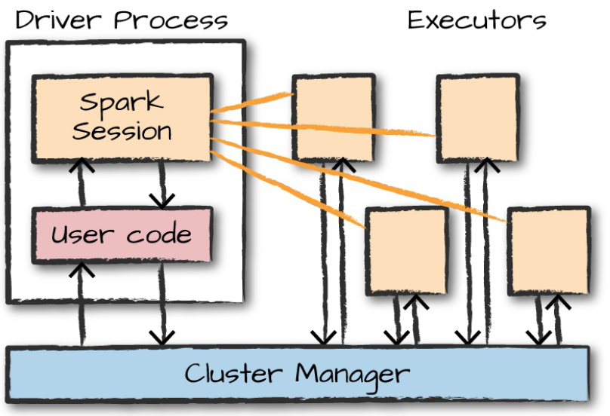
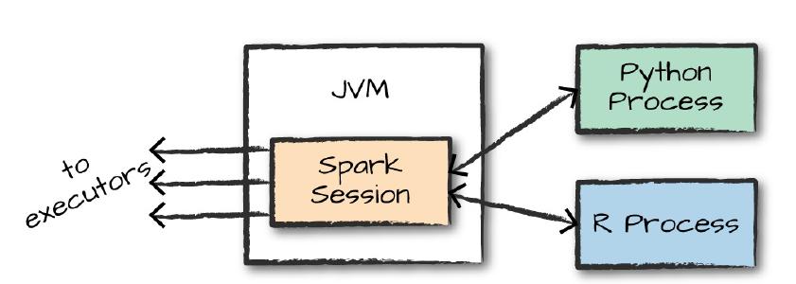
Concepts
Spark application consist of drivers and executors
Driver process runs main and does 3 things
Maintaining information of spark application
Responding to a users program or input
Analyzing, distributing and scheduling work across executors
Executors are the one who does the work that drivers assign them
It does 2 things
Executing code assigned by the driver
Reporting the state of computation back to driver node
Starting Spark
Interactive shell - spark session is created by the shell which manages application. Can run in local mode as well
Spark(2)-submit – used to submit a precompiled application to spark.

Slide 3
Concepts cont.…
SparkSession - You control spark application through driver process, called spark session.
Spark – the output of this will vary based on the programming language used. In case of pyspark it returns pyspark.sql.session.SparkSession
DataFrames –
Most commonly used structured API.
Represents a table of data with rows and columns.
List of columns and the types is called Schema.
It can span across various nodes/computers
Partitions
Spark breaks up the data in to partitions which allows executor to perform tasks in parallel
Partitions represent how the data is physically distributed across cluster of machines during execution
With data frames, you don’t manipulate partitions' manually or individually
Transformation are applied to data and spark takes care of how to execute it on the cluster.

Slide 4
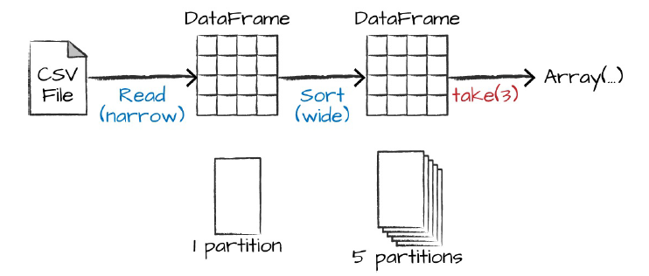
Concepts cont.…
Transformations
Spark will not act on any transformation until an action is called
Transformations are of 2 types – narrow and wide
With narrow transformations, spark will automatically perform an operation called pipe lining i.e. multiple filters are performed in memory
Wide transformation, will have input partitions contributing to many output partitions, also called shuffle. When a shuffle is performed, output is written on to the disk.
Action
Transformation allow to build logical transformation plan and trigger action is used.
Actions are of three kinds
Actions to view data in the console
Actions to collect data to native objects in respective languages – equivalent of load
Actions to write output to data sources - equivalent of save

Slide 5
For linking Jupyter notebook to PySpark
set PYSPARK_DRIVER_PYTHON=jupyter
set PYSPARK_DRIVER_PYTHON_OPTS=notebook
Setting up HIVE
https://hernandezpaul.wordpress.com/2016/01/24/apache-spark-installation-on-windows-10/
winutils.exe chmod 777 \tmp\hive

