Slide 1
A place to try a traffic decision
before you make it
Digital twin of a signalised intersection network
TEAM NEXUS · PROBLEM STATEMENT 4 · IEEE GENESIS 2026

Slide 2
WHY THIS PROBLEM
In India most families do not wait
for an ambulance. They drive.
That happened in my family, with my grandmother.
The car was not slow. The time was lost standing still, at one red
light after another. A ten kilometre drive across this city crosses
eight to twelve signalled junctions.

Slide 3
AND THEN IT HIT A WALL
Not a technical wall. A trust wall.
If you give one vehicle priority, somebody else pays for it in waiting time.
"What will this cost my network?"
Nobody could answer that, because there was nowhere to try it.
So I built the place to try it.

Slide 4
WHAT IT IS
Three things, and only three
1
A twin, not an animation
Real traffic engineering constants. 40 km/h free flow, 2-second headway,
2-second start-up lost time, 1800 PCU/h/lane. Control delay measured the
way the Highway Capacity Manual measures it.
2
You can change it and see what happens
Move a green time, press test. It replays the SAME traffic - same seed,
same vehicles, same arrival times. The difference is the plan, not luck.
3
It prices priority
Every green corridor shows what it saved AND what everyone else paid,
in vehicle-seconds. No deployed system I could find publishes that.

Slide 5
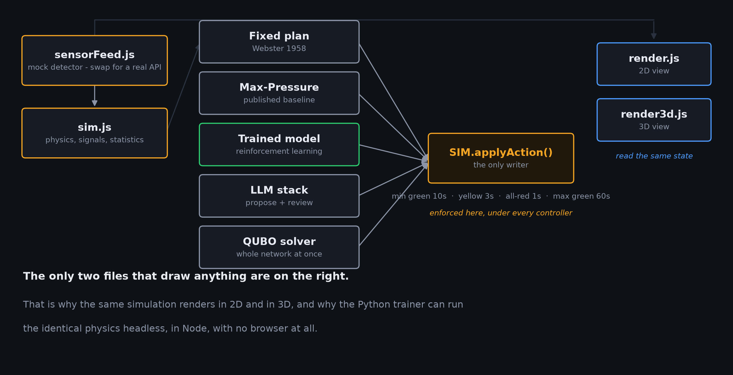
HOW IT IS BUILT
Five controllers. One writer. One safety floor.

Slide 6
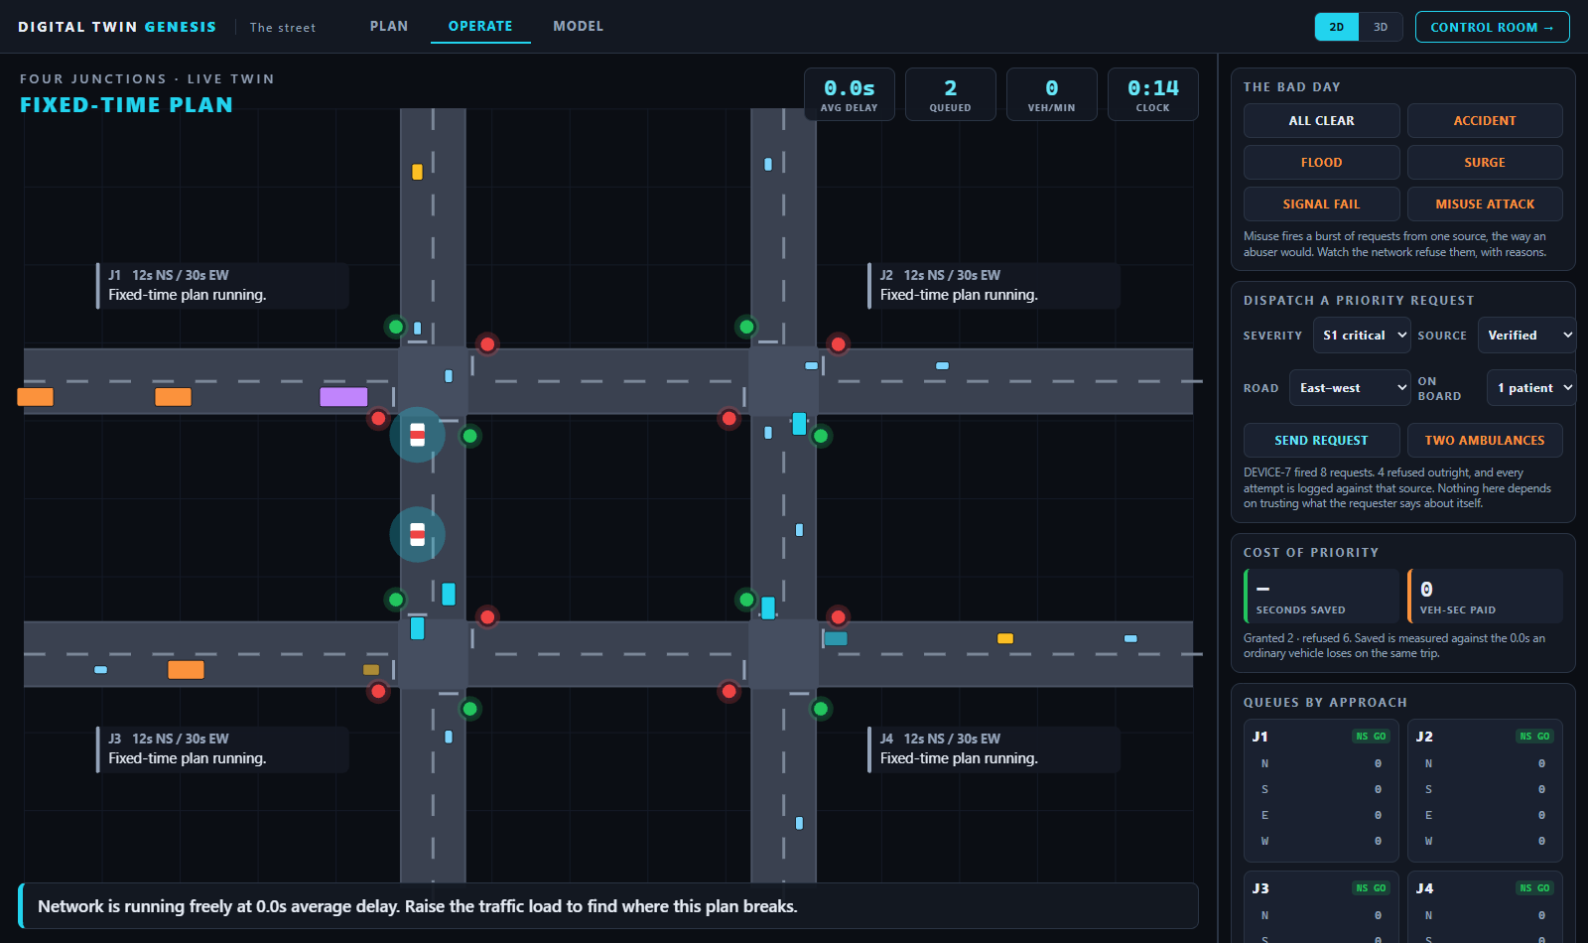
THE DELIVERABLE
Same traffic, twice. So the difference is the plan.
Every test replays a seeded
run of identical traffic.
Change a green time, test it,
and compare against Webster's
1958 minimum-delay cycle -
which is what most Indian
junctions actually run.
The tool is not claiming to have
invented signal timing. It gives
you a way to check whether
your change beats the textbook.

Slide 7
THE IDEA NOBODY ELSE PUBLISHES
Priority has a price. Show it.
Two ambulances, same junction, opposite roads. Both genuine.
Something has to give - and the system prints its own arithmetic for why.
SECONDS SAVED
VEH-SECONDS PAID
by the vehicle granted priority
measured live, on screen, per grant
by everybody else on the network
measured live, on screen, per grant
That second number is the reason a traffic department would ever agree to any of this.

Slide 8
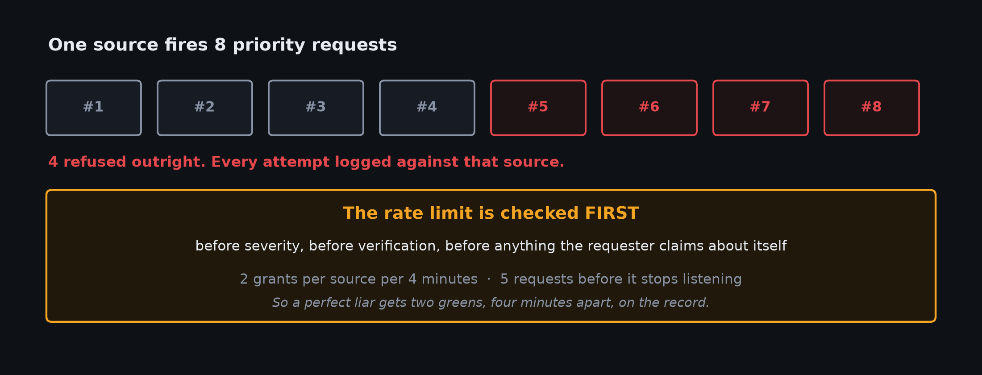
THE QUESTION I WAS ASKED IN ROUND 1
"What if a terrorist misuses the button?"

Slide 9
UNDER THE BONNET
Four things, and what each one is honestly worth
REINFORCEMENT LEARNING
STACKED LANGUAGE MODELS
Trained in Python against this exact
simulator running headless in Node.
Same physics, no second implementation.
A standard DQN never beat the fixed
plan. Monte-Carlo returns did.
One model proposes an action and a
reason. A second call reviews it and
can overrule it.
Underneath both, a local rule decides
when the API is down - and says so.
QUANTUM-READY OPTIMISATION
SUMO VALIDATION
The whole network as one QUBO - the
form a quantum annealer takes.
Solved here classically, and checked
against brute force. Nothing about it
is quantum, and I will not claim it is.
Everything above is my simulator
marking its own homework.
So it was re-run in SUMO on a real
1.71 km Vijayawada corridor imported
from OpenStreetMap, 19 junctions.

Slide 10
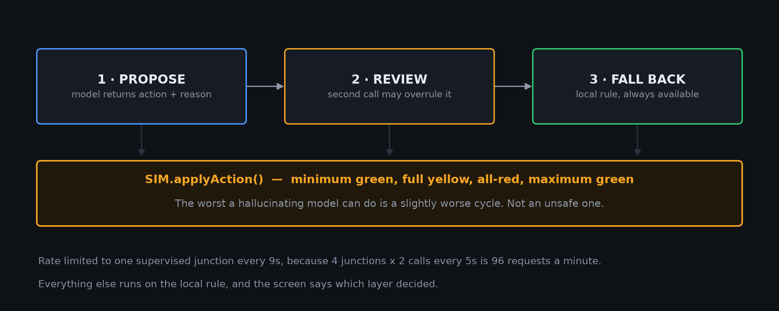
STACKED MODELS, AND THE FLOOR UNDER THEM
A model marking its own homework is worth little.
Marking someone else's is worth something.

Slide 11
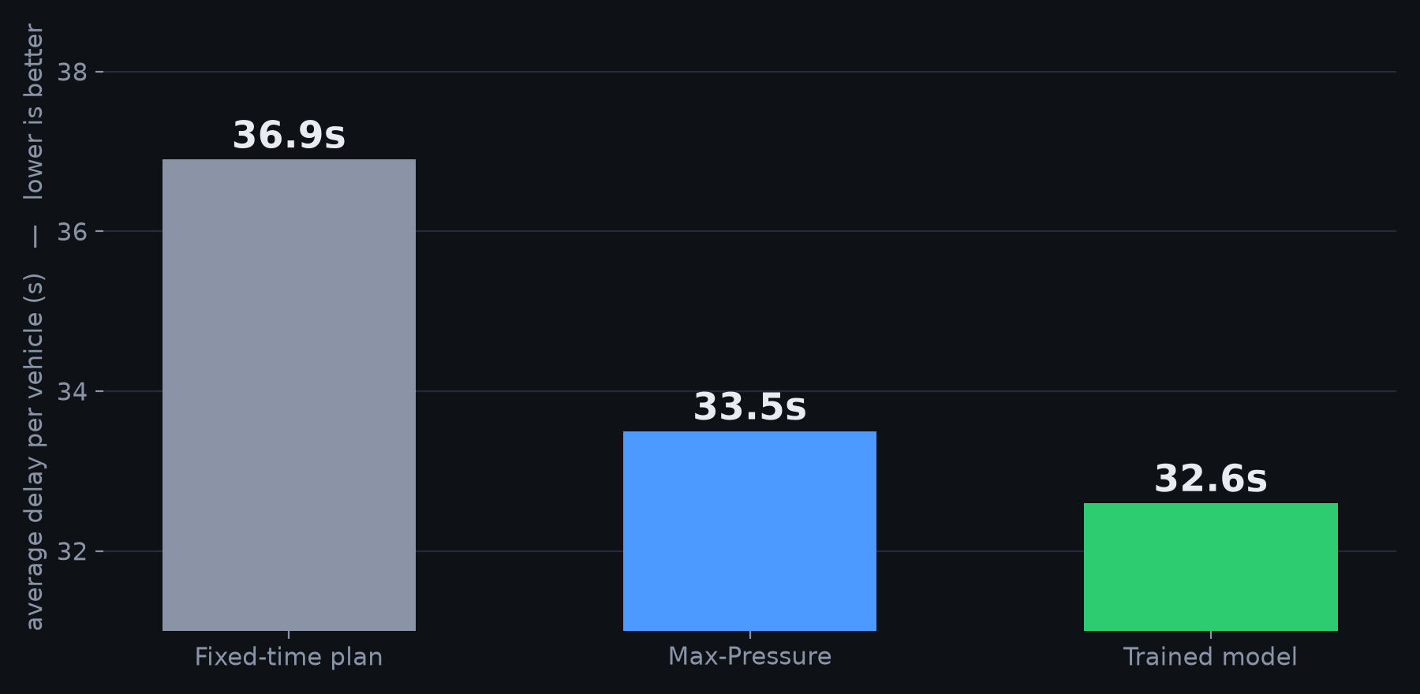
DOES IT ACTUALLY WORK
Four junctions, same seeded traffic
Axis starts at 31s so the gap is visible. Max-Pressure is a genuinely good published controller - beating it by 2.6% is the honest claim, not 10x.

Slide 12
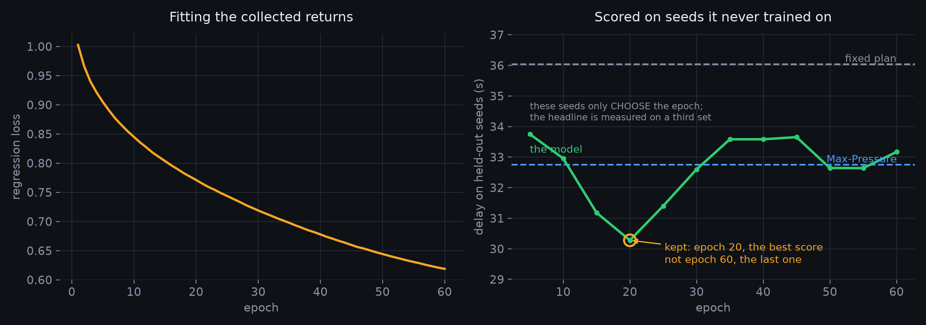
PROOF IT WAS TRAINED, NOT TUNED
The loss falls. So does the held-out score.
Left proves only that the network fits its own labels. Right is the same network scored every five epochs on seeds it was never trained on. It stays under both baselines at every single probe, and it wanders - which is what a real measurement looks like.

Slide 13
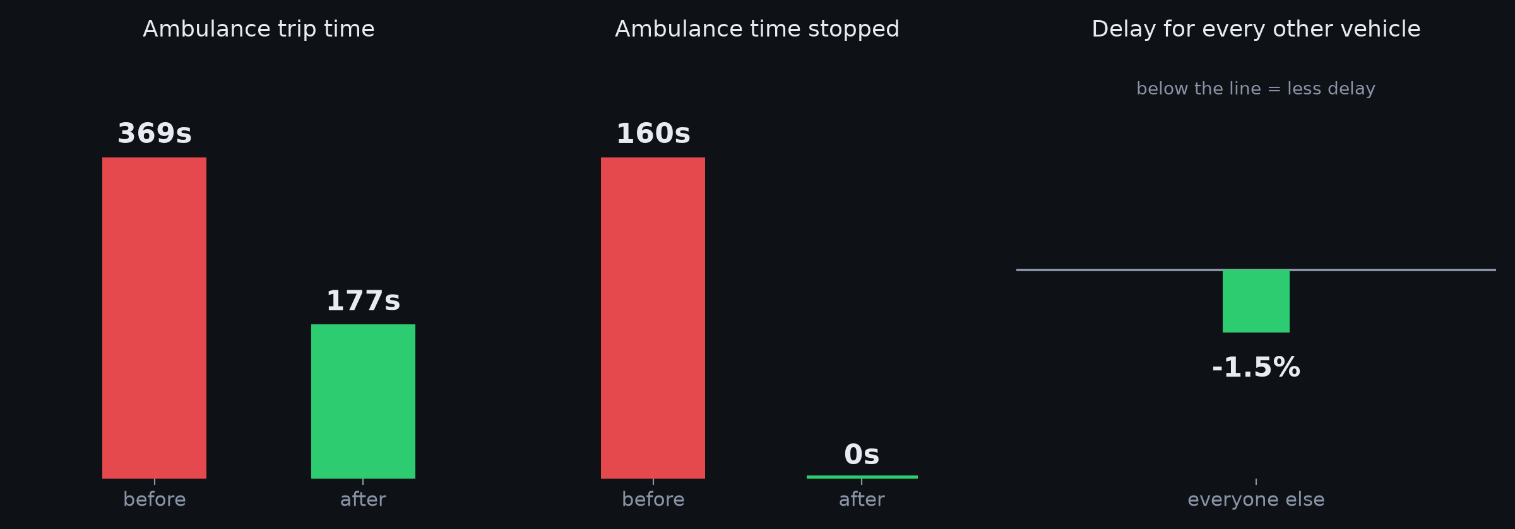
AND ON A REAL ROAD
Vijayawada corridor · 1.71 km · 19 signalised junctions
Imported from OpenStreetMap, simulated in SUMO. The ambulance gains and everyone else does not lose - which is the only version of this that a city would accept.

Slide 14
WHAT IS ALREADY OUT THERE
Adaptive control is not new. I am not pretending it is.
ALREADY DEPLOYED
Bengaluru B-ATCS
~165 junctions, ~33% at Hudson Circle
Pittsburgh Surtrac
~25% travel time reduction
WHAT THEY DO NOT GIVE YOU
Preview a change before deploying it,
on the same traffic
A stated reason for every decision,
in numbers you can check
A published price for granting priority
The narrow true claim beats the broad false one - and a judge can only catch you on the second.

Slide 15
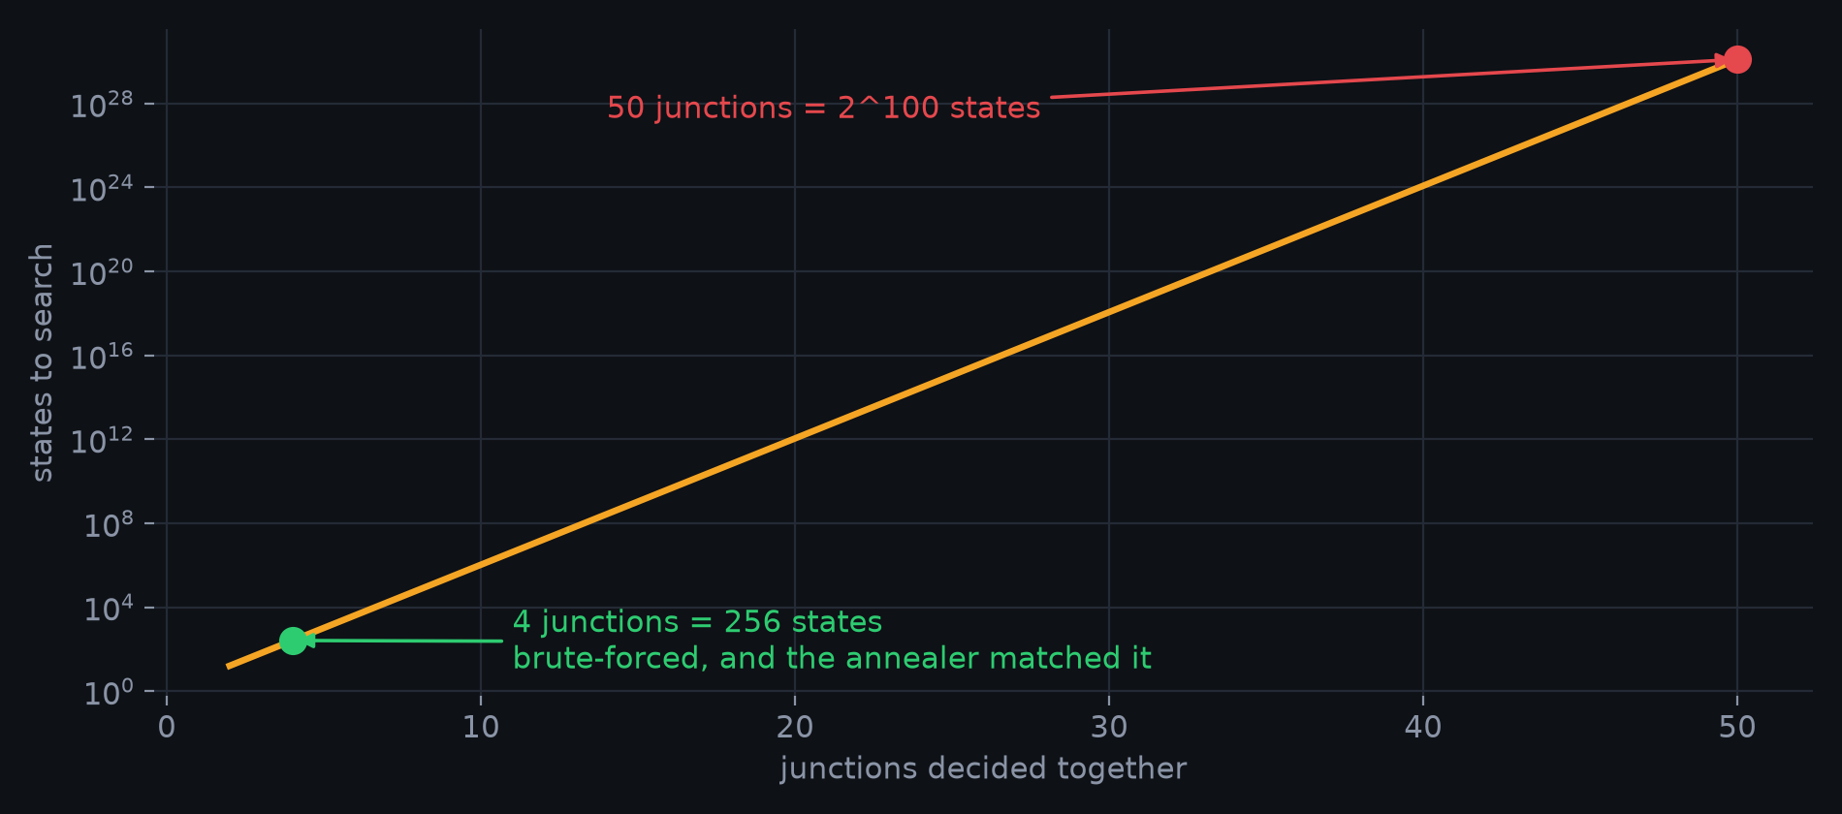
WHAT BREAKS FIRST
Why the QUBO is the interesting part

Slide 16
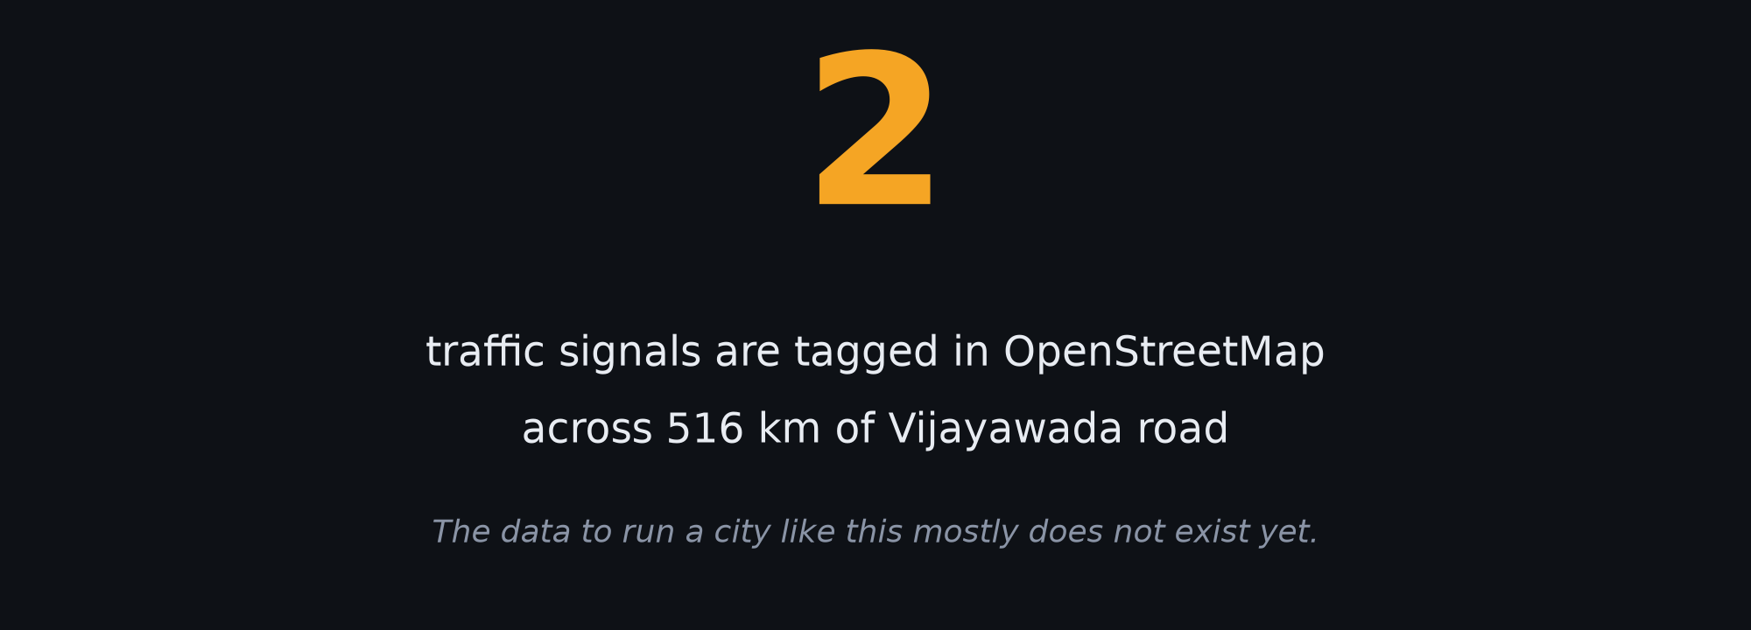
THE THING I DID NOT EXPECT TO FIND
So the first useful thing is not a better algorithm.
It is a place to test decisions before you can afford the sensors.

Slide 17
HOW YOU KNOW IT RUNS
It is tested, not just demoed
21
44
0
simulation assertions
no browser needed
checks driving both pages
in real Chromium
console errors
across the whole run
The browser harness opens both interfaces, clicks through the demo, fires the misuse attack, switches controllers, and fails on any console error or unhandled rejection.
It is the check that stops a demo dying in front of a judge.

Slide 18
Before a city changes a signal,
it should be able to try the change
and see who pays for it.
I built the place to try it.
Ask me anything — including what does not work.

