Slide 1
DEMO RUN SHEET
Read this. Do not improvise.
Amber = what to click. White quotes = what to say.
The clock in the corner is when that block STARTS.
TEAM NEXUS · BEFORE YOU START: run run.bat, open both windows side by side

Slide 2
Point at both windows
0:00
CLICK
SAY
› Nothing to click. Just point.
"Two screens, two jobs.
Left is THE STREET — the digital twin. Four junctions, real traffic engineering numbers. Five vehicle types, because Indian traffic is not all cars.
Right is THE CONTROL ROOM — what an operator sees. It has ZERO physics in it. Everything it knows arrives as a message."
EARNS: UI/UX & USER EXPERIENCE

Slide 3
The story
0:45
CLICK
SAY
› Still nothing to click.
"In India most families do not wait for an ambulance. They drive. That happened in my family, with my grandmother.
The car was not slow. The time was lost standing still, at one red light after another.
It hit a wall that was not technical. It was trust. Give one vehicle a green and somebody else pays for it — and no traffic department will discuss it until you can say what it costs.
Nobody could answer that. So I built the place to try it."
EARNS: REMARKS / PROBLEM-SOLUTION FIT

Slide 4
Change a timing. Prove it is better
1:30
CLICK
SAY
› PLAN tab
"Every test replays identical traffic. Same seed. So the difference is the plan, not luck.
That second one is Webster's minimum-delay cycle, from 1958 — what most Indian junctions actually run.
Most dashboards tell you what IS happening. This one tells you what WOULD happen if you changed something, and what it would cost."
› Point at the SEED number
› N–S GREEN -> 30 E–W GREEN -> 8
› TEST THIS PLAN — 100s
› SUGGEST A PLAN (WEBSTER 1958)
› TEST THIS PLAN — 100s again
EARNS: FUNCTIONALITY & COMPLETENESS ← NEVER CUT THIS

Slide 5
The bad day — one system, two screens
3:00
CLICK
SAY
› OPERATE tab
"A collision at J2 — that approach cannot discharge. And a flooded road: heavy vehicles barred by weight restriction.
The operator's screen did not need telling. THE NETWORK IS DEGRADED, two conditions — and it says what each one MEANS, not just what it is.
That is the difference between a dashboard and a control room."
› ACCIDENT (point at the red X)
› FLOOD
› NOW TURN TO THE CONTROL ROOM
EARNS: FUNCTIONALITY & COMPLETENESS + UI/UX

Slide 6
Two ambulances — decide, then veto
4:30
CLICK
SAY
› ALL CLEAR then TWO AMBULANCES
"Two ambulances, one junction, from adjacent sides. Only one phase can be green. There is no version where nobody waits.
It shows its work in two columns, deliberately not merged. THE CASE — severity, people on board. THE NETWORK — what the trained model values that junction at. The model is a modest adjustment, not an equal term. I will not let it outvote a critical patient.
Default is to ACT. A system that waits for a human to click before an ambulance gets a green has moved the delay, not removed it."
› Point at the two white ambulances
› TURN TO CONTROL ROOM (countdown)
› Click DO NOT PROCEED
› Fire TWO AMBULANCES again — let it run
› Watch a tag flip HELD -> PRIORITY
EARNS: TECHNICAL EXECUTION + UI/UX ← YOUR CENTREPIECE

Slide 7
The model, and the model that checks it
6:30
CLICK
SAY
› MODEL tab
"Reinforcement learning, trained against THIS simulator running headless — same physics, no second implementation to drift.
Fixed plan 36.9s. Max-Pressure 33.5s. This model 32.6s.
And the part that did NOT work: a standard DQN never beat the fixed plan. Monte-Carlo returns did.
One model proposes an action and a reason. A SECOND call reviews it and can overrule it. Under both, a local rule whenever the API is down — and the screen says which layer decided."
› TRAINED MODEL
› LLM AGENT (point at the three layers)
EARNS: TECHNICAL EXECUTION

Slide 8
Quantum-ready, and a real corridor
7:30
CLICK
SAY
› SOLVE THE NETWORK AS A QUBO
"Every controller so far decides one junction at a time. This decides all four at once, written as a QUBO — the exact form a quantum annealer takes as input.
Solved here CLASSICALLY, on this laptop. Nothing about it is quantum. But four junctions is only 256 states, so I brute-forced the optimum and checked the annealer found it. It did. 256 states here — 2^100 for fifty junctions. That is why the formulation matters.
Then re-run in SUMO on 1.71 km of real Vijayawada, 19 junctions: ambulance 369s to 177s, waiting 160s to zero, everyone else 1.5% BETTER."
› (cut this slide first if behind)
EARNS: FEASIBILITY & SCALABILITY

Slide 9
3D
8:30
CLICK
SAY
› Click 3D in the top bar
"Same simulation, two views. Nothing in the physics knows which one you are looking at — only the renderer draws. That is why the 3D view was an afternoon and touched no traffic code.
2D is the one you make decisions in. 3D is the one you show a mayor."
› Orbit once with the mouse
› Click back to 2D
EARNS: UI/UX & USER EXPERIENCE

Slide 10
Close — say it before they do
9:00
CLICK
SAY
› Nothing to click.
"Adaptive signal control is not new and I will not pretend it is. Bengaluru runs B-ATCS on ~165 junctions, ~33% at Hudson Circle. Pittsburgh's Surtrac reports 25.
So my contribution is narrower: you can PREVIEW a change before deploying it, every decision states its REASON in numbers you can check, and priority has a PUBLISHED PRICE.
One thing I did not expect: OpenStreetMap tags exactly TWO traffic signals across 516 km of Vijayawada road.
Before a city changes a signal, it should be able to try the change and see who pays for it. Ask me anything — including what does not work."
EARNS: REMARKS

Slide 11
WHAT IT LOOKS LIKE
The same run, photographed. If a judge missed a click, this is what happened.

Slide 12
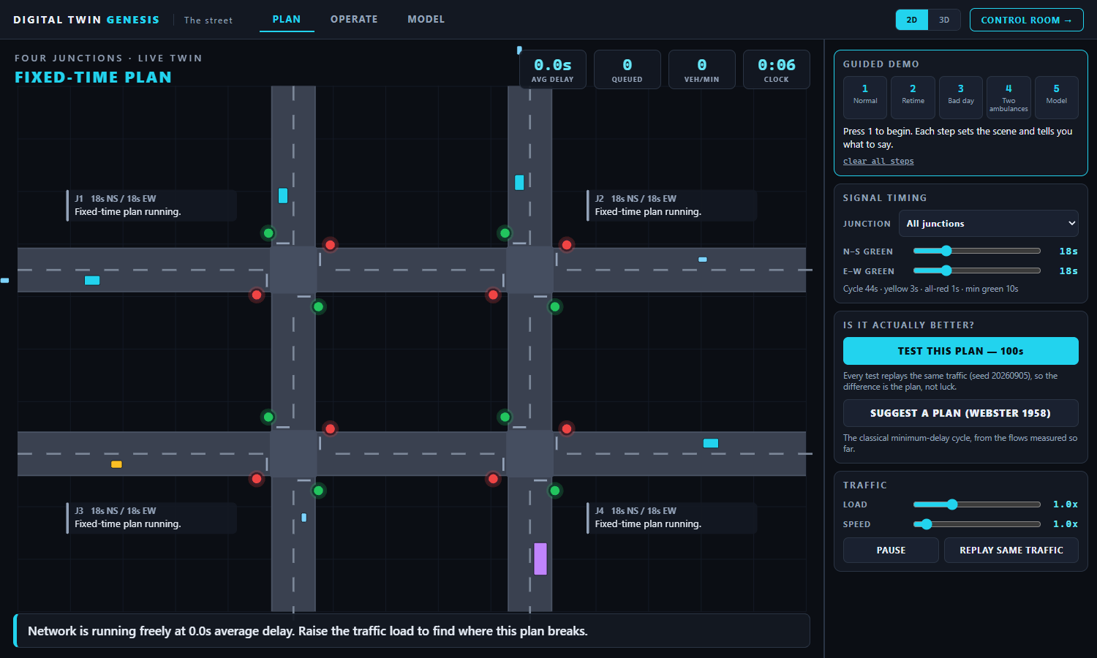
The street, running normally
Four junctions, five vehicle types, live delay and queue counts in the HUD. Every number here is measured from vehicle state, not estimated.

Slide 13
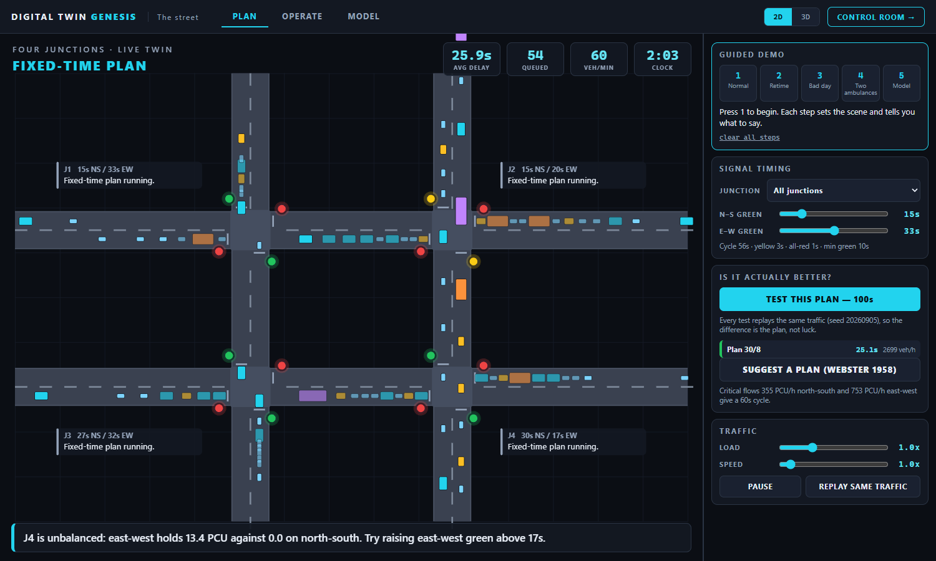
Change the timing — and find out if you were right
Two plans tested on IDENTICAL traffic (same seed). The results table keeps both and marks the better one. This is the deliverable: a planner can try a change before it goes on a real road.

Slide 14
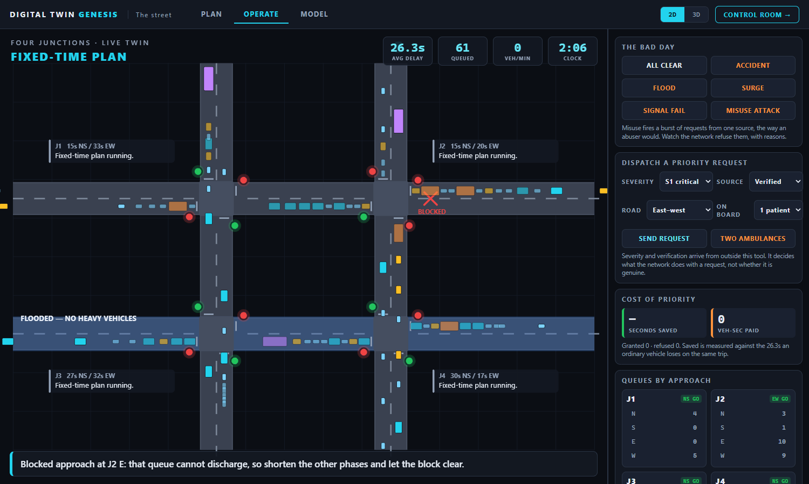
The bad day: a collision and a flooded road
The red X marks the approach that cannot discharge — watch the queue build backwards into it. The blue band is the flooded road: speeds drop and heavy vehicles are barred.

Slide 15
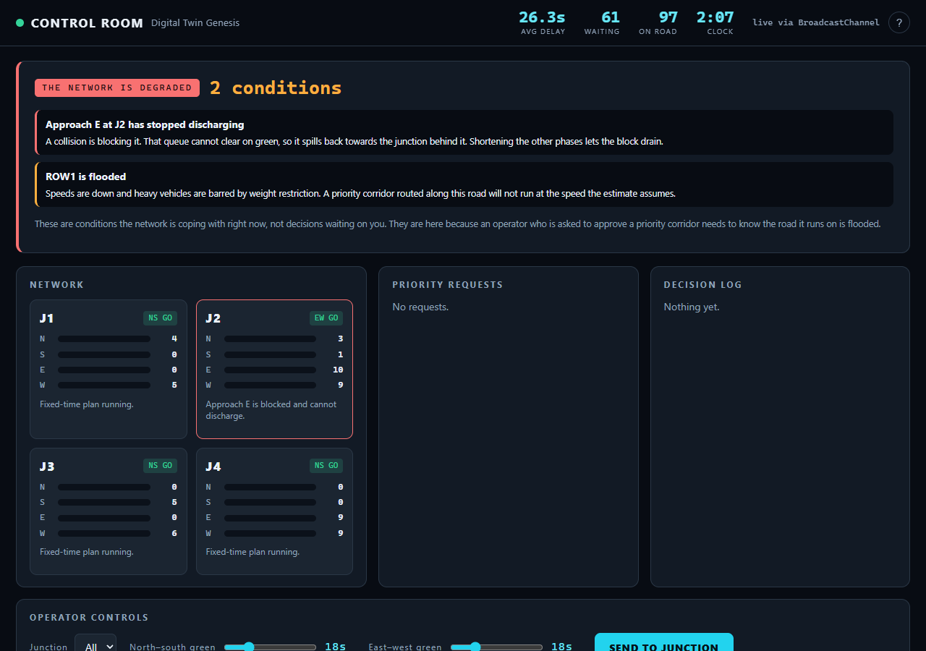
The control room noticed by itself
THE NETWORK IS DEGRADED. Each condition says what it MEANS for the operator, not just what it is — a priority corridor down a flooded road will not run at the speed the estimate assumes.

Slide 16
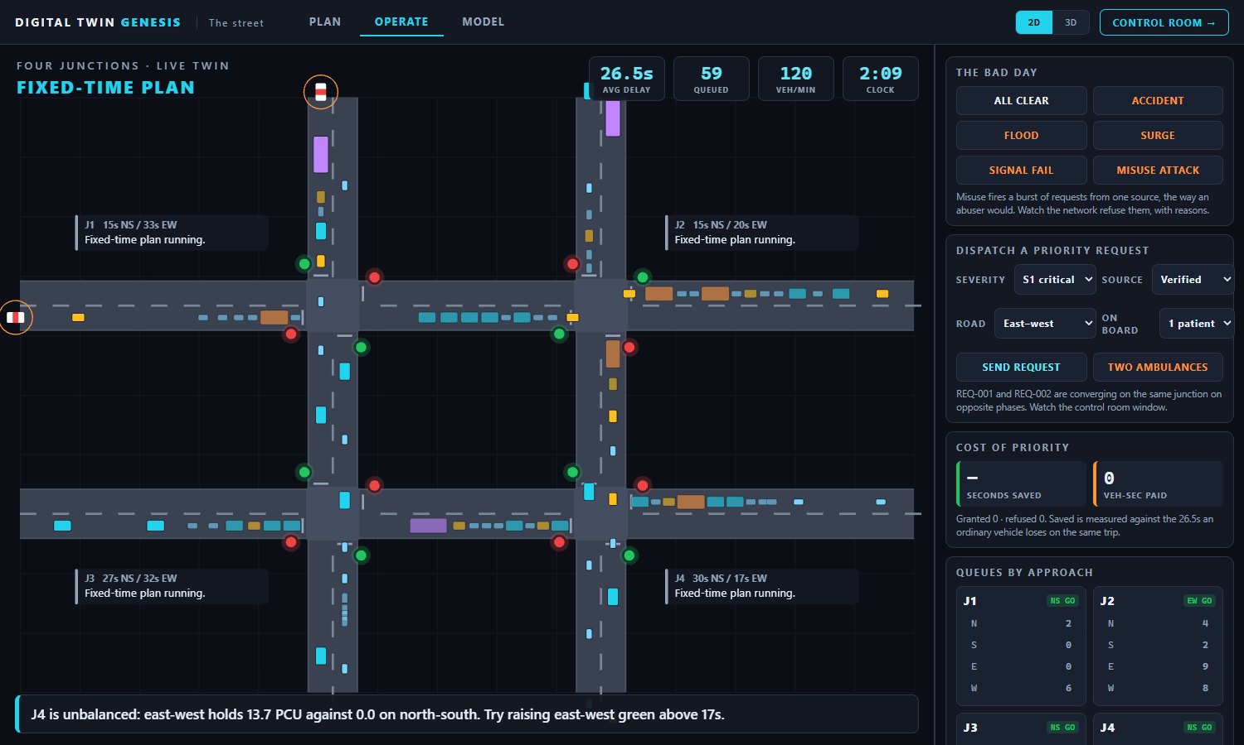
Two ambulances, one junction, adjacent approaches
Both are real vehicles from the moment the calls come in, arriving within a second of each other. Only one phase can be green.

Slide 17
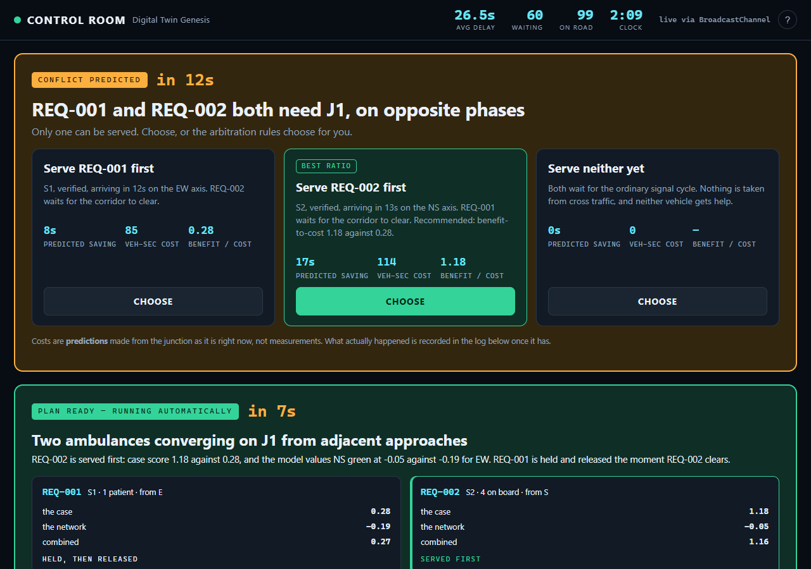
The system decided, showed its work, and can be stopped
THE CASE (severity, people on board) and THE NETWORK (what the trained model values that junction at) are kept in separate columns. It runs on its own in 8 seconds — the operator vetoes, rather than decides.

Slide 18
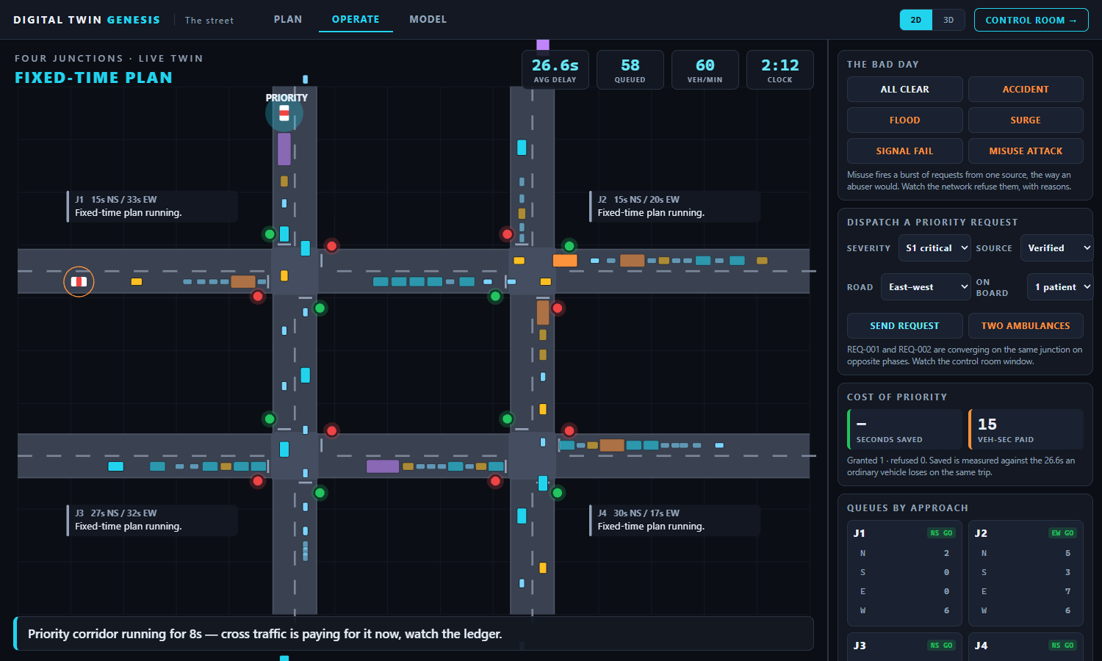
One served, one held — and the price is on screen
The corridor is running. COST OF PRIORITY shows seconds saved for the ambulance AND vehicle-seconds paid by everybody else. No deployed system publishes that second number.

Slide 19
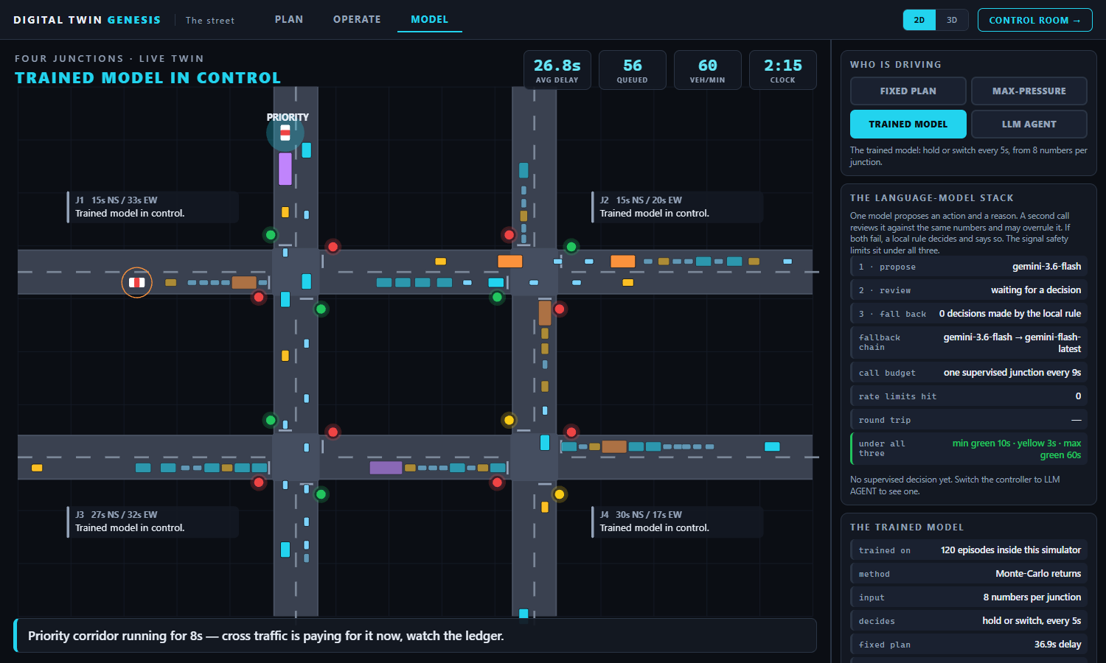
The trained model, the language-model stack, and the QUBO
Held-out benchmark against two baselines, the three-layer model stack with its fallback, and the whole network solved as a QUBO — classically, and checked against brute force.

Slide 20
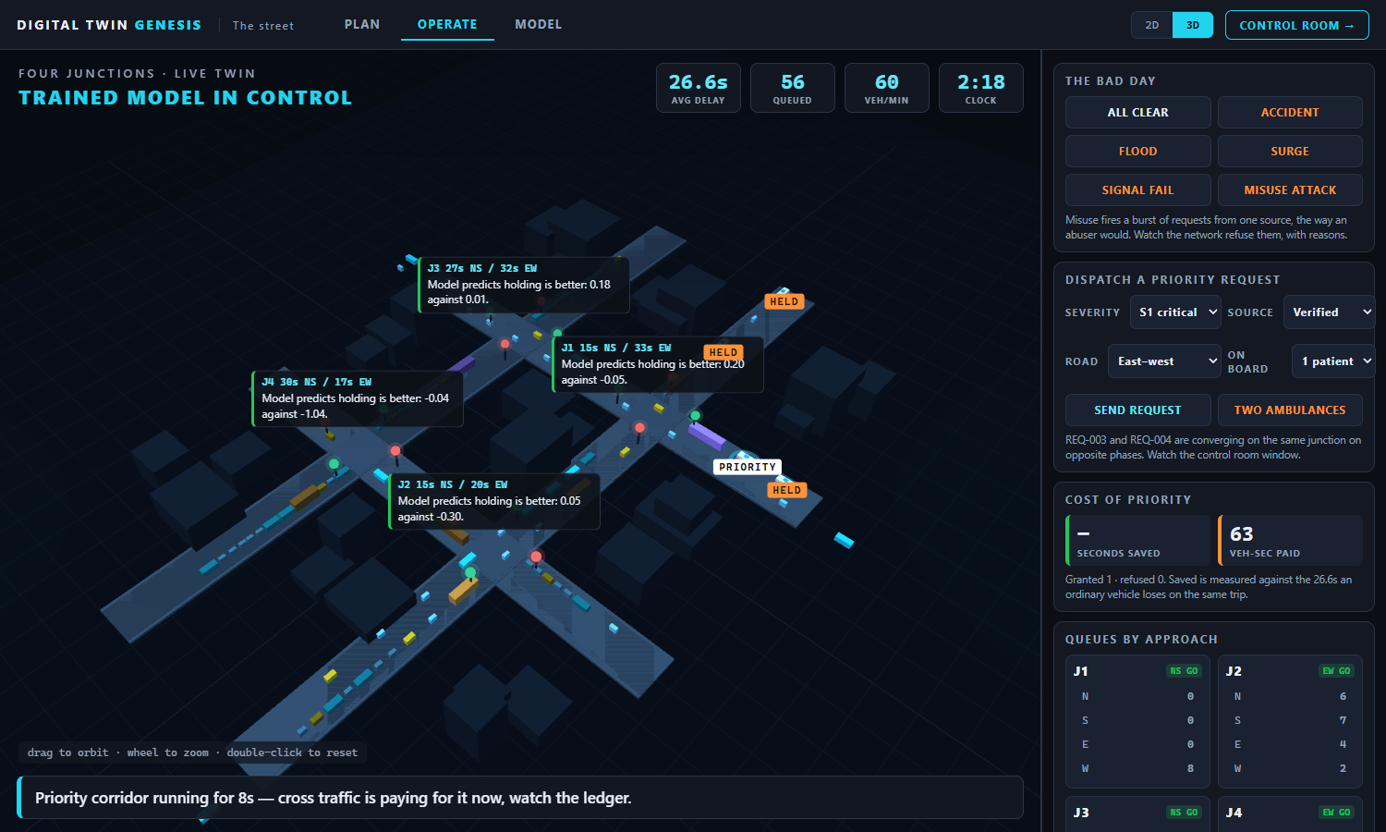
The same simulation, in 3D
Same state, different renderer. Ambulances carry PRIORITY or HELD tags, blocked approaches show as red bars, flooded roads are tinted. Nothing below the renderer changed to make this exist.

Slide 21
Before a city changes a signal,
it should be able to try the change
and see who pays for it.
Ask me anything — including what does not work.

