Slide 1

Sprocket Central Pty Ltd.
Data analytics approach
Name :- Satyavrat Bhisekar

Slide 2
Agenda
The Approach will be Implemented in Following Ways.
Data Exploration
Model Development
Interpretation

Slide 3
Introduction
Approach for New Customer Data Analysis
Existing three data-sets namely as Customer Demographic, Customer Address and Transaction Data.
By Exploring and Analyzing Data sets, We know the High valued Customers.
Which customers placed maximum ordered.
Maximum Number of customers by State.
Age distribution
Max Bike purchase
Customer’s Job industry
Number of cars owned

Slide 4
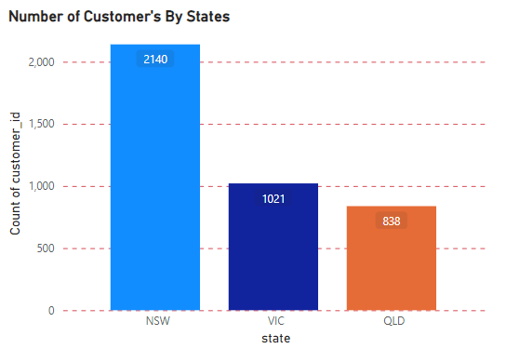
Data Exploration :- Customer’s By State.
Data Shows the Number Customer’s in Each states.
In North South Wales state has 2140 Customers. It is Highest value of Customers.
In Victoria state has 1021 Customers. It is less than North South Wales state Customers.
In QLD state has 838 Customers. The Number of Customer’s is lesser than the North South Wales and Victoria States.

Slide 5
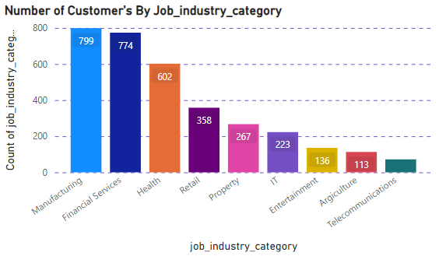
Data Exploration :- Customers By JOB industry.
Data Shows The Number Customers from By their Job industry category
The customers belongs to different industries like Manufacturing, Financial Services, Health, Retail, Property etc.
In Manufacturing industry there are 799 customer.
In Financial Services industry there are 774 customers.
In Health industry there are 602 customers.
In Retail industry there are 358 customers.
And the customers from IT, Entertainment, Agriculture, Telecommunication are lesser than 267.

Slide 6
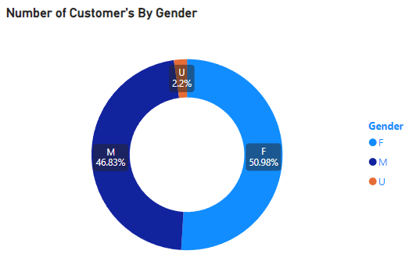
Data Exploration :- Customers By Gender
Data Shows the distribution of customer’s By Gender
The Maximum order taken by Female customer, here 50.98% Female customers has placed an order.
The order taken by Male customer is 46.83%.
And 2.2% customer are undefined.

Slide 7
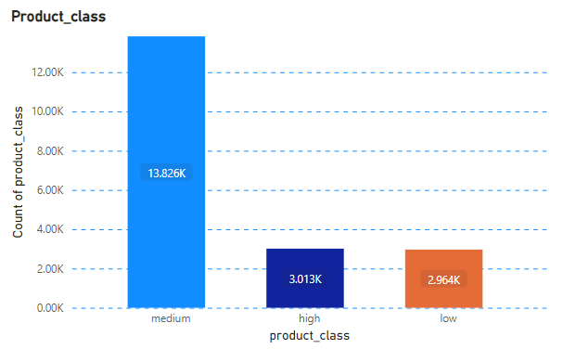
Model Development
Data shows the Maximum sales of product Class
The Maximum sales of medium product class is 13,826 which is a Highest sales.
The Minimum sales of High and Low level product class is 3013 and 2964.

Slide 8
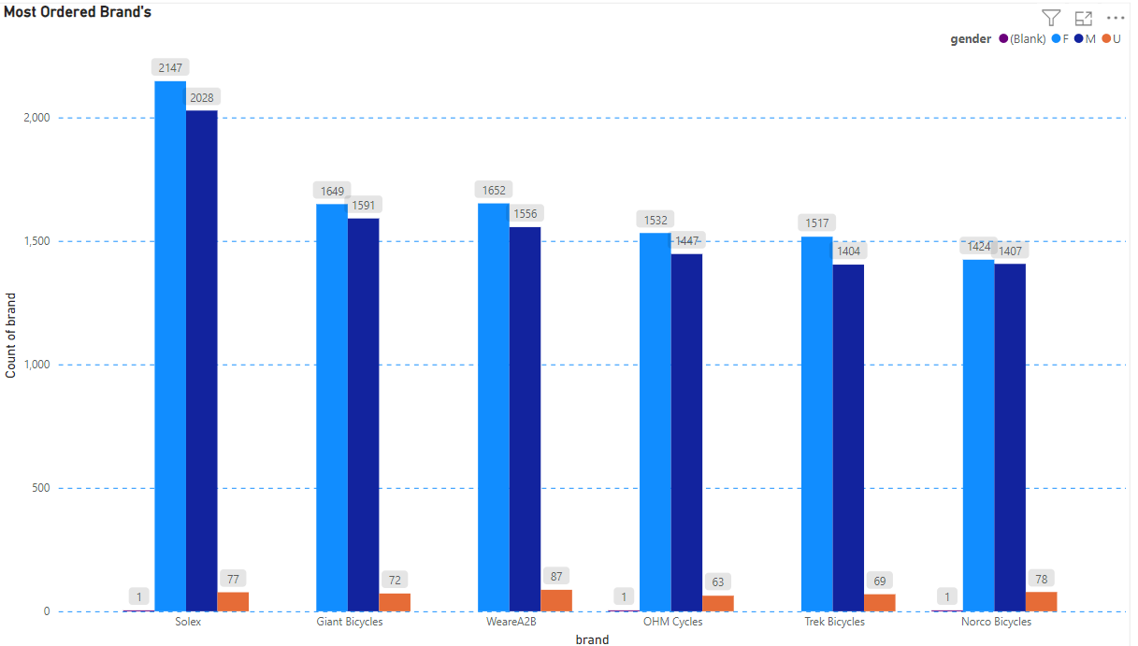
Interpretation :- Most Ordered Brands
Data Shows Most Ordered Brands taken by Female and Male Candidates
The Maximum requirement of brand is Solex brand and order taken by Female – 2147 and Male – 2028.
The Brands ordered by Female and Male cust.
Brand | Female | Male
Giant Bicycles | 1649 | 1591
WeareA2B | 1652 | 1556
OHM Cycles | 1532 | 1447
Trek Bicycles | 1517 | 1404
Norco Bicycles | 1424 | 1407

Slide 9
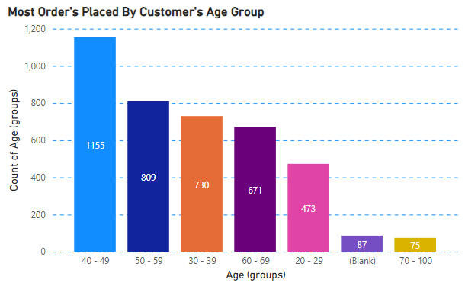
Model Development
We Divide Customer’s with their Age Groups
Customer Are more from 40 – 49 age Groups and Followed by 30 – 39, 50 – 59 age Groups.
Fewer customer are from 20 – 29 and 70-100 for obvious reasons
Age Group | Order Placed
20 – 29 | 473
30 – 39 | 730
40 – 49 | 1155
50 – 59 | 809
60 – 69 | 671
70 – 100 | 73

Slide 10
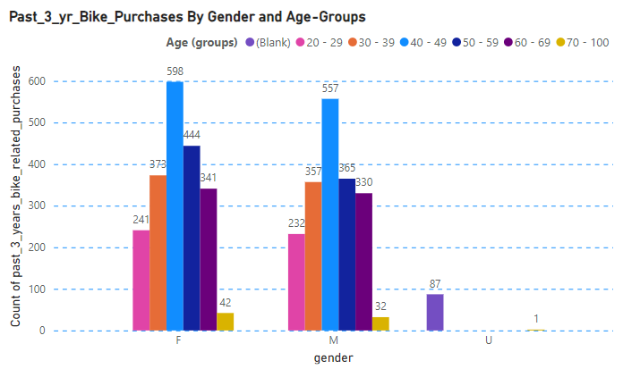
Model Development
Bike Purchases By Age Groups
The valued customers Are Between 40 – 49 Ages and followed by 30 – 39 and 50 – 59 age groups.
Age - Groups | Female | Male
20 – 29 | 241 | 232
30 – 39 | 373 | 375
40 – 49 | 598 | 557
50 – 59 | 444 | 365
60 – 69 | 341 | 330
70 – 100 | 42 | 32

Slide 11
Model Development
Customer Classification -- Targeting High Values Customers
Points for high-value clients to target from the new customer list :
Age Between 40 – 49 and 50 – 59.
High Value customers are female compare to male
Target Customers who working in Manufacturing, Financial Service and Health
Target customers who currently lives in New South Wales and Victoria.

Slide 12
Thank you

