Slide 1
Classify a satellite image using a neural network ensemble and majority rule (ensemble is created by varying the number of hidden layers and hidden nodes) and compare the results with classification using a single neural network.
GNR 602 — Advance Satellite Image Processing
Project by
Neeraj Datar 25M2165
Satyendranath kar 25M0301
Kajal Kumari 25M0325

Slide 2
Problem Statement
What is Pixel-Level Classification?
Class Legend
Assign a class label to every individual pixel in an image — not just the whole image.
Each pixel = one prediction from 6 land-cover categories.
Unlike object detection, no bounding boxes — pure dense labelling.
Building
Land (unpaved)
Road
Why Does It Matter?
Vegetation
Urban planning — detect roads, buildings, vegetation.
Disaster response — identify flooded or damaged areas.
Agriculture — monitor crop health and land use.
Water
Unlabeled
Object

Slide 3
Dataset
Satellite
256×256
70%
7
Dataset
Image Size
Train Split
Classes
Kaggle: Multi-Source Satellite Imagery for Segmentation
Resized for training
20% held for validation and 10% for test
Building, Land, Road,
Veg, Water, Unlabeled and object
Data Structure & Pairing
Each satellite image (.jpg) paired with a colour-coded mask (.png).
Masks encode land-cover with unique RGB colours per class — scanned to build a Look-Up Table.
Pixel sampling: up to 200,000 pixels randomly drawn per image to balance memory and coverage.

Slide 4
System Workflow
Data
Loading
Pre-
processing
Train
Single NN
Train
Ensemble
Compare
Results
GUI
(Streamlit)
Images +
Masks
LUT +
Pixel Sample
MLP 3→8→6→7
ReLU+Softmax
5 MLPs
Diff LR+Seed
Val Acc and Test Acc
Bar Chart
Upload &
Visualize
End-to-end pipeline from raw satellite imagery to interactive web app, comparing a single MLP baseline against a 5-member ensemble using majority voting.

Slide 5
Data Preprocessing
Colour Mapping (LUT)
Image Resizing
Pixel Sampling
Scans all mask files to find unique RGB colours → assigns an integer label per class. Builds a 256³ Look-Up Table (tensor) for O(1) decoding.
All images and masks resized to 256×256. Images: bilinear interpolation. Masks: nearest-neighbour (preserves class boundaries).
Each 256×256 image provides 65536 pixels per epouch. Pixels normalised to [0, 1] (÷255).
70/20/10 Train-Val Split
Class Weighting
Mini-Batch Training
70% of image pairs used for training, 20% held out for validation and 10% held out for test. Split uses fixed seed=42 for reproducibility.
Counts per-class pixel frequency → computes inverse-frequency weights^0.5 to reduce rare-class neglect without over-correcting.
Each image's pixel set is split into mini-batches of 16,384 pixels, enabling Adam optimisation without OOM errors.

Slide 6
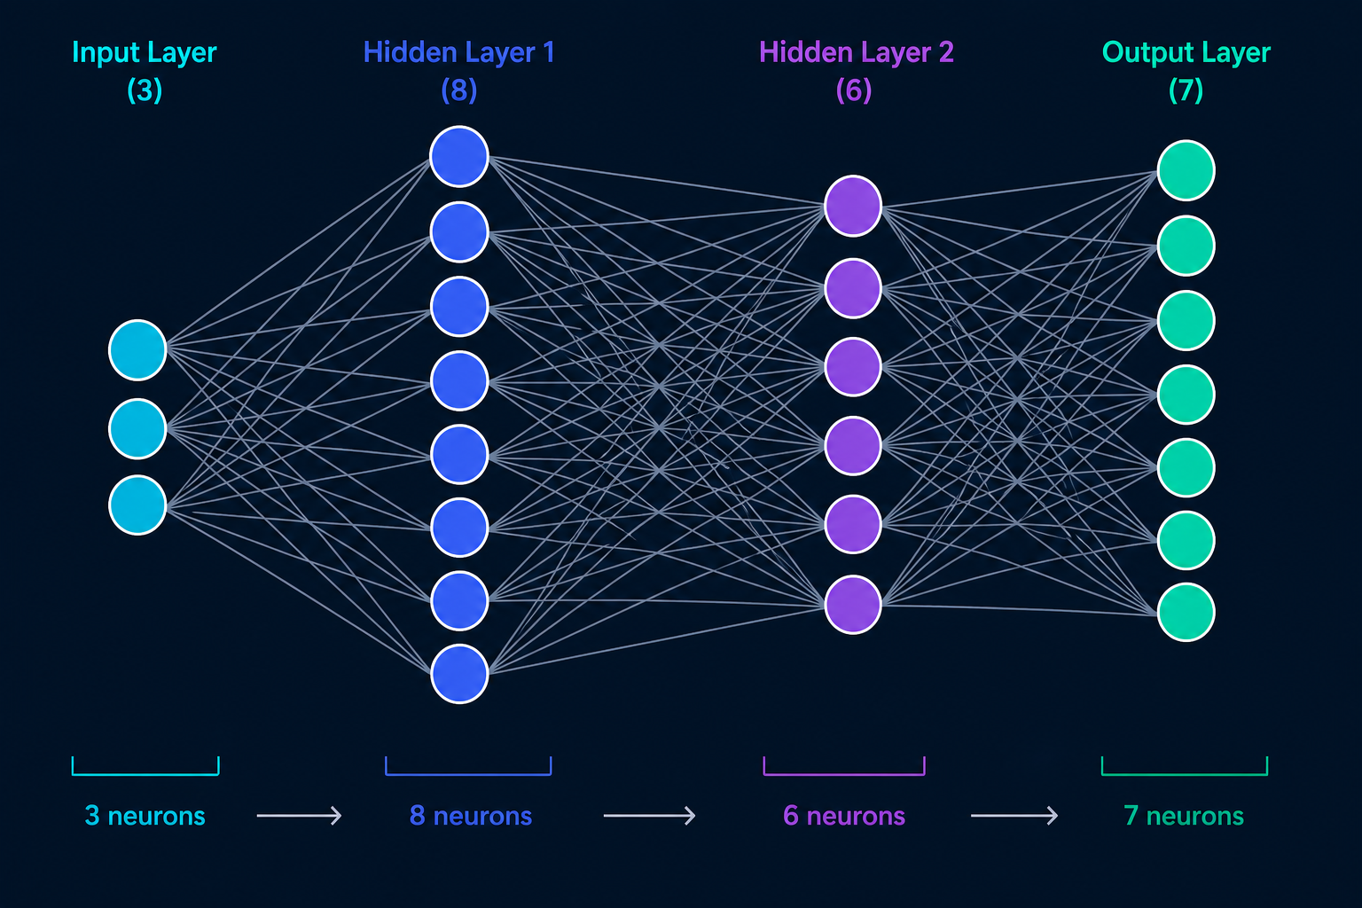
Neural Network Architecture
Single Model Architecture: [3 → 8 → 6 → 7]
Input Layer: 3 neurons — normalised R, G, B pixel values
Hidden Layer 1: 8 neurons with ReLU activation
Hidden Layer 2: 6 neurons with ReLU activation
Output Layer: 7 neurons with Softmax (class probabilities)
Weight Init: He initialisation (std = √2/fan_in)
Input
3 nodes
(R, G, B)
Hidden 1
8 nodes
(ReLU)
Hidden 2
6 nodes
(ReLU)
Output
7 nodes
(Softmax)
Activation: ReLU hidden layers; Softmax output only for inference

Slide 7
Training Pipeline
Optimiser
Loss Function
Learning Rate
Adam (from scratch)
β₁=0.9, β₂=0.999, ε=1e-8
Custom bias-corrected moments
Weighted Cross-Entropy
Logit-stable: log-softmax path
Per-pixel class weights applied
0.0015 (base)
Decayed ×0.90 each epoch
(LR Decay = Exponential)
Grad Clipping
Weight Decay
Epochs
Max norm = 5.0
Prevents exploding gradients
Clip before Adam update
1e-4 (L2 reg)
Added to gradient before
moment updates
15 (max)
Early stopping: patience=4
Best epoch weights saved
Mini-batch size: 16,384 pixels | Seed: 42 for reproducibility | Device: CUDA if available

Slide 8
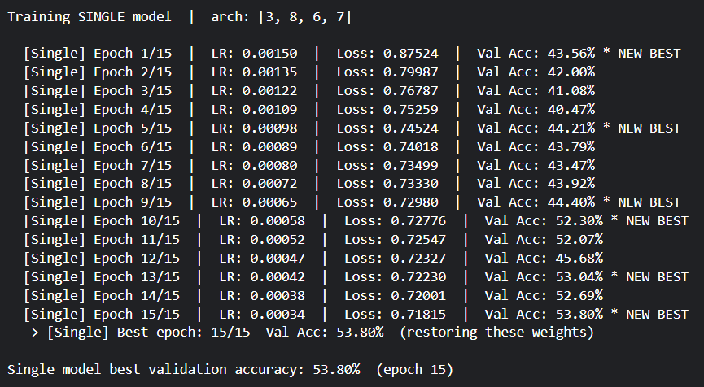
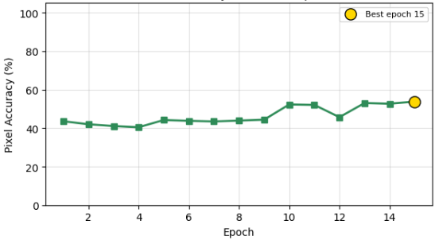
Best Epoch & Early Stopping
How Best-Epoch Checkpointing Works
After each epoch, validation accuracy is computed.
If it exceeds the previous best, model weights are saved (checkpoint).
Early stopping: if no improvement for 4 consecutive epochs, training halts.
Final model = weights from the best validation epoch (not the last epoch).
Why Early Stopping?
Prevents overfitting. The model may start memorising training pixels, hurting generalisation. Stopping at peak val accuracy ensures the best generalising weights are kept.
Best epoch = peak of the curve → weights saved here

Slide 9
Ensemble Design
Why Ensemble?
Combining multiple diverse models reduces variance and bias compared to any single model. Diversity is the key — each member makes different errors.
Member | Architecture | Hidden Layers | Hidden Nodes | Learning Rate
M1 | [3 → 8 → 7] | 1 | 8 | 0.00150
M2 | [3 → 11 → 7] | 1 | 11 | 0.00105
M3 | [3 → 8 → 5 → 7] | 2 | 8,5 | 0.00180
M4 | [3 → 12 → 7] | 1 | 12 | 0.001275
M5 | [3 → 5 → 4 → 7] | 2 | 5,4 | 0.00165
Diversity strategy: varying hidden-layer count, node count, learning rate, and random seed across members

Slide 10
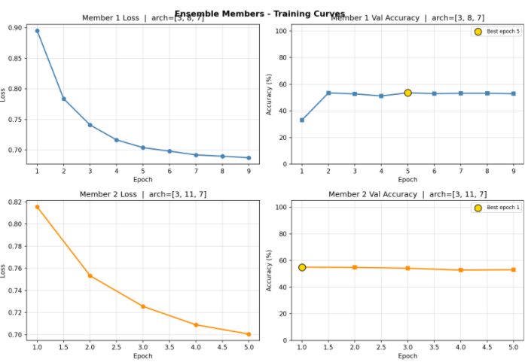
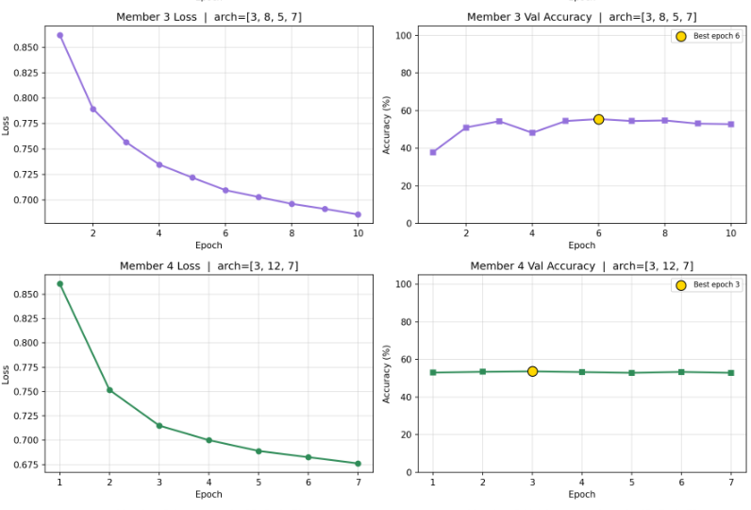
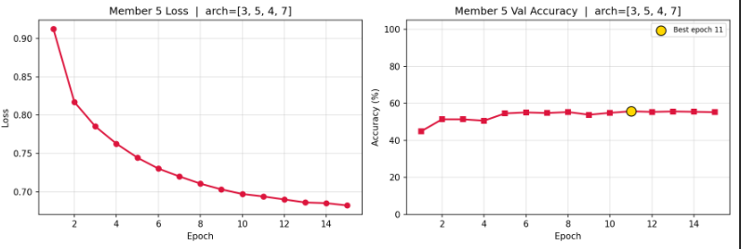
Ensemble Training

Slide 11
Majority Voting
How Voting Works
M1
Building
Each pixel is independently classified by all 5 ensemble members.
The predicted class from each member is collected into a vote.
PyTorch torch.mode() selects the class receiving the most votes.
Ties are impossible: 5 members = always an odd number → guaranteed majority.
M2
Veg
M3
Building
Building
(3/5 votes)
M4
Building
Why Odd Number of Members?
An even number of classifiers can produce tied votes (e.g. 2 vs 2). An odd count (5 here) eliminates ties completely — one class always gets ≥3 votes.
M5
Veg

Slide 12
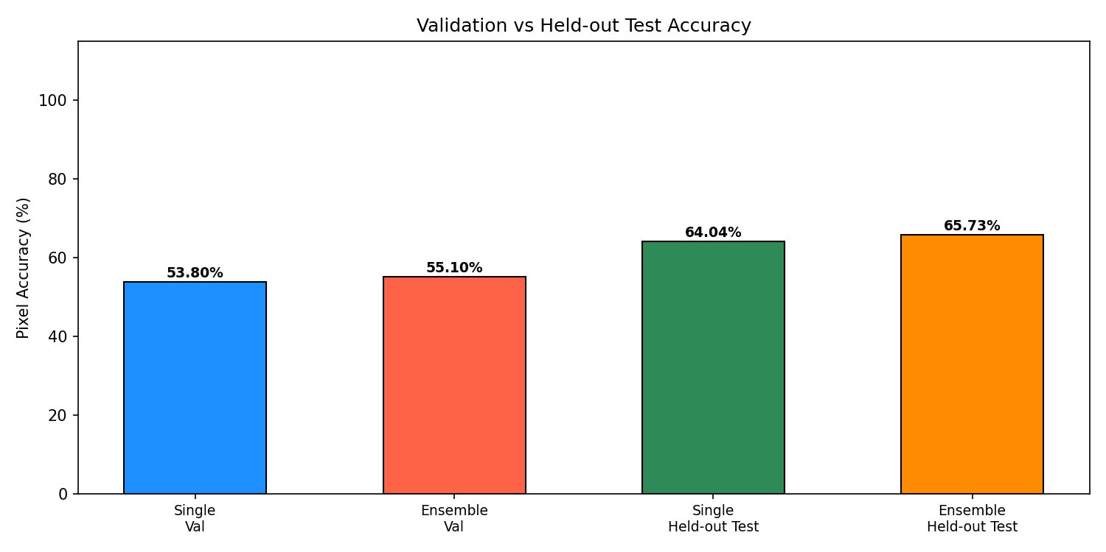
Results — Accuracy Comparison
Key Takeaway: Ensemble majority voting achieves the highest pixel accuracy, outperforming both the single model and all individual ensemble members.

Slide 13
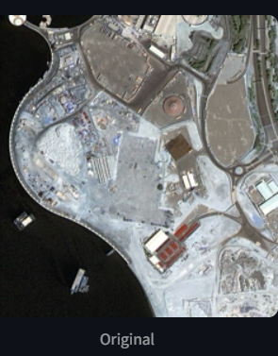
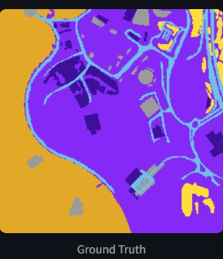
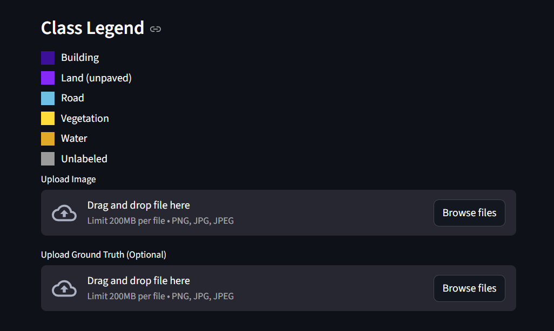
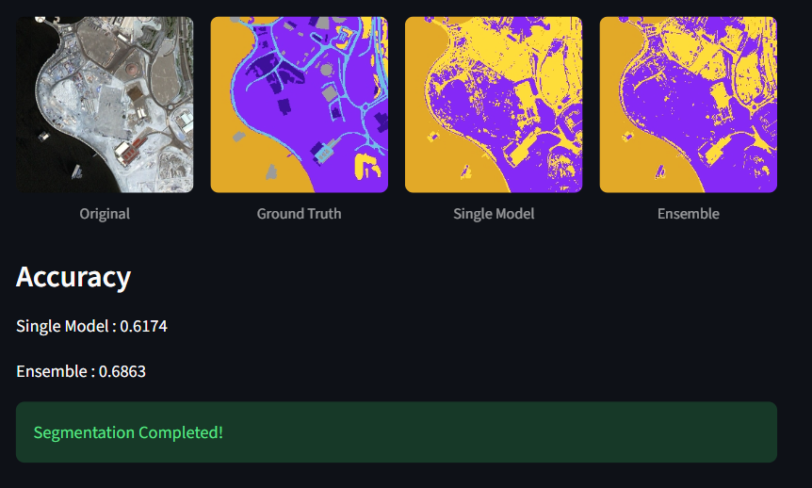
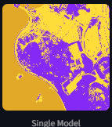
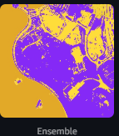
Results — Visual Comparison

Slide 14
User Interface — Streamlit App
Built with Streamlit | Runs at localhost:8501
Upload Satellite Image
Upload Ground Truth (Optional)
User uploads a PNG/JPG/JPEG satellite image (up to 200MB). Drag-and-drop or Browse files.
User can optionally upload the corresponding mask for quantitative comparison.
Single vs Ensemble Toggle
Class Legend Display
Select which model(s) to run — single MLP, individual ensemble members, or full majority-vote ensemble.
Colour-coded legend shown for all 6 land-cover classes: Building, Land, Road, Vegetation, Water, Unlabeled.
Visual Output
Accuracy Metrics
Input | Ground Truth | Single Prediction | Ensemble Prediction shown side-by-side in a 4-panel view.
If ground truth is uploaded: Overall Accuracy.

Slide 15
Libraries & Original Code
External Libraries Used
Written from Scratch (No ML Libraries)
PyTorch — Tensor ops, autograd, device management
MLP weight initialisation (He init)
NumPy — Array ops, pixel sampling, confusion matrix
Forward pass with ReLU & Softmax
Logit-stable Cross-Entropy loss
Pillow (PIL) — Image loading, resizing, RGB conversion
Adam optimiser (all moments from scratch)
Matplotlib — Training curves, accuracy bar charts
Gradient clipping & L2 weight decay
Streamlit — Interactive web GUI for inference
LR decay schedule
Pickle — Saving/loading trained model weights
Best-epoch checkpointing
Colour mapping & Look-Up Table (LUT)
Pixel-level accuracy metrics (OA)
Ensemble majority vote via torch.mode()

Slide 16
Conclusion & Future Work
✅ Ensemble majority voting outperforms the single MLP baseline on pixel accuracy.
✅ All components (Adam, cross-entropy, backprop) implemented from scratch.
✅ Best-epoch checkpointing + early stopping prevents overfitting effectively.
✅ Streamlit GUI makes the pipeline accessible without code knowledge.
Future Improvements
Deeper architectures (CNNs or U-Net) for spatial context
More ensemble members for further accuracy gains
Data augmentation to improve generalisation
Confusion-matrix visualisation in the GUI

