Slide 1
MACHINE LEARNING · ACADEMIC ANALYTICS
Student Performance Prediction System
Predicting final academic performance from behavioural and demographic signals — deliberately without prior-term grades, so the model is useful at the start of a term, not the end.
AIML Summer Internship 2026
IIHMF, MNNIT Allahabad, Prayagraj · Capstone Project 1
Regression · UCI Student Performance Dataset · Streamlit Deployment

Slide 2
THE PROBLEM
Grades predicted too late aren't
an early-warning system
A term, on a timeline
Most academic-performance models use mid-term grades (G1, G2) to predict the final grade (G3). That's a shortcut, not a solution: by the time mid-term grades exist, the term is already half over. The prediction confirms what a teacher could already see — it doesn't give them time to act.
This model
predicts here
Conventional
models predict here
Term
Starts
G1
G2
G3
This project
Deliberately excludes G1/G2, and predicts G3 using only behavioural, family, and demographic signals available on day one — a harder problem, but a genuinely usable one.
2 / 12

Slide 3
OBJECTIVES
What the system needed to do
01
02
03
04
Predict without shortcuts
Surface the real drivers
Compare, don't guess
Ship something usable
Forecast final grade (G3) using only baseline behavioural and demographic variables — no G1/G2.
Identify which leading factors — failures, absences, study habits — most affect outcomes.
Train and evaluate seven regression algorithms rather than settling on the first one that runs.
Deploy the final model behind a live Streamlit form for direct, non-technical use.
3 / 12

Slide 4
DATASET
UCI Student Performance Dataset
Cortez & Silva (2008) · Math course · Two Portuguese secondary schools
395
33
0
G1 / G2
students
(rows)
raw attributes
collected
missing values
or duplicates
excluded
by design
Feature categories
Demographics
Family Background
age, sex, address, family size
parental education & occupation, cohabitation
Academic History
Lifestyle
study time, past failures, school support
free time, social outings, alcohol use, health
Why G1/G2 are excluded: both correlate extremely strongly with G3 (r ≈ 0.80–0.90) but only exist mid-term — using them would defeat the point of an early-warning system.
4 / 12

Slide 5
METHODOLOGY
The end-to-end pipeline
1
2
3
4
5
6
7
Clean
Explore
Engineer
Split
Train
Tune
Deploy
Outliers, encoding,
leakage removal
Univariate, bivariate
& correlation analysis
Composite features,
importance-based selection
80 / 20 train-test,
5-fold CV
7 regression
algorithms compared
GridSearchCV on the
best candidate
Live Streamlit
application
Documentation-first engineering
Every stage is backed by a running project log — project scope, a phase-by-phase task tracker, an engineering decision log (with rejected alternatives), and an issue log — so nothing gets decided by intuition alone.
5 / 12

Slide 6
PREPROCESSING
Getting the data model-ready
Outlier Capping
Encoding
`absences` winsorized at the IQR upper bound (20 days) rather than dropped — keeps all 395 records intact.
Binary yes/no & binary-nominal columns mapped to 0/1; true multi-category columns (job, reason, guardian) one-hot encoded.
15 students affected
17 categorical columns
Leakage Removal
Scaling — Deferred
G1 and G2 dropped from the feature set at the earliest stage — before EDA, before feature engineering.
StandardScaler is fit only inside the training pipeline, never on the full dataset — avoids leaking test-set statistics into training.
by design, not an afterthought
correctness over convenience
6 / 12

Slide 7
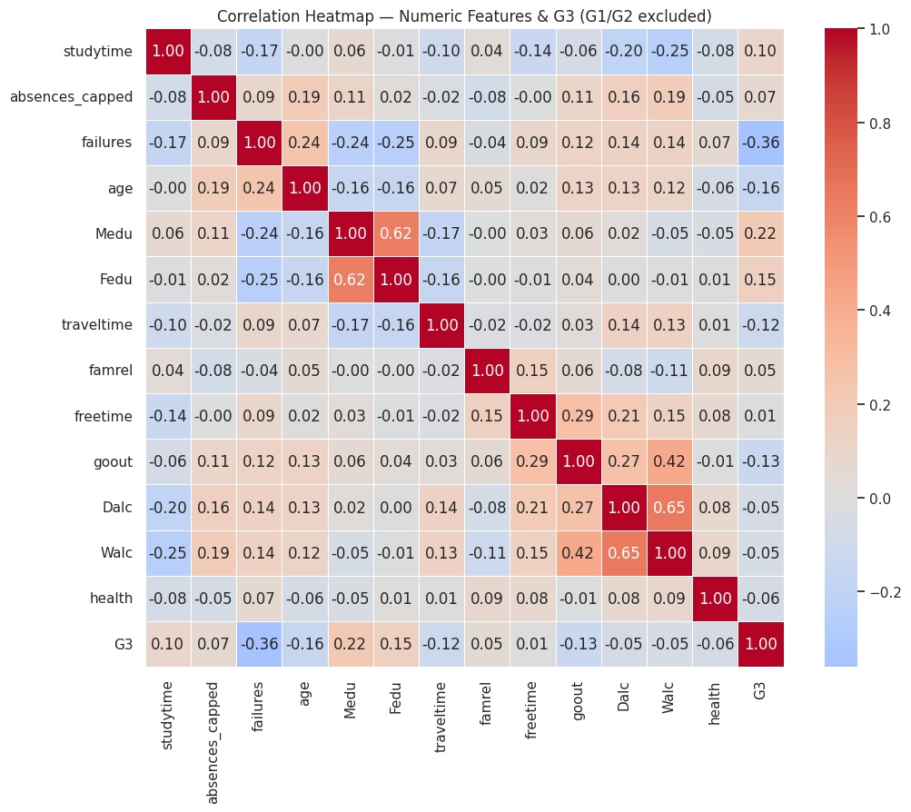
EXPLORATORY DATA ANALYSIS
What the data actually shows
Random Forest feature importance (top 8)
The surprise in this phase
`absences` has almost no linear correlation with G3 (r ≈ 0.03) — yet it's the single most important feature by Random Forest importance. Its effect is non-linear, not absent.
Correlation heatmap — numeric features vs G3 (G1/G2 excluded)
7 / 12

Slide 8
MODELING
Seven algorithms, one fair comparison
Evaluation protocol
Linear Regression
Ridge Regression
Lasso Regression
Decision Tree
• 80/20 train-test split
• 5-fold cross-validation
• GridSearchCV tuning on the best candidate
• Scaler fit on train fold only
Interpretable baseline
L2-regularized linear
L1-regularized, sparse
Single, transparent tree
Random Forest
Gradient Boosting
XGBoost
Bagged tree ensemble
Sequential boosted trees
Optimized gradient boosting
Why train seven models instead of one
With G1/G2 excluded, no single feature dominates — the strongest remaining predictor (`failures`) explains only a fraction of the variance. A fair comparison across linear, regularized, tree, and boosted models was necessary to find the best fit for a genuinely weak-signal problem, rather than assuming one algorithm would obviously win.
8 / 12

Slide 9
RESULTS
How the models actually performed
FINAL DEPLOYED MODEL
XGBoost Regressor
Tuned via GridSearchCV — n_estimators=50, max_depth=4, learning_rate=0.05, subsample=0.8
3.20
3.93
0.247
MAE
RMSE
R²
Tuning improved untuned XGBoost's test R² from 0.238 to 0.247 — a modest but real gain from a focused hyperparameter search.
Random Forest and Gradient Boosting led the untuned comparison; XGBoost was carried forward for tuning and deployment.
9 / 12

Slide 10
LIVE DEMO
From form input to prediction, instantly
Student Performance Predictor
TRY IT LIVE
studentperformanceprediction
-kbnar9atvbm9bfjbzrzrsa.streamlit.app
PREDICTION RESULT
13.4 / 20
Pass threshold met
What happens on submit
1
Form values are assembled into the same 28-feature layout used in training
0 10 (pass) 20
Age
17
2
The saved pipeline (scaler + tuned XGBoost) runs prediction in-process
Weekly study time
2 (2–5h)
Output is clipped to the valid 0–20 grade range and shown with a pass/warning badge
3
Past class failures
0
Absences
4 days
Wants higher education
Yes
Family relationship quality
4 / 5
Illustrative preview, rebuilt to match the deployed app's design
10 / 12

Slide 11
CONCLUSION
A harder, more honest
prediction problem
R²
0.247
By excluding G1/G2, this project traded away the inflated accuracy that comes from near-leakage — and built something a teacher could actually use on day one of term instead of after it's too late.
on held-out test data, with only leading indicators — no mid-term grades
Deployed a live, working Streamlit application — not just a notebook result
Published work using this dataset typically reports much higher R² — but only by including G1/G2. That comparison isn't apples-to-apples, and this project's lower number reflects a deliberately harder, more useful framing rather than a weaker model.
`failures` and `absences` emerged as the most meaningful leading indicators
Every cleaning, feature, and model decision is logged with its reasoning and rejected alternatives
11 / 12

Slide 12
FUTURE SCOPE
Where this goes next
1
2
3
Beyond two schools
Longitudinal signals
Fairness auditing
Extend past the two Portuguese schools in this dataset to test generalisability across institutions and education systems.
Replace single-snapshot attendance/behaviour with trends over time, not a static term average.
Check the model doesn't disproportionately flag students from particular demographic groups.
LMS integration
Built-in explainability
Connect directly to school learning-management systems for automatic data ingestion.
Add SHAP-based explanations to the Streamlit UI so educators see *why* a student was flagged.
12 / 12

