Slide 1
competitor analysis
Fast order from manufacturer export

Slide 2
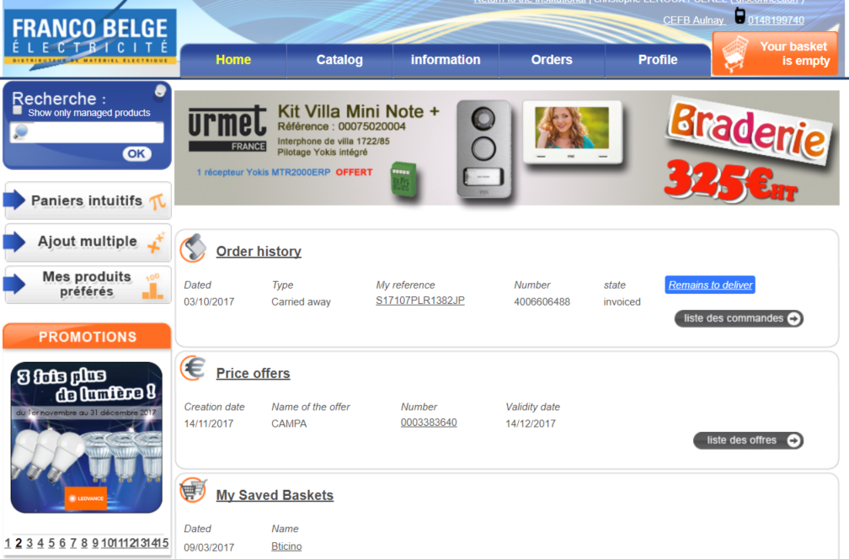
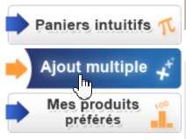
Login
User clicks on Fast order shortcut
my profil page :

Slide 3
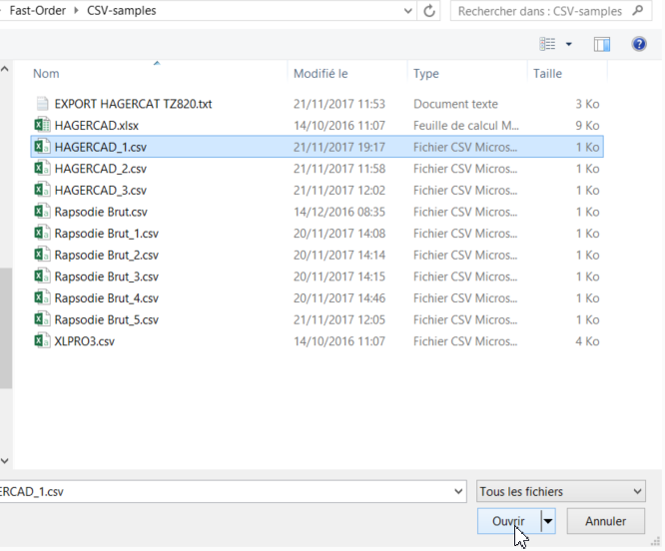
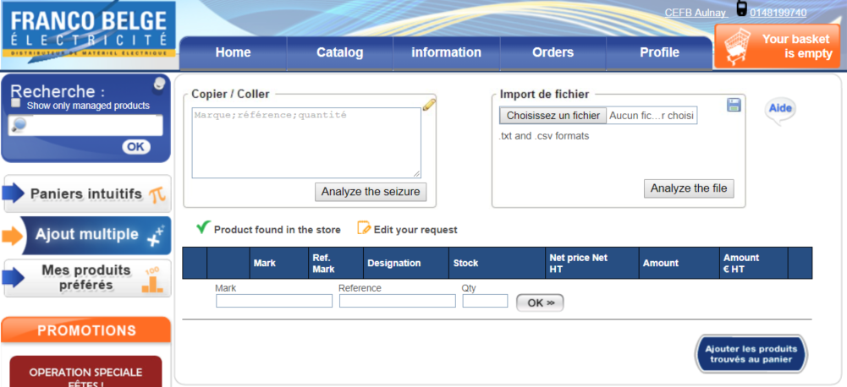
Fast order : browse for a file
Browse > select file > click on analyze button

Slide 4
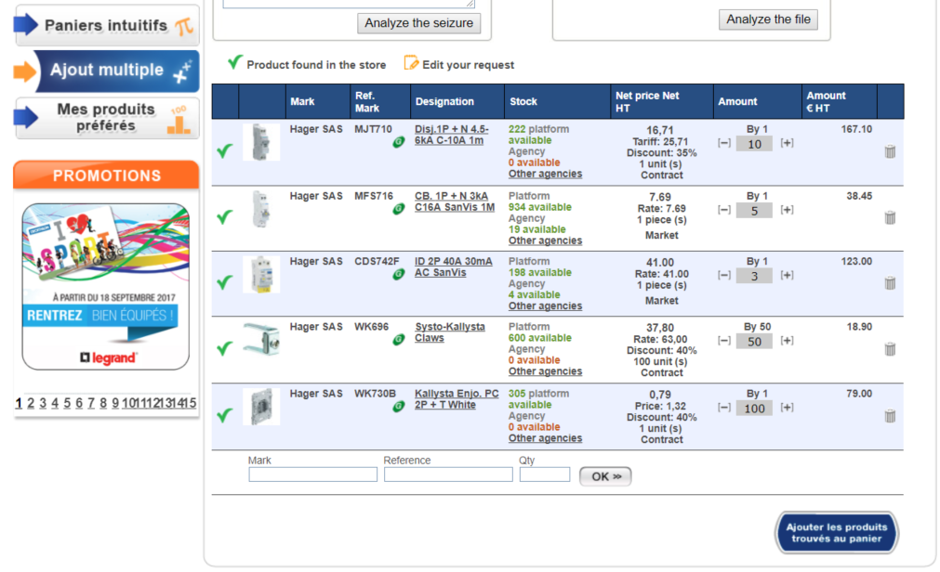
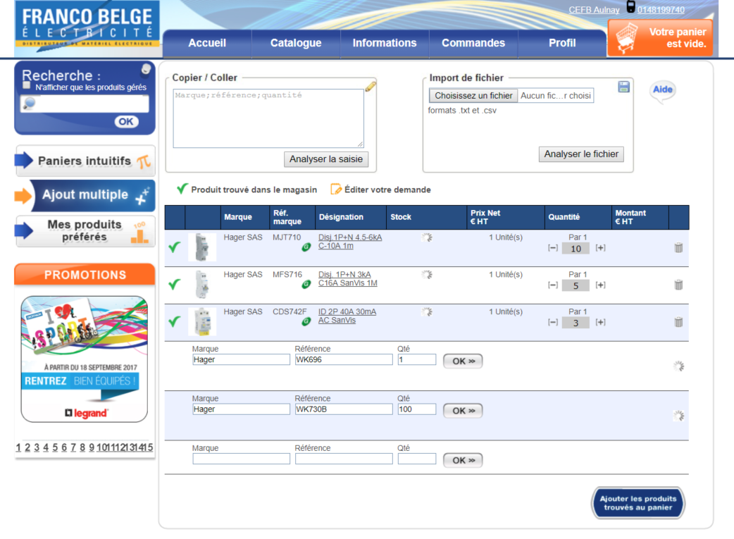
Upload
System looks for products
Upload is done
User can click on ‘add selection to cart’ >

Slide 5
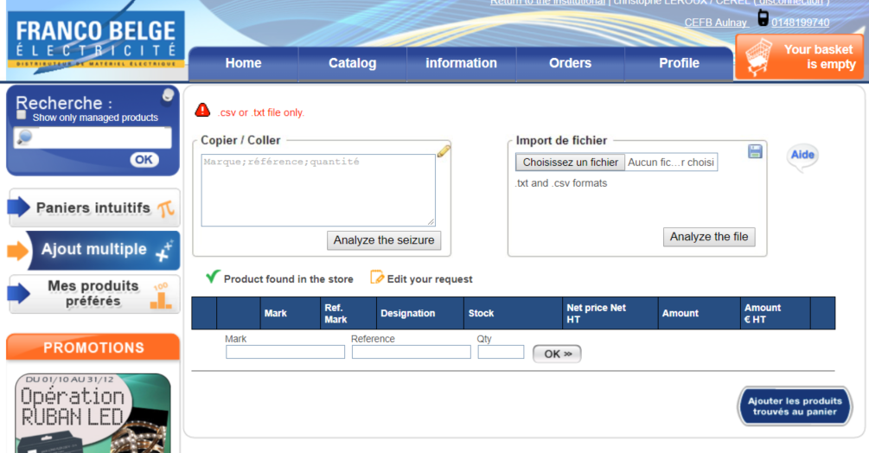
Errors
Bad file format

Slide 6
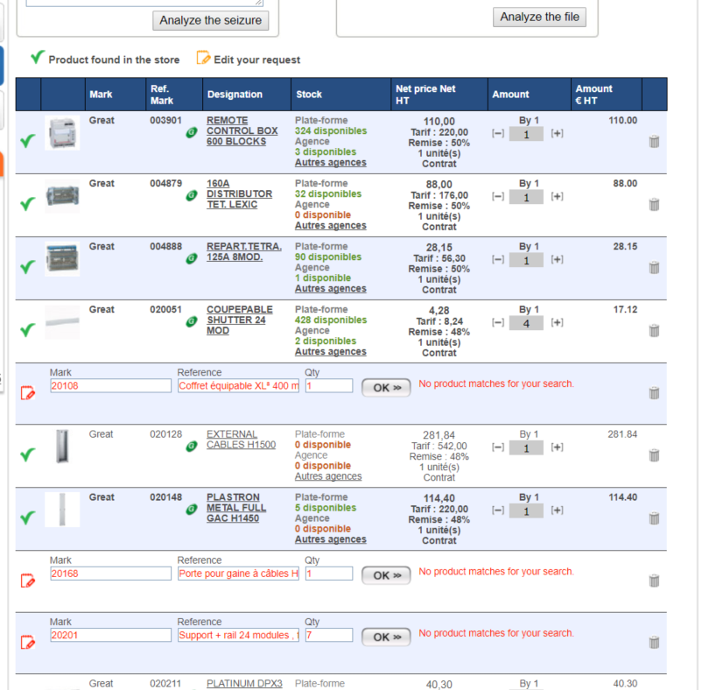
Errors
SKU’s not recognized

Slide 7
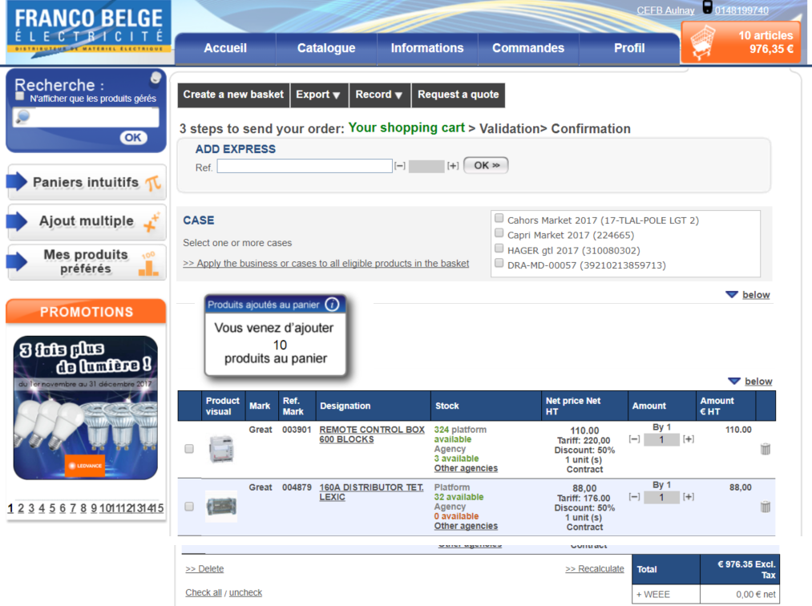
Add selection to cart
Cart page : Only recognized sku references are added to cart
< Happy path popup message

